Slide 1
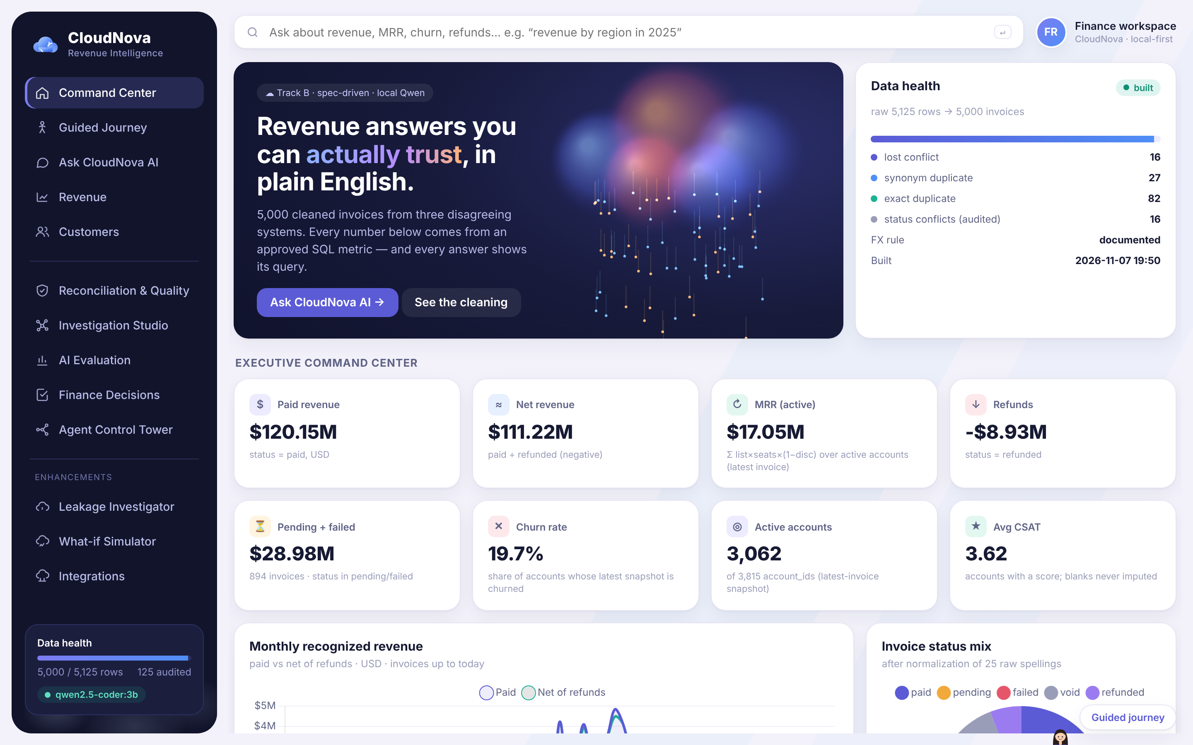
FORWARD DEPLOYED ENGINEERING · TAKE-HOME
CloudNova — My Forward Deployed Engineering Project
CloudNova's finance lead handed me a messy invoice export and said: we want to ask questions about revenue in plain English and actually trust the answers.
I wrote a spec, cleaned the data against it, loaded it into DuckDB, and built one query agent that shows the SQL behind every number. It runs locally with a small Qwen model, no API keys.
The dashboard, running locally. Figures are from the provided synthetic dataset.
Florina · November 2026 · Track B (data pipeline + query agent)
Notes:
Keep it short. The point is: messy data in, answers you can audit out.

Slide 2
THE PROBLEM
What the customer was struggling with
Old billing tool
• 5,125 rows that describe 5,000 invoices
• 18 spellings of 3 plans, 25 of 5 statuses
• 5 date formats, some ambiguous (05-01-2024)
• Amounts like "$4,900.00" and "1,200.00 EUR"
• 82 exact duplicate rows; 16 invoices where systems disagree on status
CRM
One CSV export
cloudnova_invoices.csv
Hand-kept spreadsheet
The questions finance actually asked:
Paid revenue in 2024? · Region with the highest average MRR? · How much did we refund? · Enterprise vs Starter churn? · Top 5 accounts, flag CSAT ≤ 2? · What's stuck in pending/failed?
CloudNova · FDE take-home · github.com/florina787/Data-sets (cloudnova/)
2 / 15

Slide 3
BEFORE ANY CODE
Where I started
What the assignment asked for
The first questions I asked the data
• Write the spec first, then let AI build to it
• Show how I steered the AI (.claude/, CLAUDE.md)
• An eval harness — including a case I expect to fail
• Production instincts: errors, config, no secrets
• One command to run it
• A README a stakeholder can read in 3 minutes
• Is 01/05/2024 January or May?
• When two systems disagree about an invoice, which one wins?
• Is account_id really "the customer"?
• Does "revenue" mean paid, or paid minus refunds?
• Do the amounts even match the price list?
I answered these with small profiling scripts before writing a single rule. Most of the design came from these answers.
CloudNova · FDE take-home · github.com/florina787/Data-sets (cloudnova/)
3 / 15

Slide 4
A SCOPING DECISION
Why I chose Track B instead of RAG
 | RAG over the invoices | Clean the data + governed SQL (Track B)
"Paid revenue in 2024" | Retrieves some rows; the LLM adds numbers up | One SUM over 1,000+ rows, exact to the cent
Duplicates & conflicts | Retrieved twice, counted twice | Removed once, by a written rule, with an audit trail
Business rules (paid only, refunds net) | Hope the prompt is followed | Encoded once in SQL metric definitions
Can finance check it? | Hard — the answer is generated text | Yes — every answer shows the SQL that ran
All six questions are aggregations: sums, averages, rankings. Retrieval returns rows, not totals.
Trade-off: no free-text search. There is no free text in this dataset to search, so I accepted that.
CloudNova · FDE take-home · github.com/florina787/Data-sets (cloudnova/)
4 / 15

Slide 5
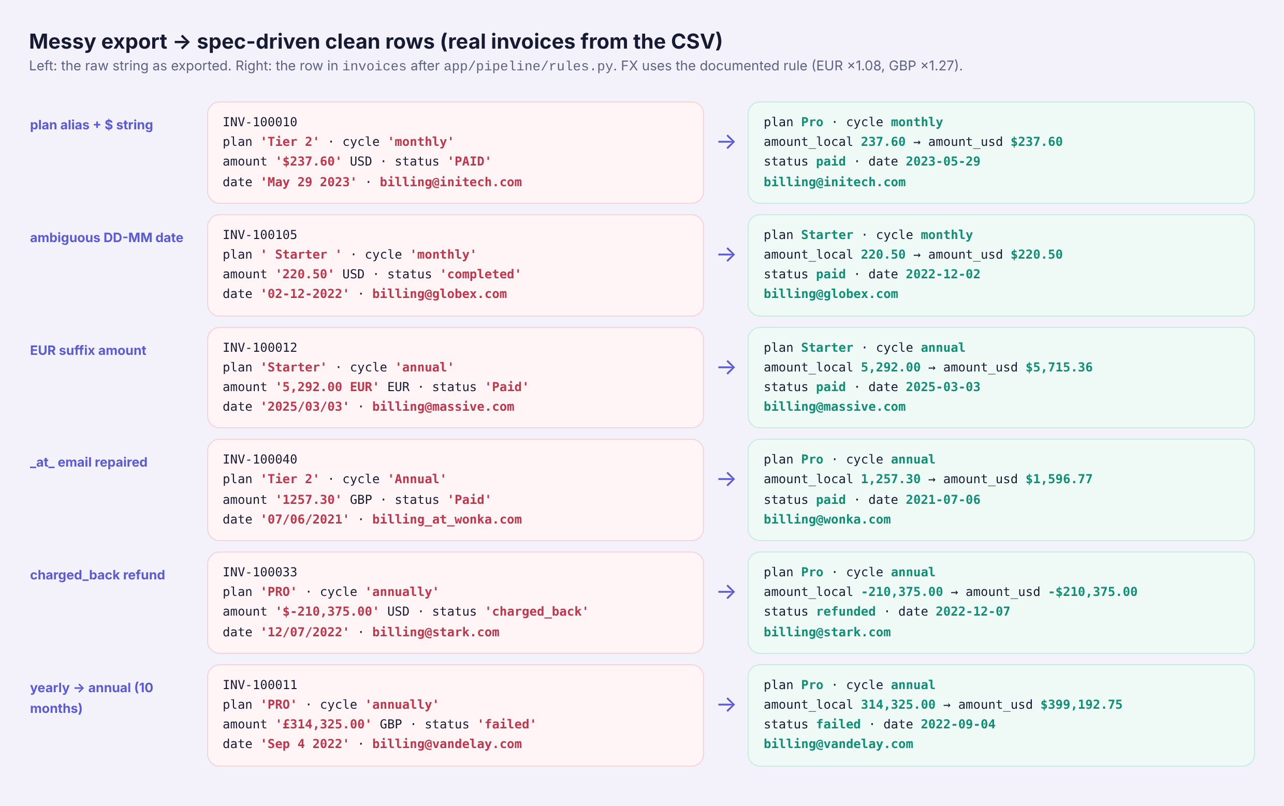
EVIDENCE BEFORE RULES
Understanding the data
Question | What the data said
NN/NN/YYYY order? | 1st part never > 12 in 1,320 rows → MM/DD
NN-NN-YYYY order? | 2nd part never > 12 → DD-MM
43 duplicated invoice ids | 27 only differ by status spelling
Real conflicts | 16 (paid/pending 7, paid/void 5, paid/failed 2, paid/refunded 2)
Left: six real invoices, raw string → clean row. Rows where both date readings are valid (81 of them) are flagged, not guessed silently.
CloudNova · FDE take-home · github.com/florina787/Data-sets (cloudnova/)
5 / 15

Slide 6
RAW → CLEANING → VALIDATION → DUCKDB
Building the data pipeline
invoices 5,000
Raw CSV
5,125 rows, read as strings
Source adapter
app/sources/base.py
Rules + cleaning
app/pipeline/rules.py · clean.py
Typed DuckDB
app/pipeline/build.py
accounts 3,815
rejected_rows 125
Cleaning order (data contract §3)
dedup_conflicts 16
• Drop exact duplicates (82)
• Collapse synonym duplicates (27)
• Conflicts: refunded > paid > failed > void > pending (16)
• Unknown plan/status → quarantined, never defaulted
Validation
• Test: every raw row is in invoices OR rejected_rows
• Price-book check: 0 violations
• Build is skipped when the raw file's sha256 hasn't changed
CloudNova · FDE take-home · github.com/florina787/Data-sets (cloudnova/)
6 / 15

Slide 7
MODEL CHOICE
Why I used a local Qwen model
• No API keys, no per-query cost, invoice data never leaves the machine
• Qwen2.5-Coder-3B (Q4 GGUF) — small enough for a 4-core CPU
• Served through llama.cpp's OpenAI-compatible server. Ollama was my first choice, but its download was blocked in my container
• One agent, deterministic routing first; the model is a fallback, not the source of numbers
Measured on 4 CPU threads
Short generation | ~0.5 s
General chat answer | 4–16 s
Text-to-SQL per question | 7–43 s
Approved-metric answer (no LLM) | < 100 ms
If Qwen is down, the app still starts in "deterministic mode": all metric answers, data quality and evals work; chat returns a clear llm_unavailable error.
CloudNova · FDE take-home · github.com/florina787/Data-sets (cloudnova/)
7 / 15

Slide 8
QWEN WRITING ALL THE SQL: 2 OF 6 CORRECT
Where the model struggled
-- Q4 churn, Enterprise vs Starter (Qwen-only)
SUM(CASE WHEN invoices.status = 'churned'
THEN 1 ELSE 0 END) AS churned_accounts
...
-- 'churned' is not a status. Churn lives in
-- accounts.churned. Also failed: ambiguous 'plan'.
Q | Qwen-only result
Q1 paid 2024 | correct
Q2 avg MRR region | SQL error: ambiguous "region"
Q3 refunds | correct
Q4 churn | invented status = 'churned'
Q5 top 5 | wrong order, no error
Q6 exposure | unknown column — blocked by guard
-- Q5 top 5 accounts (Qwen-only)
SELECT account_id, SUM(amount_usd) ...
FROM invoices WHERE status = 'paid'
...
-- ignores refunds -> ACC-5211 and ACC-1196 swap
The dangerous one is Q5: valid SQL, plausible answer, wrong. The SQL guard checks safety, not meaning.
CloudNova · FDE take-home · github.com/florina787/Data-sets (cloudnova/)
8 / 15

Slide 9
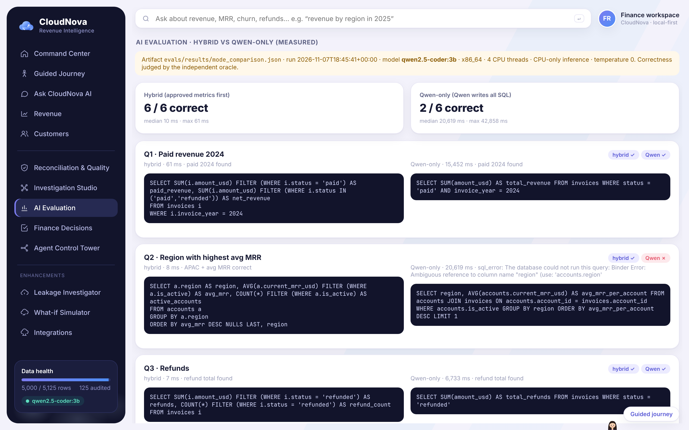
HYBRID: APPROVED METRICS FIRST, QWEN AS FALLBACK
How I improved the design
Question
Semantic planner
metric × dimension × filter
SQL guard
sqlglot allow-list
DuckDB
read-only
Answer + SQL
+ caveats
Qwen text-to-SQL
only if no metric fits
Mode (same 6 questions) | Correct | Median | Max
Hybrid (default) | 6 / 6 | 10 ms | 61 ms
Qwen-only | 2 / 6 | 20.6 s | 42.9 s
Measured 2026-11-07, temperature 0, correctness judged by an independent oracle. evals/results/mode_comparison.json
CloudNova · FDE take-home · github.com/florina787/Data-sets (cloudnova/)
9 / 15

Slide 10
THE BRIEF'S OWN RULE MAY BE WRONG
A financial problem I discovered
1. FX conversion
2. Account identity
The brief says EUR→USD 1.08, GBP→USD 1.27. But every EUR/GBP amount already equals the USD price × the rate. Multiplying again counts FX twice.
3,815 account ids but only 200 names. Every name spans several regions, plans and signup dates, so names are not a customer master.
Non-USD invoices (1,421) | × rate (brief) | ÷ rate
Match the USD price book | 0 / 1,421 | 1,421 / 1,421
Q1 paid revenue 2024 | $32,686,371.16 | $29,595,624.38
Key | Groups | Inconsistent
account_id | 3,815 | 24.4%
account_name | 200 | 100%
Why I didn't let the AI decide: these are accounting policy, not data cleaning. The inverse FX rule moves 2024 revenue by $3.09M.
That is the finance lead's decision. My job is to show the evidence and make the decision easy and auditable.
CloudNova · FDE take-home · github.com/florina787/Data-sets (cloudnova/)
10 / 15

Slide 11
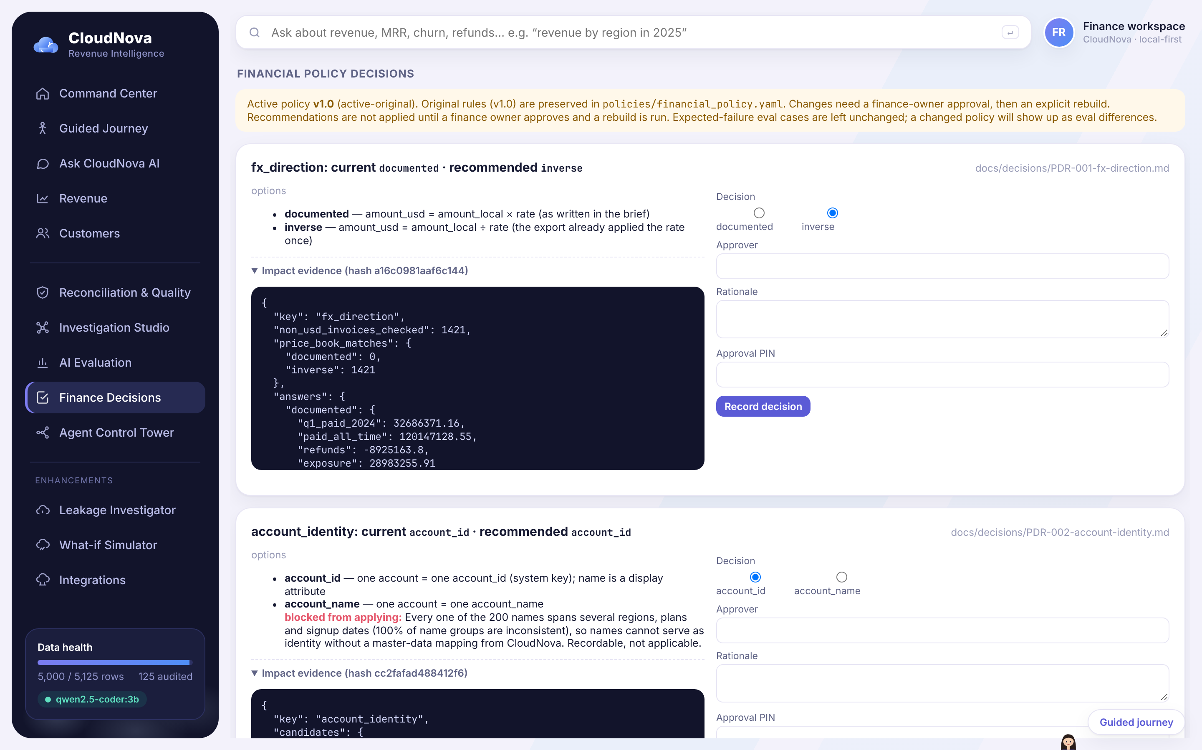
VERSIONED POLICY + APPROVAL
How I handled customer decisions
• policies/financial_policy.yaml keeps the original rules (v1.0) and is never edited by the app
• Decision records: docs/decisions/PDR-001 (FX), PDR-002 (identity)
• Approval needs: name, finance_owner role, a rationale, the operator's PIN, and the hash of the impact report they saw
• Approving only records. Applying is a separate rebuild.
Status
Record / apply / revert / audit log | implemented, 11 tests
FX change | recommended, NOT applied
Name-based identity | blocked: needs CRM master data
Real sign-in (SSO) | not built — PIN is demo-grade
CloudNova · FDE take-home · github.com/florina787/Data-sets (cloudnova/)
11 / 15

Slide 12
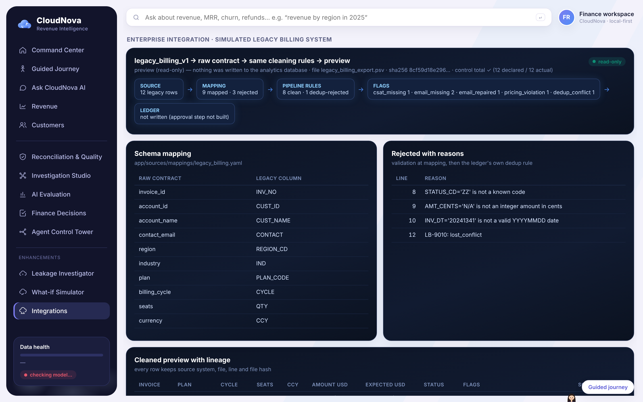
ADAPTERS FEED ONE CONTRACT
Thinking about existing enterprise systems
Finance CSV
built
Legacy billing
simulated demo
Raw contract
19 string columns + lineage
Same pipeline
same rules
CRM (Salesforce)
mapping only
SaaS billing (Stripe)
mapping only
What the legacy-billing adapter actually did with its 12-row sample export:
• Trailer control total checked · 9 rows mapped · 3 rejected with reasons (unknown code ZZ, amount N/A, date 20241341)
• 1 rejected by the ledger's own dedup rule · a planted 10× over-billing flagged · every row keeps source file, line and hash · read-only preview, ledger untouched
CloudNova · FDE take-home · github.com/florina787/Data-sets (cloudnova/)
12 / 15

Slide 13
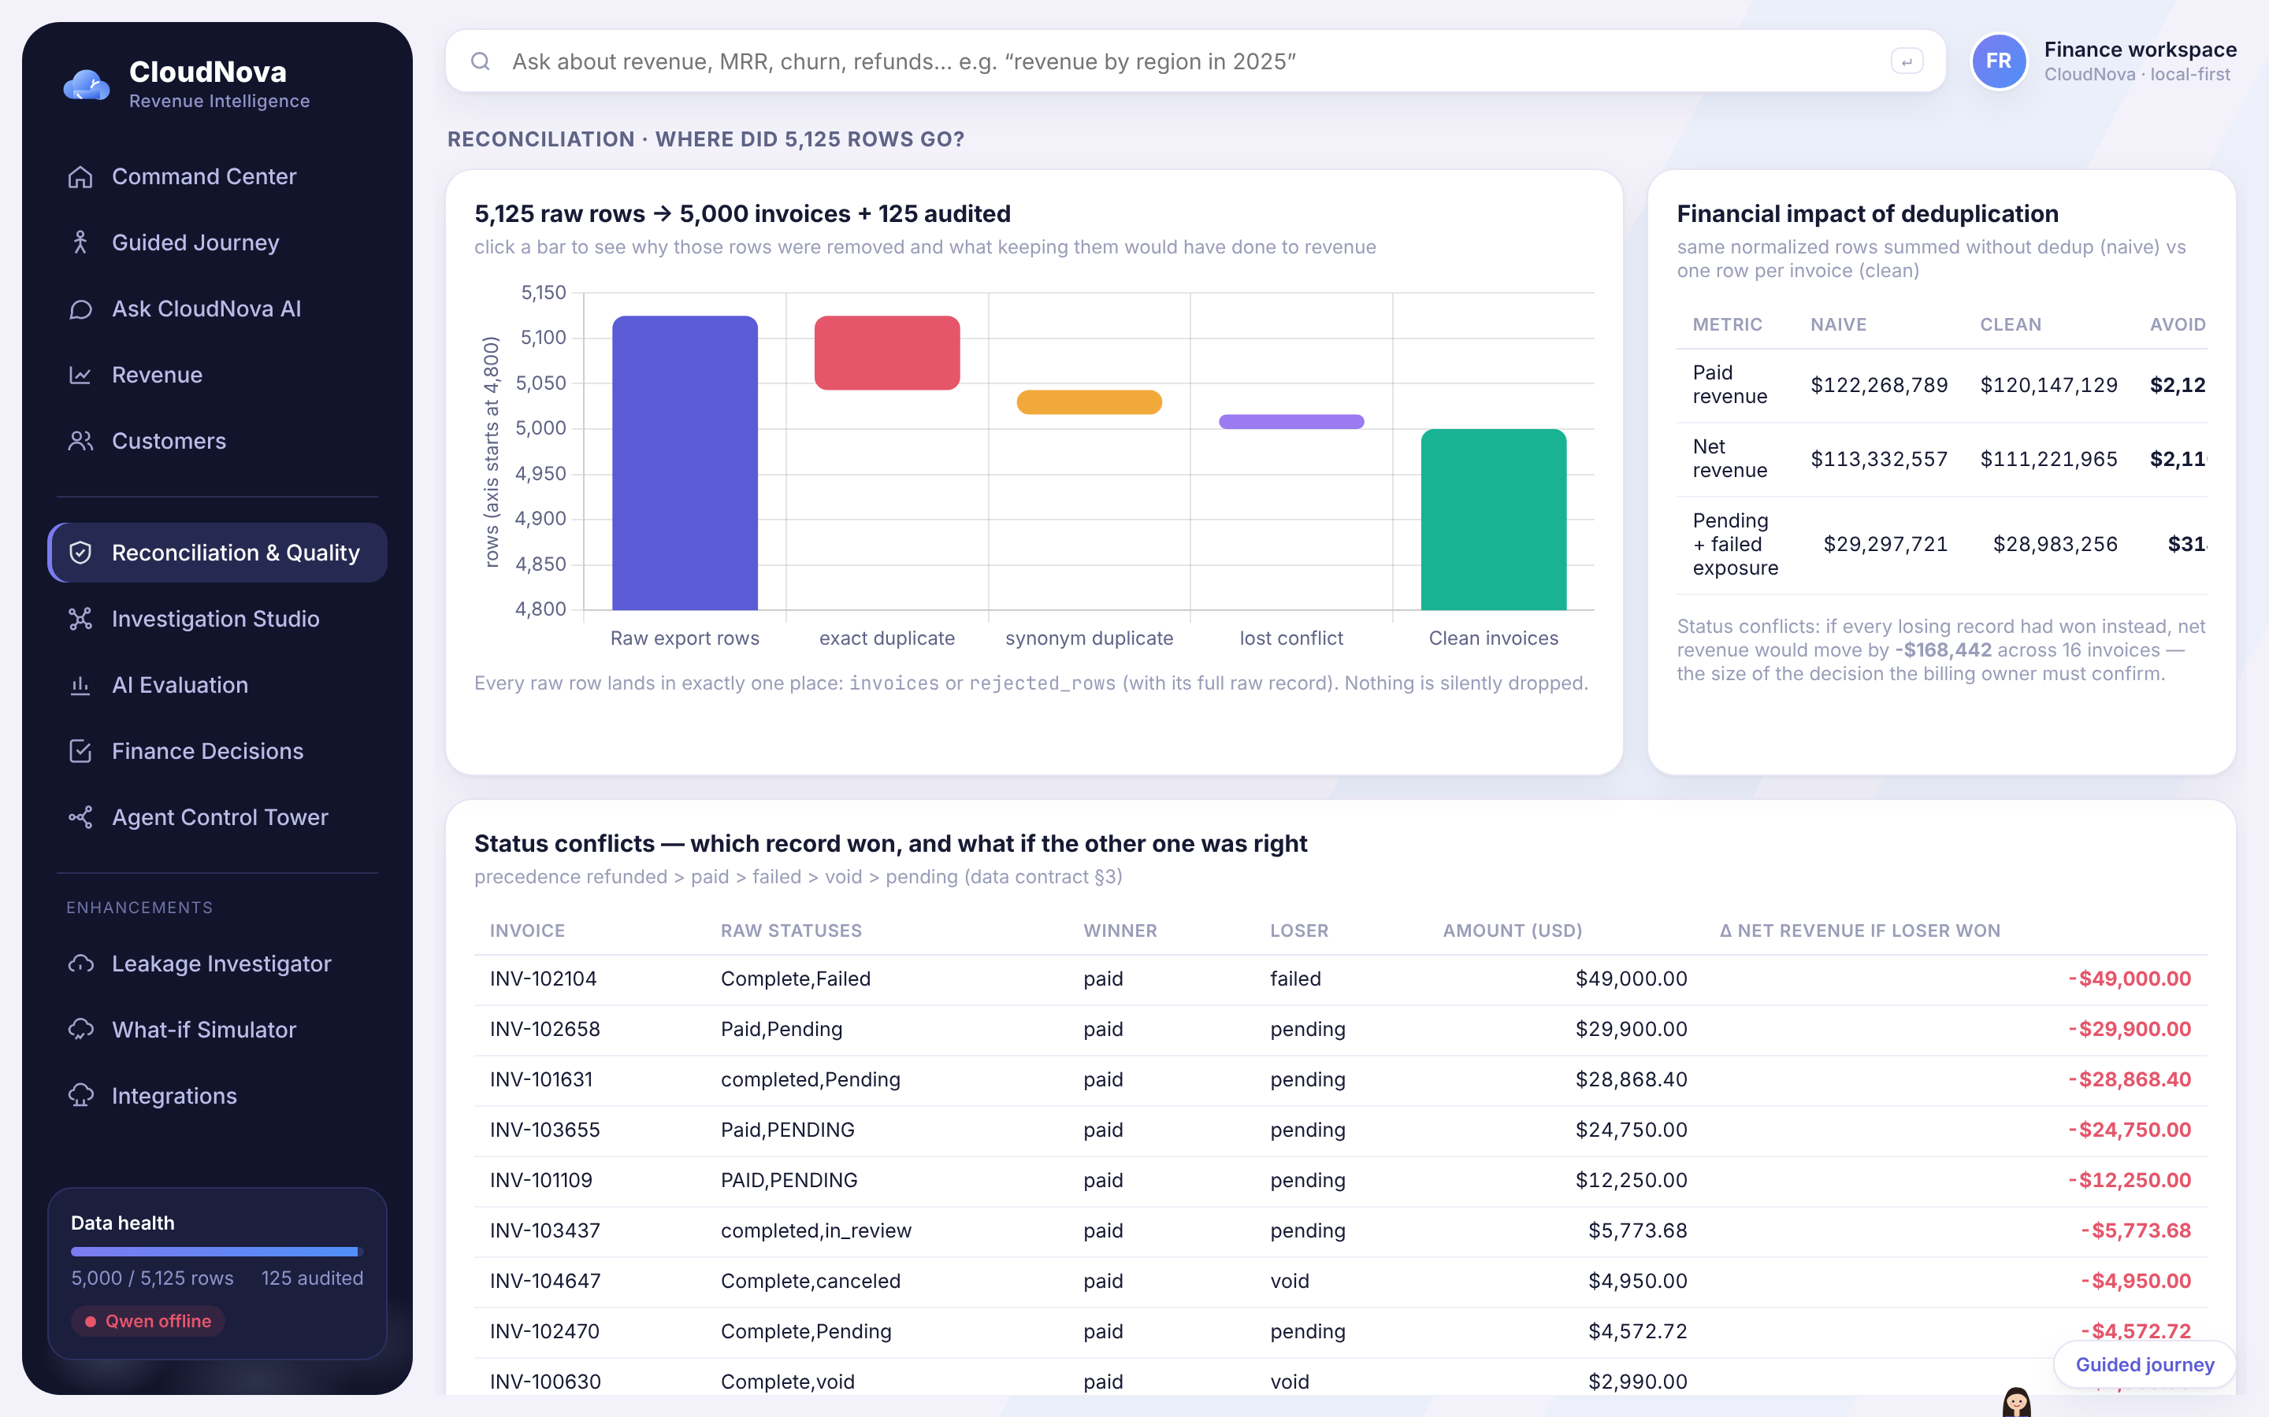
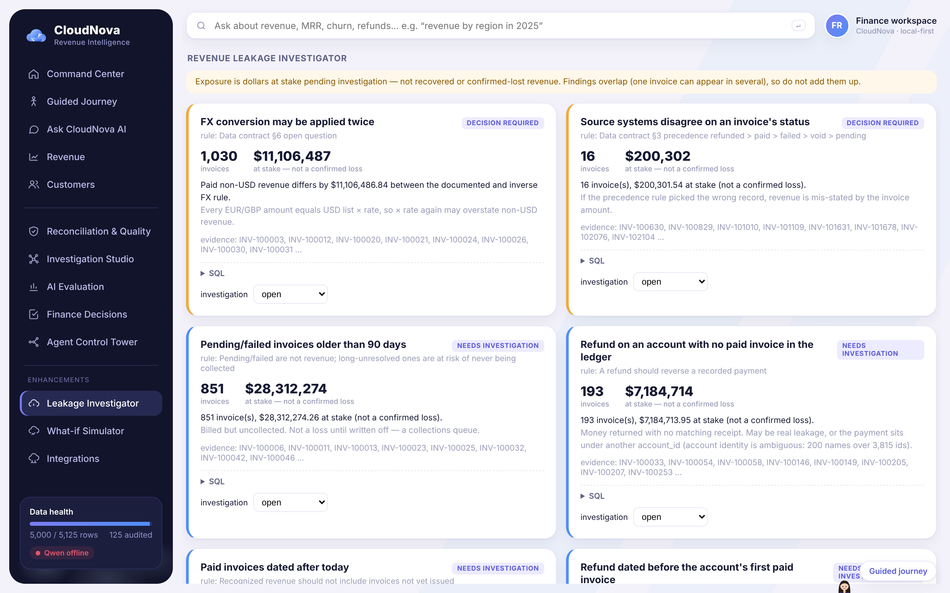
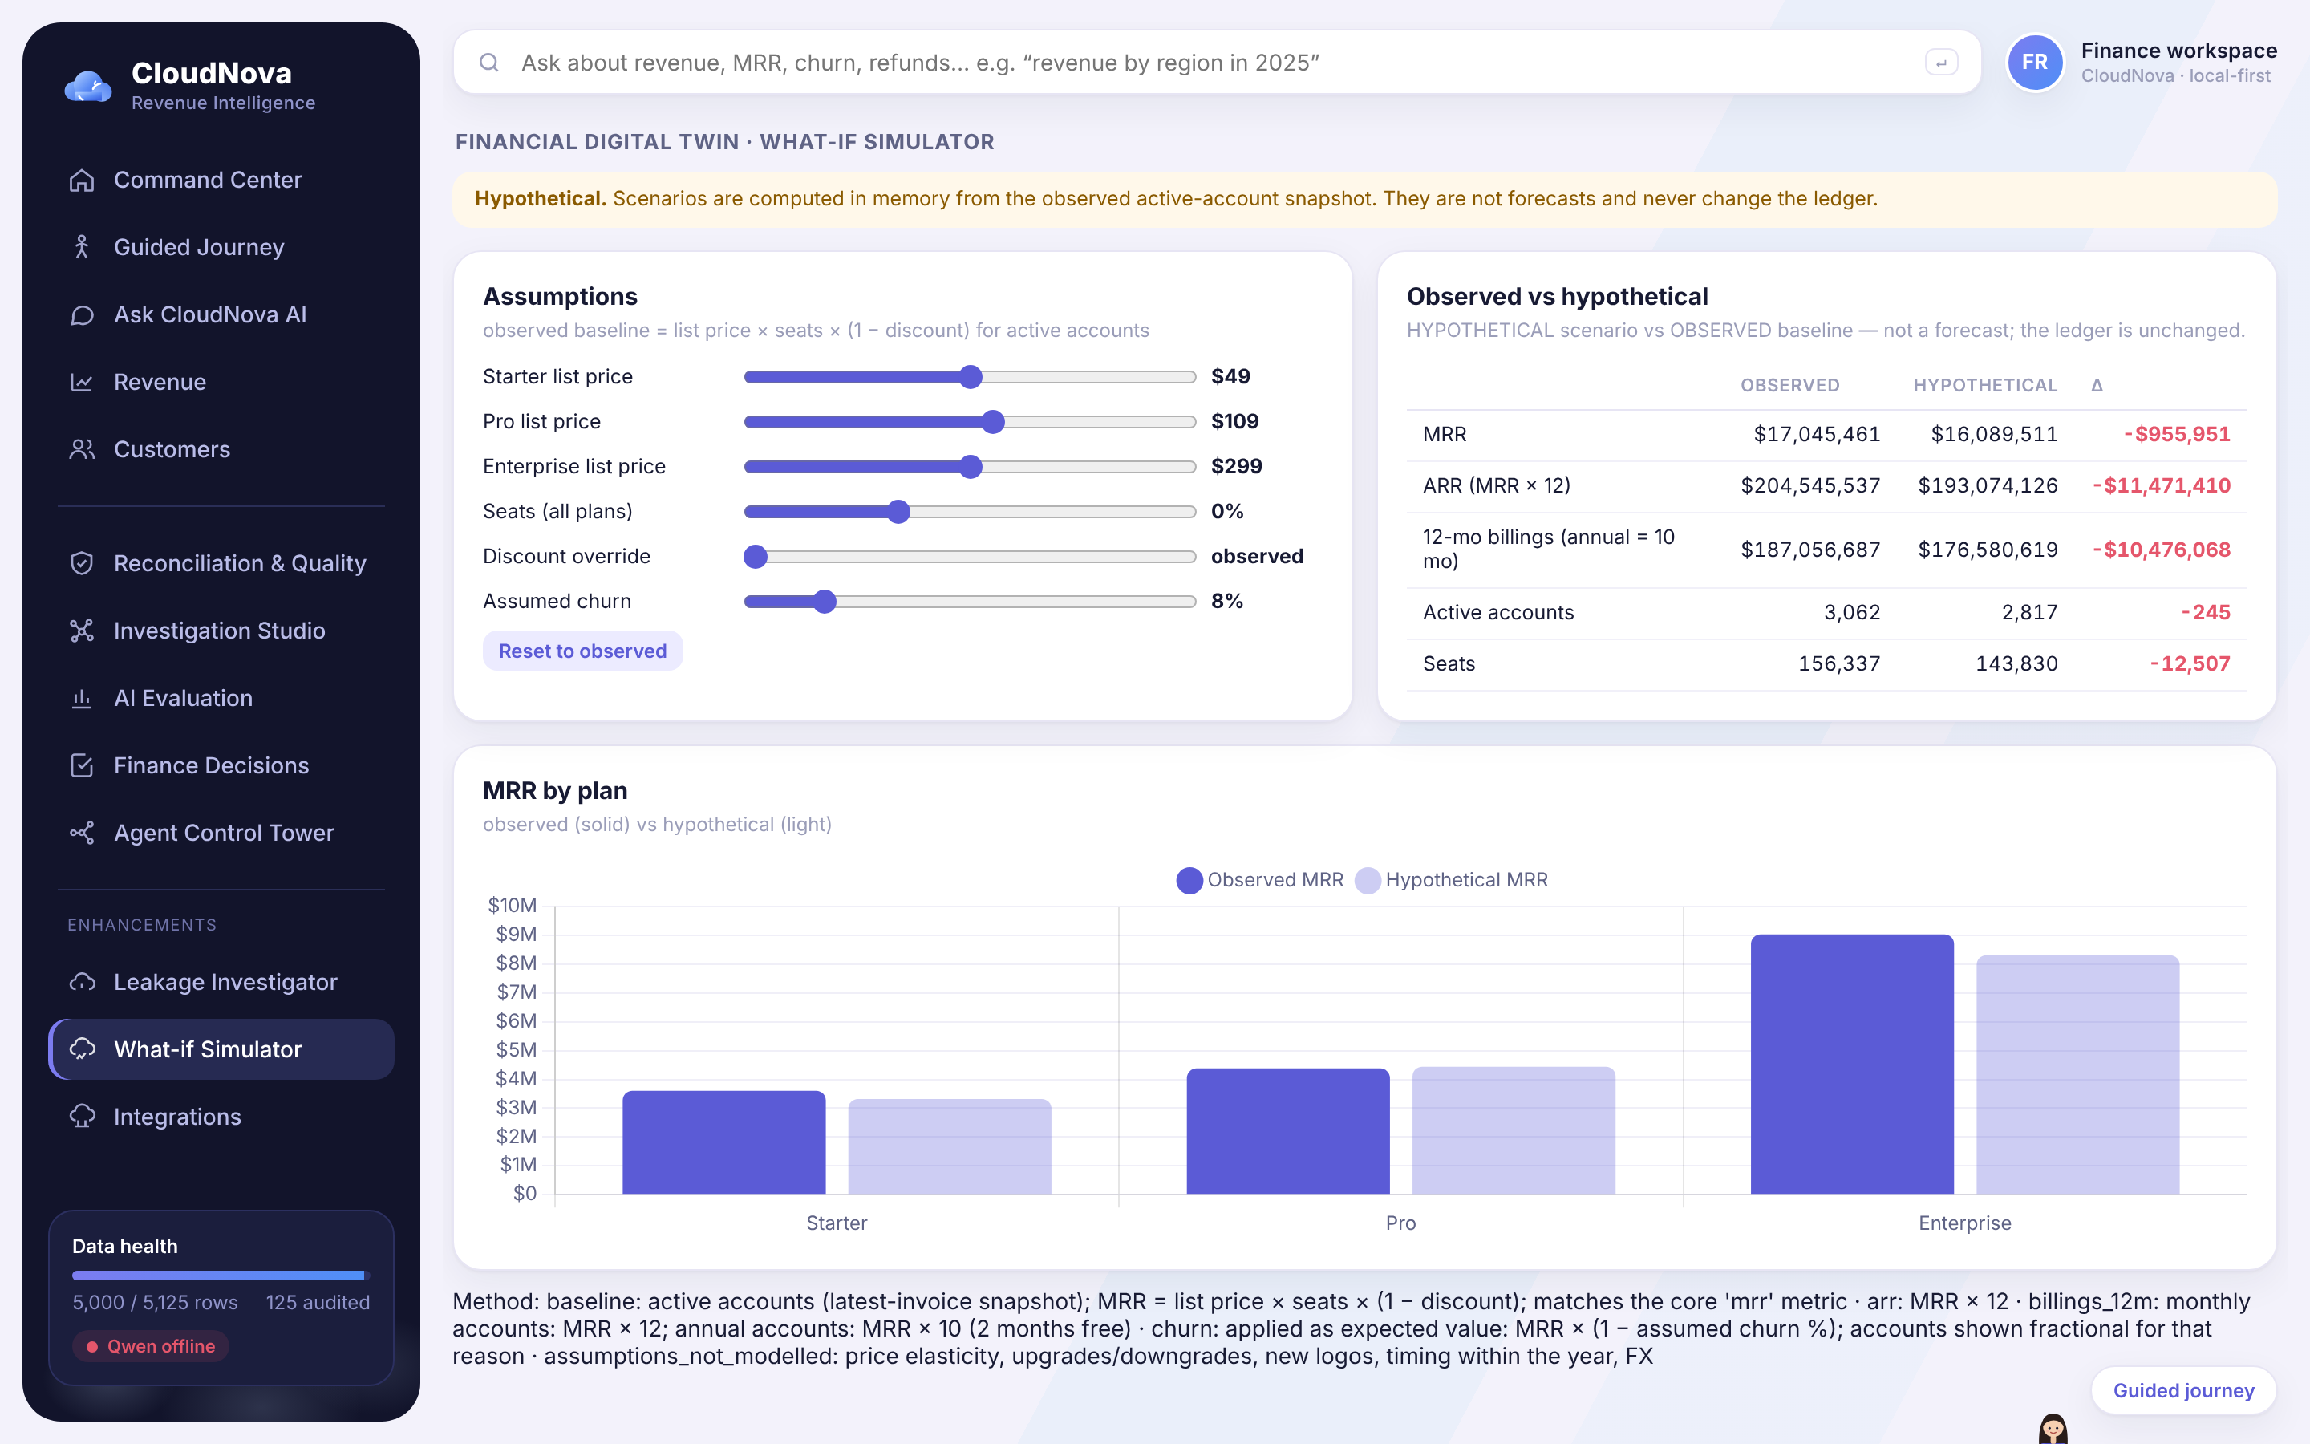
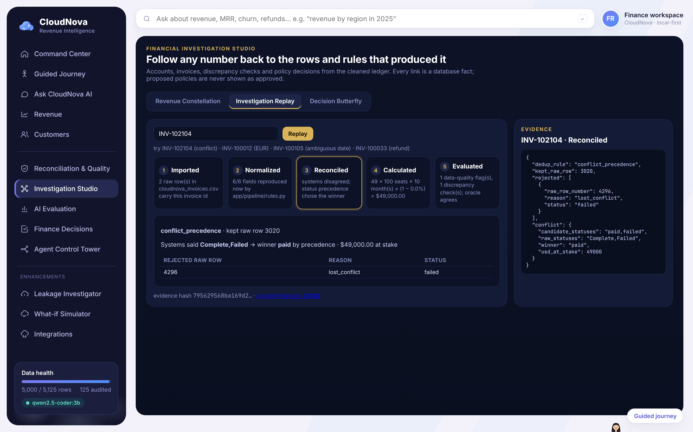
SCREENS START FROM FINANCE QUESTIONS
Building the user interface
Where did 125 rows go? Dedup avoids a $2.12M overstatement of paid revenue.
What's at risk? Evidence and dollars at stake — never called 'lost'.
What if Pro costs $109? Clearly labelled hypothetical; ledger untouched.
How was this one invoice handled? Step-by-step replay with evidence.
CloudNova · FDE take-home · github.com/florina787/Data-sets (cloudnova/)
13 / 15

Slide 14
EVIDENCE
Testing — and what went wrong along the way
Check | Result
Unit tests (this branch) | 156 passed
Unit tests (submission branch) | 114 passed
Evals, no LLM | 31 pass · 0 fail · 2 xfail · 3 skip
Evals with local Qwen | 33 pass · 0 fail · 3 xfail
Six stakeholder answers vs oracle | 6 / 6 to the cent
Mistakes I made and fixed
• "accounts" matched my count regex → Q5 answered with a count. Fixed with word boundaries.
• "support tickets" silently answered as churn rate. Now unknown measures go to Qwen or 'clarify'.
• A 24-question business battery found 8 phrasing gaps. Fixed with general rules, not per-question templates.
• Journey approval buttons were wired after Nova finished talking — clicks were ignored. Found in a browser test.
• My own README said ambiguous dates could change years. They can't; corrected after re-checking.
The oracle (evals/oracle.py) re-implements the spec with the standard library and never imports the app, so it can disagree with it.
Expected failures stay visible: FX inverse, name-based top 5, one Qwen SQL case.
CloudNova · FDE take-home · github.com/florina787/Data-sets (cloudnova/)
14 / 15

Slide 15
REFLECTION
What I learned
“I started by trying to understand the customer and their data. The model was only one part of the solution. The harder decisions involved financial definitions, system integration, validation, and making sure the customer could trust the results.”
What I'd do next
Still open / not built
• Get the two policy decisions from CloudNova and update the expected answers in one reviewed commit
• Let Qwen fill a structured query plan instead of free SQL
• Add support tickets, tenure and cohort metrics
• Real sign-in for approvals (PIN today)
• Live CRM / Stripe connectors (designed, not built)
• Churn prediction — the data has no churn dates
CloudNova · FDE take-home · github.com/florina787/Data-sets (cloudnova/)
15 / 15

