Slide 1
ASP.NET CORE, PEEK INTO THE FUTURE
By Expert Network
@FII Practic

Slide 2
WHO ARE WE
Alexandru Dimache
Florin-Constantin Ciubotariu
Daniel Bunea
Cristian Stan

Slide 3
WHAT DO WE DO

Slide 4
WHAT'S THE PLAN
Get you familiar with .NET Core
We will do a project together
And we will have a gathering where you will showcase your projects to your colleagues
Have fun and learn stuff

Slide 5
WHAT WILL YOU DO
Learn how to make an ASP.NET Core Web Application
Ask us any time you have a question or if you have something that you are not familiar with (that’s why we’re here after all)

Slide 6
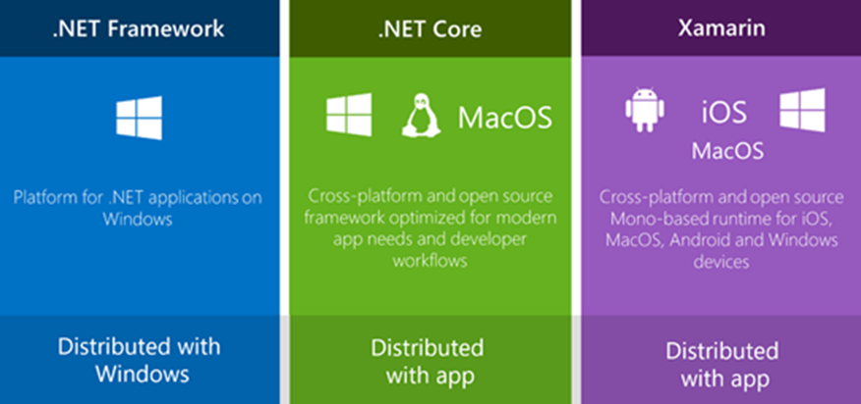
THE .NET FAMILY OF FRAMEWORKS

Slide 7
DID YOU KNOW?
StackOverflow
Microsoft
GoDaddy
DELL
Where all made in ASP.NET?

Slide 8
LET’S GET STARTED WITH THE BASICS

Slide 9
CREATE A NEW CONSOLE APPLICATION IN VS

Slide 10
COMMAND LINE INTERFACE
dotnet new [console|classlib|web|mvc|…] –n <OUTPUT_NAME>
dotnet build
dotnet run

Slide 11
EVEN MORE BASICS

Slide 12
GENERICS
Collection Types: List, Dictionary, Stack, Queue, HashSet
Using Generics we can quickly store our object
Query results will be probably stored in an IEnumerable<T> or List<T>

Slide 13
COOL! EN-LIST ME

Slide 14
LIST - BASIC USAGE
myList.Add();
myList.AddRange();
myList.Remove();
myList.RemoveAt();
myList.RemoveRange();

Slide 15
LIST - ITERATING
for(var i = 0; i < integerList.Count; i++)
{ Console.WriteLine(integerList[i]);
}
foreach(var integer in integerList)
{
Console.WriteLine(integer);
}
integerList.ForEach(integer => Console.WriteLine(integer)); //Next chapter

Slide 16
LINQ

Slide 17
LINQ SYNTAXES
Method Syntax
Query Syntax
var names = collection
.Where(item => item.Name == "Fred") .OrderBy(item => item.Age)
.Select(item => item.FullName);
var names = from item in collection
where item.Name == "Fred"
order by item.Age
select item.FullName;

Slide 18
LINQ SYNTAXES
Method Syntax
Query Syntax
var names = collection
.Count(item => item.Name == "Fred");
var names = (from item in collection
where item.Name == "Fred"
select item).Count()

Slide 19
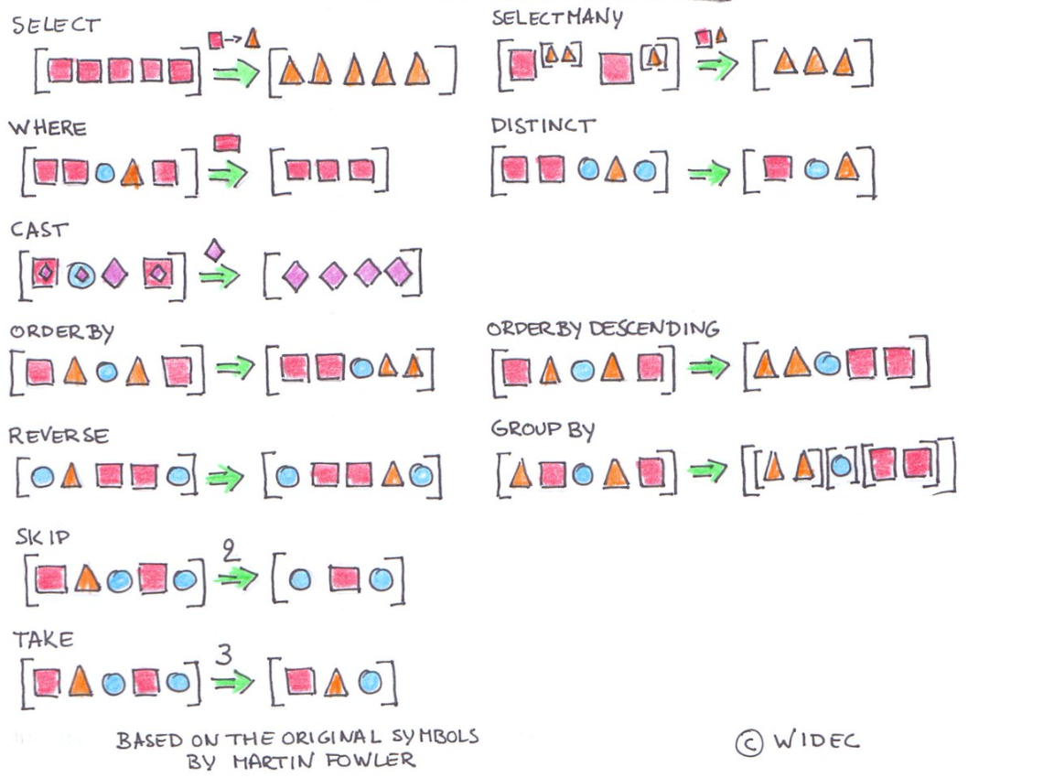

Slide 20
PRACTICE
Notes:
Exemplu pentru cele mai importante metode in LINQ (SELECT, WHERE, DISTINCT, FIRST OR DEFAULT ...)
Live coding

Slide 21
N-LAYER

Slide 22
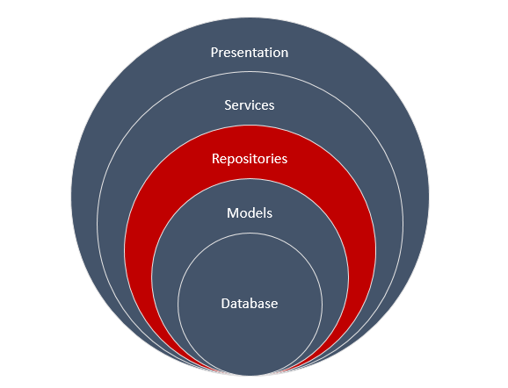
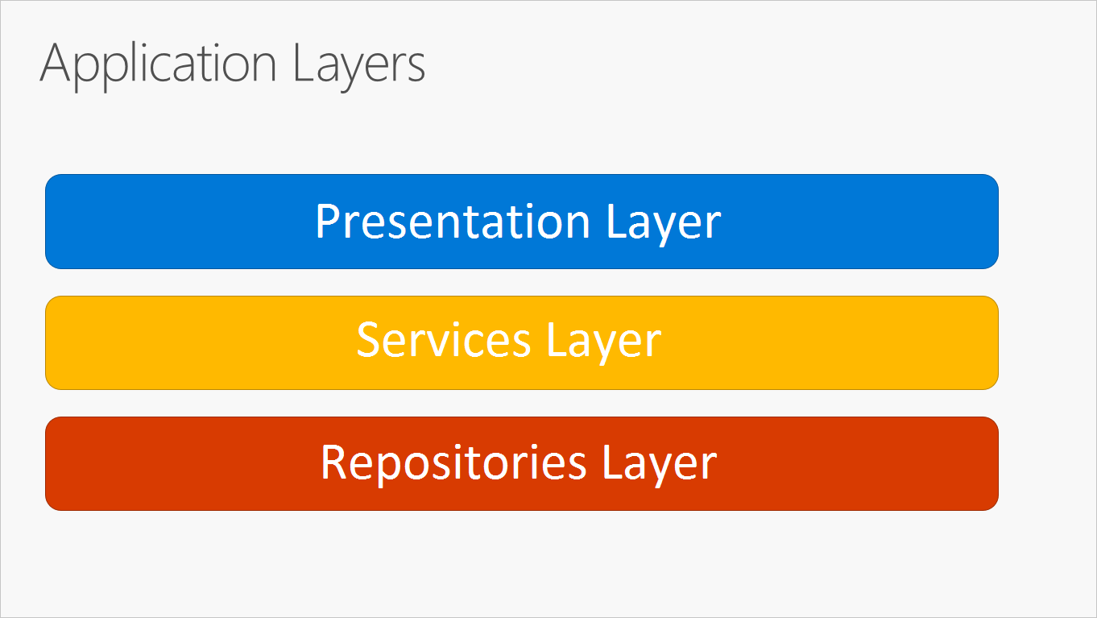
N-LAYER ARCHITECTURE

Slide 23
FACEBOOK

Slide 24


HOW FACEBOOK USES DIFFERENT PRESENTATION LAYERS
https://www.facebook.com/ExpertNetwork/
https://m.facebook.com/ExpertNetwork/

Slide 25
ENTITY FRAMEWORK CORE

Slide 26
DATABASE

Slide 27
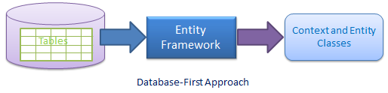
CREATE CLASSES USING AN EXISTING DATABASE

Slide 28
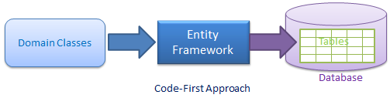
CREATE A DATABASE USING EXISTING CLASSES

Slide 29
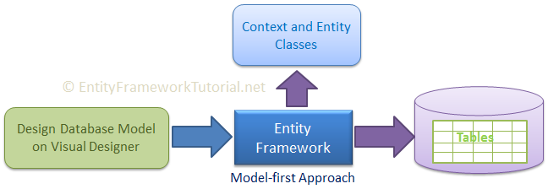
THERE IS ANOTHER ONE BUT WE WILL NOT TALK ABOUT IT

Slide 30
We will create it all from scratch

Slide 31
CREATE A NEW CLASS LIBRARY
dotnet new sln –n ExnCars
dotnet new classlib –n ExnCars.Data
dotnet sln list
dotnet sln add ExnCars.Data/ExnCars.Data.csproj
dotnet sln list

Slide 32
PREREQUISITES
cd ExnCars.Data
dotnet add package Microsoft.EntityFrameworkCore.SqlServer

Slide 33
LET’S MAKE A SIMPLE DB

Slide 34
ADD AN ENTITY (CLASS THAT REPRESENTS A TABLE)
public class Vehicle
{
public int Id { get; set; }
public string LicensePlate { get; set; }
public DateTime RegistrationDate { get; set; }
public string Color { get; set; }
}

Slide 35
ADD A CONTEXT (CLASS THAT REPRESENTS A DATABASE)
public class ExnCarsContext : DbContext
{
public DbSet<Vehicle> Vehicles { get; set; }
protected override void OnConfiguring(DbContextOptionsBuilder ){…}
}

Slide 36
ADD A CONTEXT (CLASS THAT REPRESENTS A DATABASE)
protected override void OnConfiguring(DbContextOptionsBuilder dbContextOptionsBuilder){
dbContextOptionsBuilder.UseSqlServer(@"Server=LAPTOP-26\FIIPRACTIC;Database=EXNCars;Trusted_Connection=True;");
}

Slide 37
Create Console App for ExnCars
Notes:
ExnCars.Console
Add reference to Data
SQL Server Profiler
Log to console?

Slide 38
CRUD for Vehicles
Notes:
What is CRUD
Implement it for the Vehicles Set

