Slide 1
ASP.NET CORE, PEEK INTO THE FUTURE
By Expert Network
@FII Practic

Slide 2

CLOUD

Slide 3
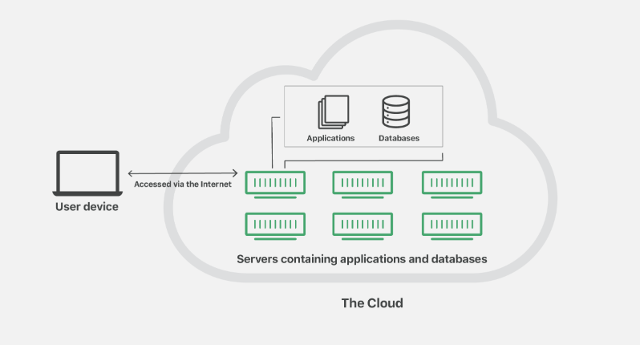
Cloud refers to servers that are accessed over the Internet, and the software and databases that run on those servers. Cloud servers are located in data centers all over the world. By using cloud computing, users and companies don't have to manage physical servers themselves or run software applications on their own machines.

Slide 4
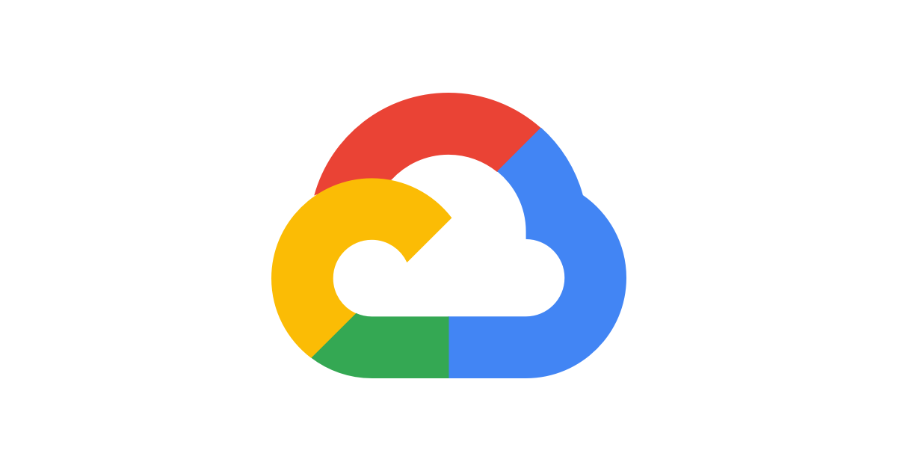



CLOUD PLATFORMS

Slide 6
+
Offers high availability.
Strong security profile.
Good scalability options.
Cross-efficient solution for an IT budget
-
You’ll need to manage it.
Must have platform expertise available.

Slide 7
OUR FIRST PUBLISH
Azure SQL Database
https://docs.microsoft.com/ro-ro/azure/sql-database/
Azure App Service
https://docs.microsoft.com/en-us/azure/app-service/

Slide 8
AZURE STORAGE

Slide 9
AZURE STORAGE
Azure storage is Microsoft's cloud storage solution for modern data storage scenarios.

Slide 10
AZURE STORAGE
Durable and highly available (You will never lose your data and you can access it anytime)
Secure
Scalable (You don't have to worry about performance issues)
Managed (You don't care about maintenance or any critical problems)
Accessible (.NET, Java, Node.JS, Python, PHP, Ruby, Go or even with simple HTTP requests)

Slide 11
AZURE STORAGE SERVICES
Azure Blobs: A massively scalable object store for text and binary data.
Azure Queues: A messaging store for reliable messaging between application components.
Azure Tables: A NoSQL store for schemaless storage of structured data.

Slide 12
AZURE BLOB STORAGE
Optimized for storing massive amounts of unstructured data, such as text or binary data.
The blobs can be served via URLs.
Ideal for:
Serving images or documents directly to a browser.
Storing files for distributed access.
Streaming video and audio.
Storing data for backup and restore, disaster recovery, and archiving.
Storing data for analysis.

Slide 13
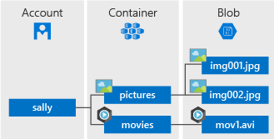
AZURE BLOB STORAGE

Slide 14
AZURE QUEUE STORAGE
Used to store and retrieve messages. Queue messages can be up to 64 KB in size, and a queue can contain millions of messages. Queues are general used to store lists of messages to be processed asynchronously.

Slide 15
AZURE QUEUE STORAGE
For example, say you want your customers to be able to upload pictures, and you want to create thumbnails for each picture. You could have your customer wait for you to create the thumbnails while uploading the pictures. An alternative would be to use a queue. When the customer finished his upload, write a message to the queue. Then, a worker reads the queue and creates the thumbnail.

Slide 16
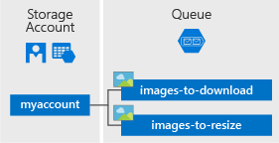
AZURE QUEUE STORAGE

Slide 17
AZURE TABLE STORAGE
Azure Table storage stores large amounts of structured data. The service is a NoSQL datastore which accepts authenticated calls from inside and outside the Azure cloud.
Azure tables are ideal for storing structured, non-relational data.

Slide 18
AZURE TABLE STORAGE
Common uses of Table storage:
Storing TBs of structured data capable of service web scale applications.
Storing datasets that don't require complex joins, foreign keys, or stored procedures and can be denormalized for fast access.
Quickly querying data using a clustered index.
Accessing data using LINQ queries.

Slide 19
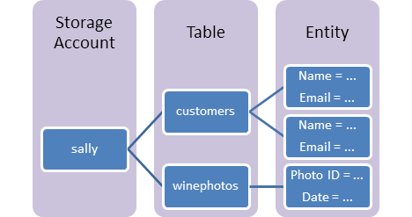
AZURE TABLE STORAGE

Slide 20

WEBJOBS

Slide 21
Azure web job is like a service that can run a task in the background. It doesn’t contain any user interface and it is the same as our Windows service.
Types
Continuous
On-demand
Scheduled

Slide 22
Let’s publish the webjob

Slide 23
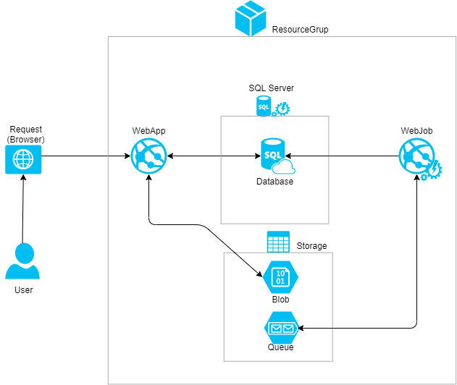

Slide 24
Fast Recap.

