Slide 1
ROMANIAN-AMERICAN UNIVERSITY
01 // WELCOME
RAU
DEV
while (curious) {
learn();
build();
share();
}
FIRST SESSION
Build skills.
Share knowledge.
Engineer together.
</>
A student-led community for people curious about software engineering.
RAU DEV • SOFTWARE ENGINEERING CLUB
01

Slide 2
+10 xp
First, presence!
RAU DEV • SOFTWARE ENGINEERING CLUB
02

Slide 3
Who are we?
RAU DEV • SOFTWARE ENGINEERING CLUB
02

Slide 4
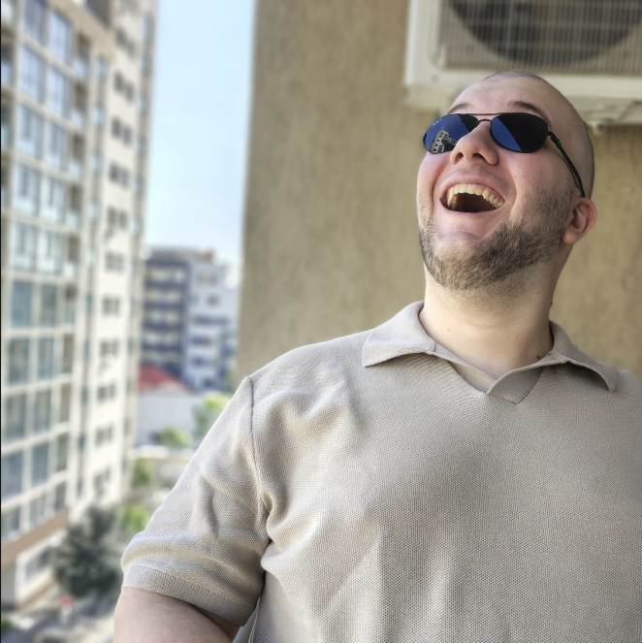
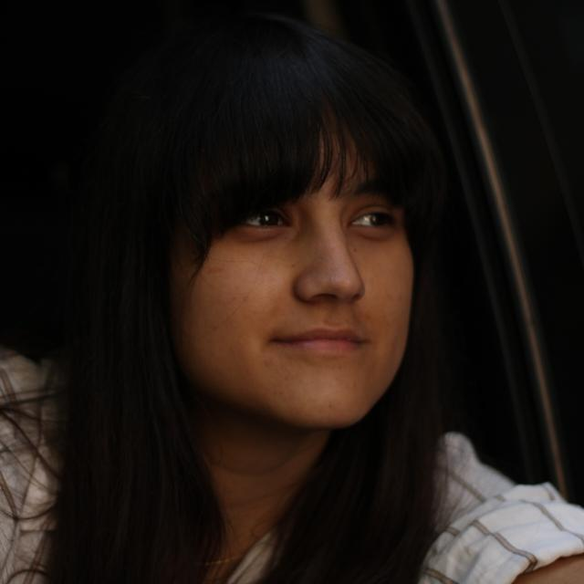
01 / WHO ARE WE?
Executive
Tiberiu-Gabriel Podăreanu
Ana-Gabriela Giurescu
Executive
Executive
RAU DEV • SOFTWARE ENGINEERING CLUB
03

Slide 5
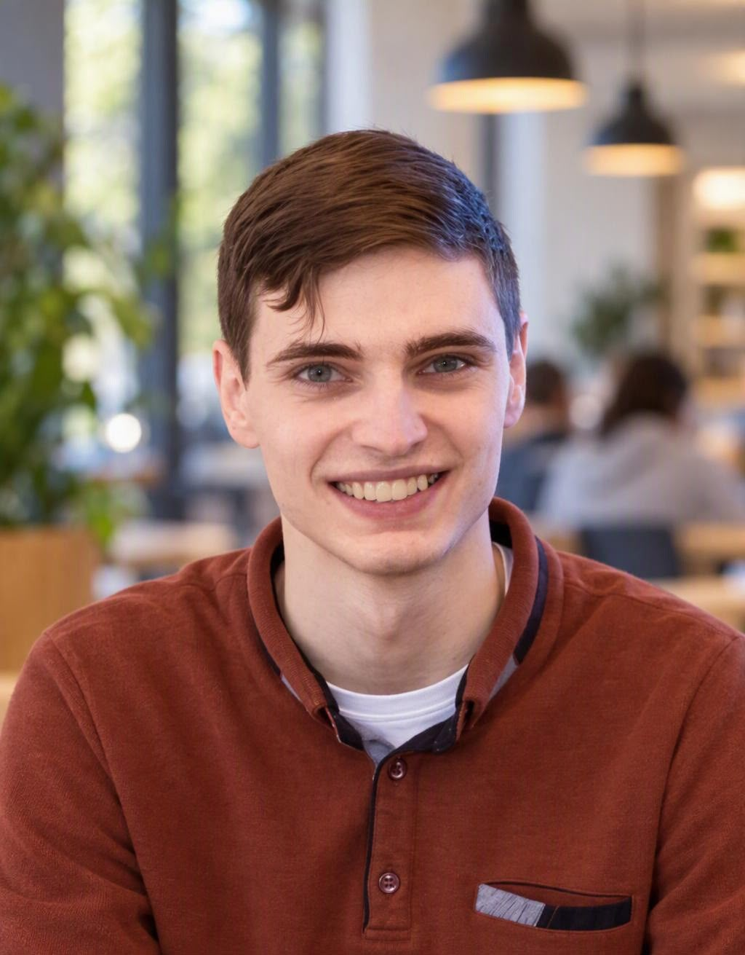
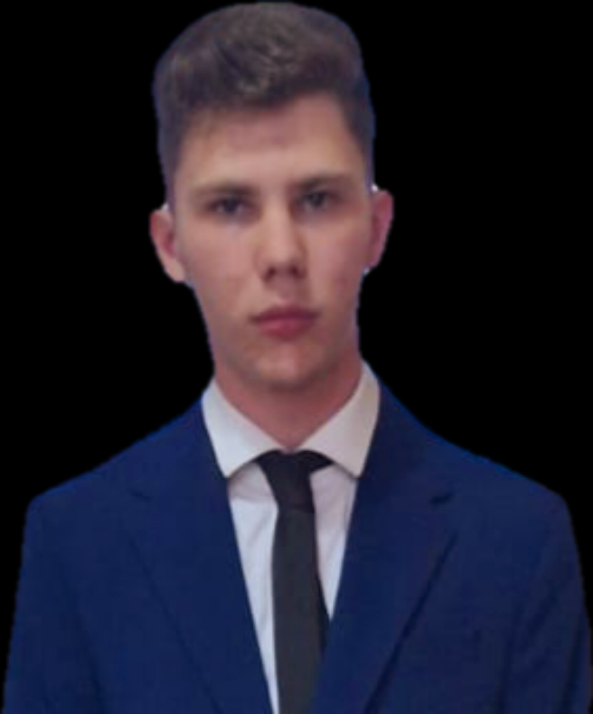
01 / WHO ARE WE?
Tech
Niculae Adelin
Theodou Alexandros
Tech Coordinator
Tech
RAU DEV • SOFTWARE ENGINEERING CLUB
04

Slide 6
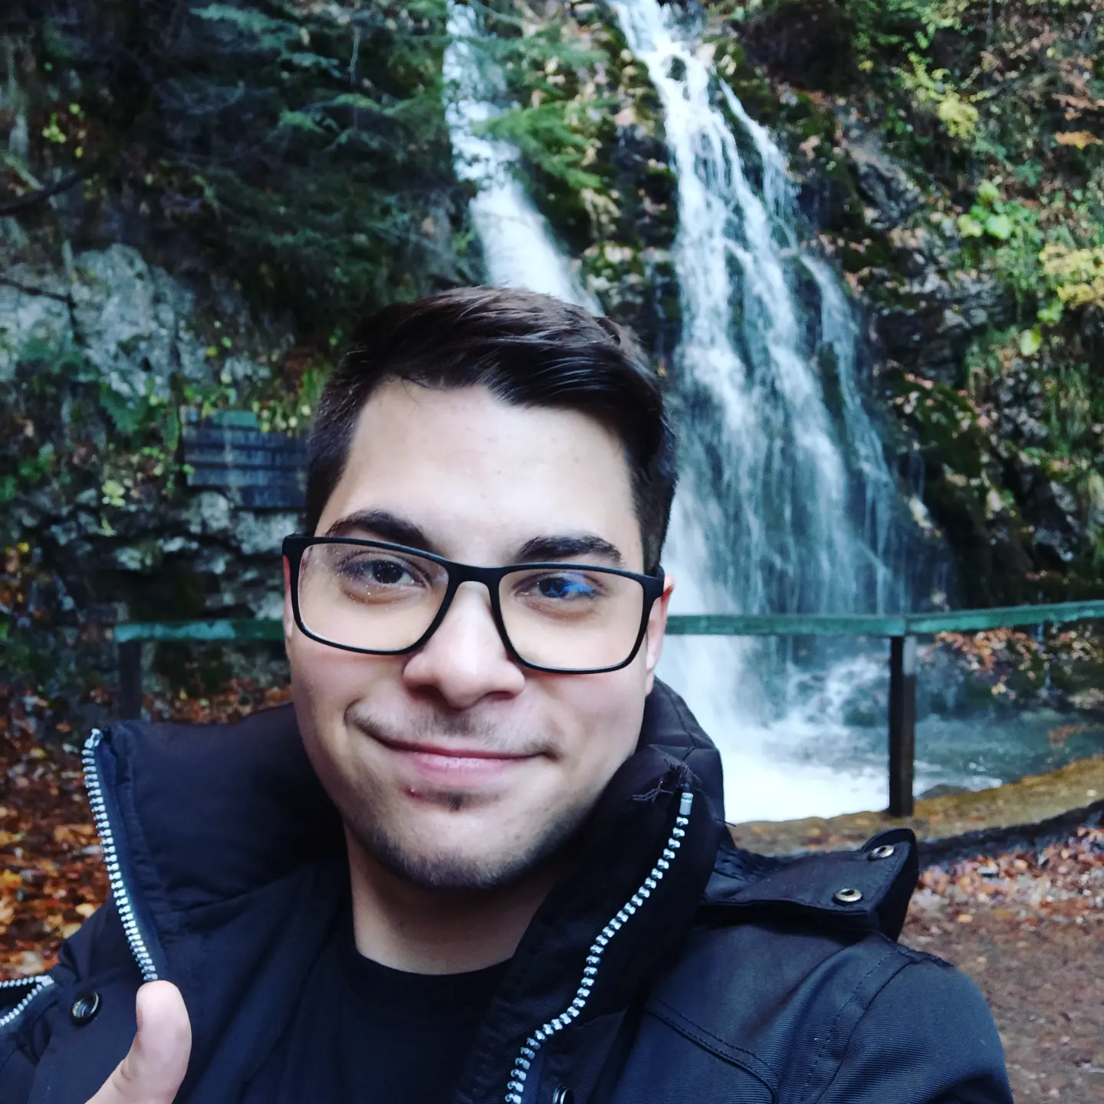

01 / WHO ARE WE?
Logistics
Iulian Fecioru
Călin Mercone
Logistics Coordinator
Logistics
RAU DEV • SOFTWARE ENGINEERING CLUB
05

Slide 7
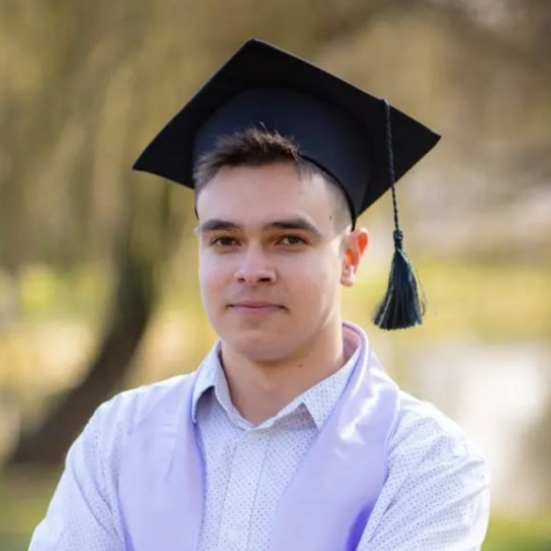
01 / WHO ARE WE?
Tutoring
Tiberiu-Gabriel Podăreanu
Iulian Popescu
Beginner Tutoring
Intermediate Tutoring
RAU DEV • SOFTWARE ENGINEERING CLUB
06

Slide 8
02 / MEET EACH OTHER
Your turn: the 30-second introduction.
Pair up with someone you haven’t spoken to yet. Take turns, then introduce your partner.
01
Name & year
02
Your tech story
03
Your curiosity
What should we call you?
What have you tried—or what would you like to try?
What’s one thing you’d love to learn or build?
Remember: you don’t need an impressive answer. A genuine one is better.
RAU DEV • SOFTWARE ENGINEERING CLUB
07

Slide 9
03 / WHAT WE CAN DO
Five ways to turn curiosity into practice.
We’ll start small, then build on what members find useful.
</>
Coding challenges
Solve problems and explain your approach.
◎
Mock interviews
Practise technical and behavioural questions.
⚙
Engineering workshops
Explore Git, testing, APIs, and more.
◖
Guest speakers
Hear honest stories from industry professionals.
✳
Projects & networking
Meet teammates and build something useful.
RAU DEV • SOFTWARE ENGINEERING CLUB
08

Slide 10
04 / OUR CULTURE
A few principles make a strong community.
The kind of club we build depends on how we treat one another.
Curiosity over ego
Progress over perfection
Ask questions. Stay open to being wrong.
Small steps count. Keep practising.
Collaboration over competition
Respect at every level
Share credit and help teammates succeed.
Make room for different backgrounds and experience.
RAU DEV • SOFTWARE ENGINEERING CLUB
09

Slide 11
Starting Challenge:
no xp :) we want to test your skills
https://cses.fi/problemset/task/1068
RAU DEV • SOFTWARE ENGINEERING CLUB
10

Slide 12
Starting Challenge Solution:
https://cses.fi/paste/f32f1ba2c3f9e940fb63c9/
RAU DEV • SOFTWARE ENGINEERING CLUB
11

Slide 13
Break Time!
RAU DEV • SOFTWARE ENGINEERING CLUB
12

Slide 14
Weekly Challenge:
+15 xp
https://leetcode.com/problems/fizz-buzz/
RAU DEV • SOFTWARE ENGINEERING CLUB
13

Slide 15
Optional Challenge:
+20 xp
https://leetcode.com/problems/intersection-of-two-arrays/
RAU DEV • SOFTWARE ENGINEERING CLUB
14

Slide 16


RAU DEV
Build skills.
Share knowledge.
Engineer together.
@raudev.club
What will you help us build first?
Questions • Ideas • Introductions
RAU DEV • SOFTWARE ENGINEERING CLUB
15

Slide 17
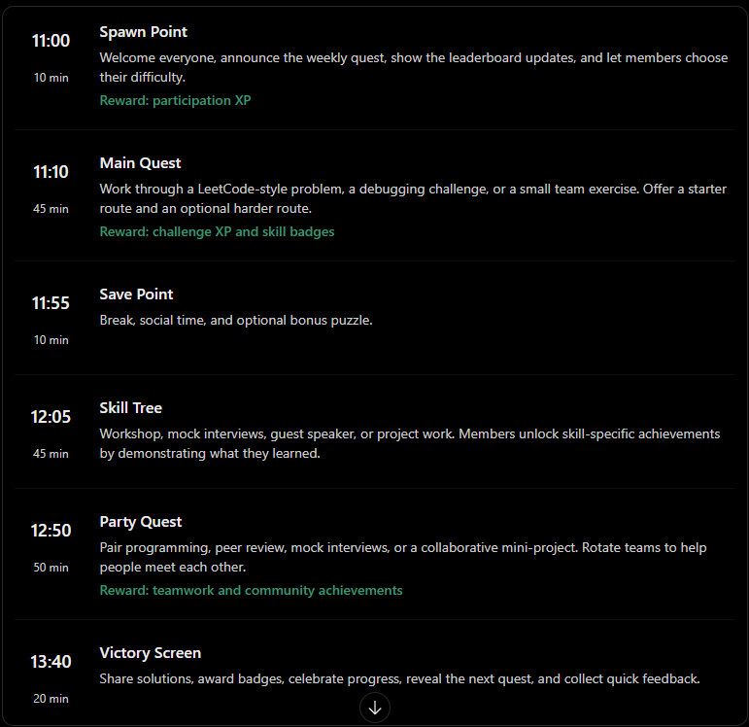

Slide 18
