Slide 1
Multi-Omics Integration for Personalised Medicine

Slide 2
Project Introduction
What to expect

Slide 3
Integration of Multi-Omics Data
Genomics
Representation
Analysis
Transcriptomics
Representation
Analysis
Epigenomics
Representation
Analysis
?
Metabolomics
Representation
Analysis
Proteomics
Representation
Analysis

Slide 4
Integration of Multi-Omics Data
Genomics
Transcriptomics
Epigenomics
Representation
Analysis
Metabolomics
Proteomics

Slide 5
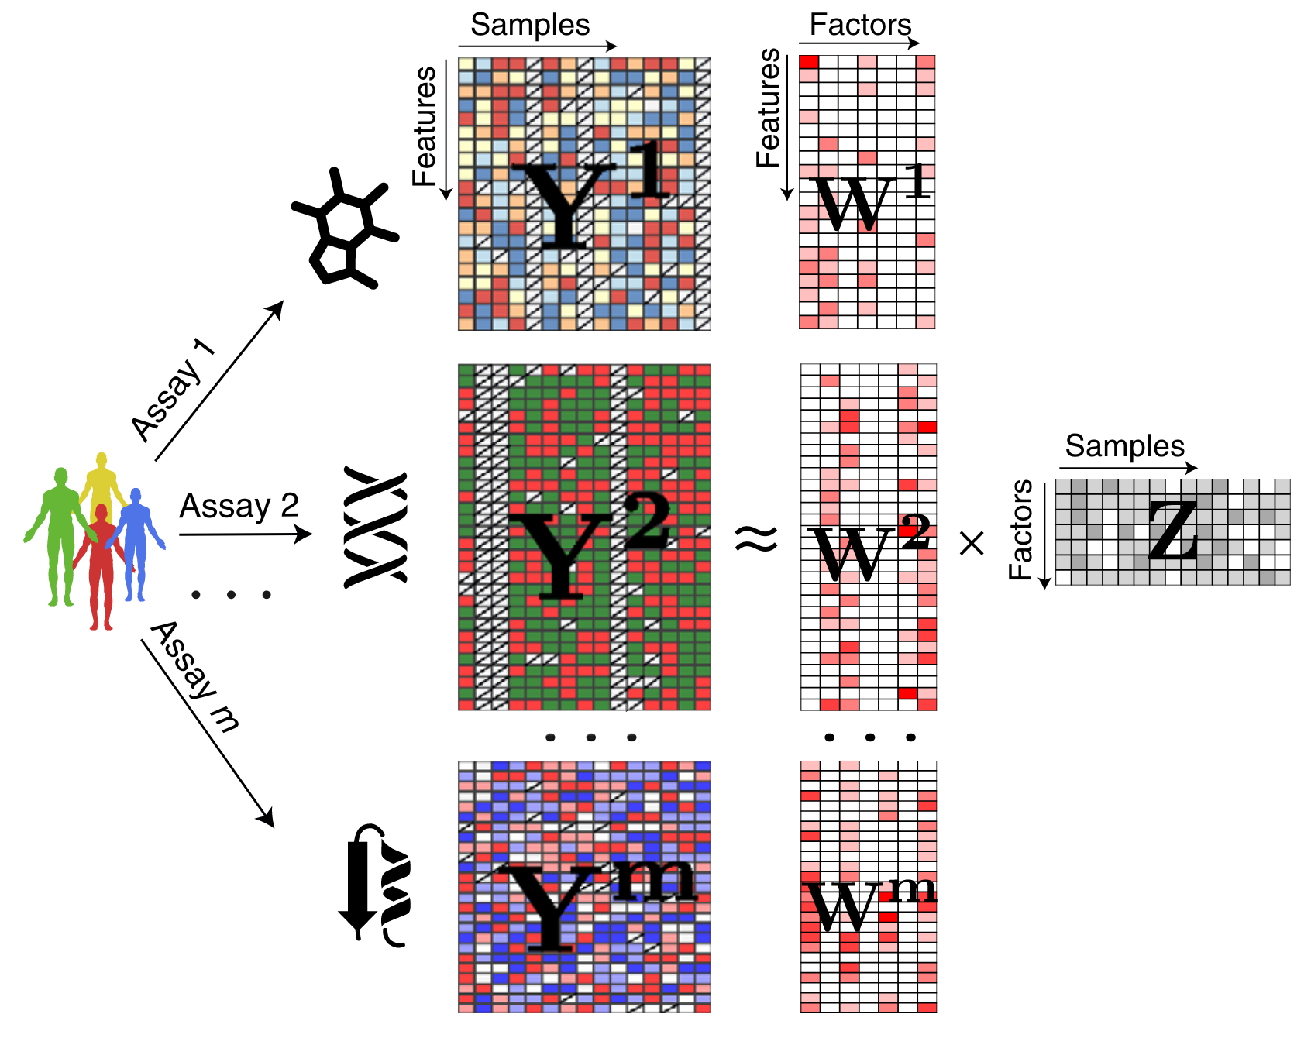
Multi-Omics Factor Analysis (MOFA)
Shared representation of all modalities
Argelaguet, Ricard, et al. "Multi‐Omics Factor Analysis—a framework for unsupervised integration of multi‐omics data sets." Molecular systems biology 14.6 (2018): e8124.

Slide 6
Application to a chronic lymphocytic leukemia (CLL) data set
Somatic mutations
200 patients
69 mutation loci
Patient metadata:
Gender
Age
IC50 before treatment
Treated after data collection
Survival
Transcriptome
136 patients
5000 transcripts
DNA methylation
200 patients
200 methylation sites
Ex vivo drug response
200 patients
62 drugs (5 concentrations)

Slide 7
Project Overview
Tuesday Data handling and the CLL data set
Wednesday Training a MOFA model
Thursday Downstream analysis
Friday Time for questions and presentation preparation

Slide 8
Data Handling
AnnData, MuData, and the CLL data set

Slide 9
From the Sequencing Machine to Count Matrices
Sequencing
Alignment
Filtering & Quality Control
Read Preprocessing
Cell Barcode & UMI Processing
Generation of Count Matrix

Slide 10
How to Represent Count Matrices (in Python)
Array
(Numpy)
DataFrame
(Pandas)
2 | 5 | ... | 0
0 | 3 | ... | 8
... | ... | ... | ..
2 | 1 | ... | 0
 | Cell 1 | Cell 2 | ... | Cell N
Gene 1 | 2 | 5 | ... | 0
Gene 2 | 0 | 3 | ... | 8
... | ... | ... | ... | ..
Gene D | 2 | 1 | ... | 0

Slide 11
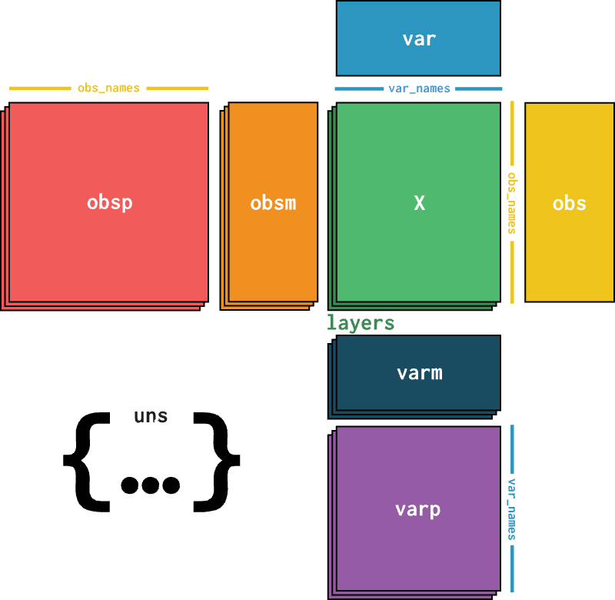
AnnData
https://anndata.readthedocs.io/
Virshup, Isaac, et al. "anndata: Annotated data." BioRxiv (2021): 2021-12.

Slide 12
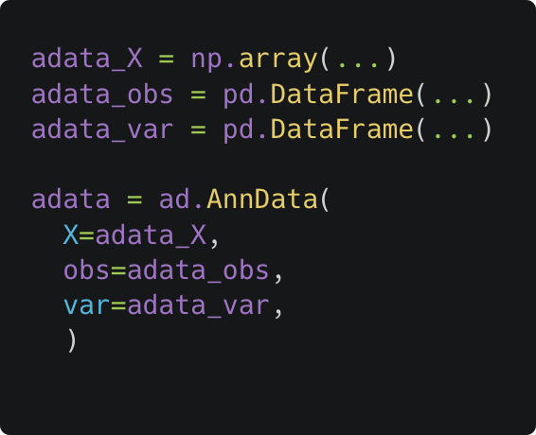
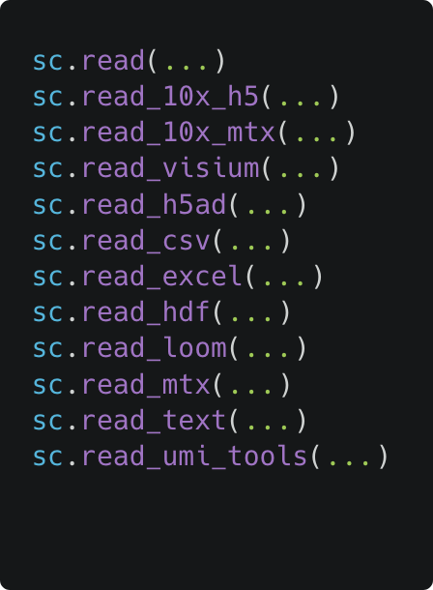
How to Create Your Own AnnData Object
Manually
With ScanPy
https://scanpy.readthedocs.io/en/1.10.x/api/reading.html

Slide 13
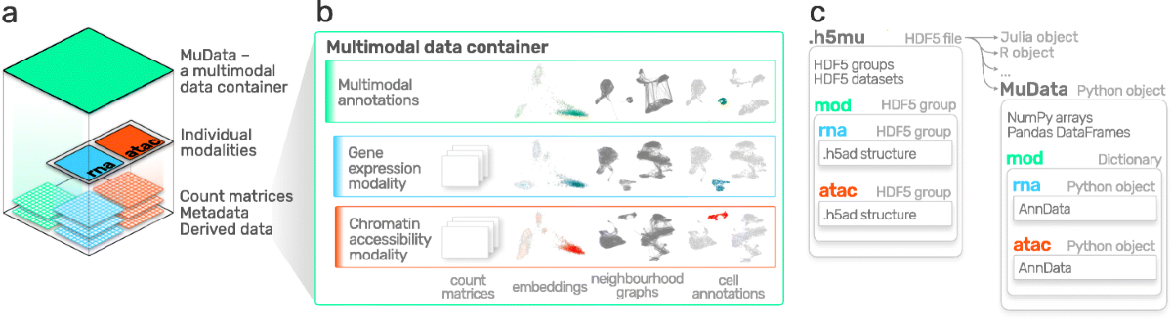
MuData
https://muon.readthedocs.io
Bredikhin, Danila, Ilia Kats, and Oliver Stegle. "MUON: multimodal omics analysis framework." Genome biology 23.1 (2022): 42.

Slide 14
The CLL Data Set
Somatic mutations
200 patients
69 mutation loci
Binary encoding (0 or 1)
Transcriptome
136 patients
5000 transcripts
Transformed counts
DNA methylation
200 patients
200 methylation sites
M-value
Ex vivo drug response
200 patients
62 drugs (5 concentrations)
Viability score (0 to 1)
Patient metadata:
Gender
Age
IC50 before treatment
Treated after data collection
Survival

Slide 15
Factor Models and MOFA
An introduction

Slide 16
Omics Data is High-Dimensional
Modality Number of features / dimensions
Proteome e.g. 10 000 proteins
Transcriptome e.g. 20 000 genes
Genome e.g. 5 million SNPs
Epigenome e.g. 20 million CpG sites
... often in just 100s to 1000s of cells / samples → $n_{dimensions}≫n_{observations}$

Slide 17
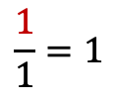

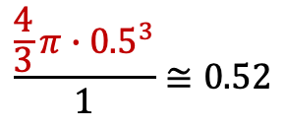
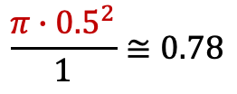
The Curse of Dimensionality
D = 1
D = 2
D = 3
D = ...
$$\frac{\frac{4}{3}π∙{0.5}^{3}}{1}≅0.52$$
$$\frac{1}{1}=1$$
$$\frac{π∙{0.5}^{2}}{1}≅0.78$$
$$≅0$$
In very high dimensions...
spheres around data points fill vanishingly small volumes
it becomes difficult to establish relations between data points
→ High dimensions are typically not suitable for direct analysis

Slide 18
Dimensionality Reduction Methods
 | Gene 1 | Gene 2 | Gene 3 | ... | Gene D
Cell 1 | 2 | 5 | 2 | ... | 0
... | ... | ... | ... | ... | ..
Cell N | 2 | 1 | 0 | ... | 0
Linear Methods
Principal Component Analysis (PCA)
Independent Component Analysis (ICA)
Latent Dirichlet Allocation (LDA)
Factor Analysis (FA)
Non-Negative Matrix Factorization (NMF)
...
Non-Linear Methods
(Variational) Autoencoder (VAE)
Deep Matrix Factorization
t-SNE
UMAP
Spectral Embedding
...
 | Dim 1 | Dim 2
Cell 1 | 0.4 | -6.2
... | ... | ...
Cell N | 0.0 | 9.1

Slide 19



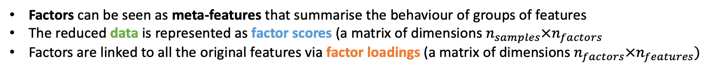



What is a Factor Model Intuitively?
Factors can be seen as meta-features that summarise the behaviour of groups of features
The reduced data is represented as factor scores (a matrix of dimensions $n_{samples}×n_{factors}$
Factors are linked to all the original features via factor loadings (a matrix of dimensions $n_{factors}×n_{features})$
$$n_{samples}$$
$$n_{samples}$$
$$n_{factors}$$
≅
⨉
$$n_{features}$$
$$n_{features}$$
$$n_{factors}$$

Slide 20

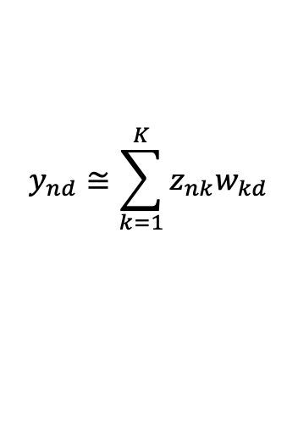
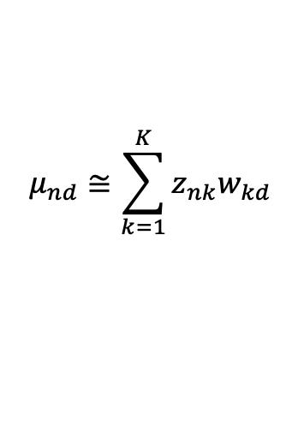




What is a Factor Model Mathematically?
Factor scores and loadings are called latent variables
Given the observed data, the goal is to infer the latent variables
$$Y≅ZW$$
Probabilistic Formulation
$$y_{nd}≅\sum_{k=1}^{K}{z_{nk}w_{kd}}$$
$$y_{nd}\sim 𝒩(μ_{nd},σ_{d}^{2})$$
$$μ_{nd}≅\sum_{k=1}^{K}{z_{nk}w_{kd}}$$
$$Y∈ℝ^{NxD}$$
Observed data
Factor scores
Factor loadings
$$Z∈ℝ^{NxK}$$
$$W∈ℝ^{KxD}$$

Slide 21
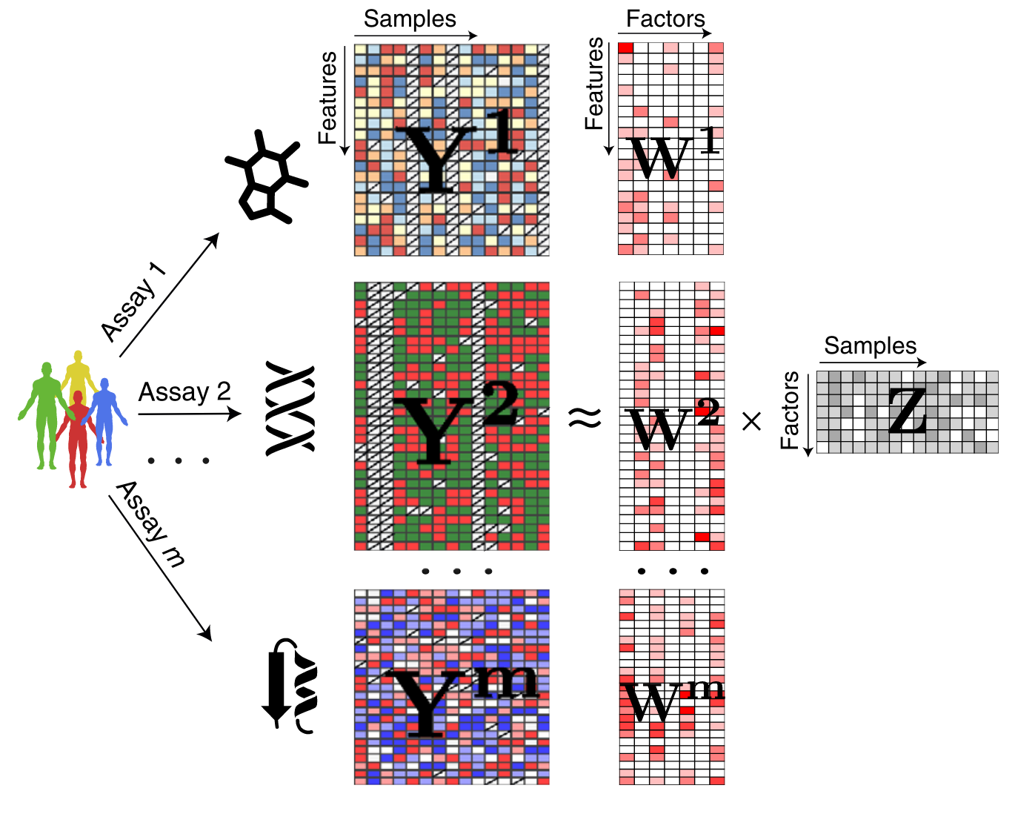
Multi-Omics Factor Analysis (MOFA)
Argelaguet, Ricard, et al. "Multi‐Omics Factor Analysis—a framework for unsupervised integration of multi‐omics data sets." Molecular systems biology 14.6 (2018): e8124.

Slide 22
Downstream Analysis
Understanding the factor scores and loadings

Slide 23
Visualisation of Factor Scores

Slide 24
Clustering of Samples

Slide 25
Prediction of Covariates

Slide 26
Recap

Slide 27
Visualisation of Factor Loadings

Slide 28
Gene Set Enrichment Analysis

Slide 29
MOFA Deep Dive
A glimpse behind the scenes

Slide 30
Bayesian Generative Modelling

Slide 31
Bayes’ Theorem

Slide 32
Bayesian Inference

Slide 33
The Power of Prior Distributions

Slide 34
Prior Distributions in MOFA

