Slide 1
Multi-Omics Integration for Personalised Medicine

Slide 2
Project Introduction
What to expect

Slide 3
Integration of Multi-Omics Data
Genomics
Representation
Analysis
Transcriptomics
Representation
Analysis
Epigenomics
Representation
Analysis
?
Metabolomics
Representation
Analysis
Proteomics
Representation
Analysis

Slide 4
Integration of Multi-Omics Data
Genomics
Transcriptomics
Epigenomics
Representation
Analysis
Metabolomics
Proteomics

Slide 5
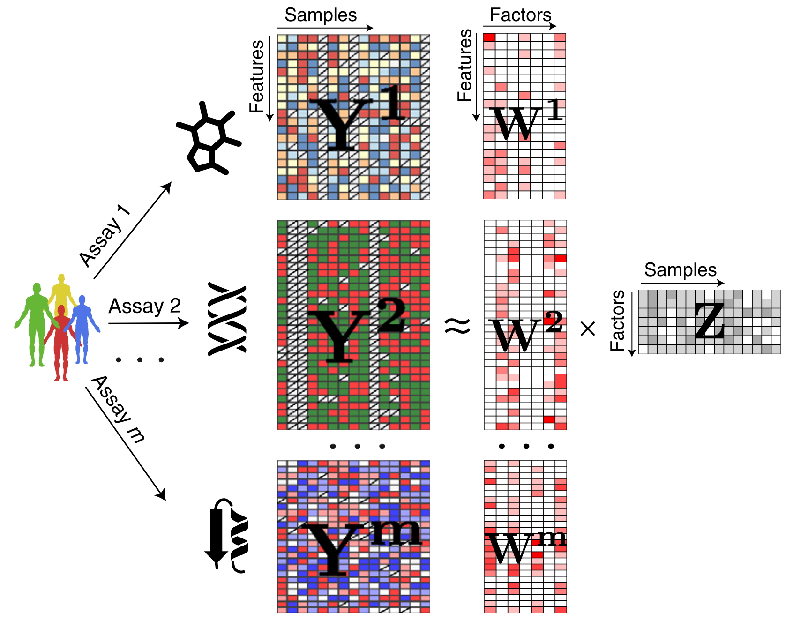
Multi-Omics Factor Analysis (MOFA)
Shared representation of all modalities
Argelaguet, Ricard, et al. "Multi‐Omics Factor Analysis—a framework for unsupervised integration of multi‐omics data sets." Molecular systems biology 14.6 (2018): e8124.

Slide 6
Application to a chronic lymphocytic leukemia (CLL) data set
Somatic mutations
200 patients
69 mutation loci
Patient metadata:
Gender
Age
IC50 before treatment
Treated after data collection
Survival
Transcriptome
136 patients
5000 transcripts
DNA methylation
200 patients
200 methylation sites
Ex vivo drug response
200 patients
310 drugs

Slide 7
Project Overview
Tuesday
Wednesday
Thursday
Friday
Slides and project work: Data handling and the CLL data set
Slides: Introduction to factor models and MOFA
Project work: Training a MOFA model
Slides & project work: Downstream analysis – Part I
Slides & project work: Downstream analysis – Part II
Time for questions and preparation of presentation

Slide 8
Data Handling
AnnData, MuData, and the CLL data set

Slide 9
From the Sequencing Machine to Count Matrices
Sequencing
Alignment
Filtering & Quality Control
Read Preprocessing
Cell Barcode & UMI Processing
Generation of Count Matrix

Slide 10
How to Represent Count Matrices (in Python)
NumPy Array
Pandas DataFrame
2 | 5 | ... | 0
0 | 3 | ... | 8
... | ... | ... | ..
2 | 1 | ... | 0
No information about variable and observation names
Inconvenient for manipulations
Very error-prone
Variable and and observation names in index / columns
Easy access and manipulations: .loc[“Gene 1”, “Cell 4”]
Less error-prone
No additional sample or variable meta-data, data representations, ...
 | Cell 1 | Cell 2 | ... | Cell N
Gene 1 | 2 | 5 | ... | 0
Gene 2 | 0 | 3 | ... | 8
... | ... | ... | ... | ..
Gene D | 2 | 1 | ... | 0

Slide 11
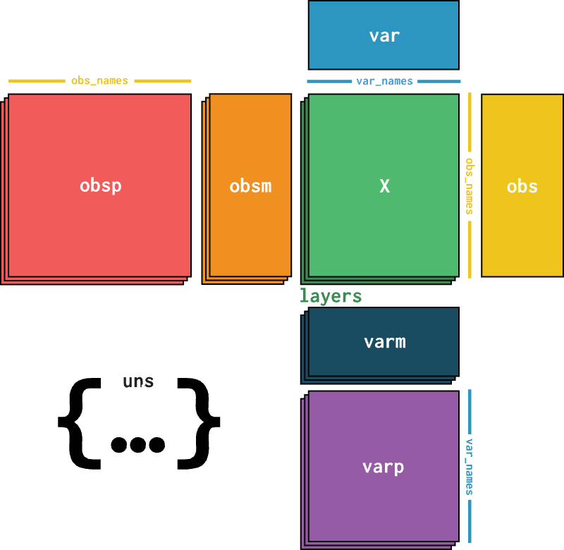
AnnData
https://anndata.readthedocs.io/
Virshup, Isaac, et al. "anndata: Annotated data." BioRxiv (2021): 2021-12.

Slide 12
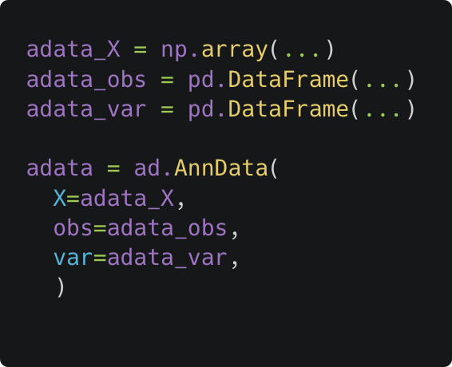
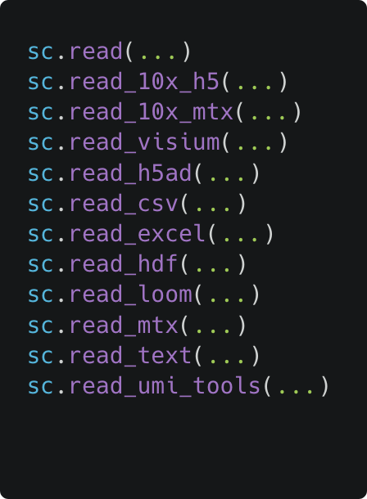
How to Create Your Own AnnData Object
Manually
With ScanPy
https://scanpy.readthedocs.io/en/1.10.x/api/reading.html

Slide 13
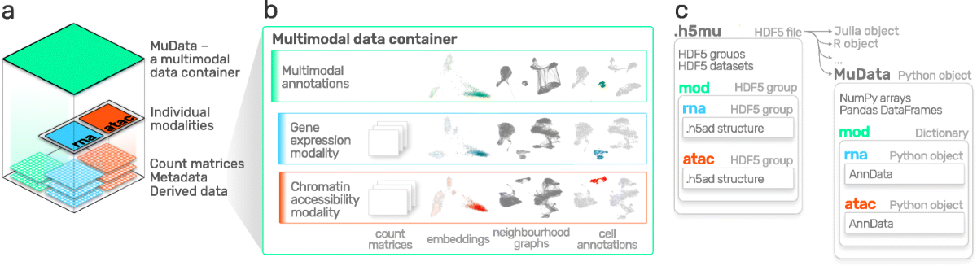
MuData
https://muon.readthedocs.io
Bredikhin, Danila, Ilia Kats, and Oliver Stegle. "MUON: multimodal omics analysis framework." Genome biology 23.1 (2022): 42.

Slide 14
The CLL Data Set
Somatic mutations
200 patients
69 mutation loci
Binary encoding (0 or 1)
Transcriptome
136 patients
5000 transcripts
Transformed counts
DNA methylation
200 patients
200 methylation sites
M-value
Ex vivo drug response
200 patients
62 drugs (5 concentrations)
Viability score (0 to 1)
Patient metadata:
Gender
Age
IC50 before treatment
Treated after data collection
Survival

Slide 15
Factor Models and MOFA
An introduction

Slide 16
Why dimensionality reduction?

Slide 17
What is a Factor Model intuitively?

Slide 18
What is a Factor Model mathematically?

Slide 19
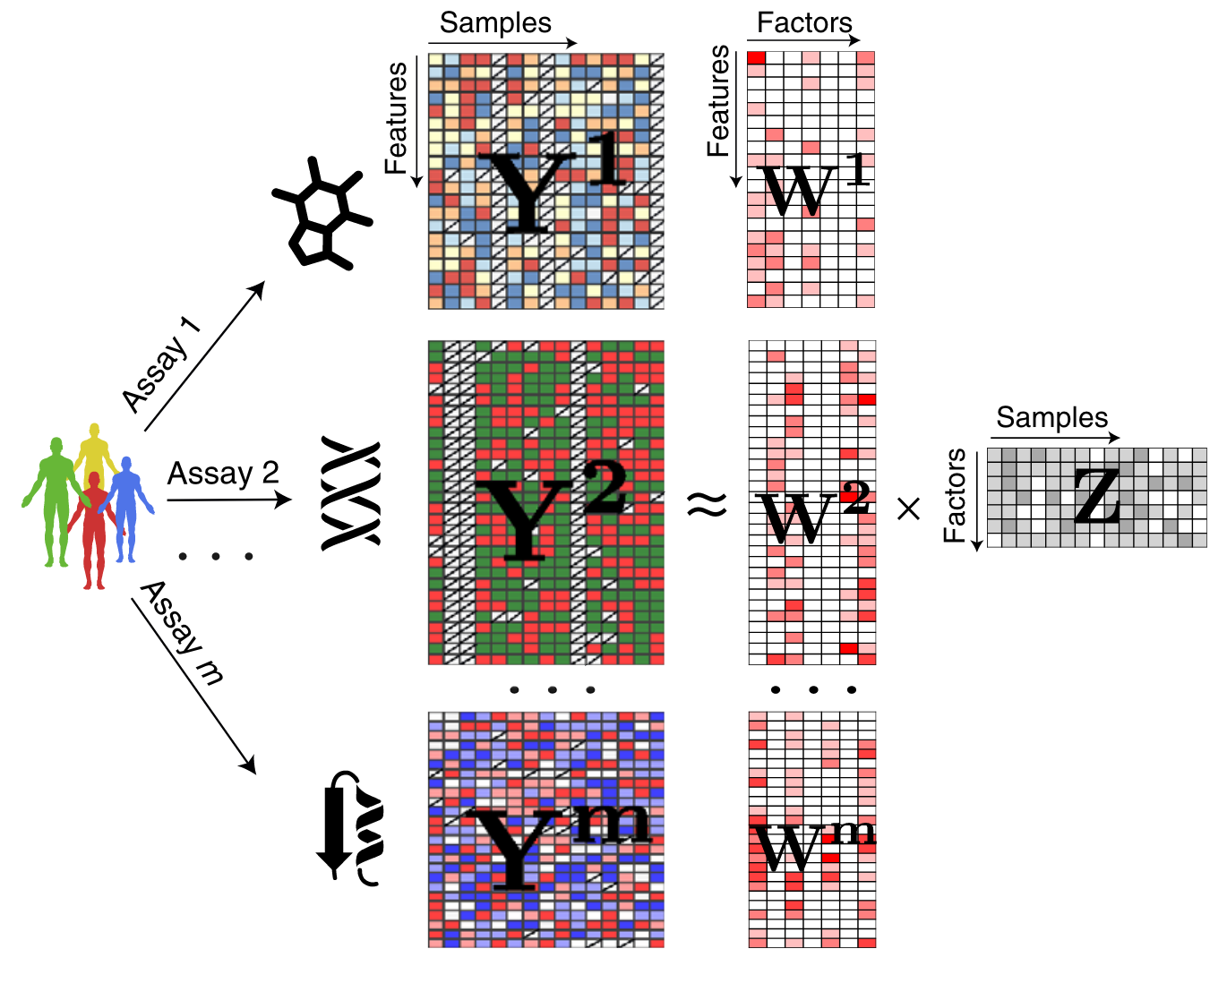
Multi-Omics Factor Analysis (MOFA)
Argelaguet, Ricard, et al. "Multi‐Omics Factor Analysis—a framework for unsupervised integration of multi‐omics data sets." Molecular systems biology 14.6 (2018): e8124.

Slide 20
Downstream Analysis – Part I
Understanding the factor scores

Slide 21
Recap

Slide 22
Visualisation of Factor Scores

Slide 23
Clustering of Samples

Slide 24
Prediction of Covariates

Slide 25
Downstream Analysis – Part II
Understanding the factor loadings

Slide 26
Recap

Slide 27
Visualisation of Factor Loadings

Slide 28
Gene Set Enrichment Analysis

Slide 29
MOFA Deep Dive
A glimpse behind the scenes

Slide 30
Bayesian Generative Modelling

Slide 31
Bayes’ Theorem

Slide 32
Bayesian Inference

Slide 33
The Power of Prior Distributions

Slide 34
Prior Distributions in MOFA

