Slide 1
Multi-Omics Integration for Personalised Medicine
EMBL-EBI Course
Introduction to Multi-Omics Data Integration and Visualisation
Group Project

Slide 2
Project Introduction
What to expect

Slide 3
Integration of Multi-Omics Data
Genomics
Representation
Analysis
Transcriptomics
Representation
Analysis
Epigenomics
Representation
Analysis
?
Metabolomics
Representation
Analysis
Proteomics
Representation
Analysis

Slide 4
Integration of Multi-Omics Data
Genomics
Transcriptomics
Epigenomics
Representation
Analysis
Metabolomics
Proteomics

Slide 5
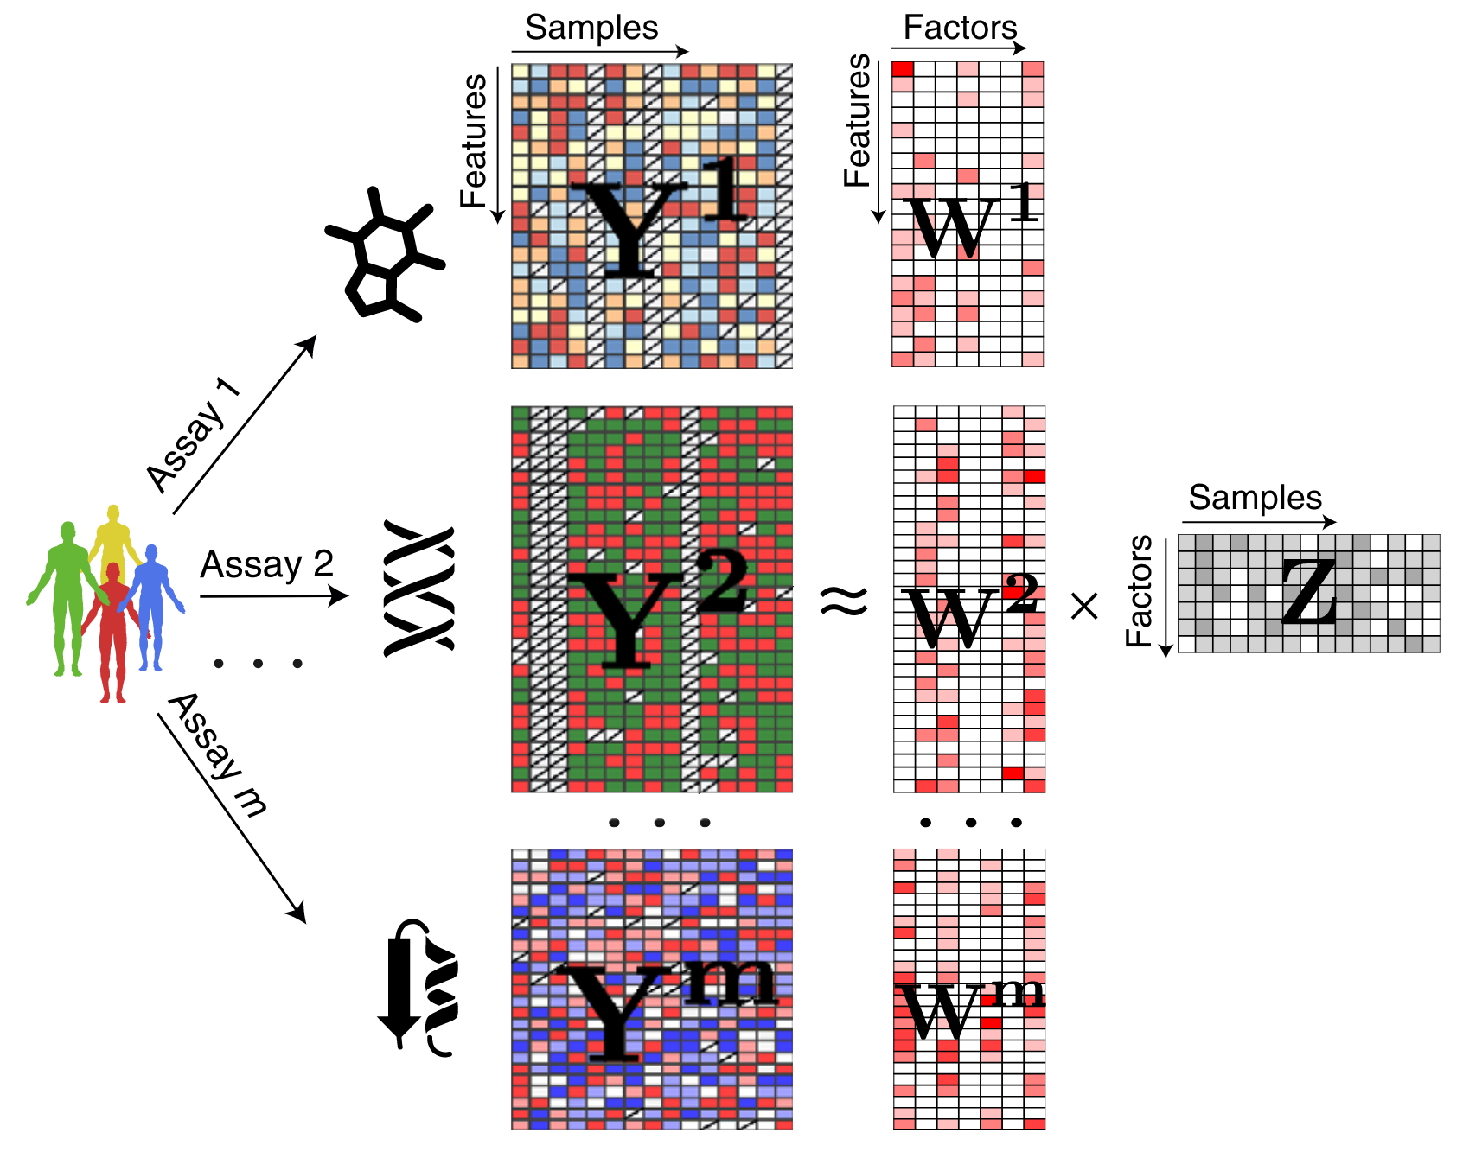
Multi-Omics Factor Analysis (MOFA)
Shared representation of all modalities
Argelaguet, Ricard, et al. "Multi‐Omics Factor Analysis—a framework for unsupervised integration of multi‐omics data sets." Molecular systems biology 14.6 (2018): e8124.

Slide 6
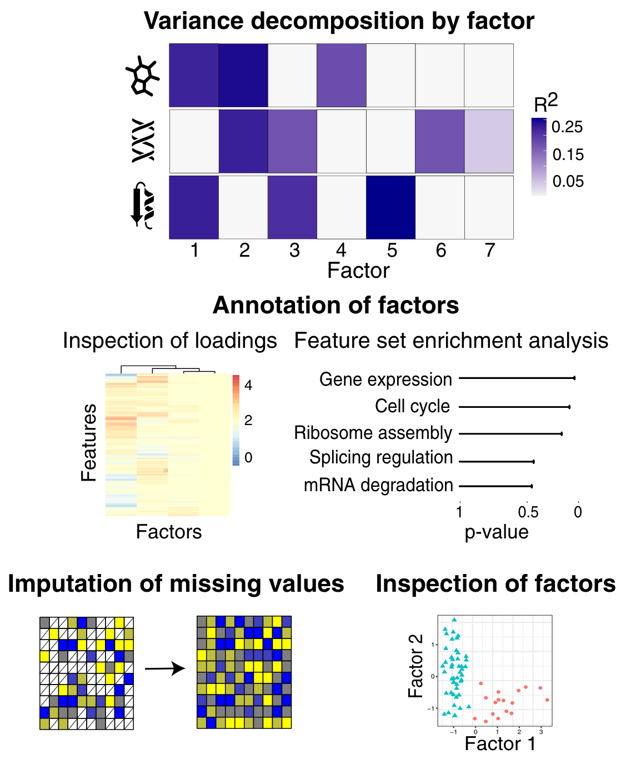
MOFA Downstream analysis
Argelaguet, Ricard, et al. "Multi‐Omics Factor Analysis—a framework for unsupervised integration of multi‐omics data sets." Molecular systems biology 14.6 (2018): e8124.

Slide 7
Application to a chronic lymphocytic leukemia (CLL) data set
Somatic mutations
200 patients
69 mutation loci
Patient metadata:
Gender
Age
IC50 before treatment
Treated after data collection
Survival
Transcriptome
136 patients
5000 transcripts
DNA methylation
200 patients
200 methylation sites
Ex vivo drug response
200 patients
62 drugs (5 concentrations)

Slide 8
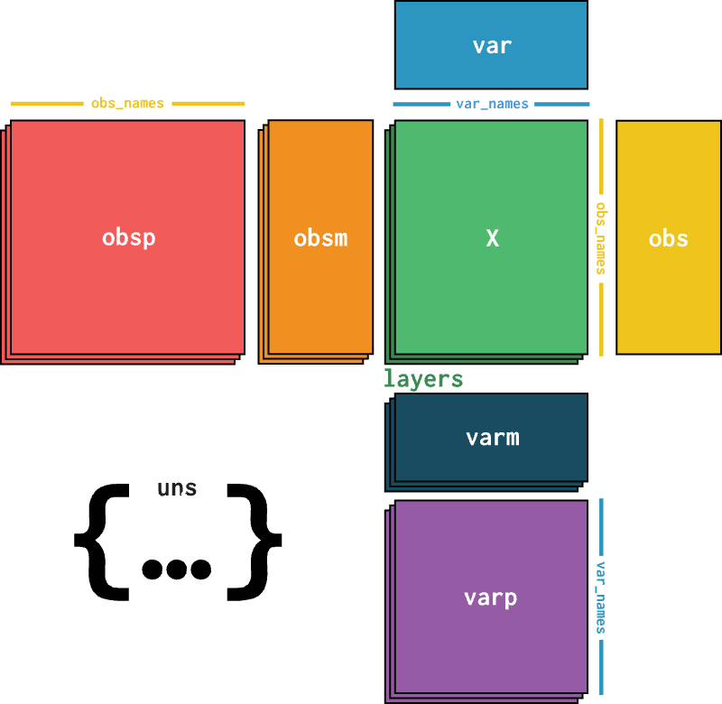
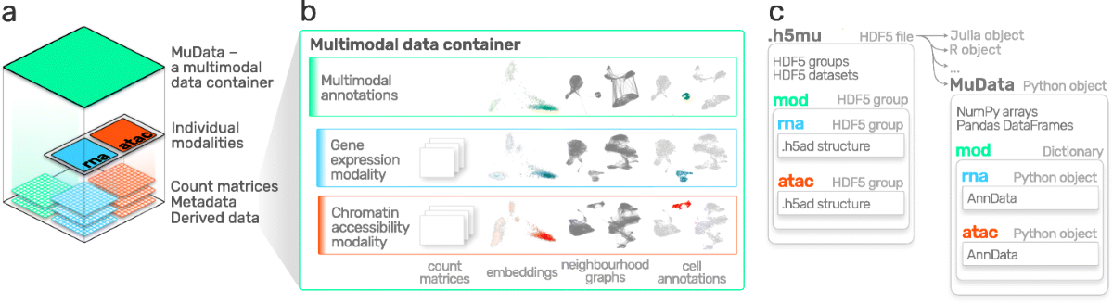
Project Overview
Tuesday Data handling and the CLL data set
Wednesday Training a MOFA model
Thursday Downstream analysis
Friday Time for questions and presentation preparation

Slide 9
Data Handling
AnnData, MuData, and the CLL data set

Slide 10
From the Sequencing Machine to Count Matrices
Sequencing
Alignment
Filtering & Quality Control
Read Preprocessing
Cell Barcode & UMI Processing
Generation of Count Matrix

Slide 11
How to Represent Count Matrices (in Python)
Array
(Numpy)
DataFrame
(Pandas)
2 | 5 | ... | 0
0 | 3 | ... | 8
... | ... | ... | ..
2 | 1 | ... | 0
 | Cell 1 | Cell 2 | ... | Cell N
Gene 1 | 2 | 5 | ... | 0
Gene 2 | 0 | 3 | ... | 8
... | ... | ... | ... | ..
Gene D | 2 | 1 | ... | 0

Slide 12
AnnData
https://anndata.readthedocs.io/
Virshup, Isaac, et al. "anndata: Annotated data." BioRxiv (2021): 2021-12.

Slide 13
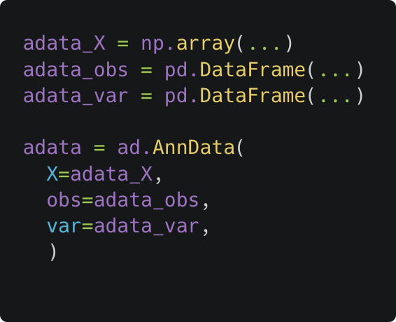
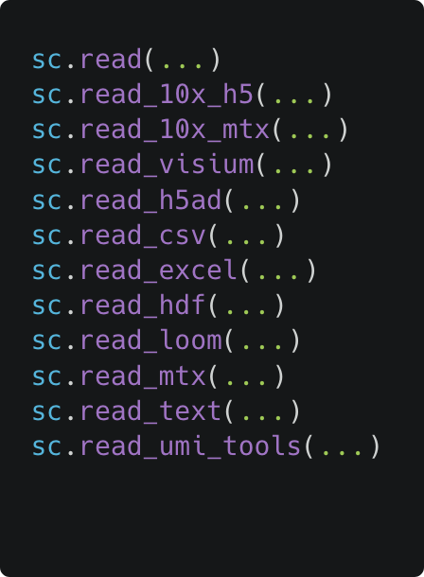
How to Create Your Own AnnData Object
Manually
With ScanPy
https://scanpy.readthedocs.io/en/1.10.x/api/reading.html

Slide 14
MuData
https://muon.readthedocs.io
Bredikhin, Danila, Ilia Kats, and Oliver Stegle. "MUON: multimodal omics analysis framework." Genome biology 23.1 (2022): 42.

Slide 15
The CLL Data Set
Somatic mutations
200 patients
69 mutation loci
Binary encoding (0 or 1)
Transcriptome
136 patients
5000 transcripts
Transformed counts
DNA methylation
200 patients
200 methylation sites
M-value
Ex vivo drug response
200 patients
62 drugs (5 concentrations)
Viability score (0 to 1)
Patient metadata:
Gender
Age
IC50 before treatment
Treated after data collection
Survival

Slide 16
Factor Models and MOFA
An introduction

Slide 17
Omics Data is High-Dimensional
Modality Number of features / dimensions
Proteome e.g. 10 000 proteins
Transcriptome e.g. 20 000 genes
Genome e.g. 5 million SNPs
Epigenome e.g. 20 million CpG sites
... often in just 100s to 1000s of cells / samples → $n_{dimensions}≫n_{observations}$

Slide 18
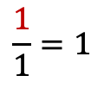

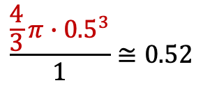
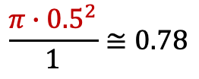
The Curse of Dimensionality
D = 1
D = 2
D = 3
D = ...
$$\frac{\frac{4}{3}π∙{0.5}^{3}}{1}≅0.52$$
$$\frac{1}{1}=1$$
$$\frac{π∙{0.5}^{2}}{1}≅0.78$$
$$≅0$$
In very high dimensions...
spheres around data points fill vanishingly small volumes
it becomes difficult to establish relations between data points
→ High dimensions are typically not suitable for direct analysis

Slide 19
Dimensionality Reduction Methods
 | Gene 1 | Gene 2 | Gene 3 | ... | Gene D
Cell 1 | 2 | 5 | 2 | ... | 0
... | ... | ... | ... | ... | ..
Cell N | 2 | 1 | 0 | ... | 0
Linear Methods
Principal Component Analysis (PCA)
Independent Component Analysis (ICA)
Latent Dirichlet Allocation (LDA)
Factor Analysis (FA)
Non-Negative Matrix Factorization (NMF)
...
Non-Linear Methods
(Variational) Autoencoder (VAE)
Deep Matrix Factorization
t-SNE
UMAP
Spectral Embedding
...
 | Dim 1 | Dim 2
Cell 1 | 0.4 | -6.2
... | ... | ...
Cell N | 0.0 | 9.1

Slide 20
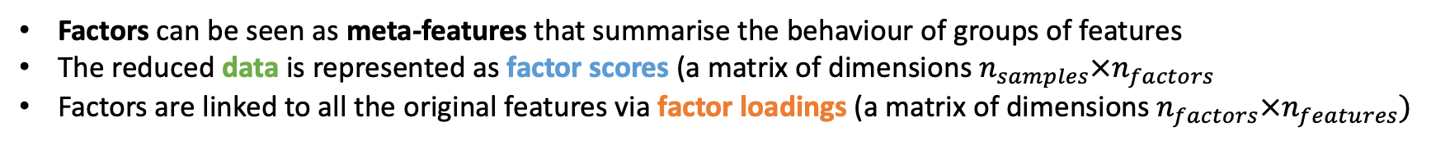
What is a Factor Model Intuitively?
Factors can be seen as meta-features that summarise the behaviour of groups of features
The reduced data is represented as factor scores (a matrix of dimensions $n_{samples}×n_{factors}$
Factors are linked to all the original features via factor loadings (a matrix of dimensions $n_{factors}×n_{features})$
≅
⨉
Samples
Samples
Factors
Features
Features
Factors

Slide 21
An Example: Movie Recommendations
A streaming service has access to the star ratings its users have given for different movies.
The service wants to know how much a user would like another movie to provide better recommendations
What could the factors represent in this situation? Do they always represent something “real”?
What about positive and negative factor scores and loadings?
How could movie ratings be predicted?
User Movie Ratings
Users
≅
⨉
Users
Factors
Movies
Movies
Factors

Slide 22



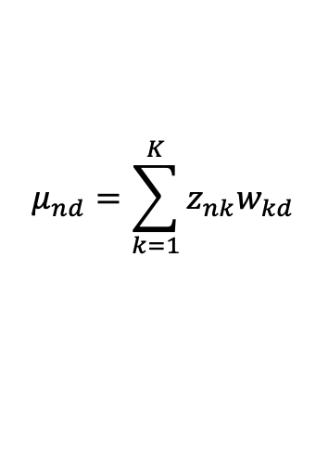
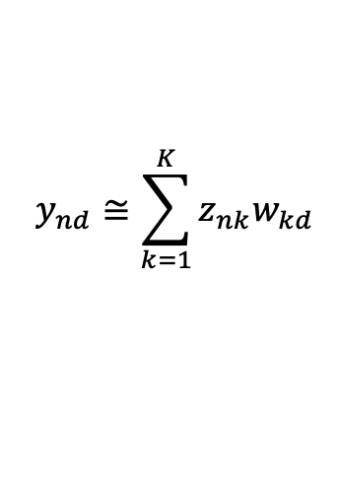



What is a Factor Model Mathematically?
Factor scores and loadings are called latent variables
Given the observed data, the goal is to infer the latent variables
Matrix Factorisation
Probabilistic Formulation
$$y_{nd}≅\sum_{k=1}^{K}{z_{nk}w_{kd}}$$
$$y_{nd}\sim 𝒩(μ_{nd},σ_{d}^{2})$$
$$μ_{nd}=\sum_{k=1}^{K}{z_{nk}w_{kd}}$$
$$Y∈ℝ^{NxD}$$
Observed data
Factor scores
Factor loadings
$$z_{nk}\sim p(z_{nk})$$
$$Z∈ℝ^{NxK}$$
$$W∈ℝ^{KxD}$$
$$w_{kd}\sim p(w_{kd})$$

Slide 23
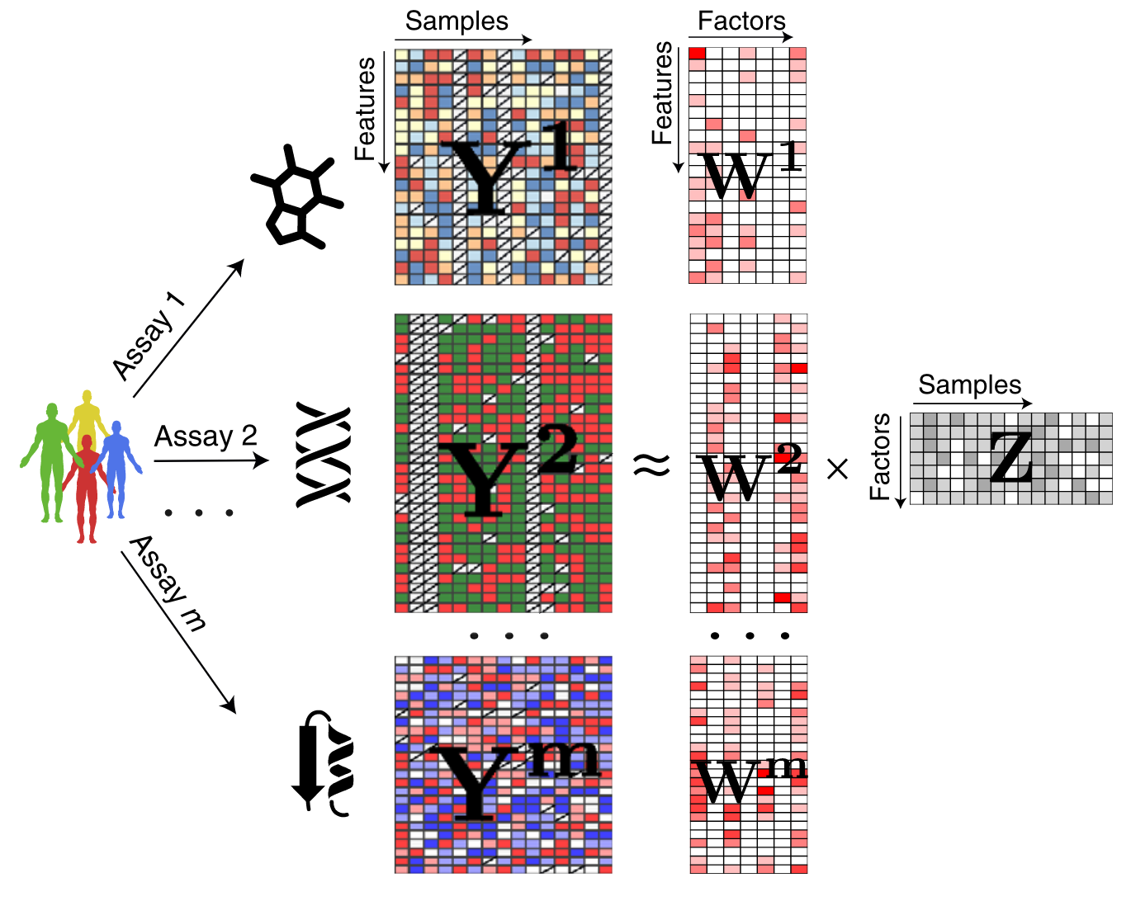
Multi-Omics Factor Analysis (MOFA)
Argelaguet, Ricard, et al. "Multi‐Omics Factor Analysis—a framework for unsupervised integration of multi‐omics data sets." Molecular systems biology 14.6 (2018): e8124.

Slide 24
MOFA Downstream analysis
Argelaguet, Ricard, et al. "Multi‐Omics Factor Analysis—a framework for unsupervised integration of multi‐omics data sets." Molecular systems biology 14.6 (2018): e8124.

Slide 25
Gene Set Enrichment Analysis (GSEA)
Gene 1 | 0.2
Gene 2 | -5.1
Gene 3 | 1.1
... | ...
Gene D | 4.0
Gene 2 | -5.1
Gene 7 | -4.9
Gene 45 | -4.5
... | ...
Gene 9 | 5.2
Gene 2 | -5.1
Gene 7 | -4.9
Gene 45 | -4.5
... | ...
Gene 9 | 5.2
Sorting
GSEA
Gene 2
Gene 7
Gene 45
Gene 6
Gene 45
Gene 1
Pathway X
Pathway Y

Slide 26
Bayesian Latent Variable Models
Generative Model
(“Telling a story of the data”)
Graphical Model
Data
Data Likelihood
K
Z
W
Y
Σ
N
D
Prior distributions
Latent variables

Slide 27
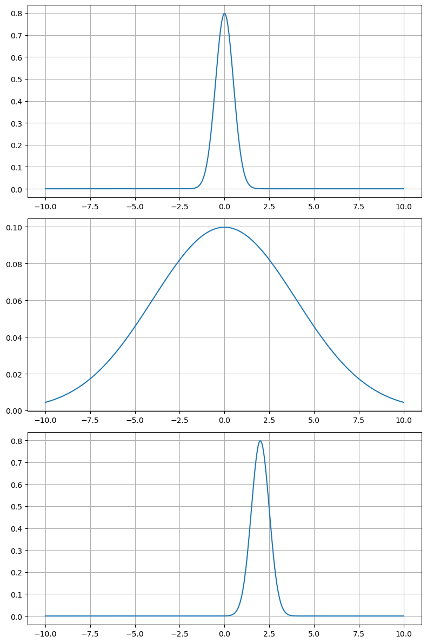
The Power of Prior Distributions
”Values should be close to 0”
Prior distributions encode a-priori assumptions about the variables before seeing any data
”Values could also be quite large”
”Values should (for whatever reason) be close to 2”

Slide 28
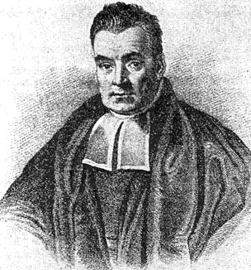
Bayes’ Theorem
Posterior
Likelihood
Prior
Marginal likelihood
Thomas Bayes
1701 – 1761
Statistician and Presbyterian minister

Slide 29
Bayesian Inference
Given the prior distribution and data likelihood, the posterior should be easy to compute...
Solution: Approximate inference
Computationally not tractable 😭

