Slide 3
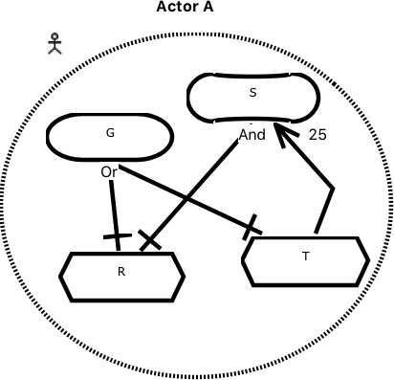
AS6: Task T contributes to softgoal S
CQ6a: Does the task contribute to the softgoal? No
X
DISABLE Task T

Slide 4
Instantiate Arguments Schemes
Answer Critical Questions
INTRO, DISABLE, REPLACE OR ATTACK GRL IE
Modify GRL Models

