Slide 1
Point-to-Point Protocol (PPP)
Accessing the WAN – Chapter 2

Slide 2
Objectives
Describe the fundamental concepts of point-to-point serial communication including TDM, demarcation point, DTE-DCE functions, HDLC encapsulation, and serial interface troubleshooting.
Describe PPP concepts including PPP layered architecture, PPP frame structure, PPP session establishment, multiprotocol encapsulation support, link control protocol (LCP), network control protocol (NCP), and Internet Protocol Control Protocol (IPCP).
Configure PPP on a serial interface including enabling PPP encapsulation, verifying the PPP connection and troubleshooting encapsulation problems.
Configure PPP authentication including explaining PAP and CHAP authentication protocols, configuring PPP authentication using PAP and CHAP, and troubleshooting PPP authentication problems.

Slide 3
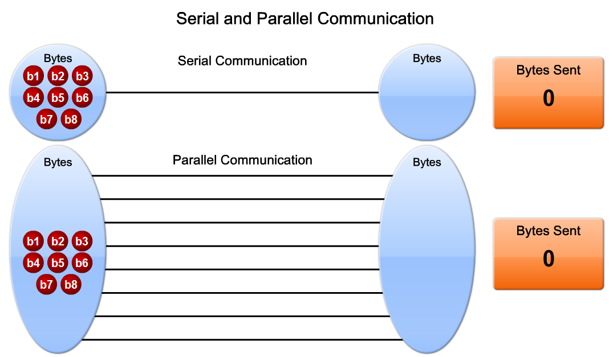
Describe the Fundamental Concepts of Point-to-Point Serial Communication
Describe the concept of serial communication as the basis of WAN technologies

Slide 4
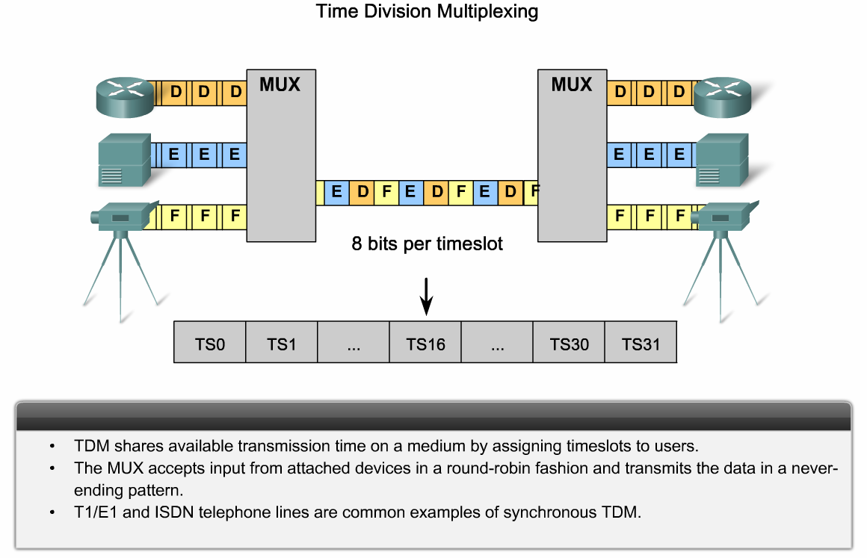
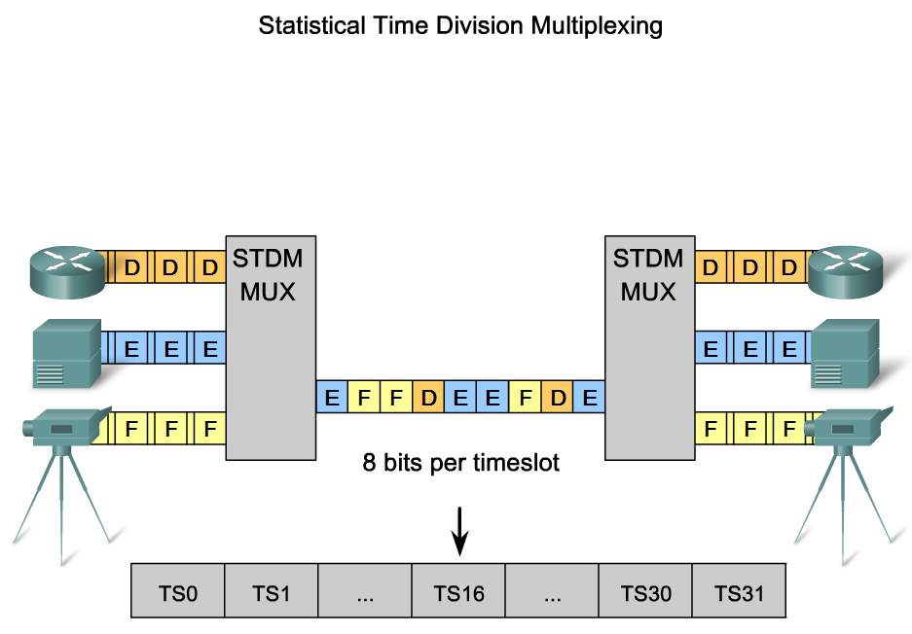
Describe the Fundamental Concepts of Point-to-Point Serial Communication
Explain how two or more data streams are transported across a single physical connection using TDM

Slide 5
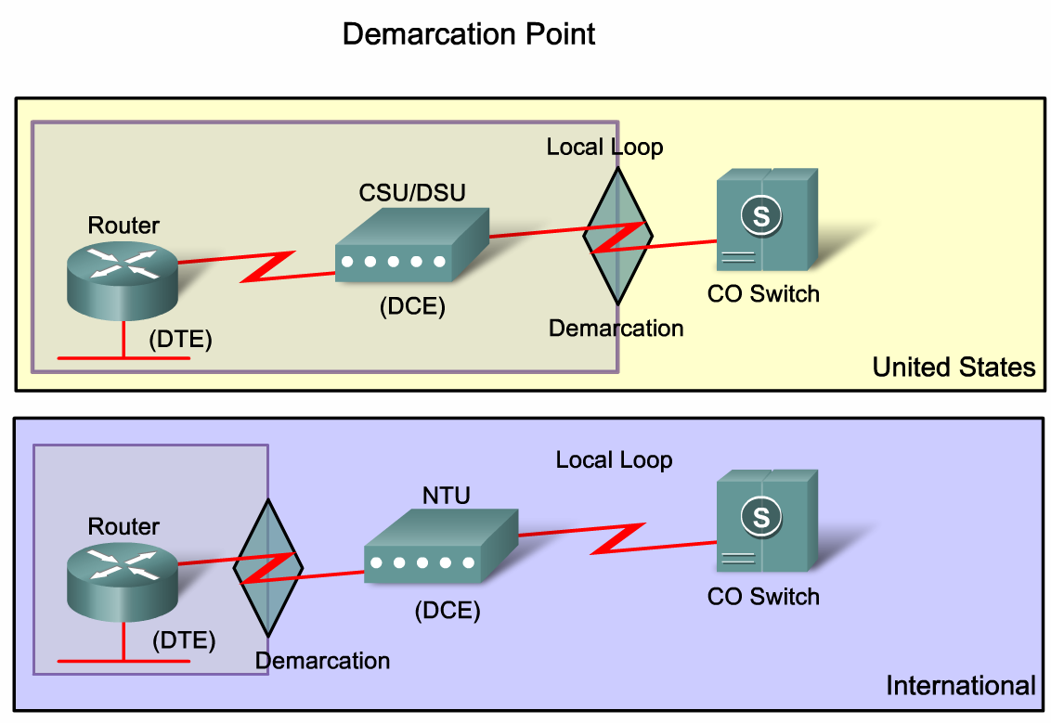
Describe the Fundamental Concepts of Point-to-Point Serial Communication
Define the location of the demarcation point relative to customer and service provider networks

Slide 6
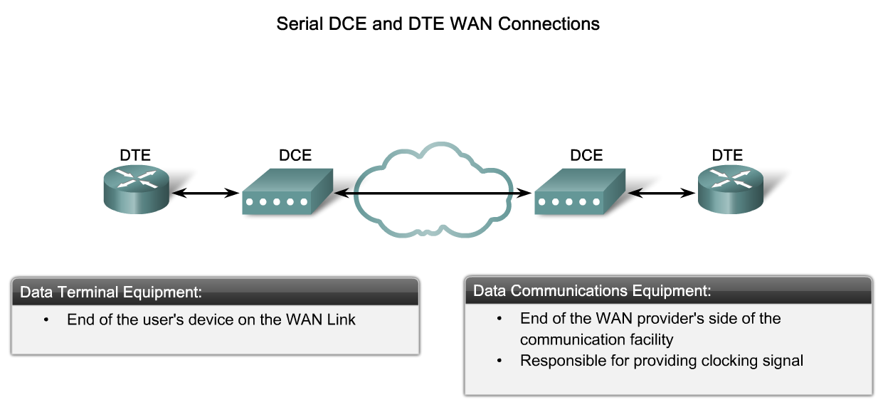
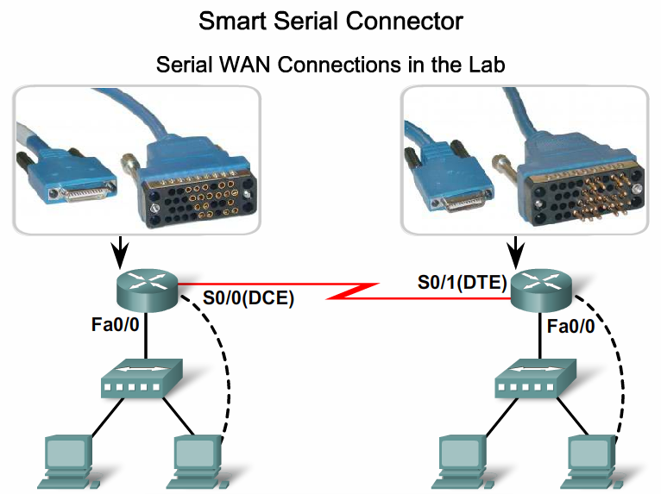
Describe the Fundamental Concepts of Point-to-Point Serial Communication
Explain the terms DTE and DCE with relative to the location of devices in a network

Slide 7
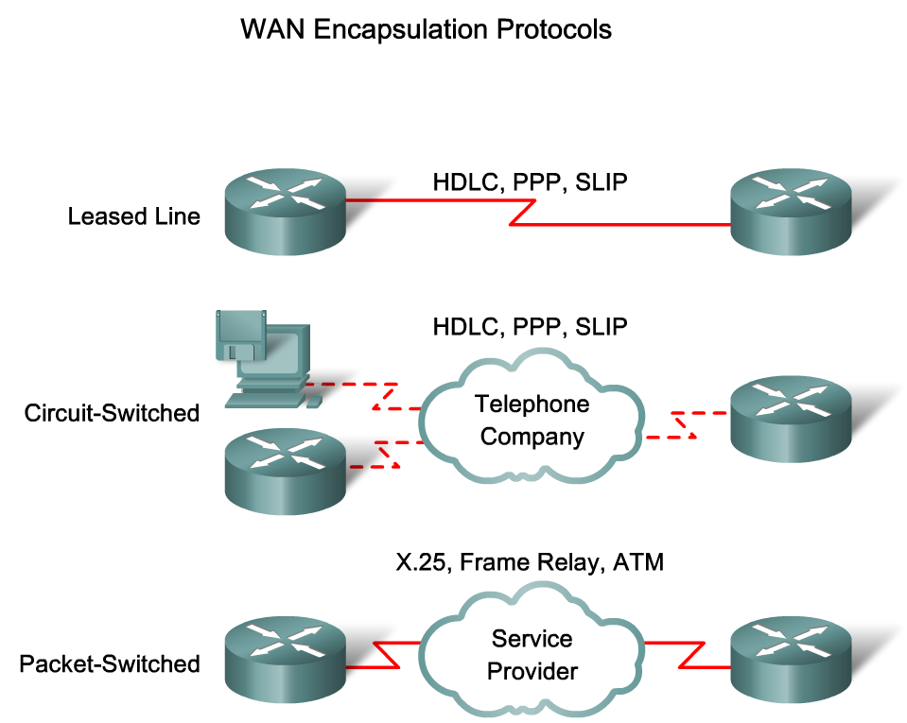
Describe the Fundamental Concepts of Point-to-Point Serial Communication
Describe how high-level data link control (HDLC) uses one of three frame types to encapsulate data

Slide 8
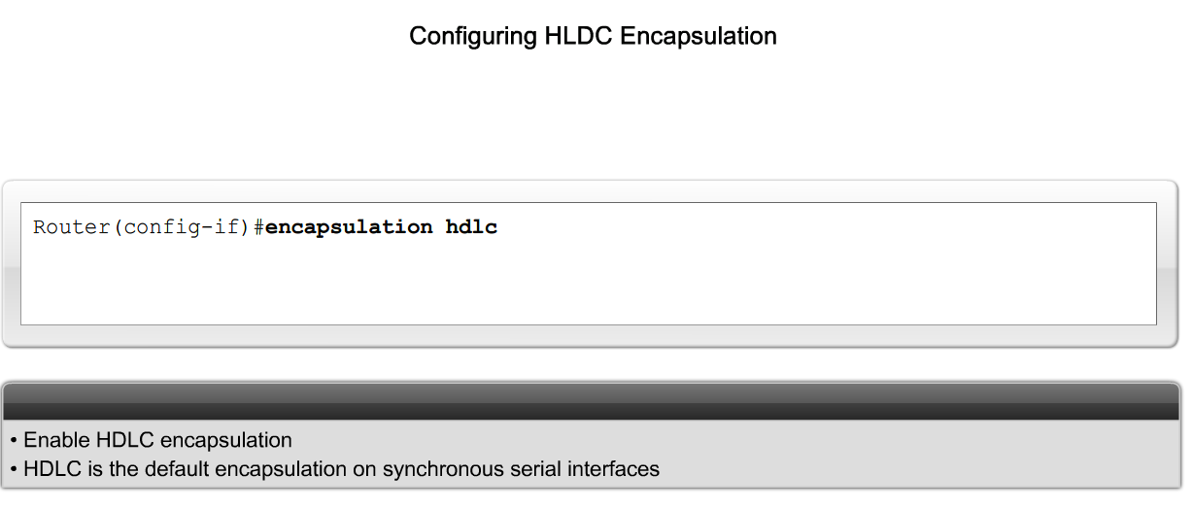
Describe the Fundamental Concepts of Point-to-Point Serial Communication
Explain when and how to configure HDLC encapsulation on a router

Slide 9
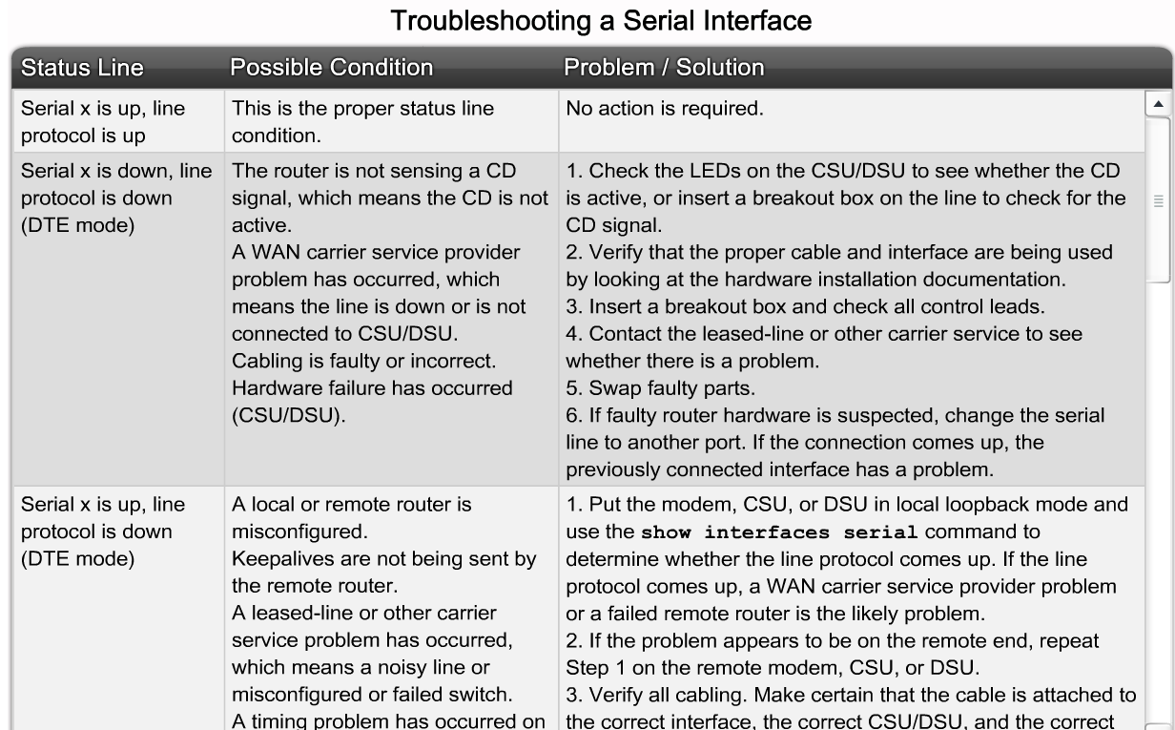
Describe the Fundamental Concepts of Point-to-Point Serial Communication
Describe the procedure to follow when troubleshooting a serial connection

Slide 10
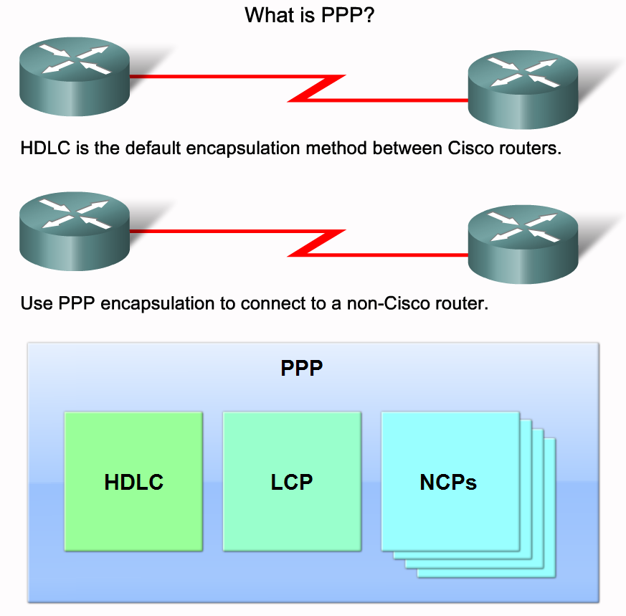
Describe Point-to-Point Concepts
Describe PPP in terms of its use in WAN links

Slide 11
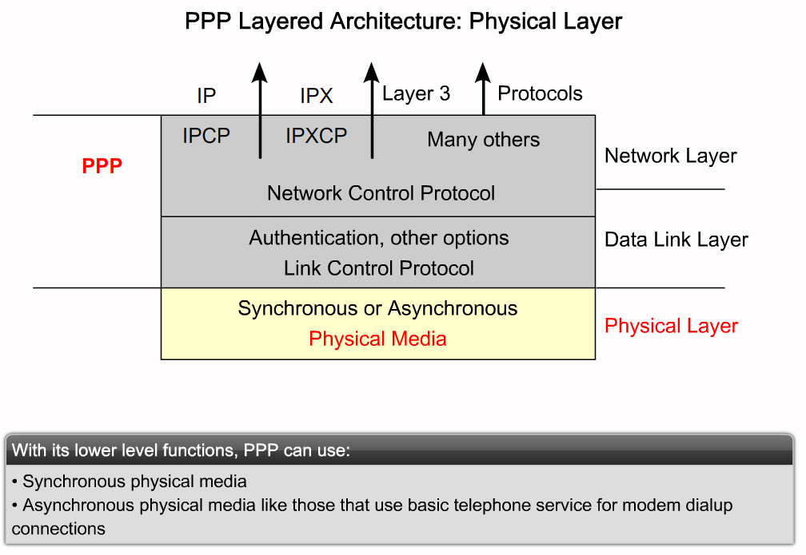
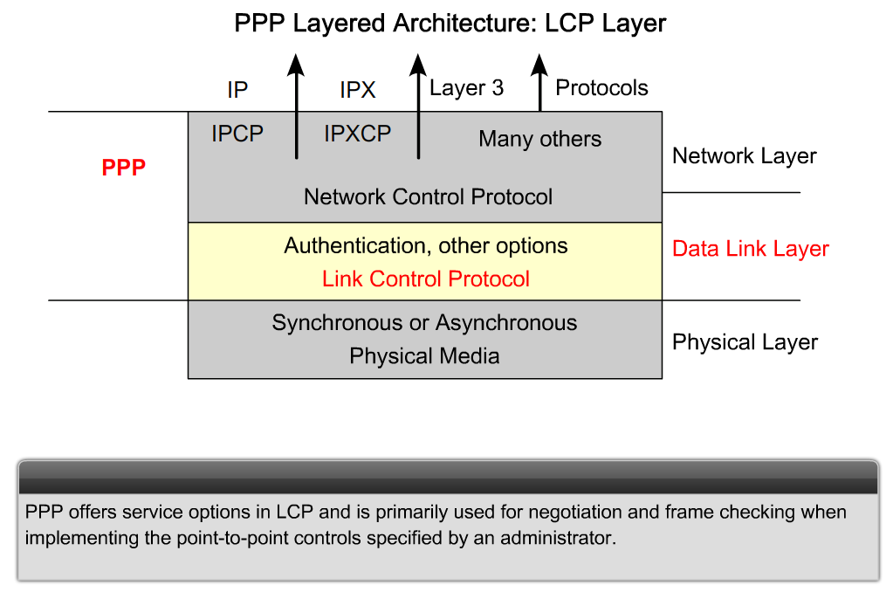
Describe Point-to-Point Concepts
Describe the general function of each layer of PPP architecture

Slide 12
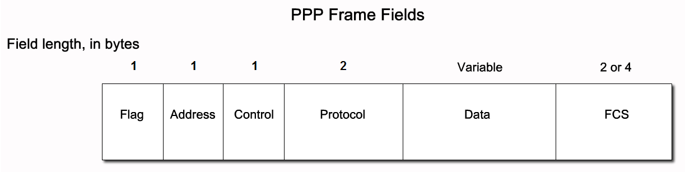
Describe Point-to-Point Concepts
Describe the purpose and format of each of the fields in a PPP frame

Slide 13
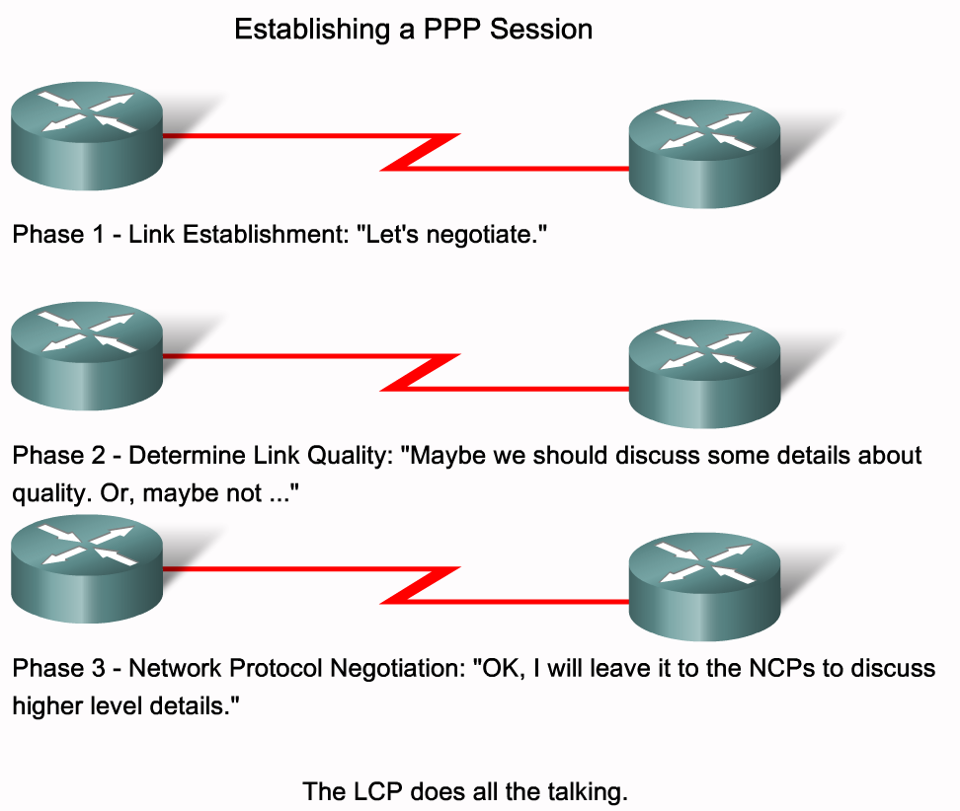
Describe Point-to-Point Concepts
Define the three phases of PPP session establishment

Slide 14
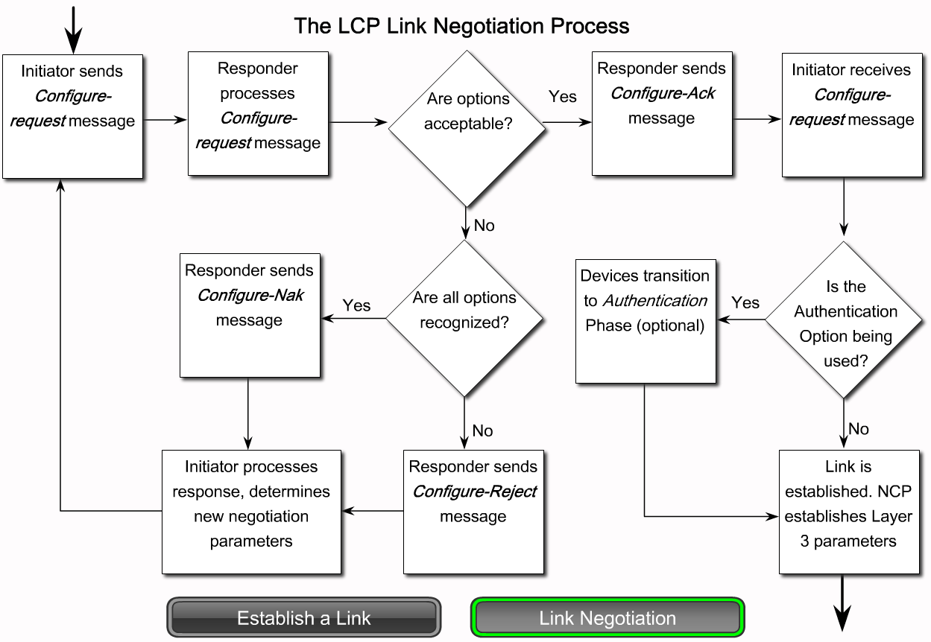
Describe Point-to-Point Concepts
Explain the role of the LCP in PPP

Slide 15
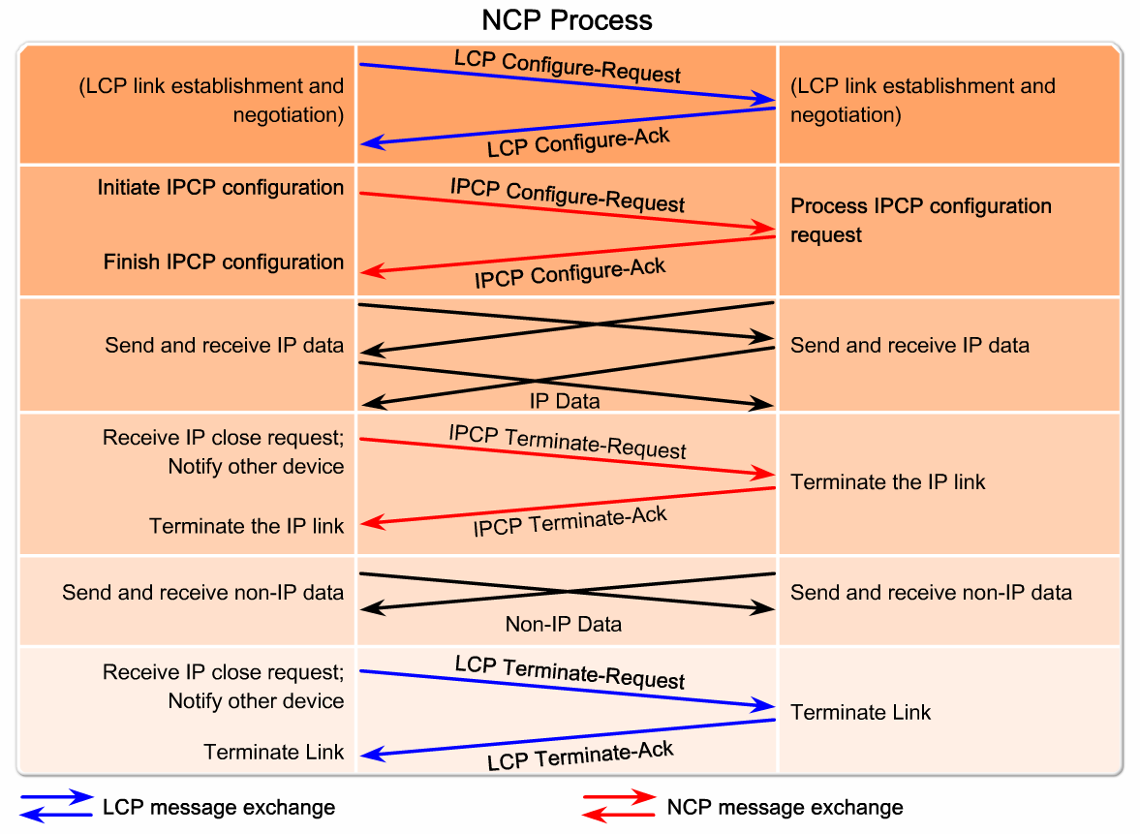
Describe Point-to-Point Concepts
Describe the characteristics of NCP

Slide 16
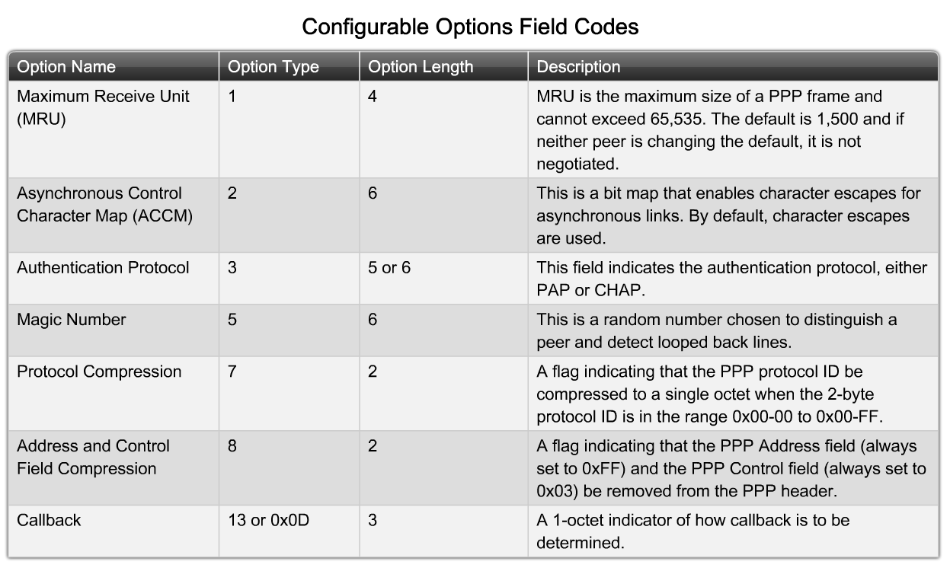
Configure PPP on a Serial Interface
Describe how configuration options are communicated in the LCP frame

Slide 17
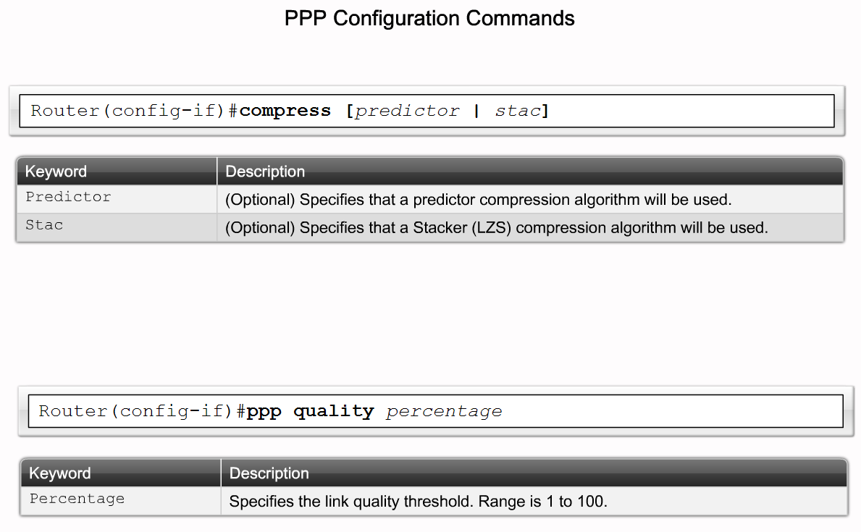
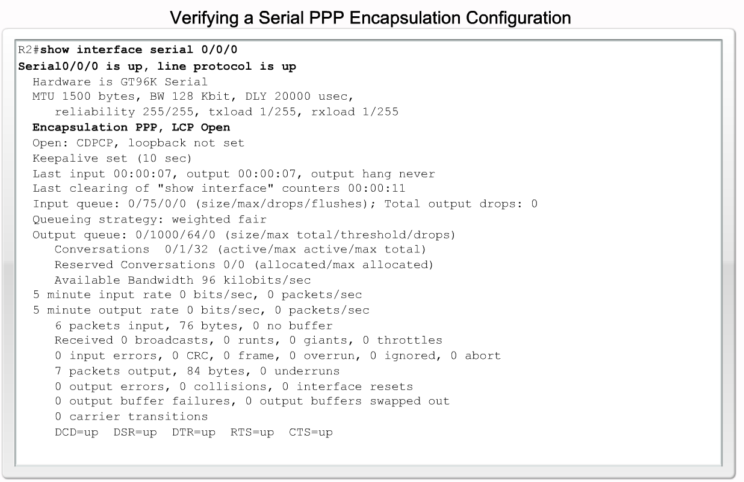
Configure PPP on a Serial Interface
Explain the purpose of the commands used to configure and verify PPP connections

Slide 18
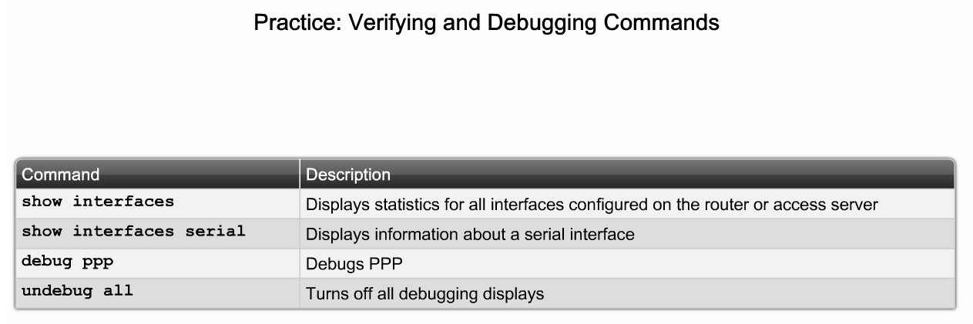
Configure PPP on a Serial Interface
Explain the output of the show interfaces serial command

Slide 19
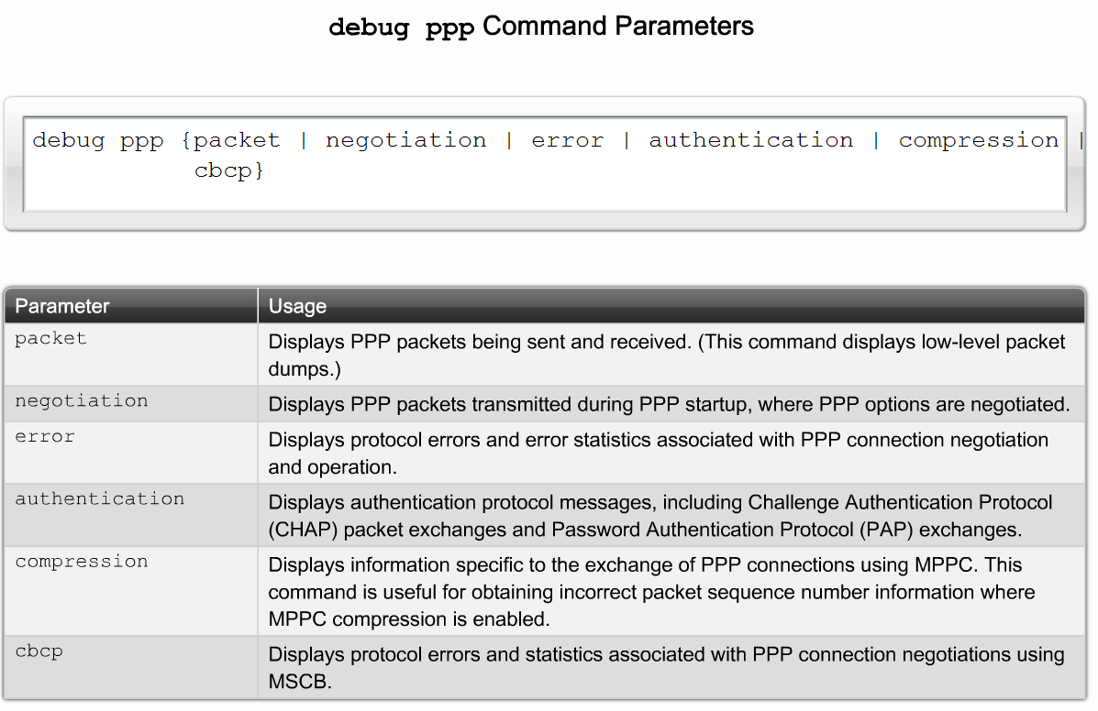
Configure PPP on a Serial Interface
Explain the output of the debug ppp command

Slide 20
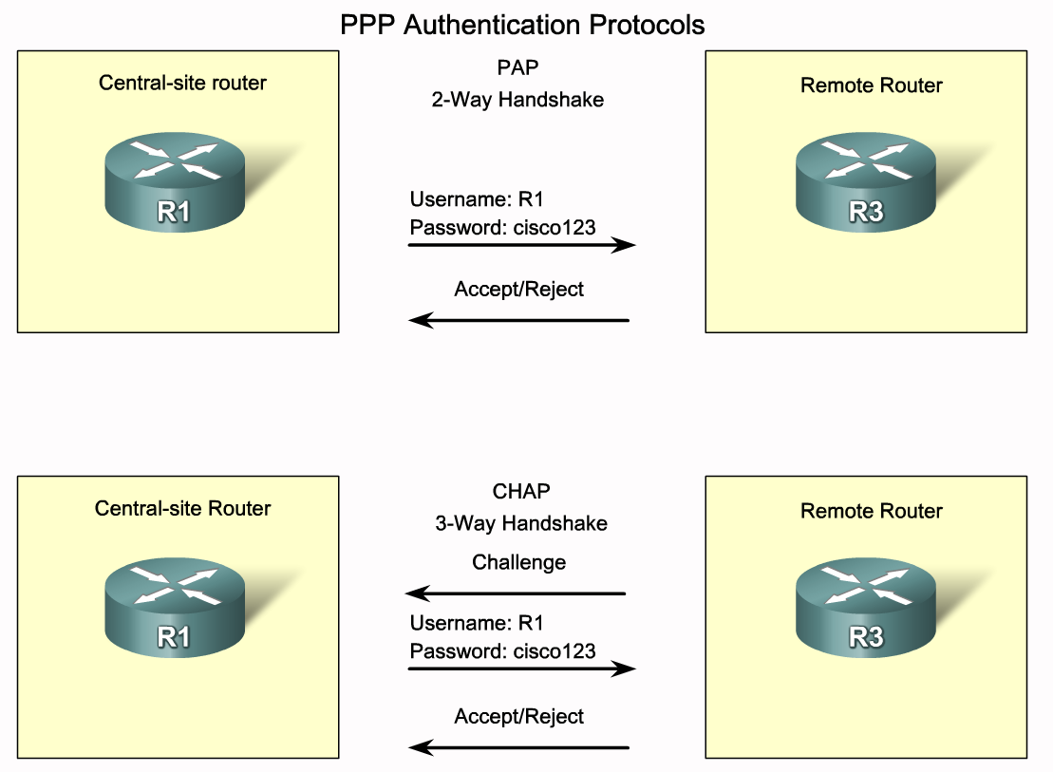
Configuring PPP with Authentication
Differentiate between PAP and CHAP

Slide 21
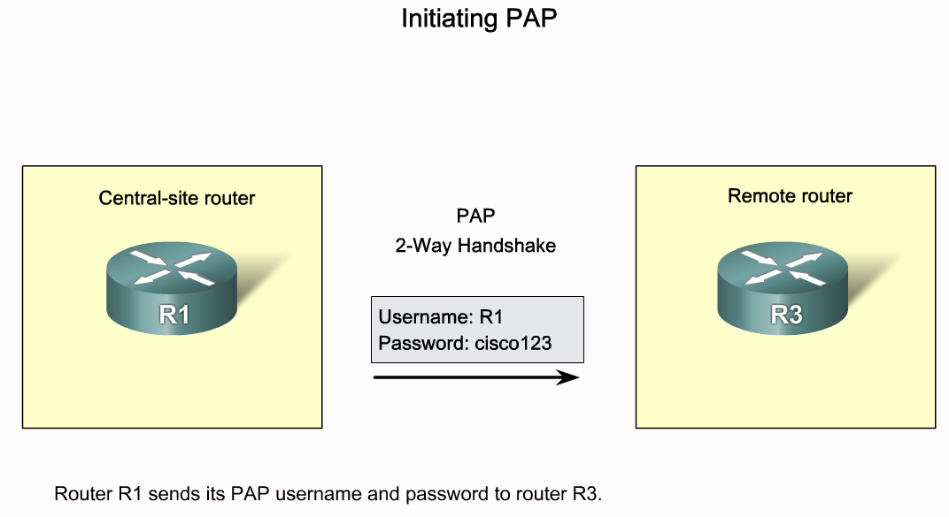
Configuring PPP with Authentication
Describe how to use PAP to authenticate a PPP connection

Slide 22
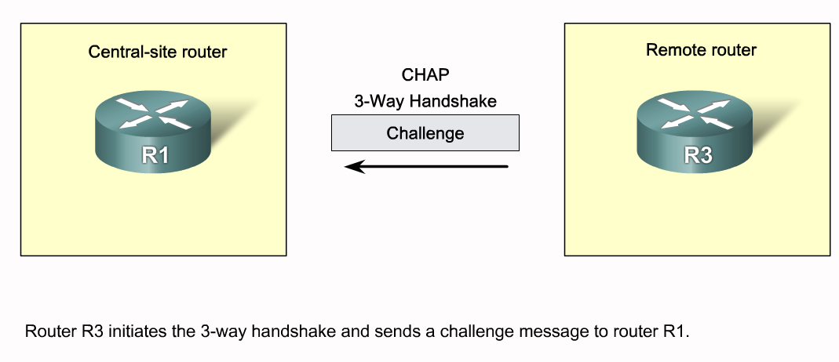
Configuring PPP with Authentication
Describe how to use CHAP to authenticate a PPP connection

Slide 23
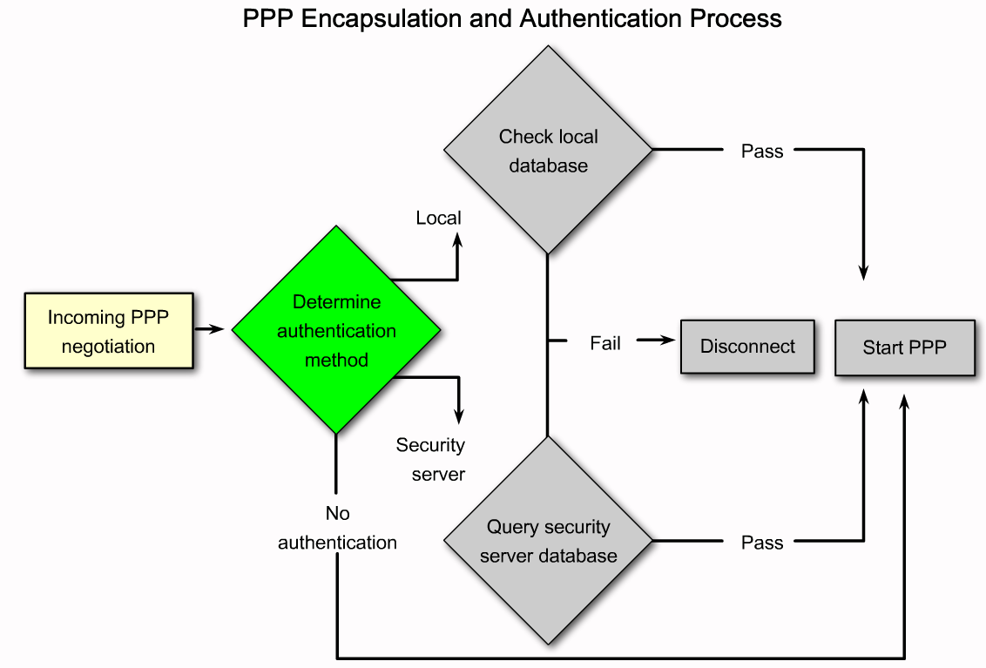
Configuring PPP with Authentication
Outline the PPP encapsulation and authentication process on a flow chart

Slide 24
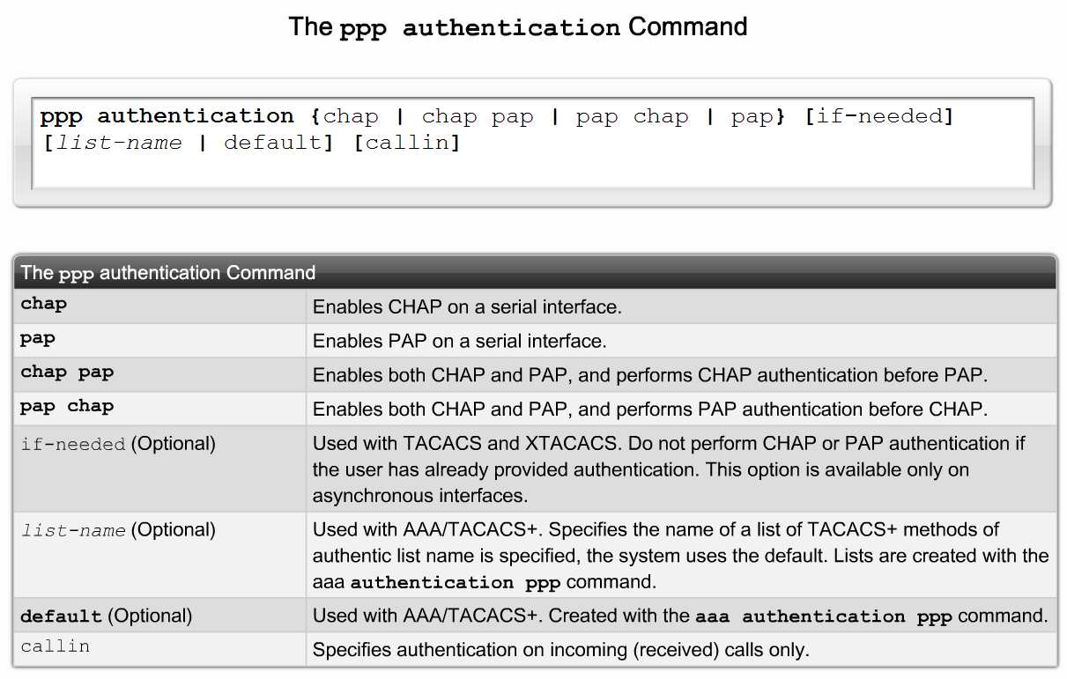
Configuring PPP with Authentication
Explain how to configure a PPP connection with authentication

Slide 25
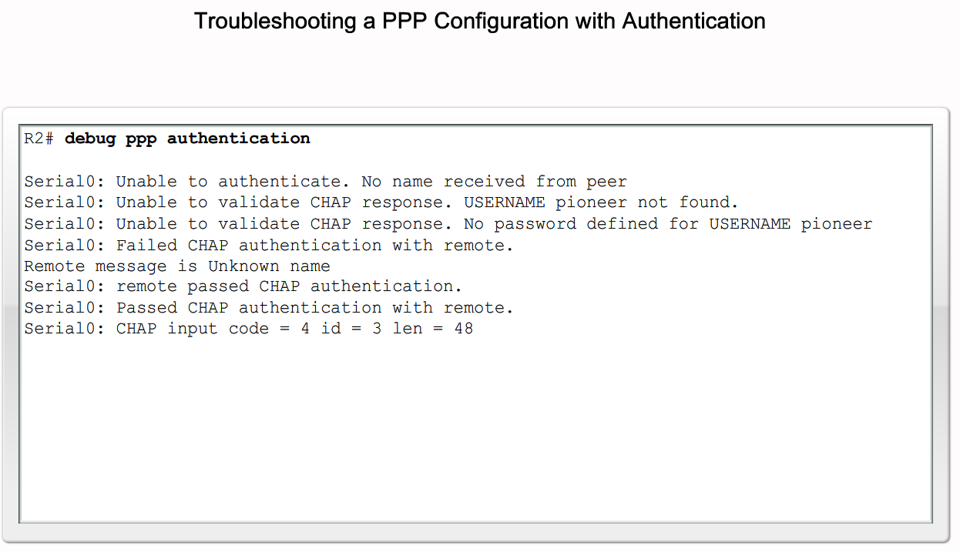
Configuring PPP with Authentication
Explain the output of the debug ppp authentication command

Slide 26
Summary
PPP is a widely used WAN protocol
PPP provides multi-protocol LAN to WAN connections
PPP session establishment – 4 phases
  Link establishment
  Link quality determination
  Network layer protocol configuration negotiation
  Link termination
WAN Encapsulation
  HDLC default encapsulation
  PPP

Slide 27
Summary
PPP authentication
  PAP
    2 way handshake
  CHAP
    3 way handshake
  Use debug ppp authentication to confirm authentication configuration
PPP configuration
  Done on a serial interface
After PPP configuration, use show interfaces command to display:
  LCP state
  NCP state

