Slide 1
Frame Relay
Accessing the WAN – Chapter 3

Slide 2
Objectives
Describe the fundamental concepts of Frame Relay technology in terms of Enterprise WAN services including Frame Relay operation, Frame Relay implementation requirements, Frame Relay maps, and LMI operation.
Configure a basic Frame Relay PVC including configuring and troubleshooting Frame Relay on a router serial interface and configuring a static Frame Relay map.
Describe advanced concepts of Frame Relay technology in terms of Enterprise WAN services including Frame Relay sub-interfaces, Frame Relay bandwidth and flow control.
Configure an advanced Frame Relay PVC including solving reachability issues, configuring Frame Relay sub-interfaces, verifying and troubleshooting Frame Relay configuration.

Slide 3
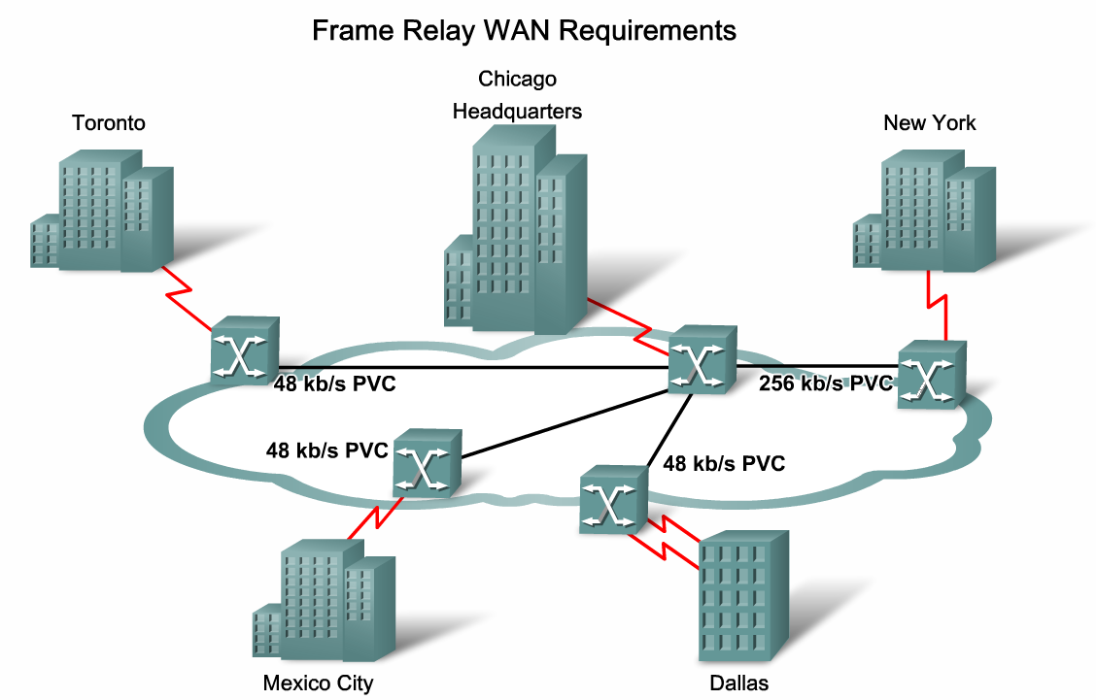
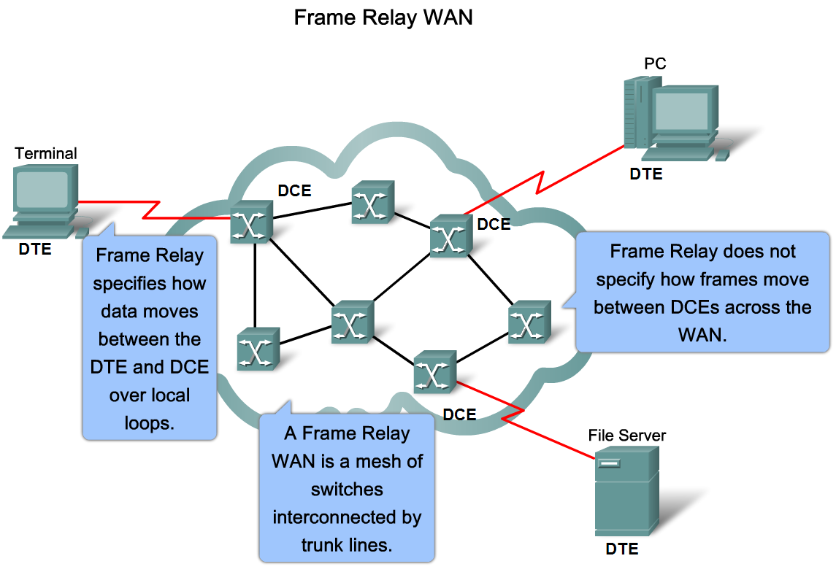
Describe the Fundamental Concepts of Frame Relay Technology
Describe how Frame Relay is used to provide WAN services to the Enterprise

Slide 4
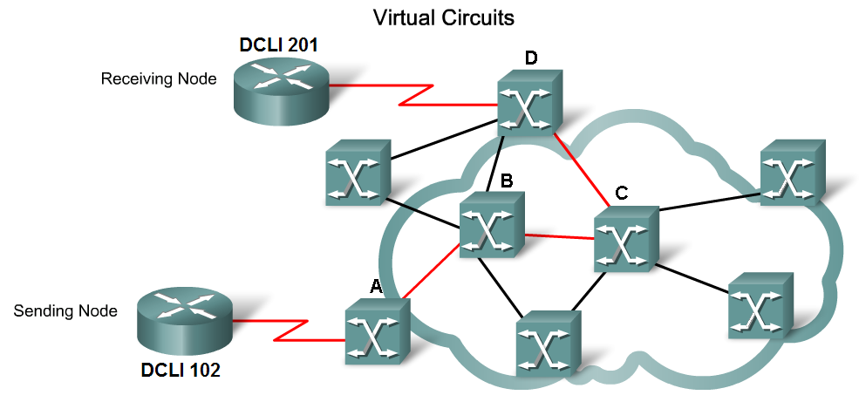
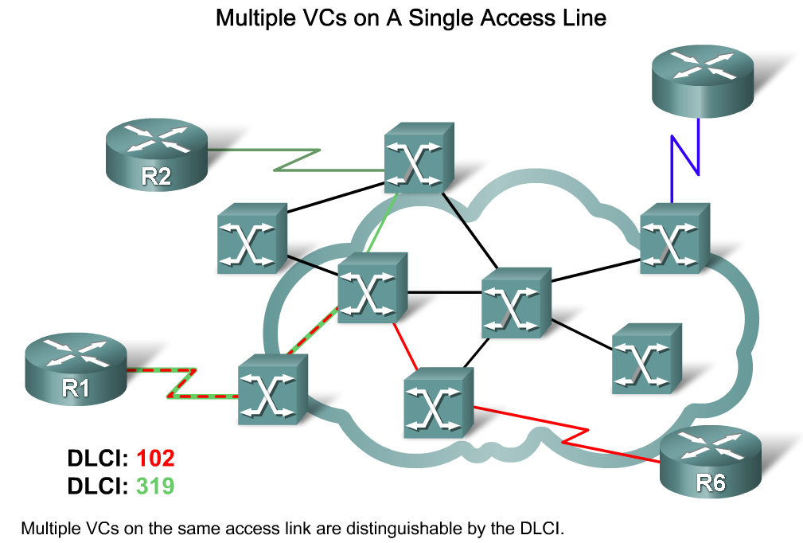
Describe the Fundamental Concepts of Frame Relay Technology
Describe how Frame Relay uses virtual circuits to carry packets from one DTE to another

Slide 5
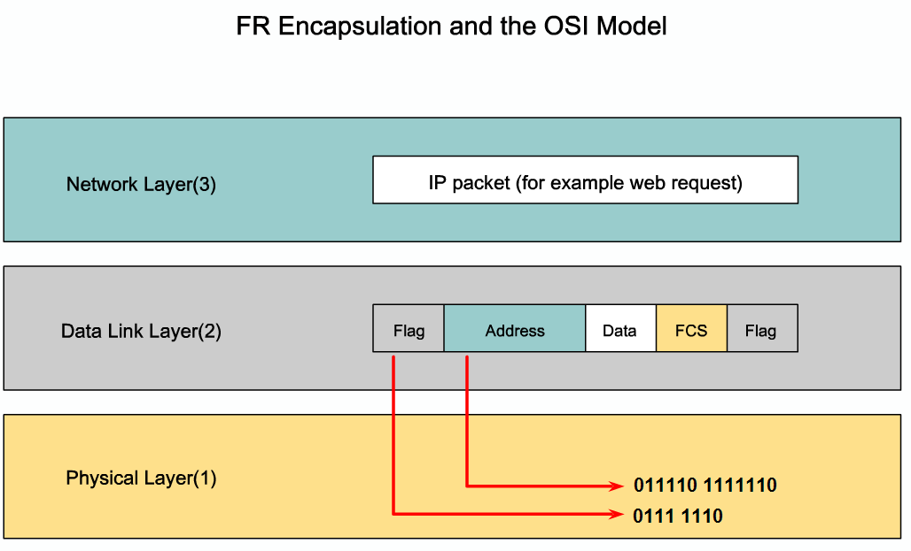
Describe the Fundamental Concepts of Frame Relay Technology
Explain how Frame Relay encapsulation works

Slide 6
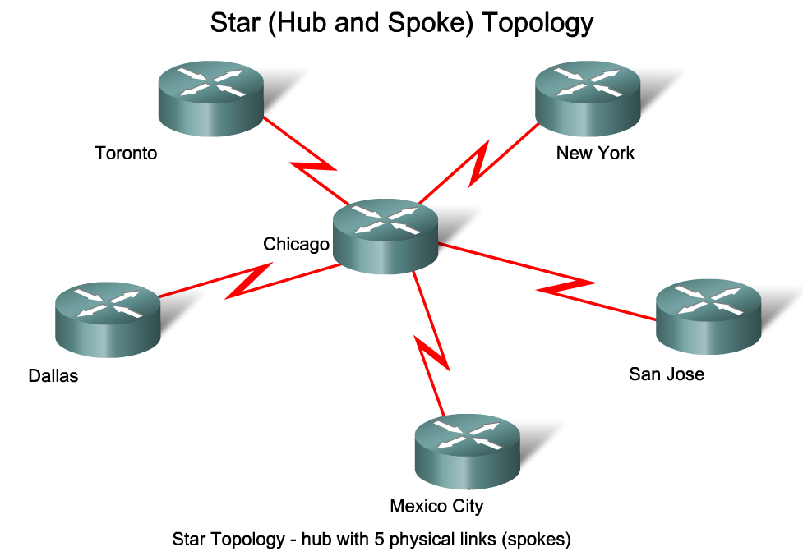
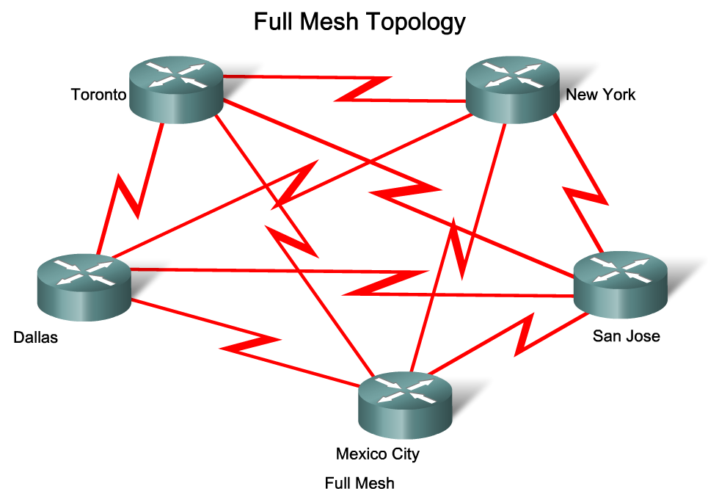
Describe the Fundamental Concepts of Frame Relay Technology
Describe the types of topologies that are used for implementing Frame Relay in different environments

Slide 7
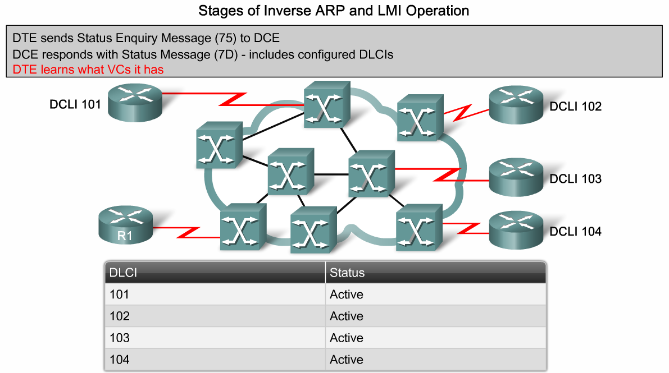
Describe the Fundamental Concepts of Frame Relay Technology
Describe how a router attached to a Frame Relay network uses LMI status messages and inverse ARP queries to map VCs to layer 3 network IP Addresses

Slide 8
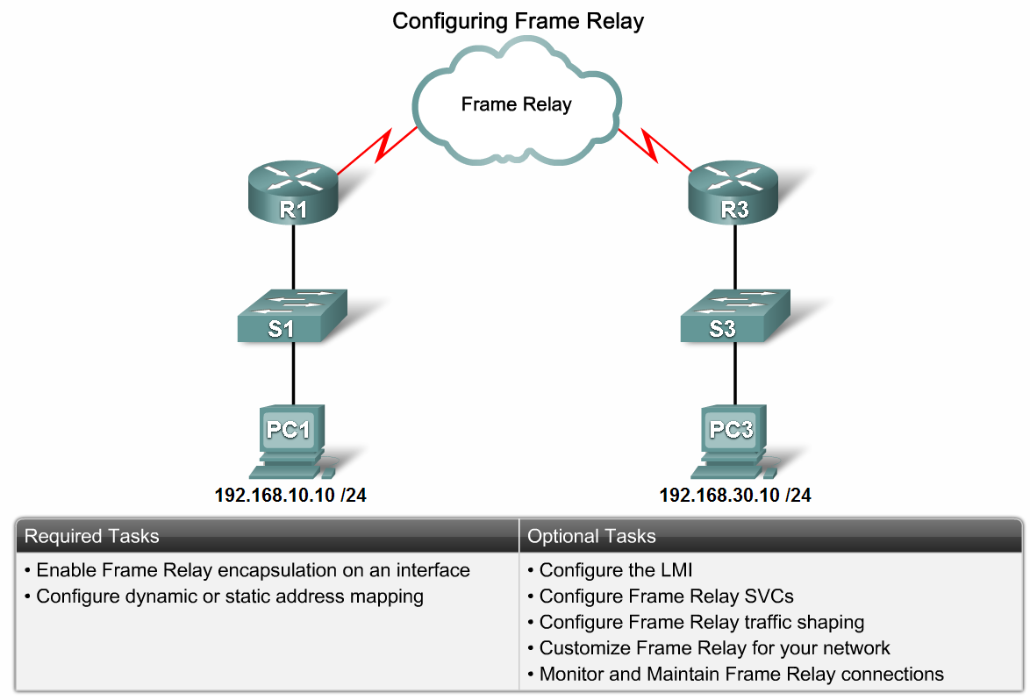
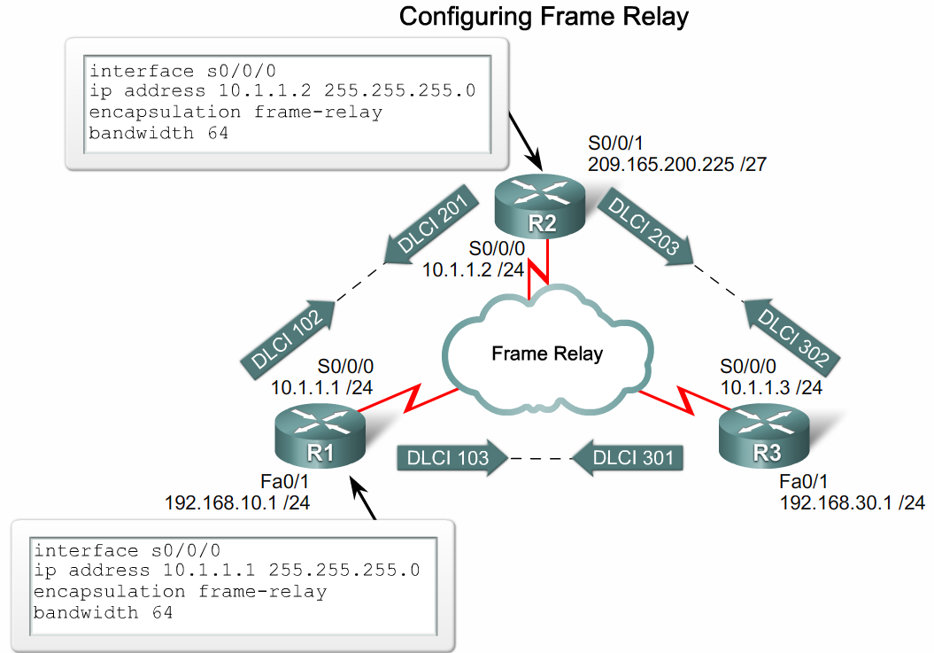
Configure a Basic Frame Relay PVC
Configure a basic Frame Relay PVC on a router serial interface

Slide 9
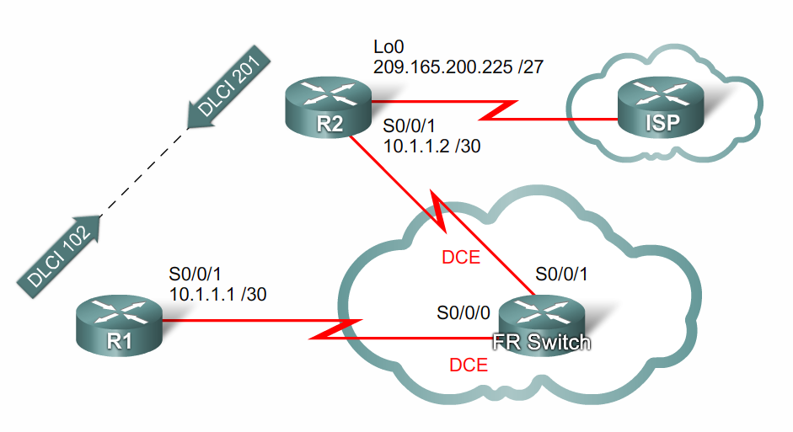
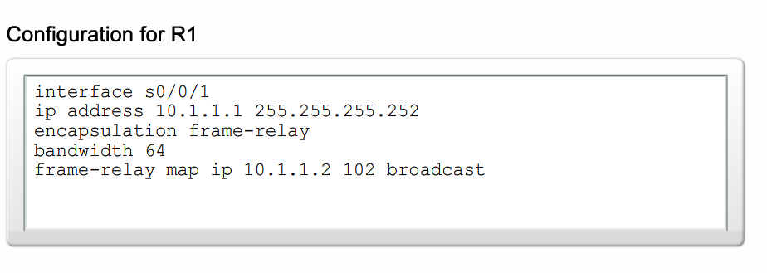
Configure a Basic Frame Relay PVC
Configure a static Frame Relay map

Slide 10
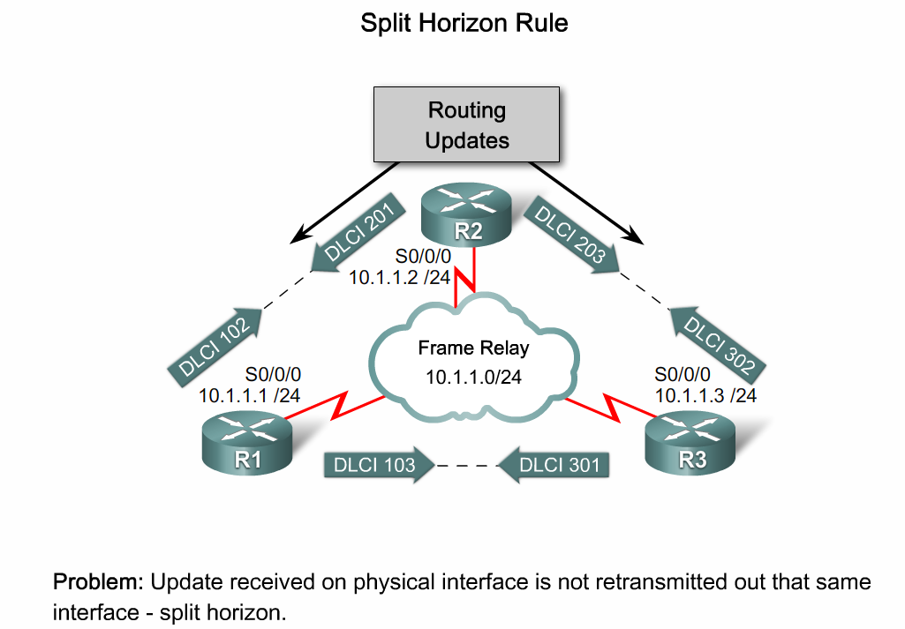
Describe Advanced Concepts of Frame Relay Technology
Explain the reachability issues associated with the Frame Relay NBMA topology

Slide 11
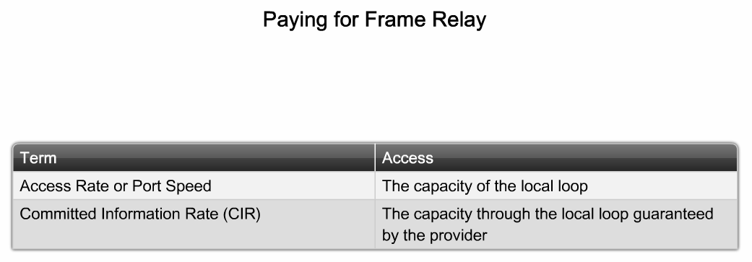
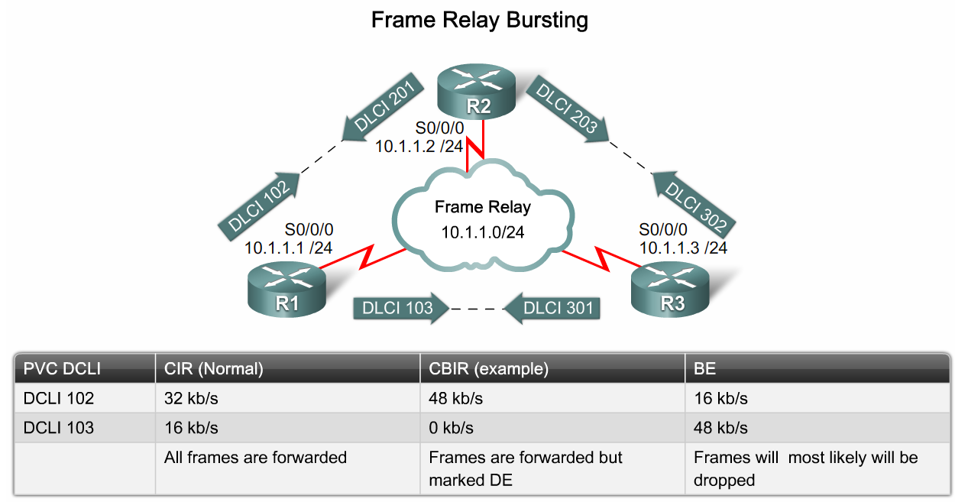
Describe Advanced Concepts of Frame Relay Technology
Describe how to implement bandwidth control in the Frame Relay technology

Slide 12
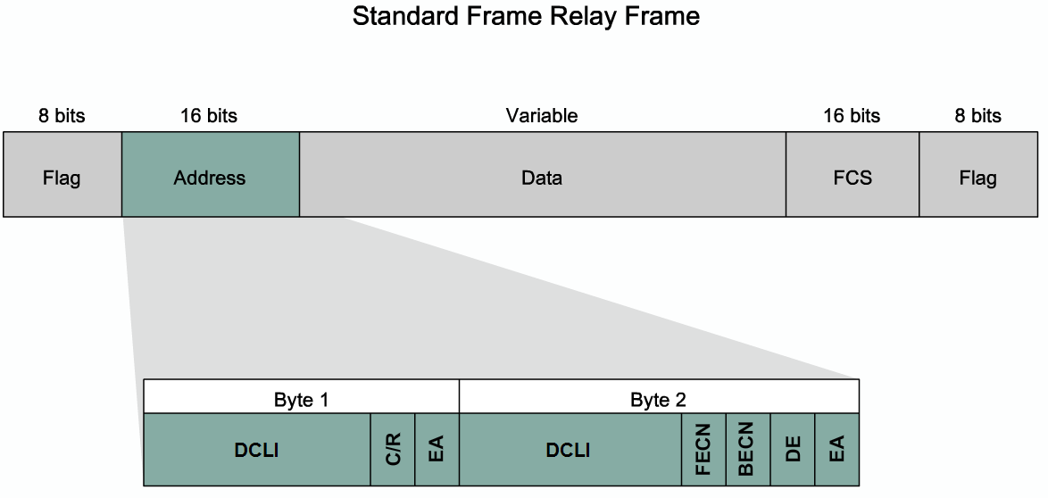
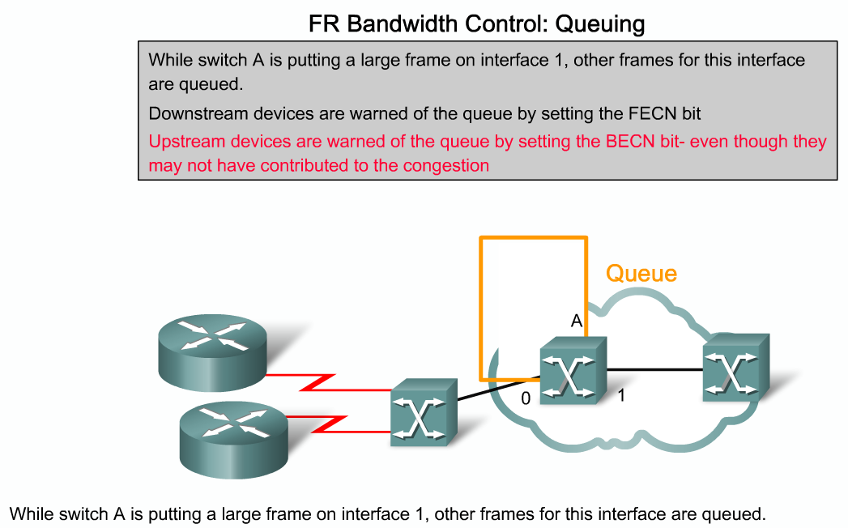
Describe Advanced Concepts of Frame Relay Technology
Describe how to implement flow control in Frame Relay technology

Slide 13
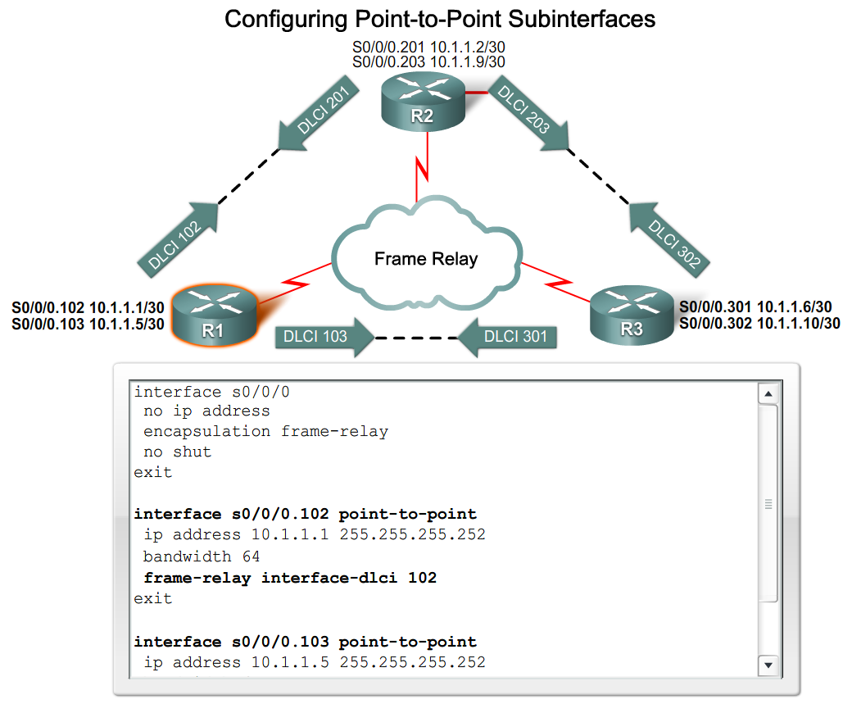
Configure an Advanced Frame Relay PVC
Explain the steps to configure point-to-point subinterfaces on a physical interface

Slide 14
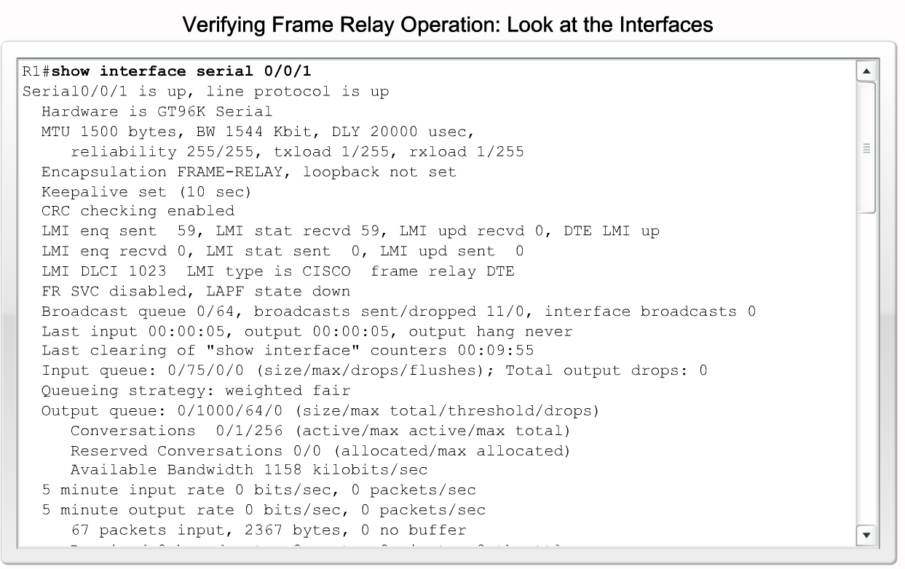
Configure an Advanced Frame Relay PVC
Describe the commands used for verifying Frame Relay operation

Slide 15
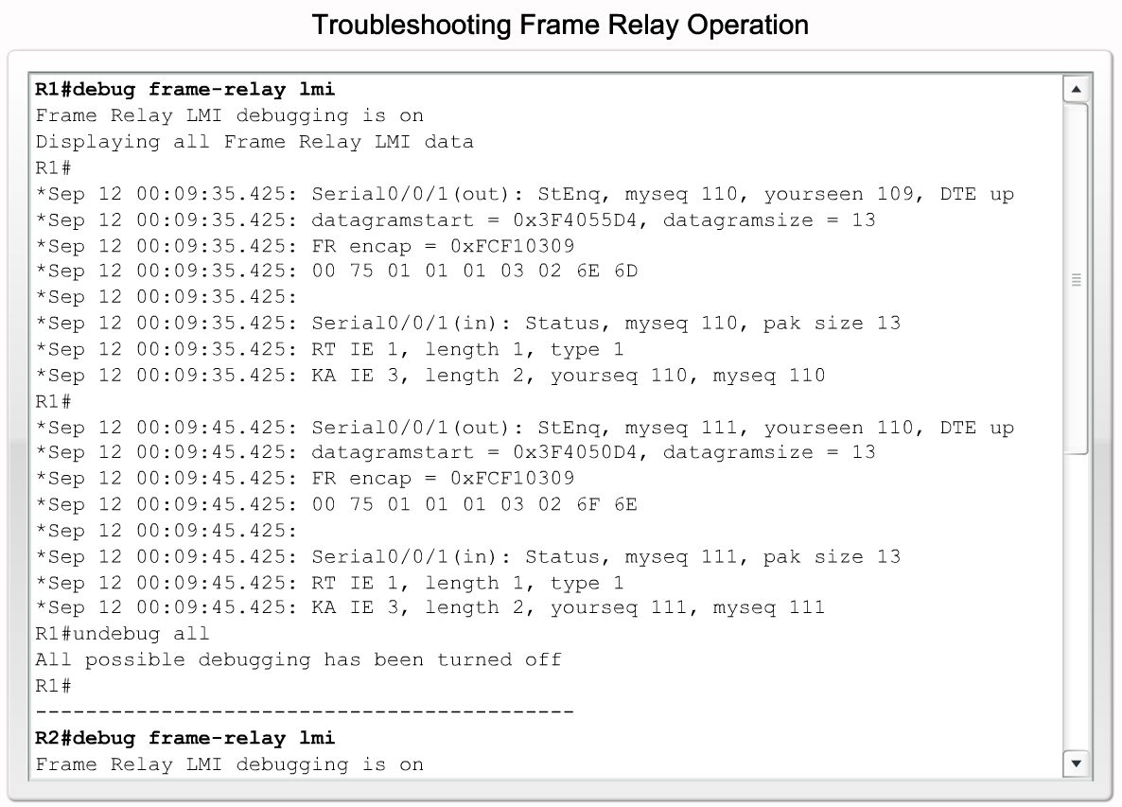
Configure an Advanced Frame Relay PVC
Describe the steps for troubleshooting a Frame Relay configuration

Slide 16
Summary
Frame relay is the most widely used WAN technology because it:
  Provides greater bandwidth than leased line
  Reduces cost because it uses less equipment
  Easy to implement
Frame relay is associated with layer 2 of the OSI model and encapsulates data packets in a frame relay frame
Frame relay is configured on virtual circuits
  These virtual circuits may be identified by a DLCI
Frame relay uses inverse ARP to map DLCI to IP addresses

Slide 17
Summary
Configuring frame relay requires
  Enable frame relay encapsulation
  Configuring either static or dynamic mapping
  Considering split horizon problems that develop when multiple VCs are placed on a single physical interface
Factor affecting frame relay configuration
  How service provider has their charging scheme set up
Frame relay flow control
  DE
  FECN
  BECN

Slide 18
Summary
The following commands can be used to help verify frame relay configuration
  Show interfaces
  Show frame-relay lmi
  Show frame-relay pvc ###
  Show frame-relay map
Use the following command to help troubleshoot a frame relay configuration
  Debug frame-relay lmi

