Slide 1
Providing Teleworker Services
Accessing the WAN – Chapter 6

Slide 2
Objectives
Describe the enterprise requirements for providing teleworker services
Explain how broadband services extend Enterprise Networks including DSL, cable, and wireless
Describe how VPN technology provides secure teleworker services in an Enterprise setting

Slide 3
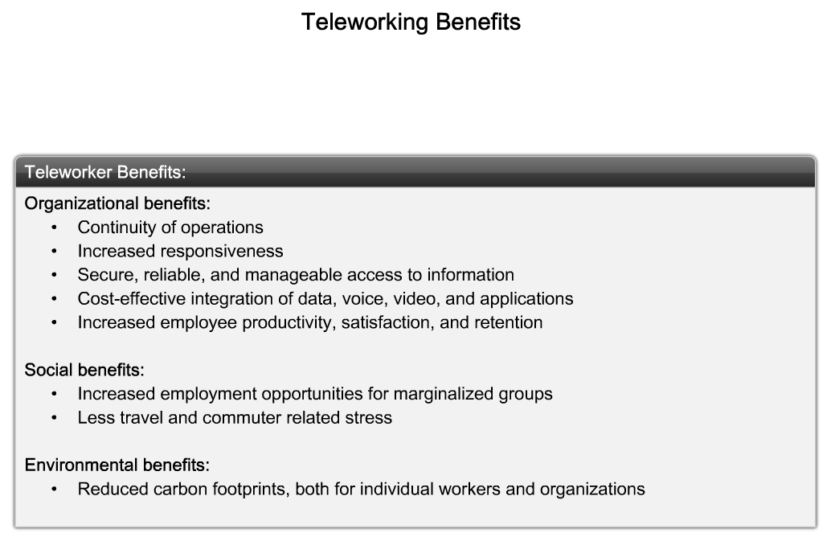
Describe the Enterprise Requirements for Providing Teleworker Services
Describe the benefits of teleworkers for business, society and the environment.

Slide 4
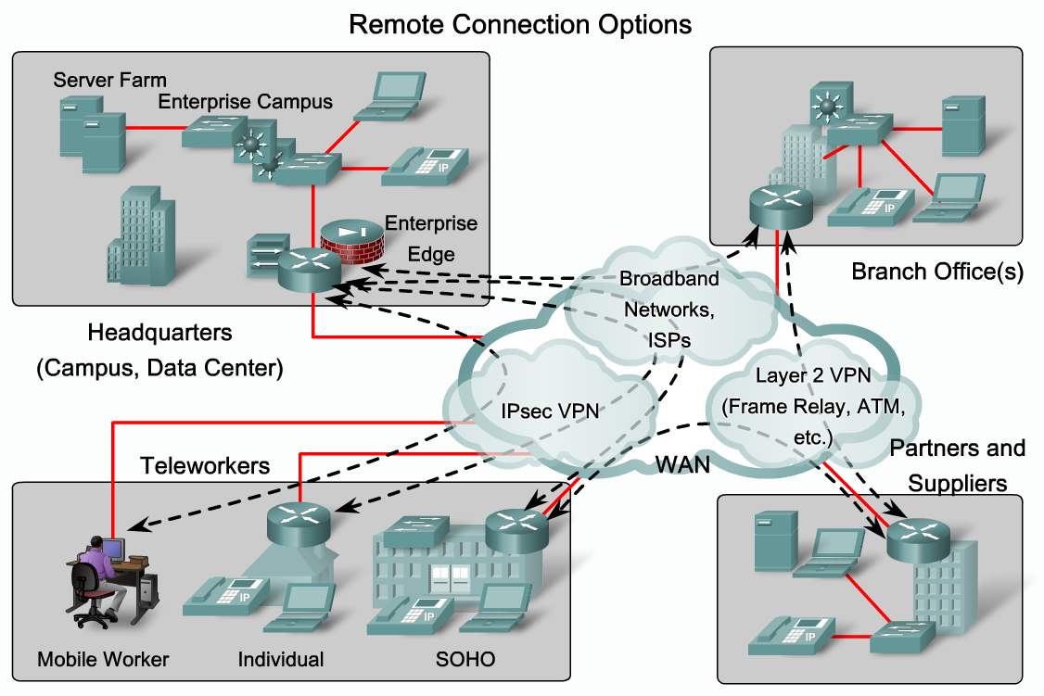
Describe the Enterprise Requirements for Providing Teleworker Services
List remote connection technologies and describe scenarios in which each would be implemented.

Slide 5
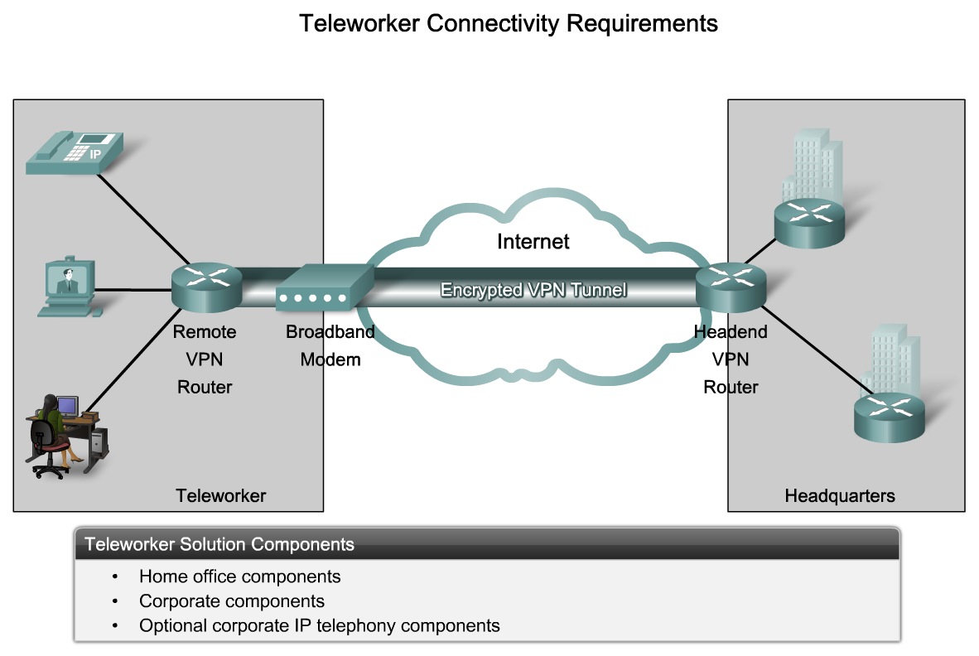
Describe the Enterprise Requirements for Providing Teleworker Services
Describe the key differences between private and public network infrastructures

Slide 6
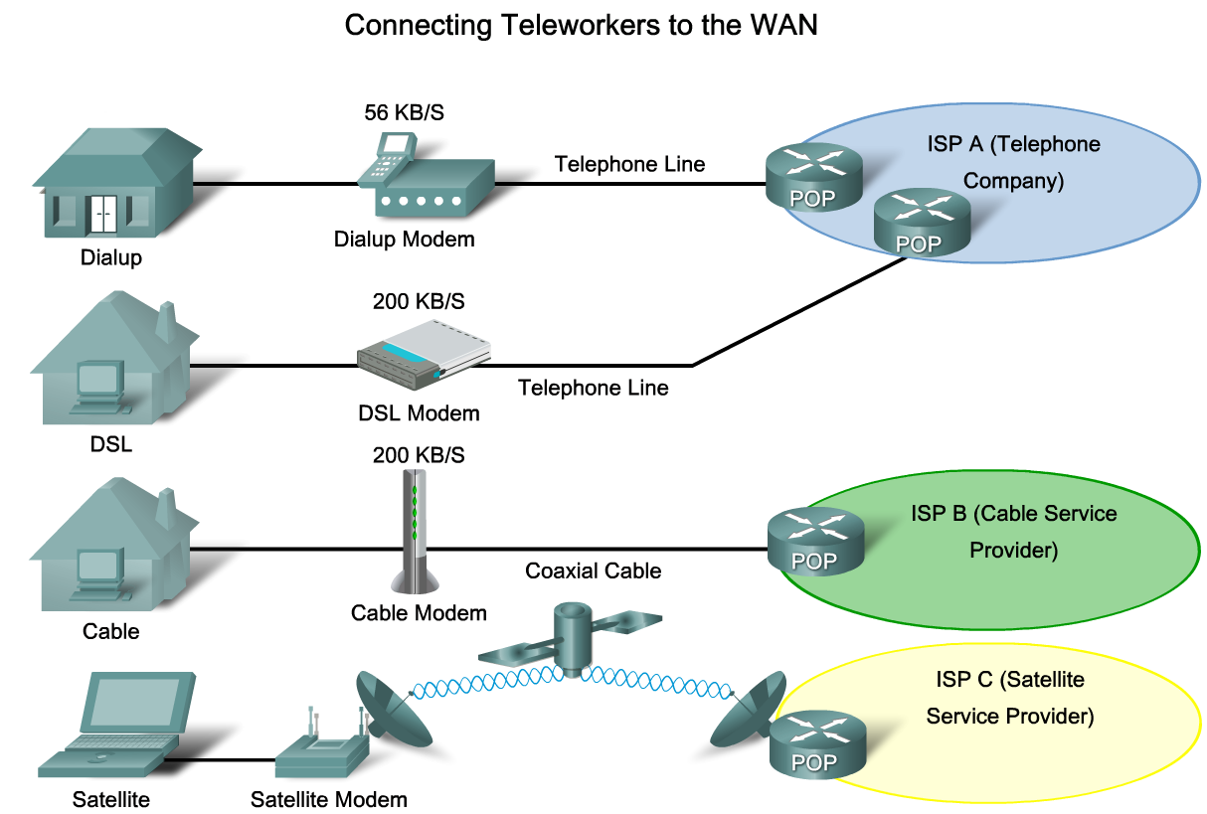
Explain How Broadband Services extend Enterprise Networks
Briefly describe how broadband services allow teleworkers to use the Internet to connect to the Enterprise WAN

Slide 7
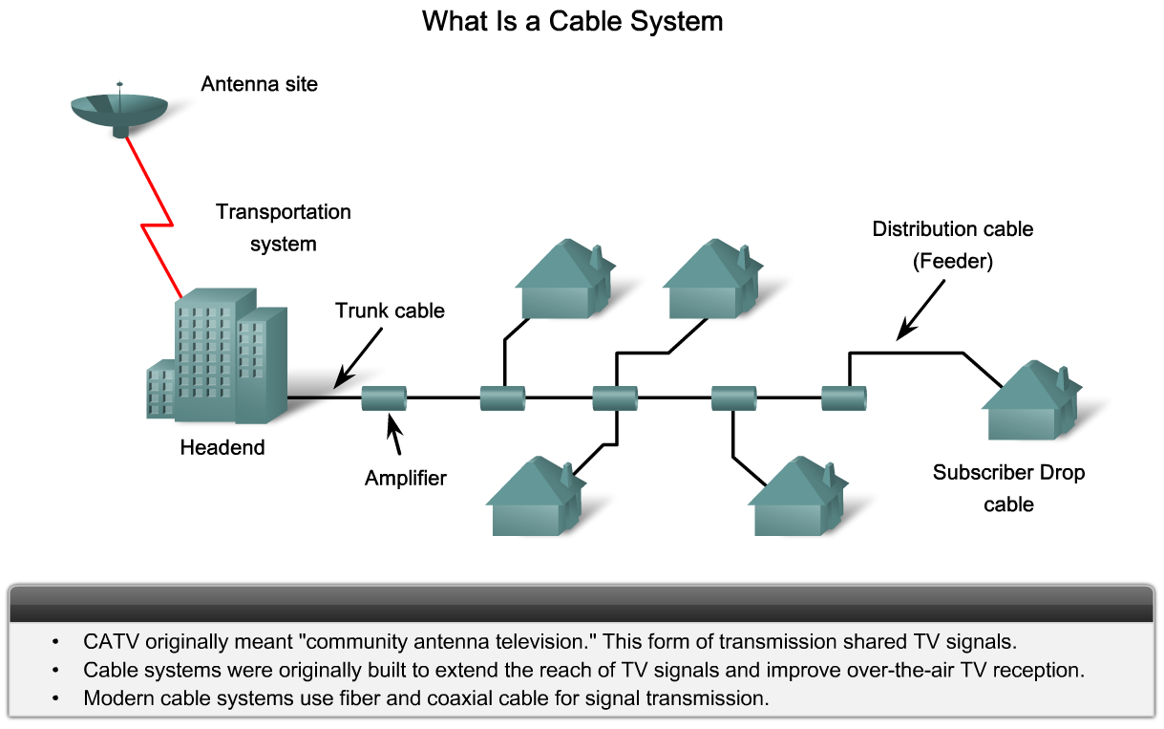
Explain How Broadband Services extend Enterprise Networks
Describe how Enterprises use cable connectivity to extend their reach

Slide 8
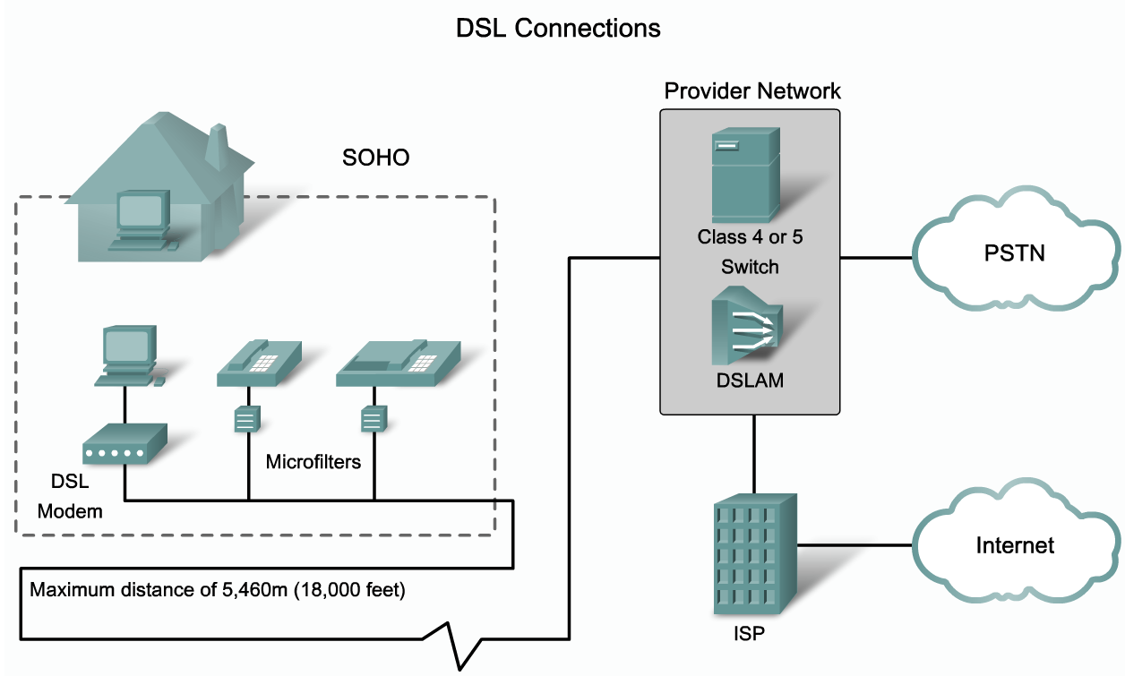
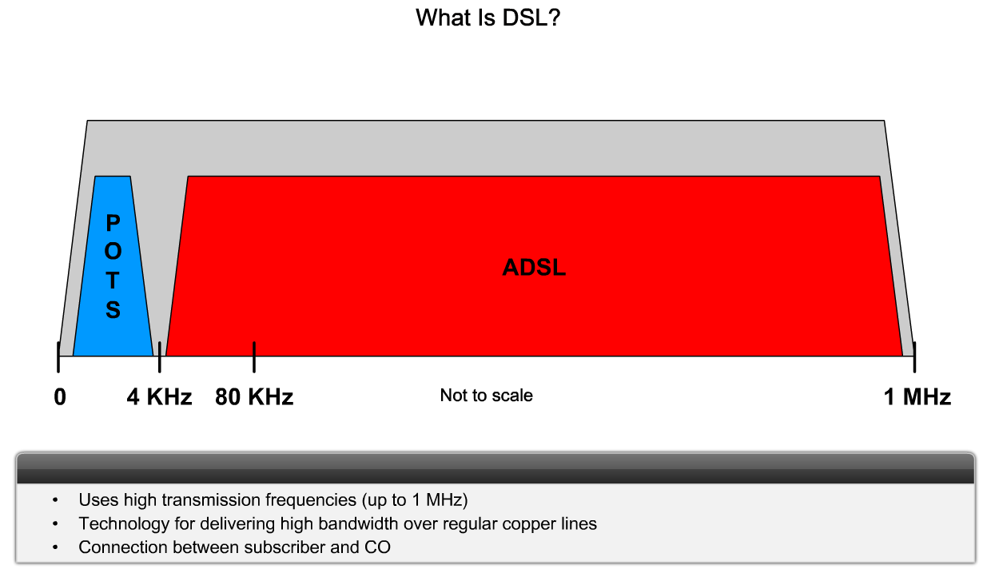
Explain How Broadband Services extend Enterprise Networks
Describe how Enterprises use DSL connectivity to extend their reach

Slide 9
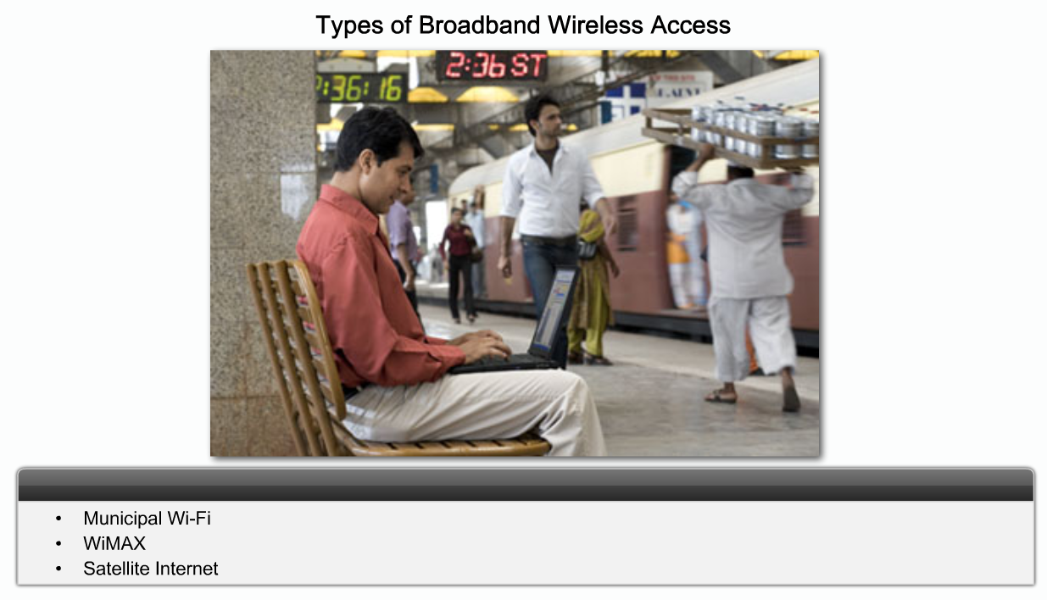
Explain How Broadband Services extend Enterprise Networks
Describe how Enterprises use broadband wireless connectivity to extend their reach

Slide 10
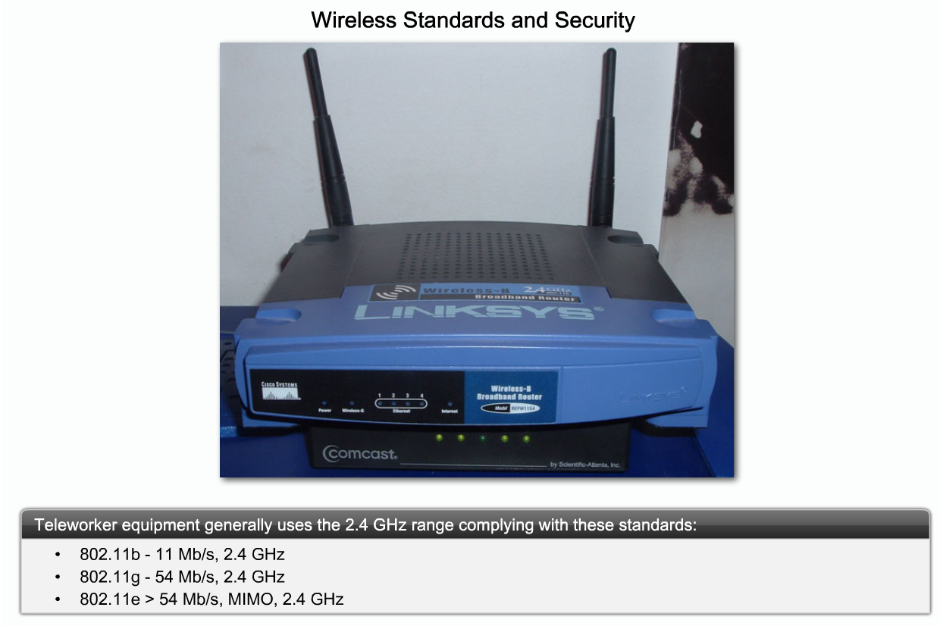
Explain How Broadband Services extend Enterprise Networks
Describe how Enterprises defend themselves from threats to wireless network security

Slide 11
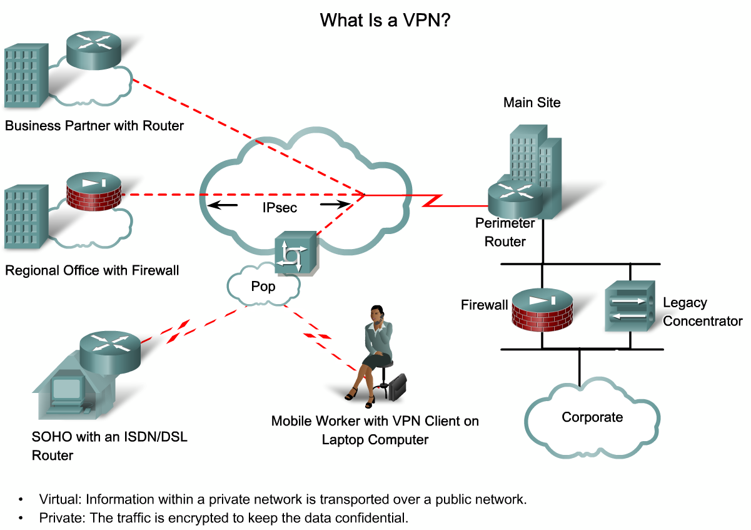
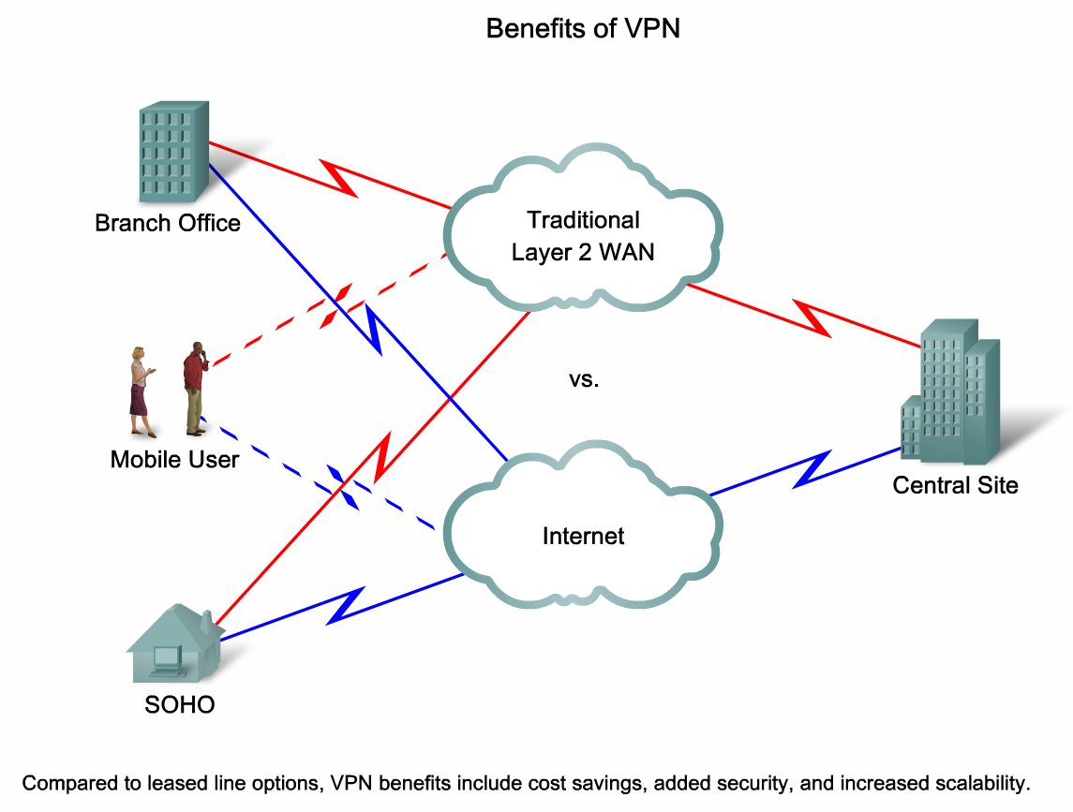
Describe How VPN Technology Provides Secure Teleworker Services in an Enterprise Setting
Explain the importance and benefits of VPN technology

Slide 12
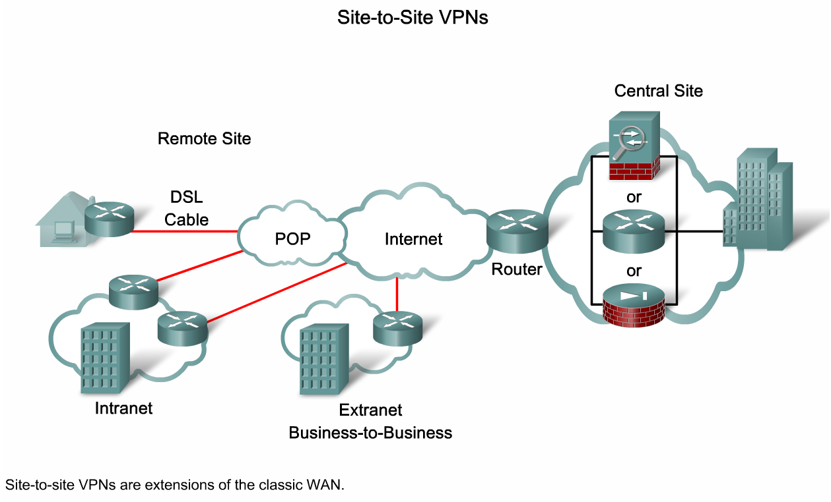
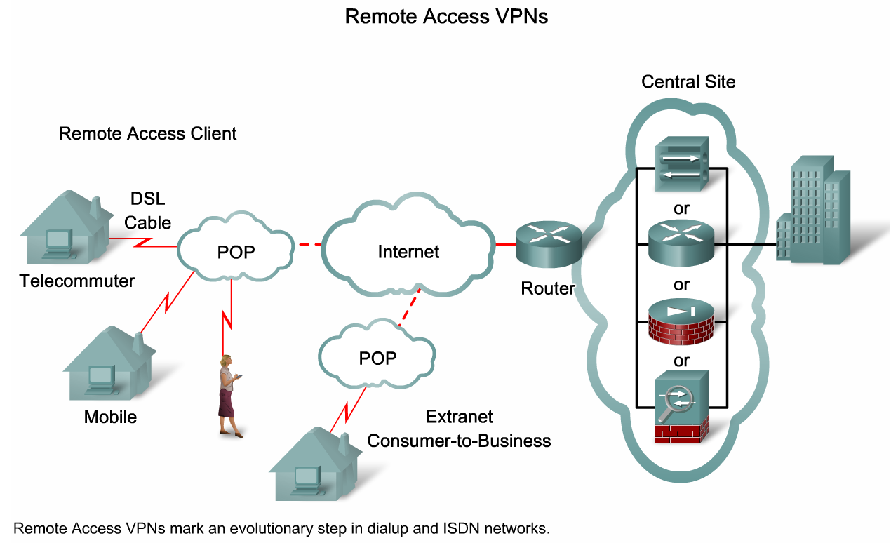
Describe How VPN Technology Provides Secure Teleworker Services in an Enterprise Setting
Compare site-to-site VPNs to remote-access VPNs

Slide 13
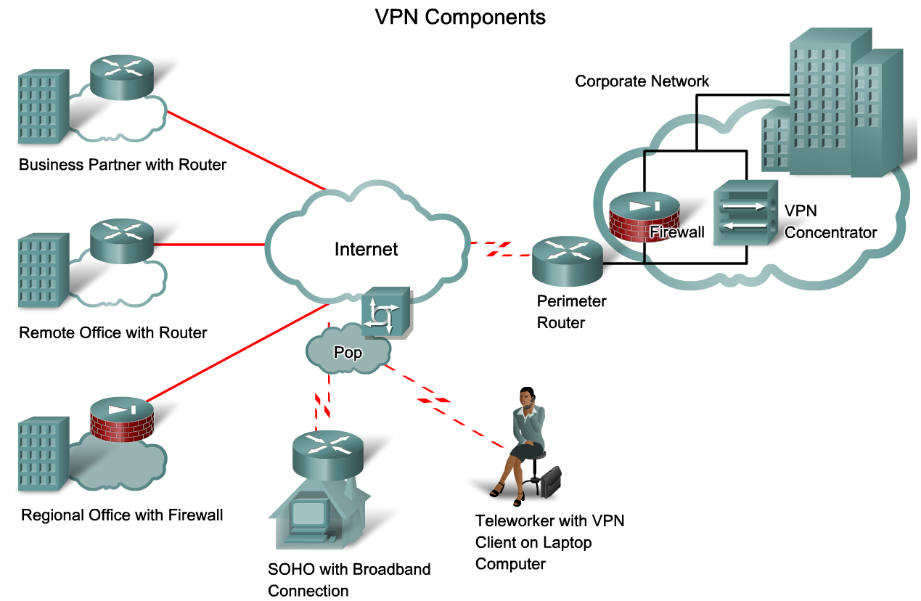
Describe How VPN Technology Provides Secure Teleworker Services in an Enterprise Setting
Describe the hardware and software components that typically make up a VPN

Slide 14
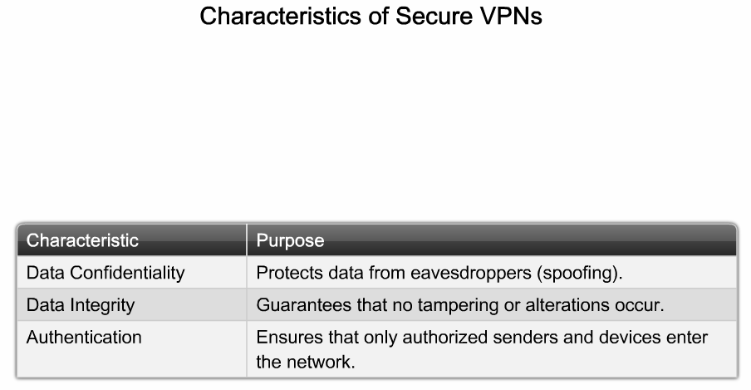
Describe How VPN Technology Provides Secure Teleworker Services in an Enterprise Setting
Describe the characteristics of secure VPNs

Slide 15
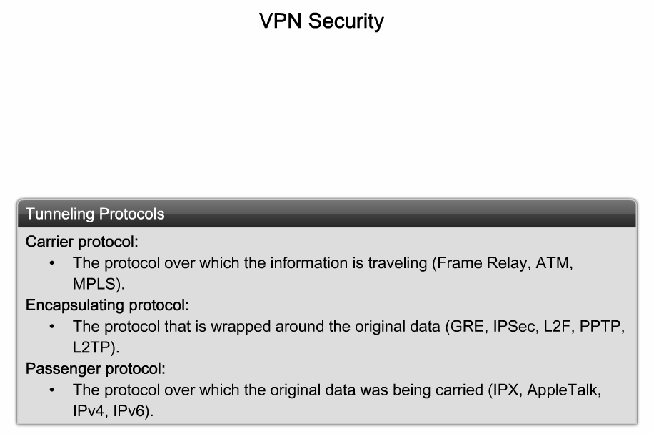
Describe How VPN Technology Provides Secure Teleworker Services in an Enterprise Setting
Describe the concept of VPN tunneling

Slide 16
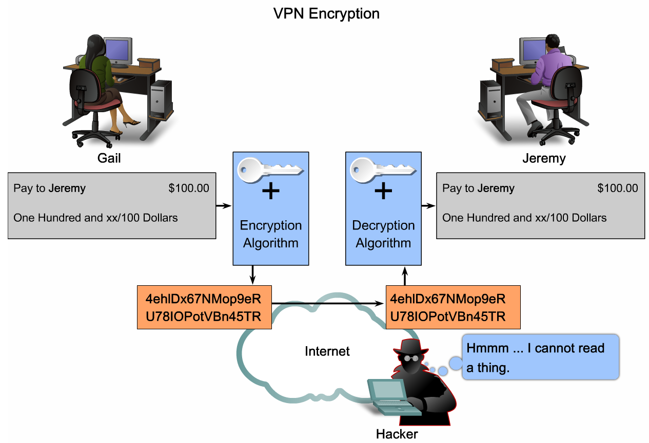
Describe How VPN Technology Provides Secure Teleworker Services in an Enterprise Setting
Describe the concept of VPN encryption

Slide 17
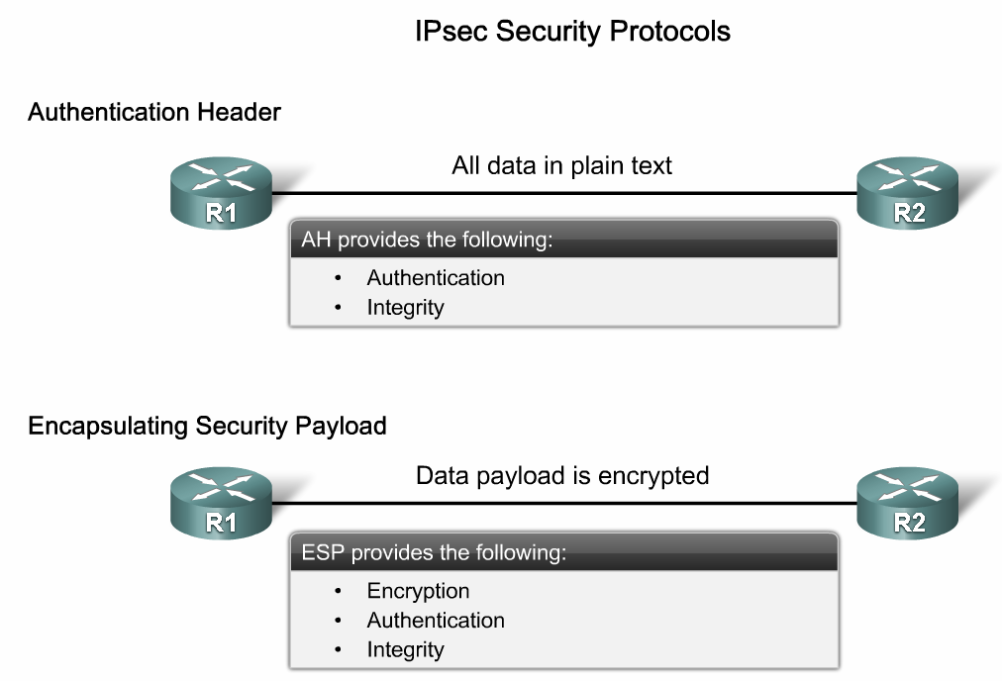
Describe How VPN Technology Provides Secure Teleworker Services in an Enterprise Setting
Describe the concept of IPsec Protocols

Slide 18
Summary
Requirements for providing teleworker services are:
  Maintains continuity of operations
  Provides for increased services
  Secure & reliable access to information
  Cost effective
  Scalable
Components needed for a teleworker to connect to an organization’s network are:
  Home components
  Corporate components

Slide 19
Summary
Broadband services used
  Cable
    transmits signal in either direction simultaneously
  DSL
    requires minimal changes to existing telephone infrastructure
    delivers high bandwidth data rates to customers
  Wireless
    increases mobility
    wireless availability via:
        municipal WiFi
        WiMax
        satellite internet

Slide 20
Summary
Securing teleworker services
  VPN security achieved through using
    Advanced encryption techniques
    Tunneling
  Characteristics of a secure VPN
    Data confidentiality
    Data integrity
    authentication

