Slide 1

Implement VTP
LAN Switching and Wireless – Chapter 4
Modified by Tony Chen
05/01/2008

Slide 2
Notes:
If you see any mistake on my PowerPoint slides or if you have any questions about the materials, please feel free to email me at chento@cod.edu.
Thanks!
Tony Chen
College of DuPage
Cisco Networking Academy

Slide 3
Objectives
Explain the role of VTP in a converged switched network
Describe the operation of VTP: VTP domains, VTP Modes, VTP Advertisements, and VTP Pruning.
Configure VTP on the switches in a converged network.
Understanding VLAN Trunk Protocol (VTP)
http://www.cisco.com/warp/public/473/21.html
http://www.cisco.com/warp/public/473/vtp_flash/
In-Depth Analysis Of VTP
http://www.firewall.cx/vlans-vtp-analysis.php

Slide 4
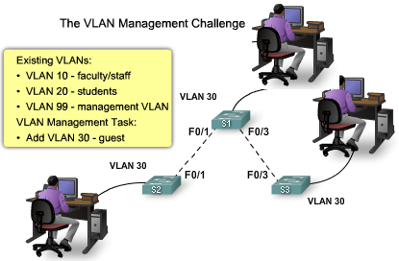
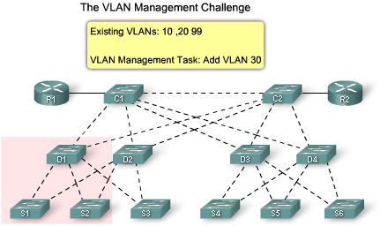
What is VTP?
The VLAN Management Challenge
  As the number of switches increases on a small- or medium-sized business network, the overall administration required to manage VLANs and trunks becomes a challenge.
Small Network VLAN Management
  The figure shows a network manager adding a new VLAN, VLAN30.
    The network manager needs to update the three trunks to allow VLANs 10, 20, 30, and 99.
    Recall that a common error is forgetting to update the allowed list of VLANs on trunks.
Larger Network VLAN Management
  After you have manually updated this network a few times, you may want to know if there is a way for the switches to learn what the VLANs and trunks are so that you do not have to manually configure them.
    VLAN trunking protocol (VTP).
Small Network VLAN Management
Larger Network VLAN Management
Notes:
Use graphic 1.1.1.1
Use graphic 1.1.1.3

Slide 5
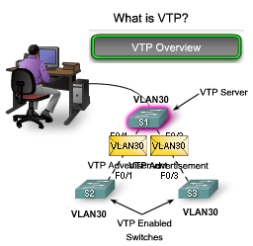
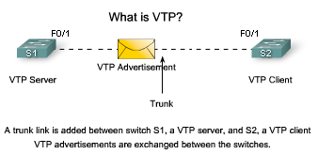
What is VTP?
What is VTP?
  VTP allows a network manager to configure a switch so that it will propagate VLAN configurations to other switches in the network.
    Switch can be configured a VTP server or VTP client.
    VTP only learns about normal-range VLANs (VLAN IDs 1 to 1005). Extended-range VLANs (IDs greater than 1005) are not supported by VTP.
VTP Overview
  VTP allows a network manager to makes changes on a switch that is configured as a VTP server.
    The VTP server distributes and synchronizes VLAN information to VTP-enabled switches throughout the switched network, which minimizes the configuration inconsistencies.
  VTP stores VLAN configurations in the VLAN database called vlan.dat.
For example: In the figure, a trunk link is added between S1, a VTP server, and S2, a VTP client.
  After a trunk is established, VTP advertisements are exchanged between the switches.
    VTP advertisements will not be exchanged if the trunk between the switches is inactive.
Notes:
Use graphic 1.1.1.1
Use graphic 1.1.1.3

Slide 6
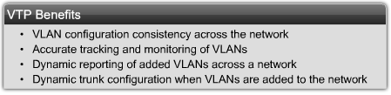
Benefits of VTP
VTP maintains VLAN configuration consistency by managing the following vlan information in a switch network:
  Addition
  Deletion
  Renaming
VTP offers a number of benefits for network managers, as shown in the figure.
Notes:
Use graphic 1.1.1.1
Use graphic 1.1.1.3

Slide 7
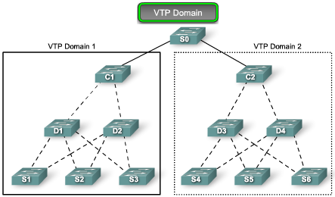
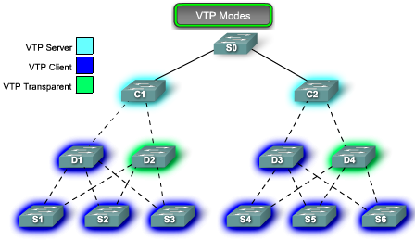
VTP Components
VTP Domain - Consists of one or more interconnected switches.
  All switches in a domain share VLAN configuration details using VTP advertisements.
  Router or Layer 3 switch defines the boundary of domain.
VTP Modes - 3 different VTP modes
  VTP Server - VTP servers advertise the VTP VLAN information to other switches in the same VTP domain.
    VTP servers store the VLAN information for the domain in NVRAM.
    The server is where VLAN can created, deleted, or renamed for the domain.
  VTP Client - VTP clients function the same way as VTP servers, but you cannot create, change, or delete VLANs.
    A VTP client only stores the VLAN information for the entire domain while the switch is on.
    A switch reset deletes the VLAN information. You must configure VTP client mode on a switch.
  VTP Transparent - Transparent switches forward VTP advertisements to VTP clients and VTP servers.
    Transparent switches do not participate in VTP.
    VLANs that are created, renamed, or deleted on transparent switches are local to that switch only.
Notes:
Use graphic 1.1.1.1
Use graphic 1.1.1.3

Slide 8
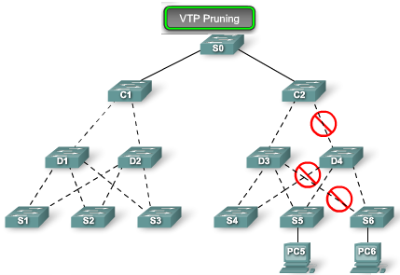
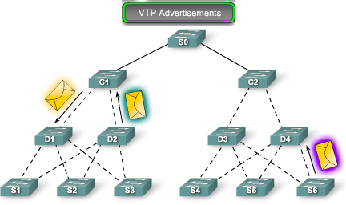
VTP Components (continue)
VTP Pruning - VTP pruning increases network available bandwidth by restricting flooded traffic to those trunk links that the traffic must use to reach the destination devices.
  Without VTP pruning, a switch floods broadcast, multicast, and unknown unicast traffic across all trunk links within a VTP domain even though receiving switches might discard them.
  [Tony] It means: destination switch does not have the same VLAN as the one that starts the broadcast packets.
VTP Advertisements - VTP uses a hierarchy of advertisements to distribute and synchronize VLAN configurations across the network.
Notes:
Use graphic 1.1.1.1
Use graphic 1.1.1.3

Slide 9
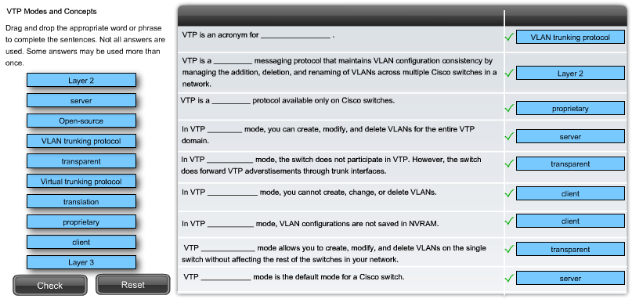
VTP
Notes:
Use graphic 1.1.1.1
Use graphic 1.1.1.3

Slide 10
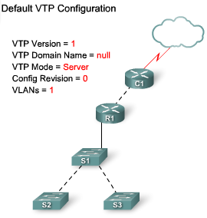
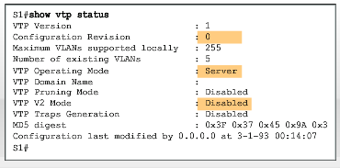
Default VTP Configuration
The Cisco command show VTP status displays the VTP status.
The default VTP settings are.
  VTP Version = 1
  VTP Domain Name = null
  VTP Mode = Server
  Configuration Revision = 0
  VLANs = 1
The following briefly describes the show VTP status parameters:
  VTP Version - Displays the VTP version the switch is running.
    By default, the switch implements version 1.
    Only one VTP version is allowed in a VTP domain.
  Configuration Revision - Current configuration revision number.
  Maximum VLANs Supported Locally - Maximum number of VLANs supported locally.
  Number of Existing VLANs - Number of existing VLANs.
  VTP Operating Mode - Can be server, client, or transparent.
  VTP Domain Name - Name that identifies the administrative domain.
  VTP Pruning Mode - Displays whether pruning is enabled or disabled.
  VTP V2 Mode - Displays if VTP version 2 mode is enabled. VTP version 2 is disabled by default.
  VTP Traps Generation - Displays whether VTP traps are sent to a network management station.
  MD5 Digest - A 16-byte checksum of the VTP configuration.
  Configuration Last Modified - Date and time of the last configuration modification. Displays the IP address of the switch that caused the configuration change to the database.
Notes:
Use graphic 1.1.1.1
Use graphic 1.1.1.3

Slide 11
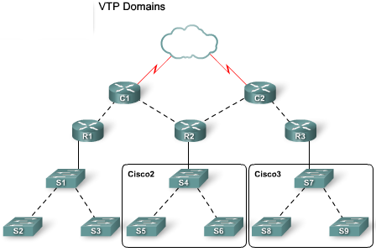
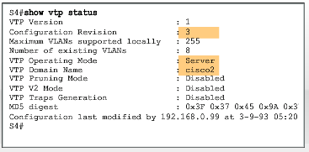
VTP Domains
VTP allows you to separate your network into smaller management domains to help reduce VLAN management.
  A VTP domain consists of one switch or several interconnected switches sharing the same VTP domain name.
  An additional benefit of configuring VTP domains is that it limits the extent to which configuration changes are propagated in the network if an error occurs.
A switch can be a member of only one VTP domain at a time.
  Until the VTP domain name is specified you cannot create or modify VLANs on a VTP server, and VLAN information is not propagated over the network.
Notes:
Use graphic 1.1.1.1
Use graphic 1.1.1.3

Slide 12
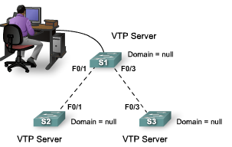
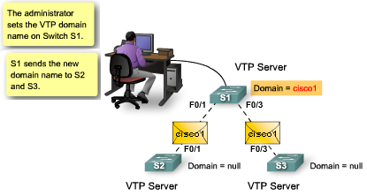
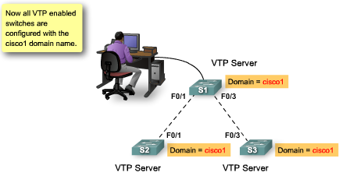
VTP Domain Name Propagation
For a VTP server or client switch to participate in a VTP-enabled network, it must be a part of the same domain.
  When switches are in different VTP domains, they do not exchange VTP messages.
  Domain name propagation uses three VTP components: servers, clients, and advertisements.
The network in the figure shows three switches, S1, S2, and S3, in their default VTP configuration.
  They are configured as VTP servers.
  VTP domain names have not been configured.
The network manager configures the VTP domain name as cisco1 on the VTP server switch S1.
  The VTP server sends out a VTP advertisement with the new domain name embedded inside.
  The S2 and S3 VTP server switches update their VTP configuration to the new domain name.
Cisco recommends that access to the domain name configuration functions be protected by a password.
Notes:
Use graphic 1.1.1.1
Use graphic 1.1.1.3

Slide 13
VTP
A lot of this chapter material is summarized in this flash
http://www.cisco.com/warp/public/473/vtp_flash/
Notes:
Use graphic 1.1.1.1
Use graphic 1.1.1.3

Slide 14
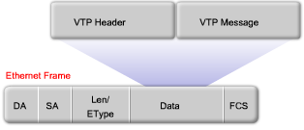
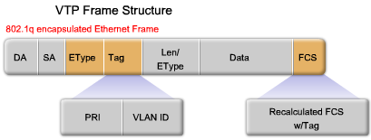
VTP Frame Structure
VTP advertisements (or messages) distribute VTP domain name and VLAN configuration changes to VTP-enabled switches.
VTP Frame Encapsulation
  A VTP frame consists of a header field and a message field.
  The VTP information is inserted into the data field of an Ethernet frame.
  The Ethernet frame is then encapsulated as a 802.1Q trunk frame (or ISL frame).
  Each switch in the domain sends periodic advertisements out each trunk port to a reserved multicast address.
  These advertisements are received by neighboring switches, which update their VTP and VLAN configurations as necessary.
Notes:
Use graphic 1.1.1.1
Use graphic 1.1.1.3

Slide 15
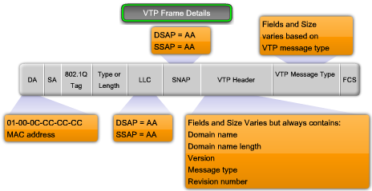
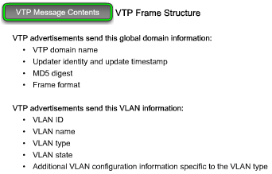
VTP Frame Details
VTP frame encapsulated as an 802.1Q frame is not static.
  The contents of the VTP message determines which fields are present.
  The following key fields are present when a VTP frame is encapsulated as an 802.1Q frame:
Destination MAC address –It is 01-00-0C-CC-CC-CC.
LLC field -Logical link control (LLC) field
  contains a destination service access point (DSAP) and a source service access point (SSAP) set to the value of AA.
SNAP field -Subnetwork Access Protocol (SNAP) field
  an OUI set to AAAA and type set to 2003.
VTP header field - The contents vary depending on the VTP message type (summary, subset, or request) but it always contains these VTP fields:
  Domain name - Identifies the domain for the switch.
  Domain name length - Length of the domain name.
  Version - Set to either VTP 1, VTP 2, or VTP 3.
  Configuration revision number - The current configuration revision number on this switch.
VTP message field -Varies depending on the message type.
Notes:
Use graphic 1.1.1.1
Use graphic 1.1.1.3

Slide 16
VTP Message Contents
VTP frames contain the following fixed-length global domain information:
  VTP domain name
  Identity of the switch sending the message, and the time it was sent
  MD5 digest VLAN configuration, including maximum transmission unit (MTU) size for each VLAN
  Frame format: ISL or 802.1Q
VTP frames contain the following information for each configured VLAN:
  VLAN IDs (IEEE 802.1Q)
  VLAN name
  VLAN type
  VLAN state
  Additional VLAN configuration information specific to the VLAN type
Note: A VTP frame is encapsulated in an 802.1Q Ethernet frame. The entire 802.1Q Ethernet frame is the VTP advertisement often called a VTP message. Often the terms frame, advertisement, and message are used interchangeably.
Notes:
Use graphic 1.1.1.1
Use graphic 1.1.1.3

Slide 17
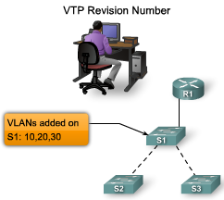
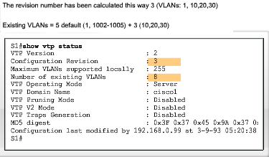
VTP Revision Number
The configuration revision number determines whether the configuration information received from another VTP-enabled switch is more recent than the version stored on the switch.
  The configuration revision number is a 32-bit number.
  The default revision number for a switch is zero.
  Each time a VLAN is added or removed, the configuration revision number is incremented.
  Each VTP device tracks the VTP configuration revision number that is assigned to it.
Note: A VTP domain name change does not increment the revision number.
  Instead, it resets the revision number to zero.
The figure shows a network manager adding three VLANs to switch S1.
  The highlighted area shows that the revision number on switch S1 is 3,
  The number of VLANs is 8,
    because 3 VLANs have been added to the 5 default VLANs.
Notes:
Use graphic 1.1.1.1
Use graphic 1.1.1.3

Slide 18
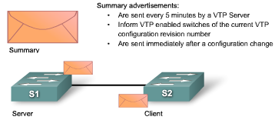
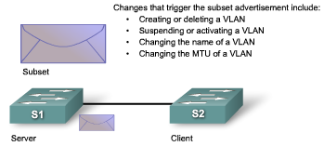
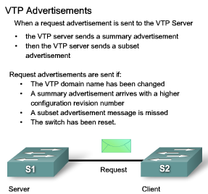
VTP Advertisements
Summary Advertisements
The summary advertisement contains the VTP domain name, the current revision number, and other VTP configuration details.
Summary advertisements are sent:
  Every 5 minutes by a VTP server or client to inform neighboring VTP-enabled switches of the current VTP configuration revision number for its VTP domain
  Immediately after a configuration has been made
Subset Advertisements
A subset advertisement contains VLAN information.
Subset advertisement are sent:
  Creating or deleting a VLAN
  Suspending or activating a VLAN
  Changing the name of a VLAN
  Changing the MTU of a VLAN
  [Tony] 1) sent if any change in the VLAN configuration.
  [Tony] 2) in response to an advertisement request message.
  It may take multiple subset advertisements to fully update the VLAN information.
Request Advertisements
When a request advertisement is sent to a VTP server in the same VTP domain, the VTP server responds by sending a summary advertisement and then a subset advertisement ([Tony] Both of them are sent).
Request advertisements are sent if:
  The VTP domain name has been changed
  The switch receives a summary advertisement with a higher configuration revision number than its own
  A subset advertisement message is missed for some reason
  The switch has been reset
http://cisco.com/univercd/cc/td/doc/product/lan/trsrb/frames.htm#xtocid31
Notes:
Use graphic 1.1.1.1
Use graphic 1.1.1.3

Slide 19
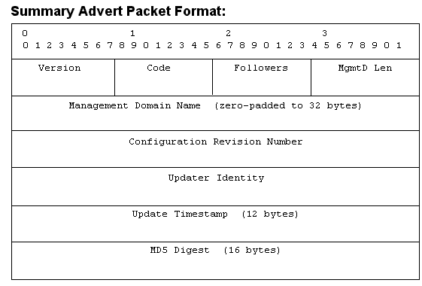
Summary advertisements:
Version
  The Version field indicates the VTP version number.
Code
  The Code field indicates the message type. Possible values are:
    0x01—Summary-Advert
    0x02—Subset-Advert
    0x03—Advert-Request
Followers
  The Followers field indicates the number of Subset-Advert messages that follow this Summary-Advert.
Management Domain Length
  The Management Domain Length field indicates the length of the name of the management domain.
Management Domain Name
  The Management Domain Name field indicates the name of the management domain.
Configuration Revision Number
  The Configuration Revision Number field indicates the revision number of the configuration information. A configuration revision number starts at zero and increments by one with each modification until it reaches the value 4294947295, at which point it wraps back to zero and starts incrementing again.
Updater Identity
  The Updater Identity field indicates the IP address of the device that received the command that caused the configuration revision number to have its current value.
Update Timestamp
  The Update Timestamp field indicates the time at which the configuration revision number was most increased to its current value. The timestamp is in the format "yymmddhhmmss", where yymmdd represents the year, month, and day and hhmmss represents the hours, minutes, and seconds.
MD5 Digest
  MD5 digest value over the secret value and all VLAN information
http://cisco.com/univercd/cc/td/doc/product/lan/trsrb/frames.htm#xtocid31
http://www.cisco.com/warp/public/473/21.html
Notes:
Use graphic 1.1.1.1
Use graphic 1.1.1.3

Slide 20
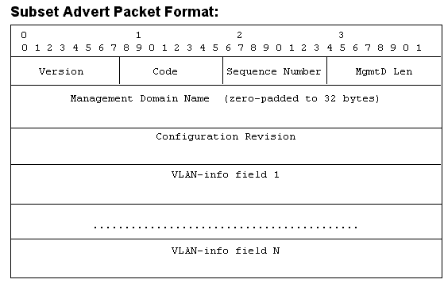
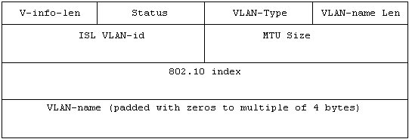
Subset Advertisements
Version
Code
Sequence Number
  The Sequence Number field indicates the order of this Subset-Advert frame within the series of Subset-Advert frames that follow a Summary-Advert.
  For the first Subset-Advert frame following a Summary-Advert frame the sequence number is 1.
Management Domain Length
Management Domain Name
Configuration Revision Number
VLAN Information Field
  VLAN Information Length
    The length is a multiple of 4.
  Status
    Bits 1 through 7 (0x02 through 0x80)—Reserved
  VLAN Type
    0x01—Ethernet
    0x02—FDDI
  VLAN Name Length
  ISL VLAN ID
    The ISL VLAN ID field indicates the ID of this VLAN on ISL trunks.
  MTU Size
    Possible values are 1500 through 18190.
  802.10 Index
    The 802.10 Index field indicates the 802.10 security association identifier (SAID) value for this VLAN.
  VLAN Name
VLAN Information Field
http://cisco.com/univercd/cc/td/doc/product/lan/trsrb/frames.htm#xtocid31
http://www.cisco.com/warp/public/473/21.html
Notes:
Use graphic 1.1.1.1
Use graphic 1.1.1.3

Slide 21
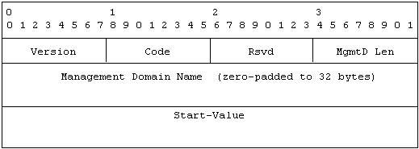
Request Advertisements
Version
  The Version field indicates the VTP version number.
Code
  The Code field indicates the message type. Possible values are:
  0x01—Summary-Advert
  0x02—Subset-Advert
  0x03—Advert-Request
Management Domain Length
  The Management Domain Length field indicates the length of the name of the management domain.
Start Value
  The Start Value field indicates the VLAN ID of the first VLAN for which information is requested. Any response to the request should contain information for all VLANs having an ISL VLAN ID greater than or equal to this value. For example, in a request for information on all VLANs, this value is 0.
http://cisco.com/univercd/cc/td/doc/product/lan/trsrb/frames.htm#xtocid31
http://www.cisco.com/warp/public/473/21.html
Notes:
Use graphic 1.1.1.1
Use graphic 1.1.1.3

Slide 22
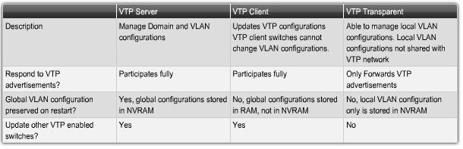
VTP Modes Overview
Server Mode
  In server mode, you can create, modify, and delete VLANs for the entire VTP domain.
    VTP server mode is the default mode for a Cisco switch.
    VTP servers advertise their VLAN configurations to other switches in the same VTP domain and synchronize their VLAN configurations with other switches based on advertisements received over trunk links.
    VTP servers track of updates through a configuration revision number.
    Other switches in the same VTP domain compare their configuration revision to see if they need to synchronize their VLAN database.
Client Mode
  If a switch is in client mode, you cannot create, change, or delete VLANs.
    The VLAN configuration information that a VTP client switch receives from a VTP server switch is stored in a VLAN database, not in NVRAM.
    When a VTP client is shut down and restarted, it sends a request advertisement to a VTP server for updated VLAN information.
Transparent Mode
  Switches configured in transparent mode forward VTP advertisements that they receive on trunk ports to other switches.
    VTP transparent mode switches do not advertise their VLAN and do not synchronize their VLAN configuration with other switch.
    A VTP transparent mode switch reboots, it does not revert to a default VTP server mode, but remains in VTP transparent mode.
Notes:
Use graphic 1.1.1.1
Use graphic 1.1.1.3

Slide 23
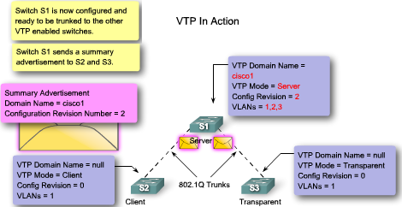
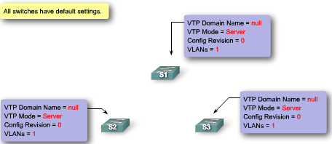
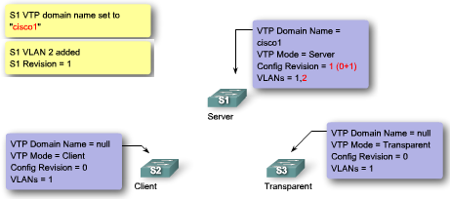
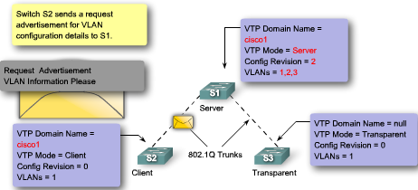
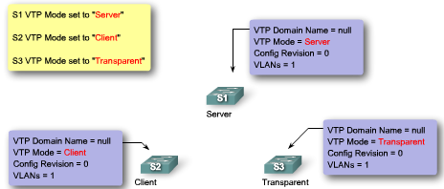
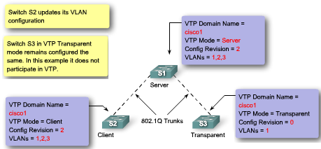
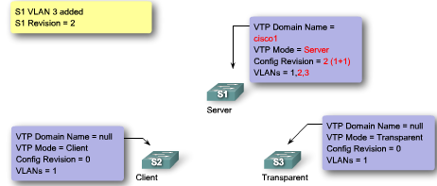
VTP in Action
5
You will now see how the various VTP features come together to distribute and synchronize domain and VLAN configurations in a VTP-enabled network. The animation starts with three new switches, S1, S2, and S3, configured with their factory default settings, and finishes with all three switches configured and participating in a VTP-enabled network.
1
3
6
2
4
7
Notes:
Use graphic 1.1.1.1
Use graphic 1.1.1.3

Slide 24
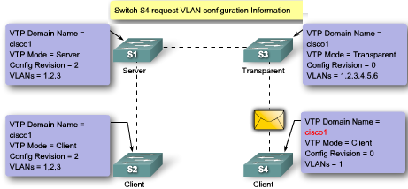

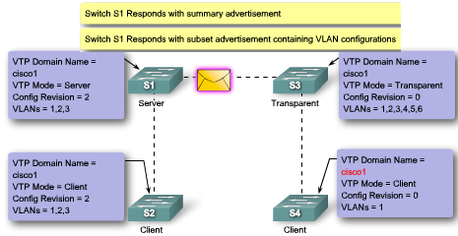
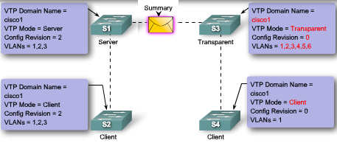
VTP in Action: VTP transparent mode
Continued from the previous slide
You have seen how VTP works with three switches. This animation examines in more detail how a switch configured in VTP transparent mode supports the functionality of VTP.
2
1
3
Notes:
Use graphic 1.1.1.1
Use graphic 1.1.1.3

Slide 25
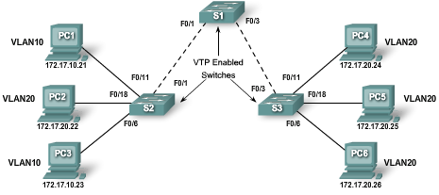
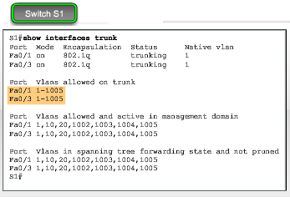
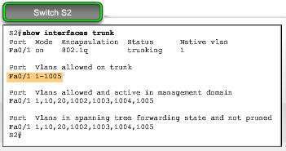
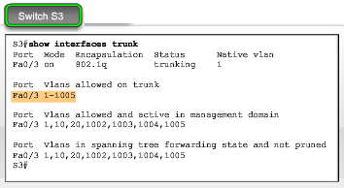
VTP pruning
VTP pruning prevents unnecessary flooding of broadcast information from one VLAN across all trunks in a VTP domain.
  VTP pruning permits switches to negotiate which VLANs are assigned to ports at the other end of a trunk and, hence, prune the VLANs that are not assigned to ports on the remote switch.
  Pruning is disabled by default.
VTP pruning is enabled using the vtp pruning global configuration command.
  You need to enable pruning on only one VTP server switch in the domain.
In the figure, you would enable VTP pruning on switch S1.
  Switch S3 has VLAN 20 configured,
  Switch S2 has VLAN 10 and VLAN 20 configured.
Notes:
Use graphic 1.1.1.1
Use graphic 1.1.1.3

Slide 26
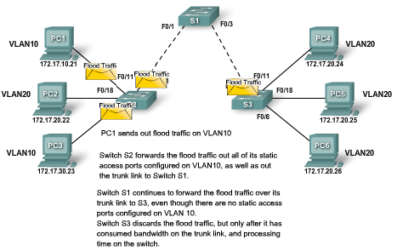
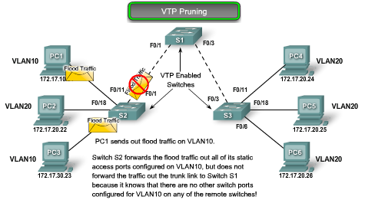
VTP Pruning in Action
VTP Pruning in Action
  A VLAN creates an isolated broadcast domain.
  A switch floods broadcast, multicast, and unknown unicast traffic across all trunk links within a VTP domain.
  When a computer or device broadcasts on a VLAN, for example, VLAN 10 in the figure, the broadcast traffic travels across all trunk links throughout the network to all ports on all switches in VLAN 10.
    In the figure, switches S1, S2, and S3 all receive broadcast frames from computer PC1.
  The link between switches S1 and S3 does not carry any VLAN 10 traffic, so it is a candidate for VTP pruning.
VTP Pruning
  The flood traffic is stopped from entering the trunk connecting switches S1 and S2.
  VTP pruning only prunes the egress port F0/1 on switch S2.
Notes:
Use graphic 1.1.1.1
Use graphic 1.1.1.3

Slide 27
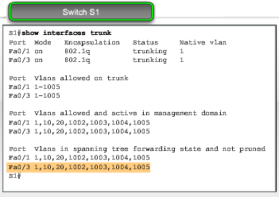
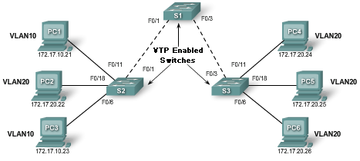
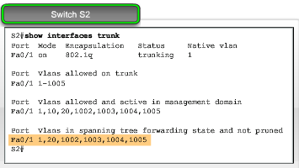
VTP Pruning Enabled
The figure shows a network topology that has switches S1, S2, and S3 configured with VTP pruning.
  When VTP pruning is enabled on a network, it reconfigures the trunk links based on which ports are configured with which VLANs.
  VTP pruning only prunes the egress port.
The highlighted area shows that the trunk on port F0/1 allows VLAN 10 traffic.
The highlighted area shows that the trunk on port F0/1 does not allow VLAN 10 traffic. VLAN 10 is not listed.
Notes:
Use graphic 1.1.1.1
Use graphic 1.1.1.3

Slide 28






VTP Pruning Enabled
TestLet (S2 is replaced by S3)
5
3, 4
1
1, 3
Notes:
Use graphic 1.1.1.1
Use graphic 1.1.1.3

Slide 29


VTP Configuration Guidelines
VTP Server Switches
  Confirm that all of switches you are have been set to default settings.
  Always reset the configuration revision number before installing a previously configured switch into a VTP domain.
    Not resetting the configuration revision number allows for potential disruption in the VLAN configuration across the rest of the switches.
  Configure at least two VTP server switches in your network.
    In case the primary VTP server becomes disabled, if all the switches are in VTP client mode, you cannot create new VLANs on the network.
  Configure a VTP domain on the VTP server.
    Other switches connected through trunk links receive the VTP domain information automatically through VTP advertisements.
  If there is an existing VTP domain, make sure that you match the name exactly.
    VTP domain names are case-sensitive.
  If you are configuring a VTP password, ensure that the same password is set on all switches in the domain.
    Switches without password or with the wrong password reject VTP advertisements.
  Ensure that all switches are configured to use the same VTP version.
    VTP version 1 is not compatible with VTP version 2. By default, Cisco Catalyst 2960 switches run version 1 but are capable of running version 2.
  Create the VLAN after you have enabled VTP on the VTP server.
    VTP information is only exchanged on trunk ports.
Notes:
Use graphic 1.1.1.1
Use graphic 1.1.1.3

Slide 30
VTP Configuration Guidelines
VTP Client Switches
  As on the VTP server switch, confirm that the default settings are present.
  Configure VTP client mode.
    Switch is not in VTP client mode by default. You have to configure this mode.
  Configure trunks.
    VTP works over trunk links.
  Connect to a VTP server.
    When you connect to a VTP server or another VTP-enabled switch, it takes a few moments for the various advertisements to make their way back and forth to the VTP server.
  Verify VTP status.
    Before you begin configuring the access ports, confirm that the revision mode and number of VLANs have been updated.
  Configure access ports.
    When a switch is in VTP client mode, you cannot add new VLANs. You can only assign access ports to existing VLANs.
Notes:
Use graphic 1.1.1.1
Use graphic 1.1.1.3

Slide 31





Configuring VTP: Step 1
Configure the VTP Server
Initially none of the devices are connected.
  The topology highlights switch S1. You will configure this switch to be a VTP server.
The output of the show vtp status command confirms that the switch is by default a VTP server.
  the revision number is still set to 0
  the switch does not belong to VTP domain.
Configure the VTP Server
If the switch was not already configured as a VTP server, you could configure it using the the vtp mode {server} command.
The domain name is configured using the the vtp domaindomain-name command.
  switch S1 has been configured with the domain name cisco1.
For security reasons, a password could be configured using the vtp passwordpassword command.
The default version for Catalyst 2960 is version 1.
Assume that three VLANs have been configured and have been assigned VLANs names.
Notes:
Use graphic 1.1.1.1
Use graphic 1.1.1.3

Slide 32




Configuring VTP: Step 2
Configure the VTP client
The topology highlights switches S2 and S3. You will be shown the VTP client configuration for S2.
  To configure S3 as a VTP client, you will follow the same procedure.
Configure the VTP Client
Before configuring a switch as a VTP client, verify its current VTP status.
  Show vtp status
Configure VTP client mode using the following Cisco IOS command syntax:
  Enter global configuration mode with the configure terminal command.
  Configure the switch in client mode with the vtp mode {client} command.
Notes:
Use graphic 1.1.1.1
Use graphic 1.1.1.3

Slide 33



Configuring VTP: Step 3 Confirm and Connect
After configuring the main VTP server and the VTP clients, you will connect the VTP client switch S2 to the switch S1 VTP server.
  The topology highlights the trunks that will be added to this topology.
Confirm VTP Operation
  There are 2 commands for confirming that VTP domain and VLAN configurations have been transferred.
Use show VTP status command to verify the following:
  Configuration revision number has been incremented to 6.
  There are now three new VLANs indicated by the existing number of VLANs showing 8.
  Domain name has been changed to cisco1.
Use show vtp counters command to confirm that the advertisements took place.
Configure Access Ports
  The task now is to configure the port F0/11 on switch S2 to be in VLAN 20. Use the switchport access vlan [number] interface command
Notes:
Use graphic 1.1.1.1
Use graphic 1.1.1.3

Slide 34

Troubleshooting VTP Connections
In this topic, you will learn about common VTP configuration problems. This information, combined with your VTP configuration skills, will help you when troubleshooting VTP configuration problems.
Notes:
Use graphic 1.1.1.1
Use graphic 1.1.1.3

Slide 35


Troubleshooting VTP: Incompatible VTP Versions
VTP versions 1 and 2 are incompatible with each other.
  Modern Cisco Catalyst switches, such as the 2960, are configured to use VTP version 1 by default.
  However, older switches may only support VTP version 1.
  Switches that only support version 1 cannot participate in the VTP domain along with version 2 switches.
  If your network contains switches that support only version 1, you need to manually configure the version 2 switches to operate in version 1 mode.
Notes:
Use graphic 1.1.1.1
Use graphic 1.1.1.3

Slide 36

Troubleshooting VTP: VTP Password Issues
When using a VTP password to control participation in the VTP domain, ensure that the password is set correctly on all switches in the VTP domain.
  Forgetting to set a VTP password is a very common problem.
  If a password is used, it must be configured on each switch in the domain.
  By default, a Cisco switch does not use a VTP password.
  The switch does not automatically set the password parameter, unlike other parameters that are set automatically when a VTP advertisement is received.
Notes:
Use graphic 1.1.1.1
Use graphic 1.1.1.3

Slide 37


Troubleshooting VTP: Incorrect VTP Domain Name
The VTP domain name is a key parameter that is set on a switch.
  An improperly configured VTP domain affects VLAN synchronization between switches.
  As you learned earlier, if a switch receives the wrong VTP advertisement, the switch discards the message.
Solution
  To avoid incorrectly configuring a VTP domain name, only set the VTP domain name on one VTP server switch.
    All other switches in the same VTP domain will accept and automatically configure their VTP domain name when they receive the first VTP summary advertisement.
Notes:
Use graphic 1.1.1.1
Use graphic 1.1.1.3

Slide 38




Troubleshooting VTP: Switches Set to VTP Client Mode
It is possible to change the operating mode of all switches to VTP client.
  By doing so, you lose all ability to create, delete, and manage VLANs within your network environment.
Solution
  To avoid losing all VLAN configurations in a VTP domain by accidentally reconfiguring the only VTP server in the domain as a VTP client, you can configure a second switch in the same domain as a VTP server.
  It is not uncommon for small networks that use VTP to have all the switches in VTP server mode.
Notes:
Use graphic 1.1.1.1
Use graphic 1.1.1.3

Slide 39



Troubleshooting VTP: Incorrect Revision Number
The topology in the figure is configured with VTP. There is one VTP server switch, S1, and two VTP client switches, S2 and S3.
S4, which has been previously configured as a VTP client, is added to the network.
  The revision number of the switch S4 is 35, which is higher than the revision number of 17 in the existing network.
  S4 comes preconfigured with two VLANs, 30 and 40, that are not configured in the existing network.
  The existing network has VLANs 10 and 20.
When switch S4 is connected to switch S3, VTP summary advertisements announce the arrival of a VTP-enabled switch with the highest revision number in the network.
  The figure shows how switch S3, switch S1, and finally switch S2 all reconfigure themselves to the configuration found in switch S4.
  As each switch reconfigures itself with VLANs that are not supported in the network, the ports no longer forward traffic from the computers because they are configured with VLANs that no longer exist on the newly reconfigured switches.
Notes:
Use graphic 1.1.1.1
Use graphic 1.1.1.3

Slide 40


Troubleshooting VTP: Incorrect Revision Number
Solution
  The solution to the problem is to reset each switch back to an earlier configuration and then reconfigure the correct VLANs, 10 and 20, on switch S1.
  To prevent this problem in the first place, reset the configuration revision number on previously configured switches being added to a VTP-enabled network.
  The figure shows the commands needed to reset switch S4 back to the default revision number.
POP QUIZ:
  How about just power cycle the switch 4 and rest the revision number before plug it into the network?
Notes:
Use graphic 1.1.1.1
Use graphic 1.1.1.3

Slide 41




Managing VLANs on a VTP Server
When a new VLAN, for example, VLAN 10, is added to the network, the network manager adds the VLAN to the VTP server, switch S1 in the figure.
  As you know, VTP takes care of propagating the VLAN configuration details to the rest of the network.
  It does not have any effect on which ports are configured in VLAN 10 on switches S1, S2, and S3.
The figure displays the commands used to configure VLAN 10 and the port F0/11 on switch S1.
After you have configured the new VLAN on switch S1 and configured the ports on switches S1, S2, and S3 to support the new VLAN, confirm that VTP updated the VLAN database on switches S2 and S3.
  The output of the command is used to verify the configuration on switch S2.
  The output confirms that the new VLAN has been added to F0/1 on switch S2. The highlighted area shows that VLAN 10 is now active in the VTP management domain.
Notes:
Use graphic 1.1.1.1
Use graphic 1.1.1.3

Slide 42
Summary
VTP is a Cisco proprietary protocol used to exchange VLAN information across trunk links.
A switch can be in one of 3 VTP operating modes
  Client
    Cannot create, modify or delete VLAN
  Server
    Can create, modify & delete VLAN
  Transparent
  Can create, modify, & delete LOCAL VLAN
  Forwards VTP advertisements.

Slide 43
Summary
VTP pruning
  Limits unnecessary dissemination of VLAN information.
Verify VTP configuration
  Show VTP status
  Show interfaces trunk
Tony Chen COD
Cisco Networking Academy

