Slide 1

Uncertainty
Johnny’s Notes

Slide 2
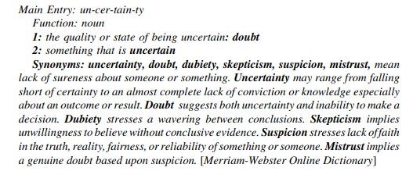
9.1 Uncertainty –Def.

Slide 3
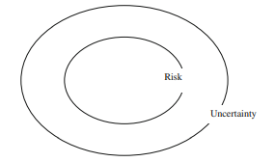
9.2 Uncertainty -Def
Definition:
Limited knowledge on past, present, future events, systems, parameters, variables, external factors…
Risk as low-level Uncertainty vs Deep Uncertainty
(Probability/stochastic/Bayesian) vs (lack of consensus on knowledge or values)

Slide 4
9.1 Uncertainty & Policy(Making)
Example 1: PKB Schiphol Airport (1990s): Need to make policies for planning and growth. They hired some modelers who failed Kwakkels class; These guys said hey! Our machine learning model automatically correlates xyz, this means the GNP is correlated to passenger throughput. Cool. Let's tell little Williem (minster at the time controlled by the monarchy) to make a policy based on our projections. RESULTS: Passenger throughput skyrocketed & max. capacity was reached in 8 years instead of 25. (woopies). Now Passenger throughput was related to GNP, but had sensitivity to other external factors… a.k.a. airport become a hub to get to other places via KLM & Co. (alliances), which the modelers had no clue of. So, the modelers had modeled using the (empirical/rational) past to predict the future (problem of induction) instead of thinking of new creative ways that the airport might grow. So, the black swan event happened in their lifetime and …. (ahh fuck. kwawkels told you so. )
Example 2: Climate Change & Uncertainty
Magnitude, whole range of future scenarios to describe different increase in global temp
Speed of climate change (which determines how fast policy's need to be created and implemented)
Who is most, least, no importa affected? (areas, regions)
What should be done?
Lack of Knowledge/consensus on costs, benefits, alternatives, criteria for evolution, values

Slide 5
9.2 Uncertainty –
Uncertainty -> types and sources?
How to Identify & prioritize?

Slide 6
9.2 Uncertainty –What??
Definition:
Limited knowledge about future, past, or current events.
Not a probability (risk), not stochastics, but a notion of (unknown) possibility
Although some types of uncertainties can be treated with a probability (denote- risk), others cannot, (denote- deep uncertainty)
Limited knowledge on past, present, future events, systems, parameters, variables, external factors…
Risk as low-level Uncertainty (Probability/stochastic/Bayesian) vs Deep Uncertainty (lack of consensus on knowledge or values)
System Nomenclature
Model ; Boundaries ; External Factors ; Factors ; Input ; output (outcomes) ; scenarios ; interrelationships among factors; system behavior
Domains: From Policy-Maker/Stakeholders to Modeler
From values to Math to scenarios as a decision tool to a decision
Dimensions
Location
Level
Magnitude:

Slide 7
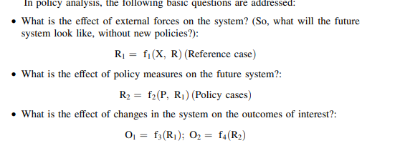
9.2 Uncertainty –What??....
System Nomenclature
rational-style policy analysis -> create a model of the system of interest that defines the boundaries of the system and describes its structure and operations—i.e., the elements, and the links, flows, and relationships among these elements.
Relationships -> mental -> cause & effect -> math -> computer code -> magic
System outputs = outcomes of interest (O)
Valuation of outcomes = relative importance = give it a weight (W)
Known as Relevant criteria for evaluation of policies

Slide 8
9.2 Uncertainty –What??
Model outcome uncertainty is sometimes called prediction error, since it is the discrepancy between the true value of an outcome and the model’s predicted value. If the true values are known (which is rare, even for scientific models), a formal validation exercise can be carried out to compare the true and predicted values in order to establish the prediction error. However, practically all policy analysis models are used to extrapolate beyond known situations to estimate outcomes for situations that do not yet exist.
Model outcome uncertainty is the accumulated uncertainty caused by the uncertainties in the locations external factors and (new) system domain for policies that are propagated through a model and are reflected in the resulting estimates of the outcomes of interest
Sources: Exact & Fixed parameters, a prior chosen & calibrated parameters;
A pirior = estaimated values a pirior by experts| calibrated = values estimated by historical model calibration for ballpark value
How can the Model be useful for practice?
(1) build model credibility with its users and with consumers of its results
(2) describe the uncertainty in the model outcomes Model outcome uncertainty is the accumulated uncertainty caused by the uncertainties in the locations external factors and system domain for policies that are propagated through a model and are reflected in the resulting estimates of the outcomes of interest

Slide 9

9.2 Uncertainty –What??
Dimensions
Location
Level
Magnitude:
How can I describe the nature of uncertainty from this Matrix?
Epistemic: incomplete knowledge ….human (un-)rationality
Fix? Reduce How? Collect more knowledge/info or wait til future becomes known
Aleatoric |ontic: the systems| situation |phenomena's inherent variability
Fix? Traditional Probability &Statistics or sometimes with observations/experiments
Deep = Ambiguity: "no consensus on values or knowledge" … multiple equally valid frames of knowledge
Fix? Eliminate those frames or buyout

Slide 10
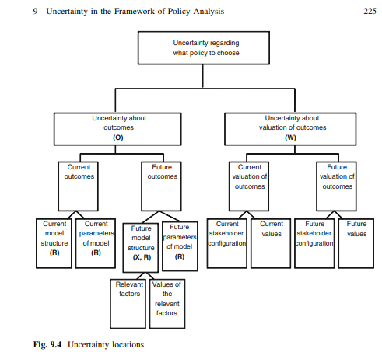
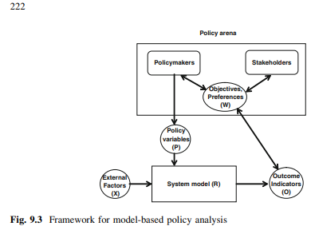
9.2 Uncertainty –What??

Slide 11
9.2 Uncertainty –What??
Dimensions
Location: where the uncertainty manifests itself within the policy analysis framework.
(1) uncertainty about the external factors (X);
What: Magnitudes; System response to these
Where: Mode: Structure & parameter
(2) uncertainty about the system response to the external factors and/or policy changes (R);
(3) uncertainty in locations (1) and (2) combine to produce uncertainty about the system outcomes (O) or, in the case of model-based decision support, model outcome uncertainty;
(4) uncertainty about the relative importance placed on the outcomes by the participants in the policymaking process (their weights (W) or valuation of the outcomes)
Future stakeholders configuration & their future values
Current stakeholders changing valuation over time (due to xyz, external; disaster, oil prices, mobile telephony)

Slide 12
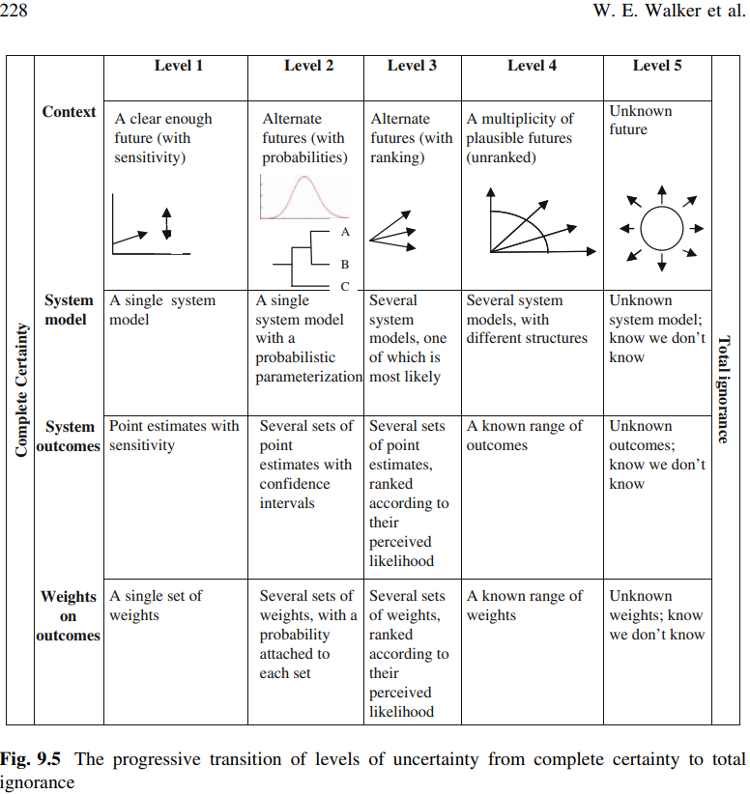
9.2 Uncertainty –What??
Dimensions
Level:
locations of uncertainty: (a) the future world (X)
(b) the model of the relevant system for that future world (R),
(c) the outcomes from the system (O)
(d) the weights that the various stakeholders will put on the outcomes (W).

Slide 13
9.2 Uncertainty –What??
Dimensions: Level
Complete certainty = idealized situation (extreme)
L1 = acknowledge uncertainty existence, but refuses /unable to measure degree of it.
Fix? Sensitivity Analysis on model parameters
L2 = good statistical description with probabilities and confidence intervals. (4 prediction models, a multi-forecasts (scenarios) with probabilities)
L3 = am able to enumerate alternatives and rank them by perceived likelihood, but no probability). (multi –parameterizations, sets of outcomes & weights).
L4 = am able to enumerate multi-plausible alternatives without ranking…
Due to? Little knowledge, known mechanisms, functional relationships, or decisionmakers cannot agree on rankings. Issue? Picking probability distributions, valuing outcome desirability
L5 = We only know what we do not know
Total ignorance

Slide 14
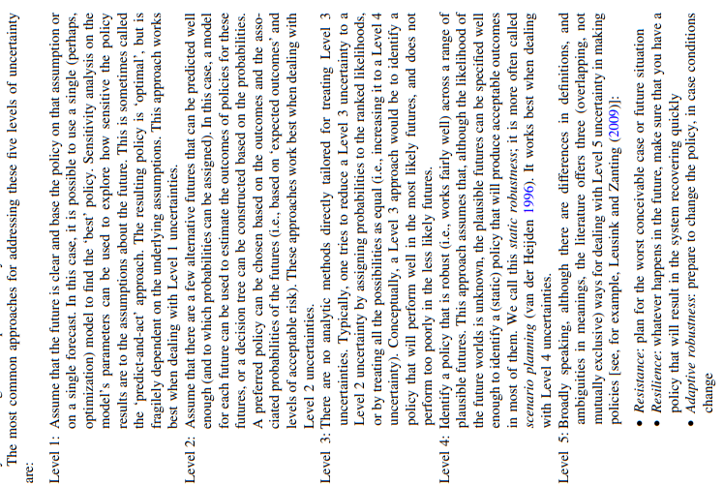
9.2 Uncertainty –a WTF approach 2 Policy

Slide 15
Uncertainty
The first approach is likely to be very costly and might not produce a policy that works well, because of Black Swans. The second approach accepts short-term pain (negative system performance), but focuses on recovery. The third approach appears to be the most robust and efficacious way of dealing with Level 5 uncertainties (Kwakkel et al. 2012)
.
.
Remember this is a biased perspective from Kakkwel! It may be more robust and efficacious, but also at the cost of long term planning , resources, manhours, and $$. Study & implementation time fames are something he doesn’t consider and (assumption) can take +2 years.

Slide 16
9.2 Uncertainty –a WTF approach 2 Policy
Predict & Act
Expected Outcome
Scenario Planning
Exploratory Modeling & Analysis
Dynamic Adaptive
Design
Stage setting
Assembling a basic policy
Increasing Robustness of basic policy
Actions: Mitigating, Hedging, Seizing, Shaping
Setting up the monitoring System
Preparing the trigger responses
Actions: Defensive, Corrective, Reassessment
Implementation Phase

Slide 17
9.2 Uncertainty –a WTF approach 2 Policy
Predict & Act
Executive type problems
Build model to estimate outcomes of alternative policies for a future world
Stochastic model valued by Cost-benefit Analysis, multi-criteria analysis, or optimization technique
Gives you the BEST policy to make a policy great again (trump…)
WHEN TO USE?
Short planning horizon & stable system (mas o menos). (narrow time frames constrain range of possible futures. Therefore we can get reasonable error bands, important policy-exogenous, and policy-dependent events.)
As you extend the future time frame, the qualitive nature of the problem changes, so your basically gaming with your model, the policy, ad peoples taxes, …

Slide 18
9.2 Uncertainty –a WTF approach 2 Policy
Expected Outcome
WHEN TO USE? Probability of different futures is known (probability-weighted) ….
if probabilities can be assigned to the scenarios (X), the system model and/or the parameters of the model (R), and/or the stochastic variables in the model, then probabilities can be assigned to the outcomes of interest (O)…
TOOLS: Cost-benefit-Analysis ; Decision An analysis; Real Options Analysis (ROA)
Concepts: Net Present Value (NPV) of the expected benefits minus the expected costs is often calculated
Concepts: Flexibility value = NPV (with flexibility)-NPV (without flexibility).
This formula entails the comparison of NPV between a project with an option and without one.
Having an option comes at a cost. Therefore you must ask yourself if it is worth knowing the cost of having an option by evaluating its Flexibility… (because this type of analysis costs too.)

Slide 19
9.2 Uncertainty –a WTF approach 2 Policy
Scenario Planning:
Describe a set of scenarios
Scenarios are ‘‘stories’’ of possible futures, based upon logical, consistent sets of assumptions, and fleshed out in sufficient detail to provide a useful context for engaging planners and stakeholders.
Evaluate them based on outcomes &:
Consistency: the assumptions made are not self-contradictory; a sequence of events could be constructed leading from the present world to the future world;
• Plausibility: the posited chain of events can happen;
• Credibility: each change in the chain can be explained (causality);
• Relevance: changes in the values of each of the scenario variables is likely to have a large effect on at least one outcome of interest.
1 specific the system, outcomes, relevant time horizon with a system diagram…
2 Id external factors driving both system and relevant outcome changes
3 Categorize factors and resulting system changes as fairly certain or uncertain
4. Assess the relevance of the uncertain factors/system changes.
5. design several scenarios based on combination of different developments in the external factors.

Slide 20
9.2 Uncertainty –a WTF approach 2 Policy
Scenario Planning Continued…:
PROBLEMS….
Deciding which future external developments to include in the scenarios. Typically, these developments are decided upon by experts (collectively and individually)
Even if we knew all of the relevant external factors, the values of these factors are likely to be uncertain
large range in the performance estimates generated by the scenarios.
If the uncertainty included in this range is large, policymakers often tend to fall back on a single ‘most likely’ scenario (assuming Level 3 uncertainty), or the do-nothing approach, arguing that ‘‘we do not have sufficient information to make a decision at this time’

Slide 21
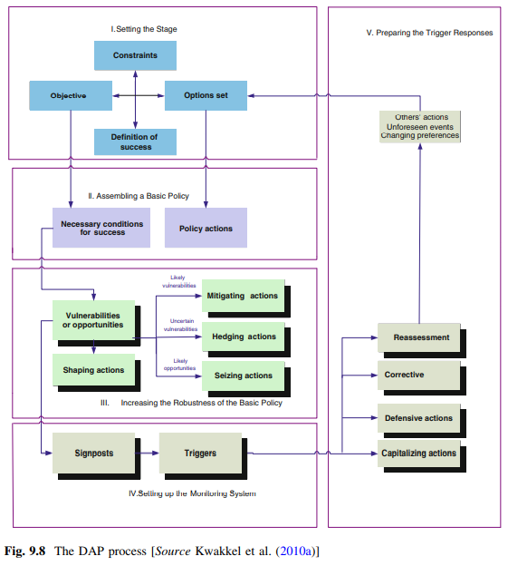
9.2 Uncertainty
• Mitigating actions (M)—actions to reduce the likely adverse effects of the basic policy;
• Hedging actions (H)—actions to spread or reduce the risk of uncertain adverse effects of the basic policy;
• Seizing actions (SZ)—actions taken to seize likely available opportunities;
• Shaping actions (SH)—actions taken to reduce the chance that an external condition or event that could make the policy fail will occur, or to increase the chance that an external condition or event that could make the policy succeed will occur.
-----------------------------------------------------------------------------------------------
• Defensive actions (DA)—actions taken after the fact to clarify the policy, preserve its benefits, or meet outside challenges in response to specific triggers that leave the basic policy unchanged;
• Corrective actions (CR)—adjustments to the basic policy in response to specific triggers;
• Capitalizing actions (CP)—actions taken after the fact to take advantage of opportunities that further improve the performance of the basic policy;
• Reassessment (RE)—a process to be initiated or restarted when the analysis and assumptions critical to the policy’s success have clearly lost validity.

Slide 22
9.2 Uncertainty
• Sign posts are information that should be tracked
usually about vulnerabilities and opportunities

Slide 23
9.2 Uncertainty
•Implementation Phase
Once the basic policy and additional actions are agreed upon, the entire adaptive policy is implemented. In this phase, the actions to be taken immediately (from Step II and Step III) are implemented and a monitoring system (from Step IV) is 246 W. E. Walker et al.established.

Slide 24
9.2 Uncertainty –a WTF approach 2 Policy
Exploratory Modeling & Analysis

Slide 25
9.2 Uncertainty –a WTF approach 2 Policy
Predict & Act
Expected Outcome
Scenario Planning
Exploratory Modeling & Analysis
Dynamic Adaptive
Design
Stage setting
Assembling a basic policy
Increasing Robustness of basic policy
Actions: Mitigating, Hedging, Seizing, Shaping
Setting up the monitoring System
Preparing the trigger responses
Actions: Defensive, Corrective, Reassessment
Implementation Phase

