Slide 1


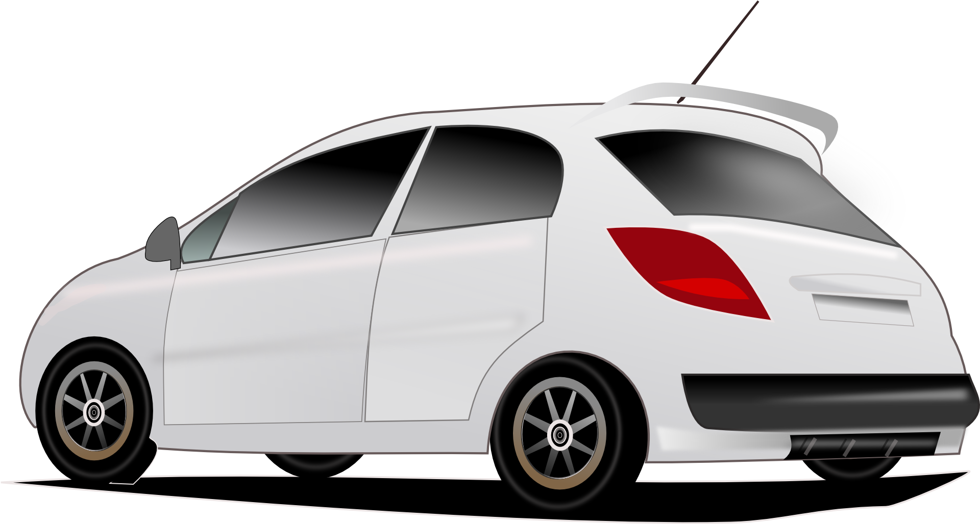

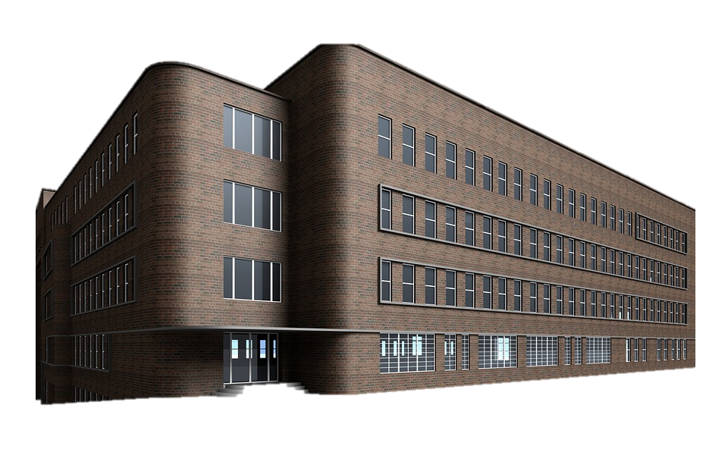

Car drives 20 km to work. Empties battery
I’m going to work today
When to charge: Price low, right now, at home?
Arrive at work and plug in

Slide 2
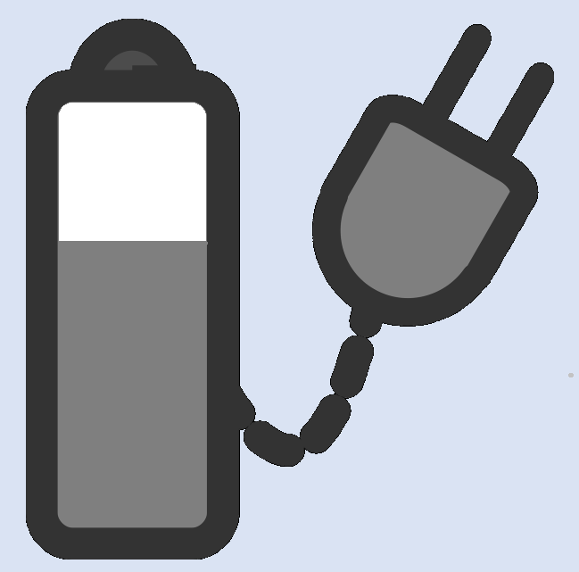


Driving home, emptying battery
Car arrives at home and plugs in
Car charges at night.
Repeat cycle

