Slide 1

End-to-End Salient Object Detection
Intern: Florjetë Kuka
© 2025 Copyright Genpact. All Rights Reserved.

Slide 2

Agenda
Project Overview
CNN Encoder–Decoder Architecture
Evaluation Results
Conclusions
© 2025 Copyright Genpact. All Rights Reserved.

Slide 3
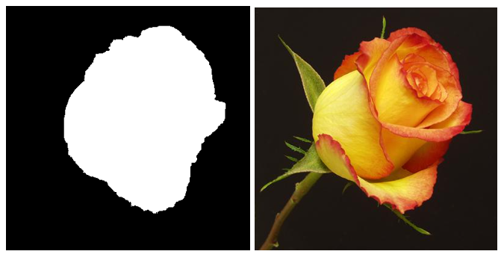
Project Overview
Goal
Build a Salient Object Detection system using a CNN architecture implemented from scratch in PyTorch.
Technologies
PyTorch
Google Colab
MSRA10K Dataset
Features
Image preprocessing
Encoder-decoder CNN
Saliency mask prediction
Model evaluation using IoU and F1-score
Figure 1. Mask and corresponding image from the MSRA10K dataset

Slide 4
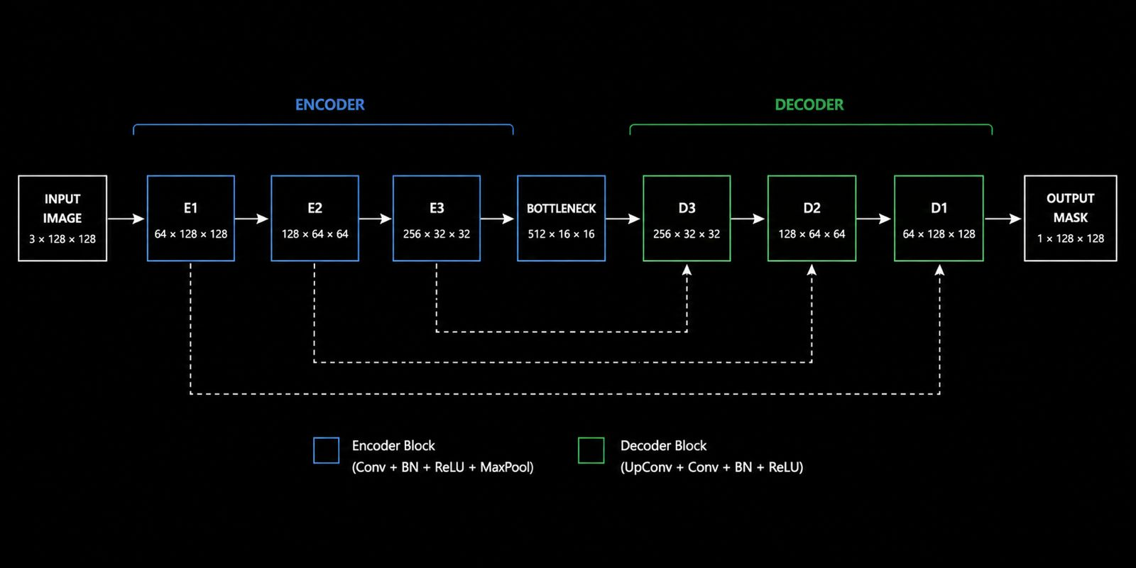
CNN Encoder–Decoder Architecture
Encoder extracts image features
Bottleneck learns deeper representations
Decoder reconstructs segmentation mask
Skip connections improve boundary details

Slide 5
Results
Table 1. Metric results
Improvements:
Batch Normalization
Data Augmentation
Threshold Tuning
Longer Training
Metric | Value
IoU | 0.6470
Precision | 0.7582
Recall | 0.8267
F1-score | 0.7895

Slide 6
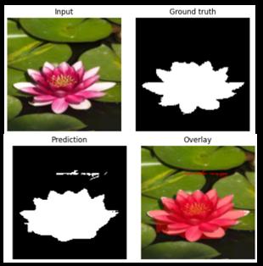
Conclusions
Project Outcome
Future Work
Complete SOD Pipeline
Built fully in PyTorch
Improved Segmentation
Higher IoU and F1-score
From-Scratch Architecture
Encoder–decoder CNN
Higher Resolution
224×224 training
Advanced Augmentation
Better generalization
Improved Decoder
Sharper object boundaries
Figure 2. Example model prediction and saliency mask visualization.

Slide 7


Thank you
© 2025 Copyright Genpact. All Rights Reserved.

