Slide 1

Status Presentation – Dodo: Extended SLIP Model
Chair of Robotics and Systems Intelligence
Munich Institute of Robotics and Machine Intelligence (MIRMI)
Technical University of Munich
Topics:
Project Scope
Project Distribution
Work Plan
Florian Martineau
Stefan Loy
Yani Zhang
Munich, 16th of December 2021

Slide 2
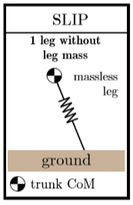
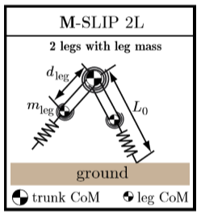
Project Scope
Chair of Robotics and Systems Intelligence
Munich Institute of Robotics and Machine Intelligence (MIRMI)
Technical University of Munich
Extension of SLIP Model
Scope of our SLIP-Model:
Two legs (with mass, damping, stiffness)
Hip-Actutation (Controll)
Losses (Damping in legs and hip)
Optimal controller

Slide 3
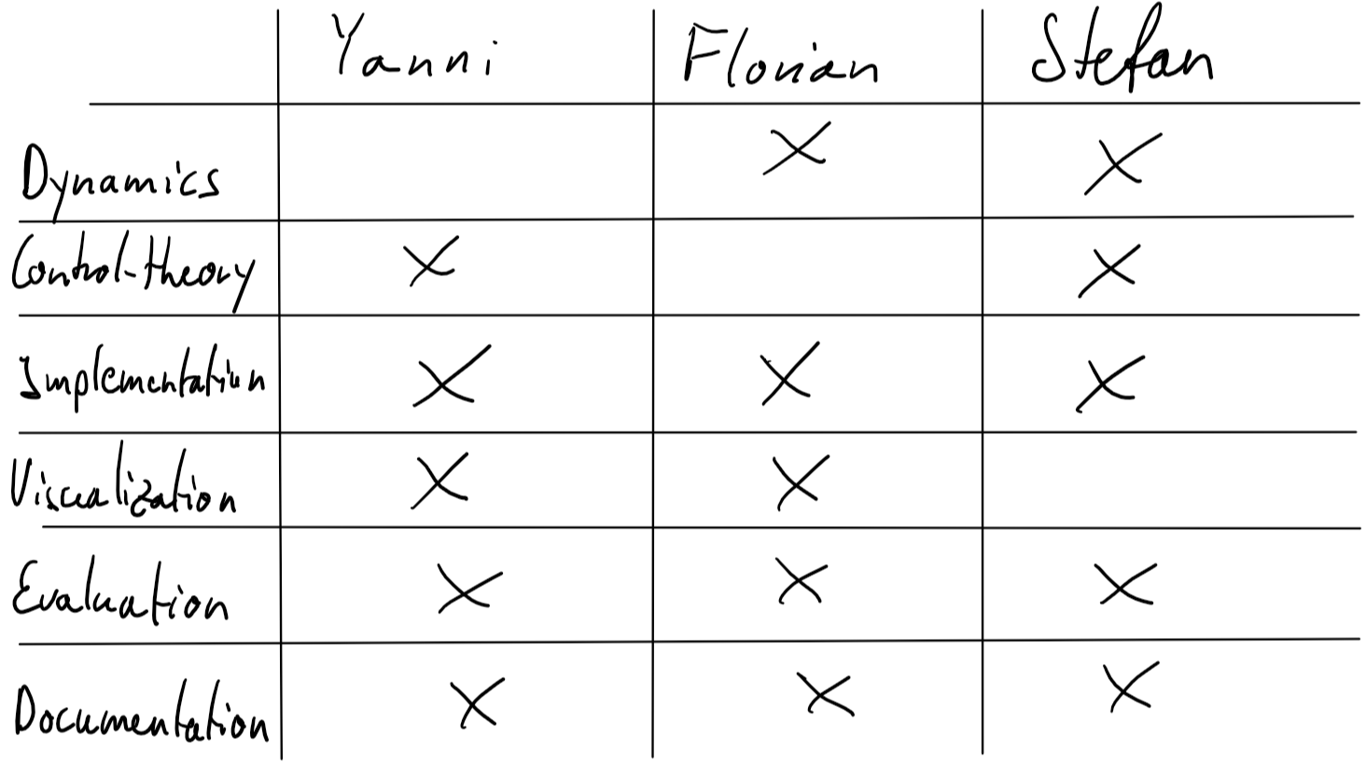
Expert Fields and Project Distribution
Chair of Robotics and Systems Intelligence
Munich Institute of Robotics and Machine Intelligence (MIRMI)
Technical University of Munich

Slide 4
Work Plan as Gant-Chart
Chair of Robotics and Systems Intelligence
Munich Institute of Robotics and Machine Intelligence (MIRMI)
Technical University of Munich

