Slide 1
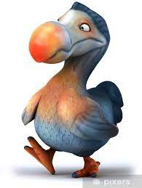

Dodo – Alive!
Chair of Robotics and Systems Intelligence
Munich Institute of Robotics and Machine Intelligence (MIRMI)
Technical University of Munich
BIOLOGICAL PARAMETERS OF A PREHISTORIC BIRD
Munich | February 2022 | Florian Martineau, Stefan Loy, Yani Zhang

Slide 2
Agenda
Chair of Robotics and Systems Intelligence
Munich Institute of Robotics and Machine Intelligence (MIRMI)
Technical University of Munich
Included physical parameters of our modell
Known physical parameters of the dodo
Near-species animals in the present
Estimates on further physical parameters
Munich | February 2022 | Florian Martineau, Stefan Loy, Yani Zhang

Slide 3
Included physical parameters of our modell
Chair of Robotics and Systems Intelligence
Munich Institute of Robotics and Machine Intelligence (MIRMI)
Technical University of Munich
Parameter-Type
Dominating | Mass | Mass-Distribution | Height | Leg-Length (Upper and lower) | Centre of mass
Additional | Hip Spring-Damper | Knee Spring-Damper | Leg Spring
Dynamical | Running-Speed | Walking-Speed
Munich | February 2022 | Florian Martineau, Stefan Loy, Yani Zhang

Slide 4
Near-species animals in the present
Chair of Robotics and Systems Intelligence
Munich Institute of Robotics and Machine Intelligence (MIRMI)
Technical University of Munich
Anatomicly similar to pigeons
Munich | February 2022 | Florian Martineau, Stefan Loy, Yani Zhang

Slide 5
Known physical parameters of the dodo
Chair of Robotics and Systems Intelligence
Munich Institute of Robotics and Machine Intelligence (MIRMI)
Technical University of Munich
Total mass: Between 10.6 and 17.5kg → Probably at lower end of spectrum → 12kg
Height: 1m
Mass-Distribution: Most of mass concentrated in mid-body. Almost no mass on legs, small medium-low mass of head/beak
From master-thesis:
m_leg = m_thight + m_shank + m_pes = 456.54 g + 459.26 g + 158.66 g = 1074.46 g
m_trunk = m_total – 2 * m_leg = 9.851 kg
→ 82% of total mass is centred at trunk, equally 9% in each leg
Spring-Damping
Master-Thesis: d = 0.05 N*s
My Approach: spring-stiffness in correspondance to mass-ration dodo to human
Quite fast running – speed, strong/robust legs
Munich | February 2022 | Florian Martineau, Stefan Loy, Yani Zhang

Slide 6
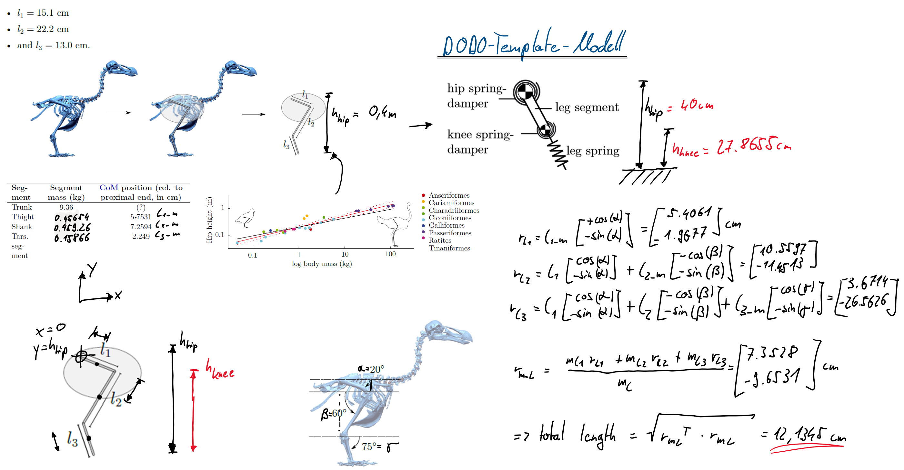
Calculation of knee-position / leg-length
Chair of Robotics and Systems Intelligence
Munich Institute of Robotics and Machine Intelligence (MIRMI)
Technical University of Munich

Slide 7
Parameters of our modell
Chair of Robotics and Systems Intelligence
Munich Institute of Robotics and Machine Intelligence (MIRMI)
Technical University of Munich
Parameter-Type
Dominating | Mass 12kg | Mass-Distribution 82% trunk 18% legs | Height 1m | Leg-Length (Upper and lower) L_1 = 12.1345cm L_0 = 27.8655cm | Centre of mass H_hip = 40cm
Additional | Hip Spring-Damper c = 1125 Nm/rad | Knee Spring-Damper c = 150 Nm/rad |  | Leg Spring c = 3000 N/m
Dynamical | Running-Speed | Walking-Speed 1.41 m/s |  | Leg-retraction 14 deg/s
Munich | February 2022 | Florian Martineau, Stefan Loy, Yani Zhang

Slide 8
Code in Matlab
Chair of Robotics and Systems Intelligence
Munich Institute of Robotics and Machine Intelligence (MIRMI)
Technical University of Munich
L0=.40; M=12; g=9.81;
l0 = .6966*L0; %lower leg length
l1 = .3034*L0; %upper leg length
m_L = .18*M; %leg mass
m_B = M-m_L; %rest of body mass
c_phi = 1125; %Nm/rad
d1 = 2*sqrt(c_phi*m_L);
c_theta = 150;
d2 = 2*sqrt(c_theta*m_L);
c1 = 3000;
omega = 14*pi/180; %rad/s
Munich | February 2022 | Florian Martineau, Stefan Loy, Yani Zhang

