Slide 1
Data enlightenment
SIX Financial Information
A way to gather and analyse information about customer data usage

Slide 2
Goals
SIX goals:
Gather information about customer data
usage
Improve enrichment of data feed
Increase quality of delivered data
SIX customer goals
More individual and specific data feed
Overview about SIX product usage
Improve workflow efficiency

Slide 3
How to achieve goals
Gathering information about customer data usage → Customer should be responsible
Providing API for data delivery
Meaningful representation of gathered data
→ Directed weighted graph
Possibility to forecast future actions based on learned user behaviour → Markov chain

Slide 4


Strengths and Weaknesses
Granular data analysis
Strictly based on individual customer usage
Pragmatic approach
Extensibility for future data mining analysis
New API for customers
No bulk delivery of reference data

Slide 5
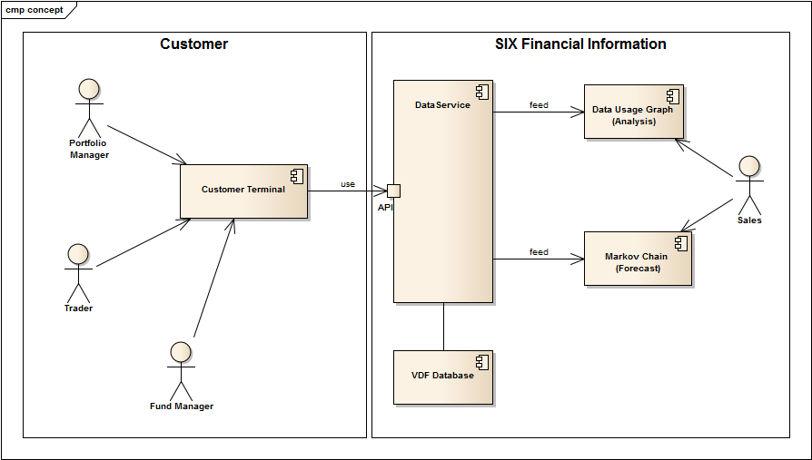
Solution

Slide 6
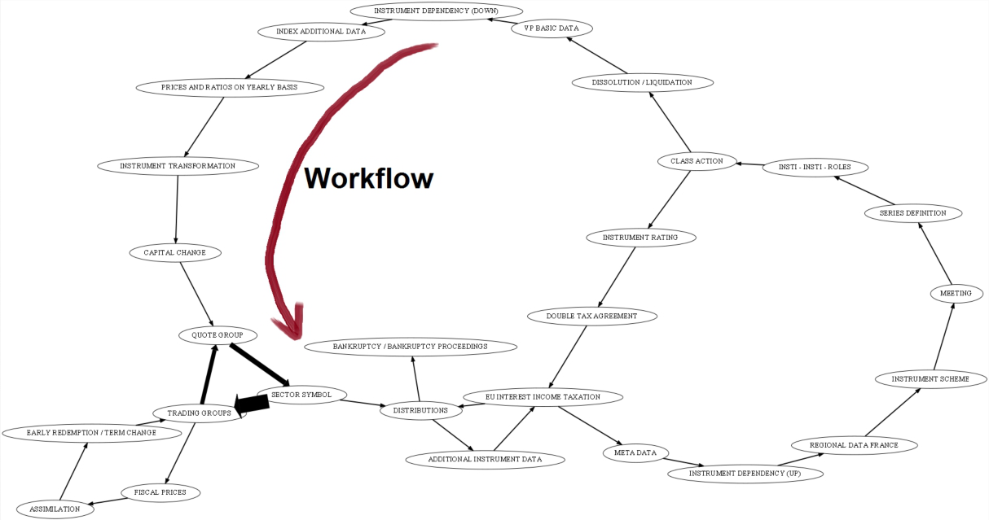
Solution

