Slide 1

Developing Backends with Actix Web

Slide 2
HttpServer App
URI-Path -> Handler Function
"/" -> fn()
"/hello" -> fn()

Slide 3
Route Registration
URI-Path -> Handler Function
"/" -> fn()

Slide 4
async fn main() -> Result<(), Error> {
HttpServer::new(|| {
App::new() // Registration of routes is here!
})
.bind(("0.0.0.0", 8080)).unwrap()
.run().await
}

Slide 5
Route Registration
URI-Path -> Handler Function
"/" -> fn()

Slide 6
Handler Function
Requirements:
-> Has to be an async Function or a closure that returns a Future
-> Args Datatypes must implement FromRequest trait
-> Return type implements the Responder trait (or can be turned into a valid HttpResponse)

Slide 7
Handler Function
impl FromRequest
async fn hello() -> impl Responder {
"Hello Rustaceans!"
}

Slide 8
Register routes
provides useful tools for registering routes and for extracting data from request
web::to(handler_fn) // any method is allowed
web::get().to(handler_fn) // only get method is allowed
… or use a procedural macro

Slide 9
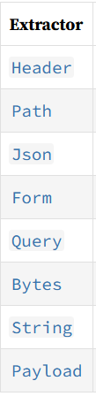
Extract data from request
Extract data from the client‘s HttpRequest by using structs provided by the web module
fn get_params(info: web::Query<Info>) -> impl Responder

Slide 10
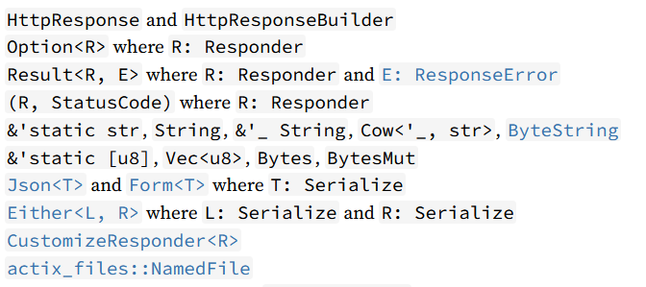
Types and structs that implement Responder by default

Slide 11
Defining a scope
Registered routes in a scope will share a common path prefix
e.g.
service(
web::scope("/scope")
route("/sub1", web::to(|| async {"sub1"}))
route("/sub2", web::to(|| async {"sub2"}))
)

Slide 12
Customize a HttpResponse
The Responder trait provides a method for customizing responses:
customize()
The HttpResponse struct provides a method to build a customized response:
build()

Slide 13
Serve a static file
To serve static files you can use the actix-files crate
You can use the extraction pattern provided for requests:
"/{filename}"
Extraction example:
fn extract(req: HttpRequest) -> impl Responder {
req.match_info().query("filename").to_string()
}

Slide 14
Serve a static file
Example:
#[get("/{filename:.*}")]
pub async fn serve_static_file(req: HttpRequest) -> Result<NamedFile> {
let static_path = format!("./static/{}", req.match_info().query("filename"));
let file: PathBuf = static_path.parse().unwrap();
Ok(NamedFile::open(file)?)
}

Slide 15
Add middleware
The middleware module provides useful tools for pre-processing requests and post-processing responses.
Middleware can be added by calling the wrap-method on an App
wrap()

Slide 16
Add middleware
Example:
App::new()
.wrap(
middleware::DefaultHeaders::new().add(("x-version", "1.0"))
)
.wrap(middleware::NormalizePath::trim())

Slide 17
Other Frameworks / Libraries
Warp
Rocket
Thruster
Hyper (more low level)

Slide 18
github.com/floscodes/actix_talk

