Slide 1

Developing Backends with Actix Web

Slide 2
… in your Cargo.toml
[dependencies]
actix-web = "4"
serde = "1.0.193"

Slide 3
HttpServer App
URI-Path -> Handler Function
"/" -> fn()
"/hello" -> fn()

Slide 4
Route Registration
URI-Path -> Handler Function
"/" -> fn()

Slide 5
async fn main() -> Result<(), Error> {
HttpServer::new(|| {
App::new() // Registration of routes is here!
})
.bind(("0.0.0.0", 8080)).unwrap()
.run().await
}

Slide 6
Route Registration
URI-Path -> Handler Function
"/" -> fn()

Slide 7
Handler Function
Requirements:
-> Has to be an async Function or a closure that returns a Future
-> Args Datatypes must implement FromRequest trait
-> Return type can be resolved into a HttpResponse (e.g. it implements the Responder trait)

Slide 8
Handler Function
impl FromRequest
async fn hello() -> impl Responder {
"Hello Rustaceans!"
}

Slide 9
Defining a scope
Registered routes in a scope will share a common path prefix
e.g.
service(
web::scope("/scope")
route("/sub1", web::to(|| async {"sub1"}))
route("/sub2", web::to(|| async {"sub2"}))
)

Slide 10
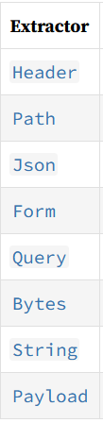
Types that implement FromRequest
Extract data from the client‘s HttpRequest

Slide 11
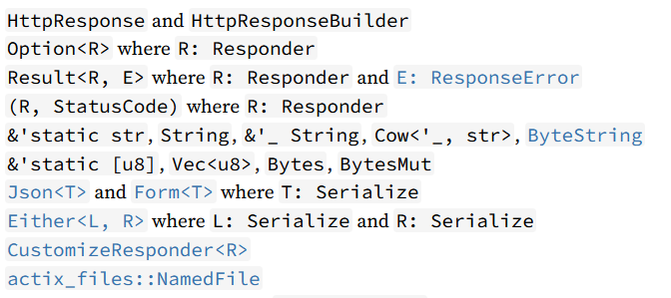
Types that implement Responder by default

Slide 12
Customize a HttpResponse
The Responder trait provides a method for customizing responses:
customize()
The HttpResponse type provides a method to build a customized response:
build()

Slide 13
Other Frameworks / Libraries
Warp
Rocket
Thruster
Hyper (more low level)

