Slide 1
Account Bug
Originally prepared by
Zoya Shaham Maya Maimon
Presented by
Dan Goldwaser

Slide 2
Program Overview
The Account program manages accounts.
The programs consists of three classes:
  Main – handles I/O and initialization
  Account – an account
  ManageAccout – account manager, an active class. Each account is managed by a different thread.

Slide 3
Class Account
Attributes
  The Account’s name
  The amount of money in the account
Methods
  Deposit – Adds a sum of money to an account.
  Withdraw – Subtracts a sum of money from an account.
  Transfer – Subtracts a sum of money from one account and adds the same amount of money to another account
synchronized

Slide 4
Class ManageAccount
Attributes
  Account – the account it manages
  Accounts [ ] – a static array of accounts, each manager initializes it’s account in the proper array index.
Methods
  Run - perform operations on the account: Adding 300.
  subtracting 100 .
  transfer 99 to another account.

Slide 5
Bug Overview
Account operations are synchronized functions
However , if there is a transfer between account A to account B, the lock for account B will never be required by account A, and the amount in account B may have several possible results.

Slide 6
Bug Execution Example
public void run(){
account.depsite(300);
account.withdraw(100);
Account acc=accounts[(i+1)%num] account.transfer(acc,99);
}
Accounts
Account A
Account B
300
0
101
200
101
300
200
0
99
synchronized void transfer(Account ac,double mn){
amount-=mn;
ac.amount+=mn;//no acquire for the other lock!!
}

Slide 7
Bug Pattern
The bug conforms to the Weak Reality bug pattern (“no lock “) , even though the accounts operations are all synchronized the transfer method operates on two accounts but locks only one…
Solution – call the other account deposit() instead of direct access.

Slide 8
Using tools to find bugs
Static tools
  Look at program without requiring execution
  Covers all program paths
  Hard to be accurate, considers infeasible paths
Dynamic tools
  look for errors that occur in a particular run
  don’t look for errors in untested paths

Slide 9
FindBugs Overview
A static bug finding tool developed at the university of Maryland.
The tool tries to identify bugs according to bug patterns, in this case: Inconsistent Synchronization
The bug detector seeks out such bugs by analyzing accesses to fields, in order to determine which accesses are made while the object self-lock is held.
“fields which are sometimes accessed with a lock
held and sometimes without are good candidates”
[Finding Bugs Is Easy David Hovemeyer and William Pugh]

Slide 10
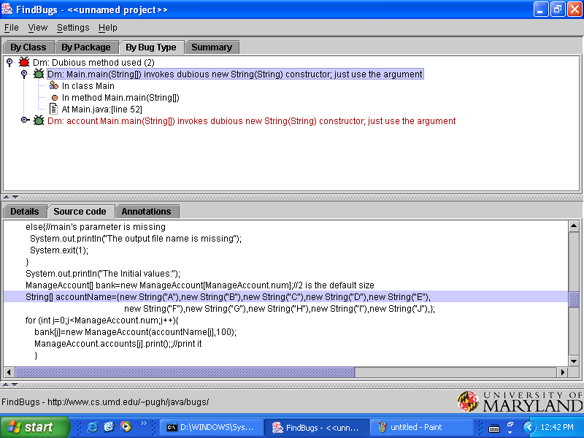
FindBugs Results
“fields which are sometimes accessed with a lock held and sometimes without are good candidates”
SO?
All the fields in the account program don’t have private access –the FindBugs detector ignores such fields to reduce the number of “false positives” .
Programming Style bug detected, however concurrent bug left undetected…

Slide 11
RaceFinder Overview
Increase the probability of concurrent bugs by generating biased interleaving that produce race conditions.
Scheduling heuristics:
  Yield – choose randomly if to execute the yield() primitive.
  Barrier – a counting semaphore that causes threads to wait just before the shared variable is accessed, causing the threads to access the variable simultaneously
Noise can be applied to a single variable a subset or all (white noise)

Slide 12
RaceFinder Results
RaceFinder test suites are divided according to noise level ,heuristic type and heuristic probability.
The following test suites were checked:
  Reference – normal run (without noise)
  ({Single variable,Subset,White noise},{Barrier,Yield},{Low,Medium,High})
The normal run had no bugs, However..

Slide 13
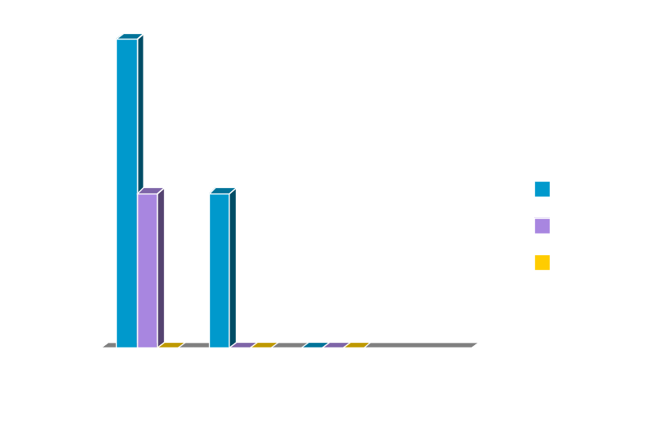
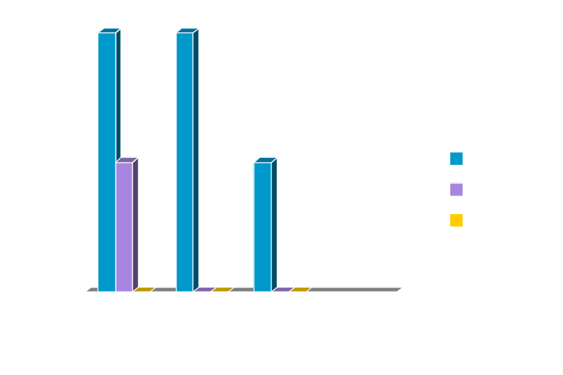
RaceFinder Results
Yield
Barrier

Slide 14
Summary
Though the “account bug” conforms to a relatively simple bug pattern it’s not detected easily – the findBugs tool didn’t detect it, and during the various tests done by raceFinder the bug only occurred 10 times (over 160 test done)

