Slide 1
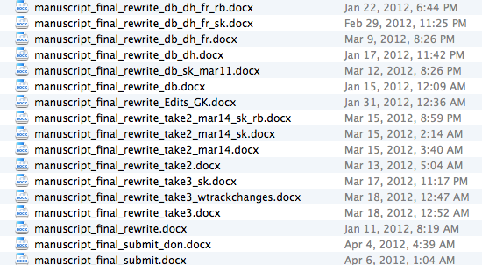
What is version control? What are version VCS (Version Control Systems)?
->software to automatically manage, save and restore changes to a set of files
What do VCS help with? (and how difficult it is)
Tracking and logging modifications (simple)
Backup of a complete project history (still simple)
Collaboration of 2-∞ people on the same project (complicated)

Slide 2
Important terms
Repository: a set of files that the VCS knows about (may be in different folders), i.e. paper manuscript and graphics files
Changeset: a set of modifications or ‘diffs’ to the repository (changes to files, adding/deleting files/folders), i.e. adding a paragraph to the manuscript and replacing a graphics files
Snapshot: one state of the repository, i.e. my paper on March 12, 2012, 8:26 PM)
Commit: An instruction to the VCS that the repository has changed, as detailed by a changeset or snapshot
(Changeset/Snapshot/Commit are used somewhat synonymous)
Working directory: top-level directory of the repository, abbreviated as workdir

Slide 3
How do VCS work? - 1. Tracking and logging modifications
When ‘initializing’ a repository, the VCS creates a folder (the VCS database, often hidden) in the workdir and copies all initial files to it
User makes changes and tells VCS about them (‘committing’)
VCS copies* changed files from workdir to database (either as ‘diffs’/changeset or as complete files/snapshot ) and assigns a unique identifier/version number to them
And so on..
*a lot of optimization/compression is done to save disk space

Slide 4
How do VCS work? - 1. Tracking and logging modifications
The VCS can now restore the repository to any of the commited versions (by copying the database entry belonging to the version number to the workdir)
The VCS can also report differences between any two arbitrary version numbers (by running a ‘diff’ between the two corresponding database entries)
That’s everything for use case 1 (Tracking and logging modifications)…. Pretty simple

Slide 5
How do VCS work? - 2. Backup of a complete project history
Backup: usually means copying files to a different hard drive or server
Backup using VCS: the complete workdir (current files + VCS database) is copied to a server
Slight complication: commits to workdir and backup to server are not necessarily synced
-> Every time a backup is made:
The VCS determines which version numbers exist in the workdir but not on the server
Only the database entries belonging to these are copied to the server
That’s everything for use case 2 (Backing up)…. Pretty simple
Note that often the server copy is called the ‘master’

Slide 6
How do VCS work? - 3. Collaboration of 2-∞ people on the same project
(and things get complicated…)
Definition of collaboration in this context:
-> several users simultaneously modify the repository (changing/adding/ deleting files)
This necessitates two things:
Users can work on an isolated version of the repository without interfering with others (or changing the master repository)
When the time has come, users can easily combine the different changes they made into the master repository
To allow for this, VCS support operations called ‘branching’ (1) and ‘merging’ (2)

Slide 7
How do VCS work? - 3. Collaboration of 2-∞ people on the same project
(and things get complicated…)
The basic problem: no more linear project history
Let’s assume: 2 developers (Alice and Bob) work on a project backed up on the same server
Both A+B make commits to the project on their local machine
(but eventually all changesets should be combined in the same workdir)
The commit history is ‘diverged’ or ‘branched’

Slide 8
How do VCS work? - 3. Collaboration of 2-∞ people on the same project
A ‘branch’ is essentially a complete copy of the whole repository (when creating a branch, a repository copy is created in the VCS database*)
An arbitrary number of branches can exist (and also backed up to the server), e.g. Alice’s and Bob’s changes
The VCS can set the files in the workdir to any of the branch commits (e.g. Bob can see Alice’s work without changing his own)
Internally, VCS essentially deals with branching the same as with other commits: a snapshot of the repository is saved in the database …but there are 2 complications
*a lot of optimization/compression is done to save disk space

Slide 9
How do VCS work? - 3. Collaboration of 2-∞ people on the same project
In a branched repository, there is no more linear commit repository
-> Problem 1: Commits can’t be saved in the VCS database under ‘V1’, ‘V2’, ‘V3’, etc..
-> Problem 2: it’s still necessary to know how commits are related (for reasons explained later)
Modern VCS like Git solve these two problems by:
Assigning a unique identifier based on commit content to each commit (instead of a number) ->Git uses SHA1-hashes (40 digit hexadecimal numbers, i.e. b0c2115fcf96d6df28872d2a42f9e7726790e2df)
Every commit contains a pointer to its parent commit

Slide 10
Merging 1

Slide 11
Merging 2

Slide 12
Merging 3

Slide 13
Recommended workflow 1

