Slide 1
Rasperry Pi Doorbell
Assel Massaurova Florian Schwarzmayr Ziyan Wang

Slide 2
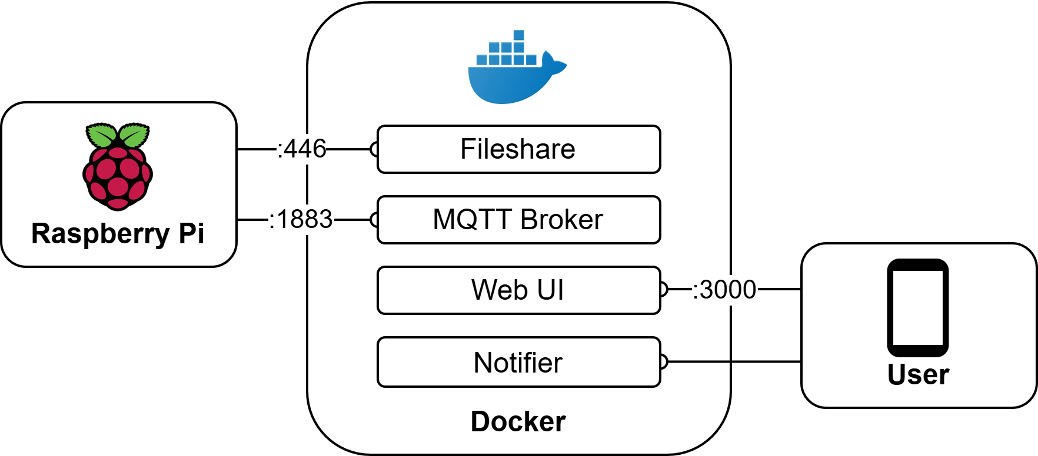
Overview
System Overview
raspberry takes an Image and publishes a message
notifier subscribes to the topic and forwards the event

Slide 3
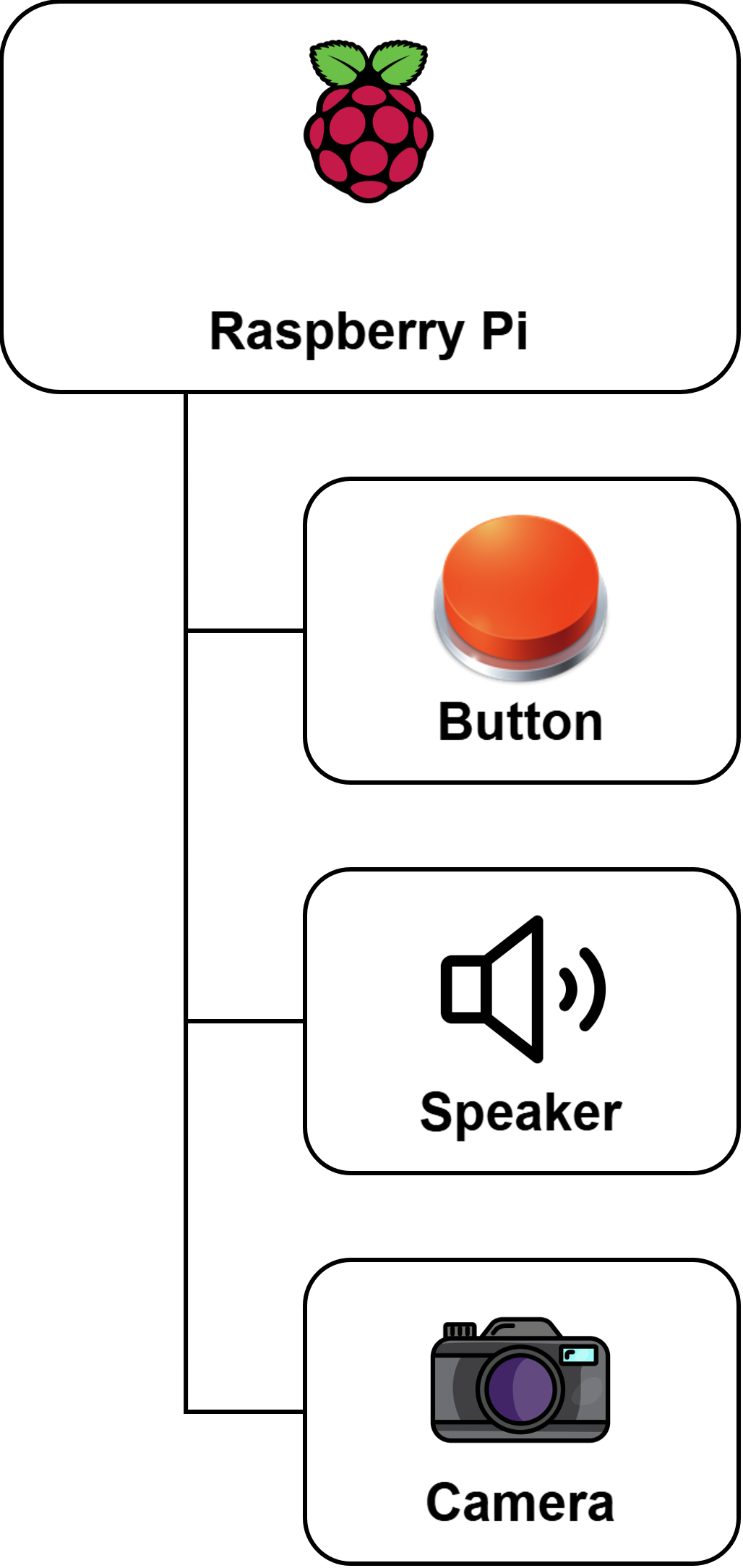
Raspberry Pi
When the button is pressed an image is taken
A sound is played via the speaker
FaceRecognition is used to check if there is a face in the frame
The image is stored to the fileshare
A message is published via MQTT including the filename
RPi Components

Slide 4
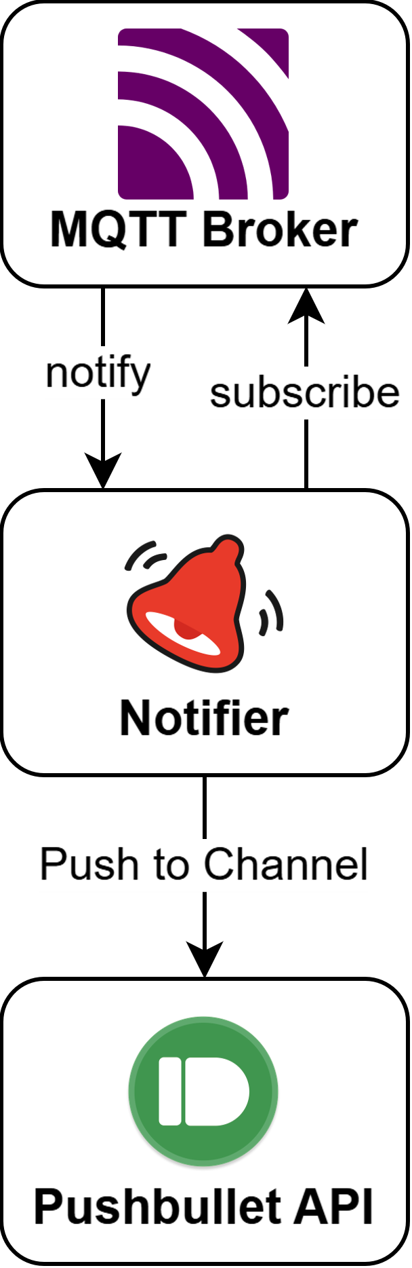
Notifier
The Notifier subscribes to an MQTT Topic
A message is received
The image contained in the message is uploaded to pushbullet
A message is created with the image as an attachment
The message gets pushed to the pushbullet channel
Notification Components

Slide 5
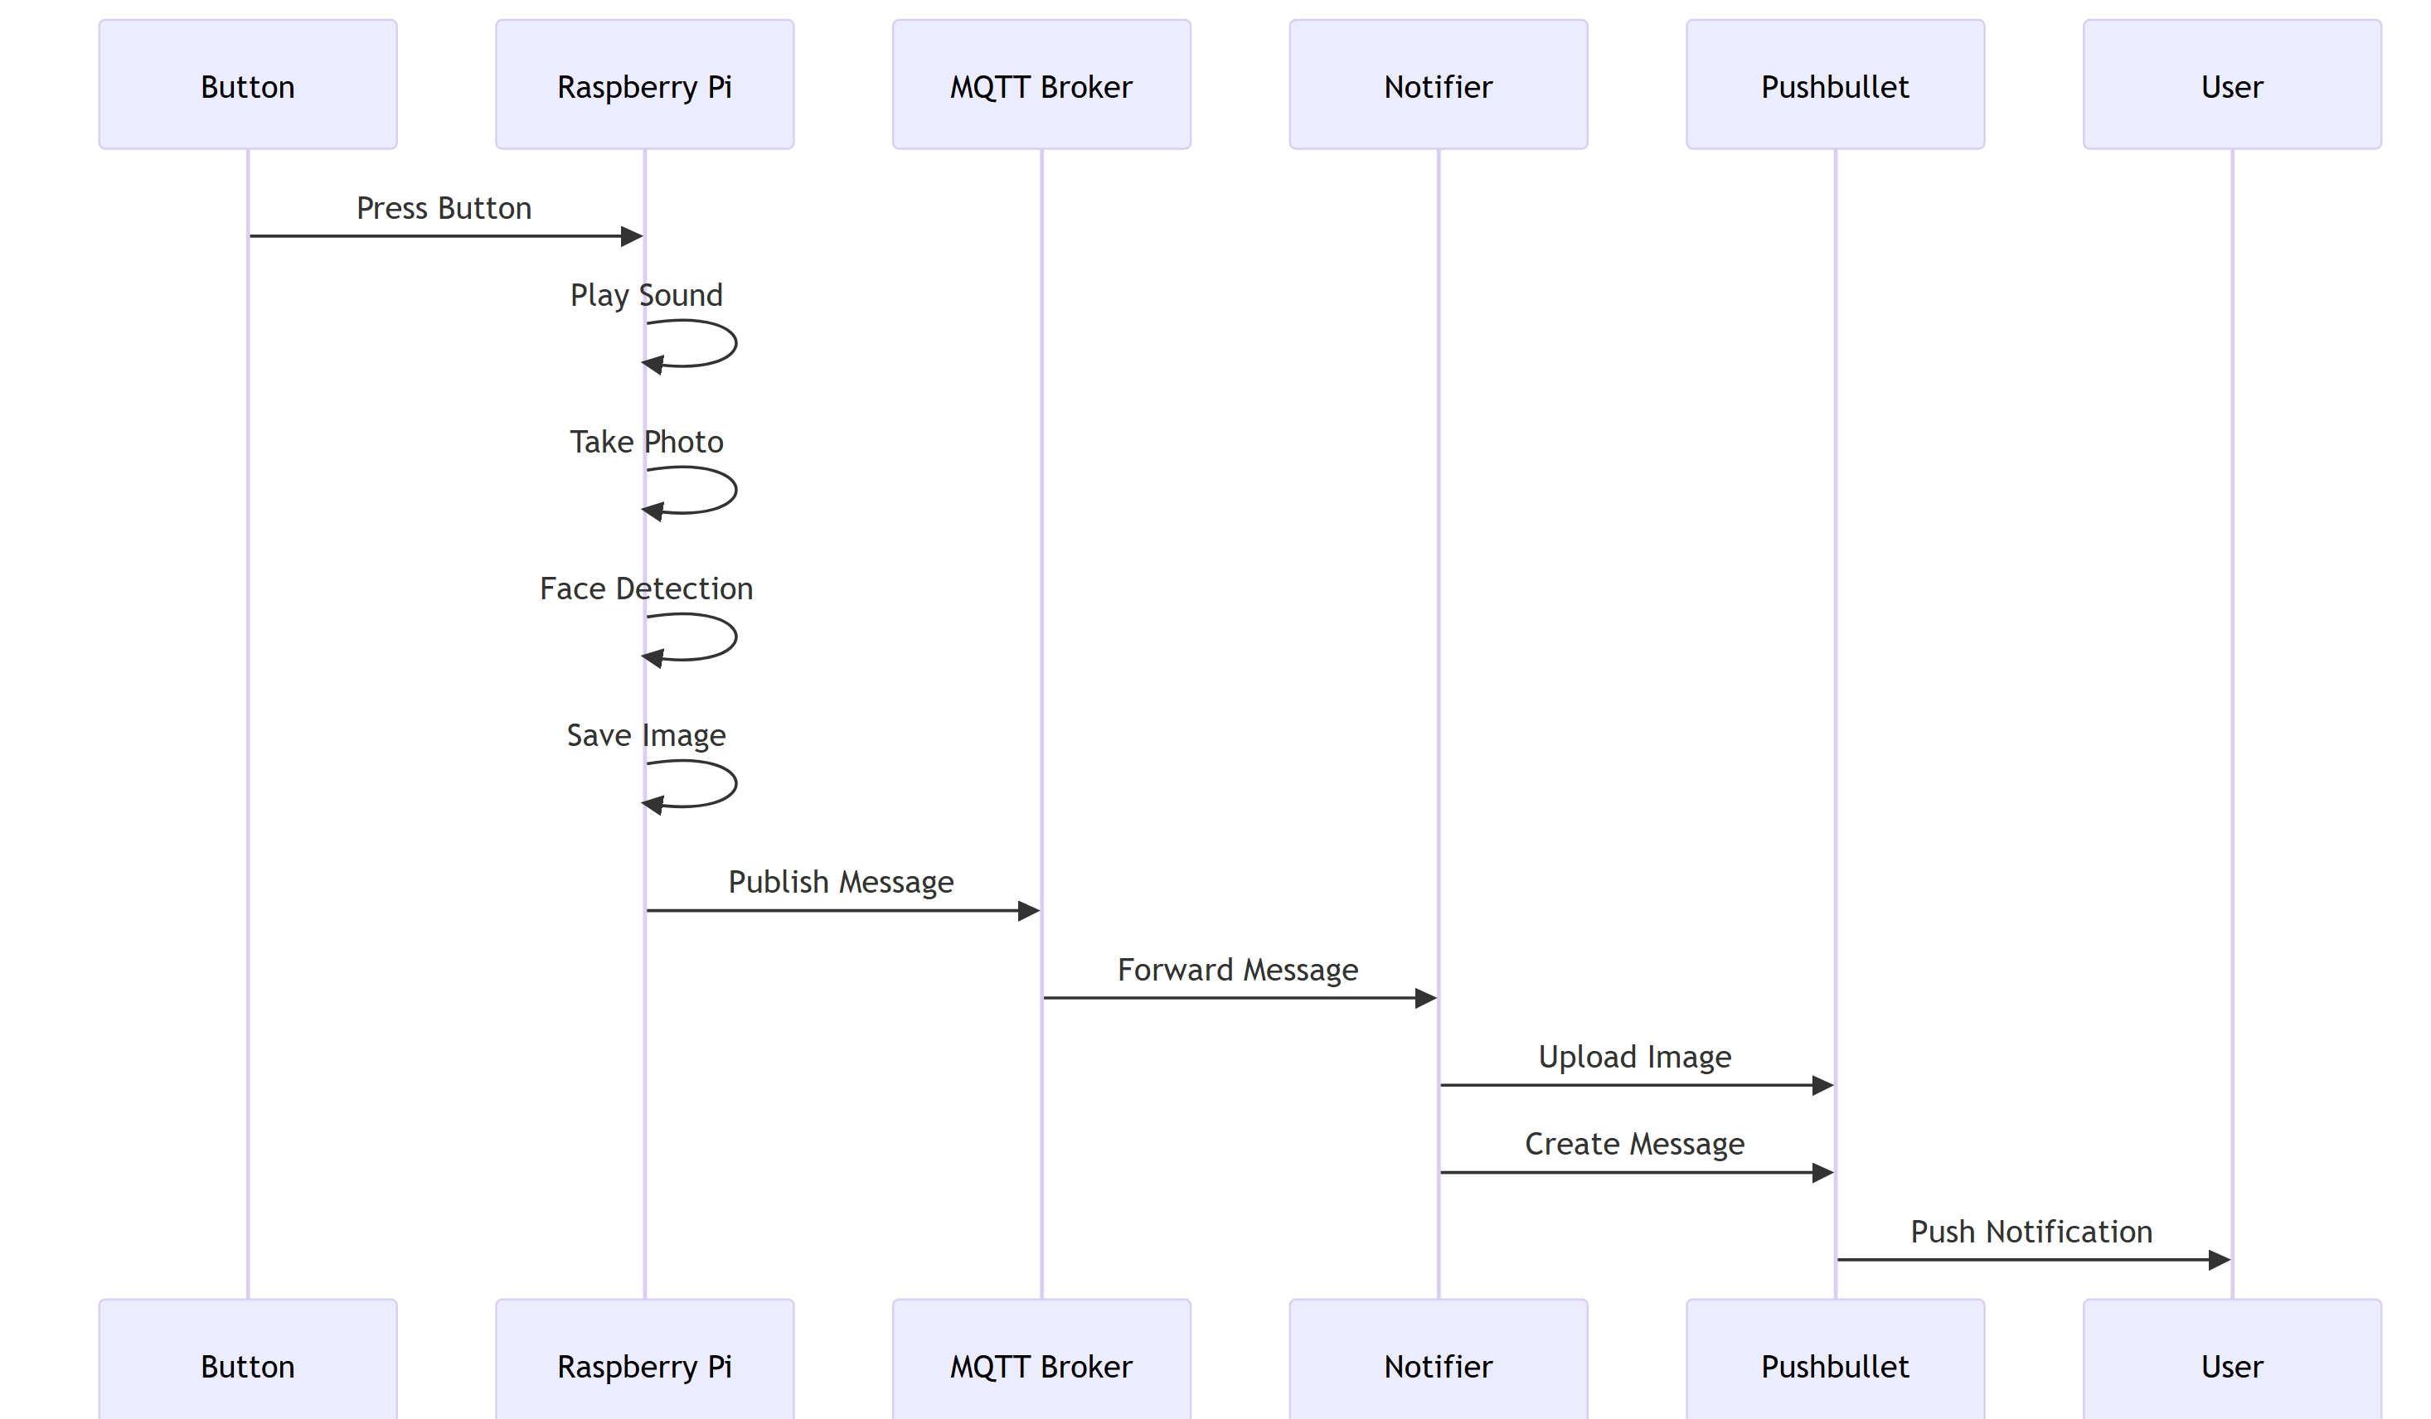
Application Flow

