Slide 1
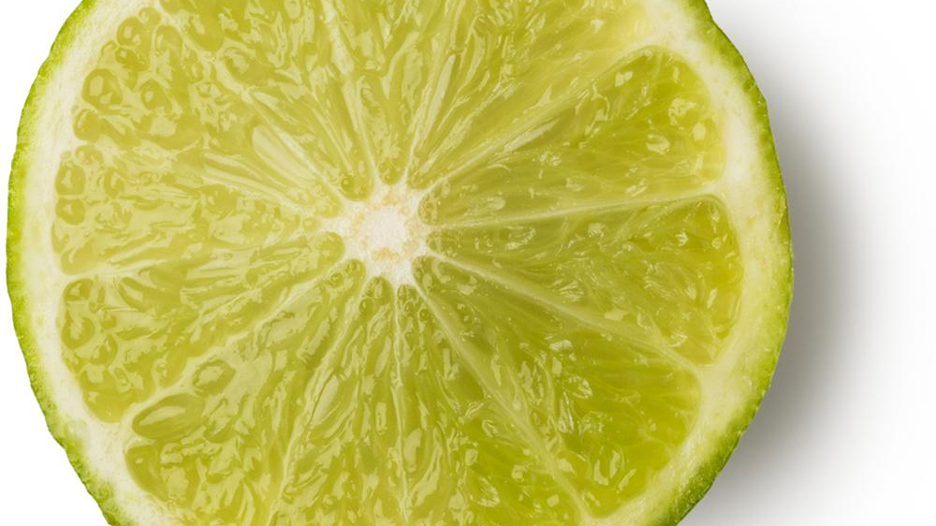
Do you trust your model?
An introduction to LIME
Fatima Loumaini
linkedin.com/in/fatima-loumaïni85

Slide 2
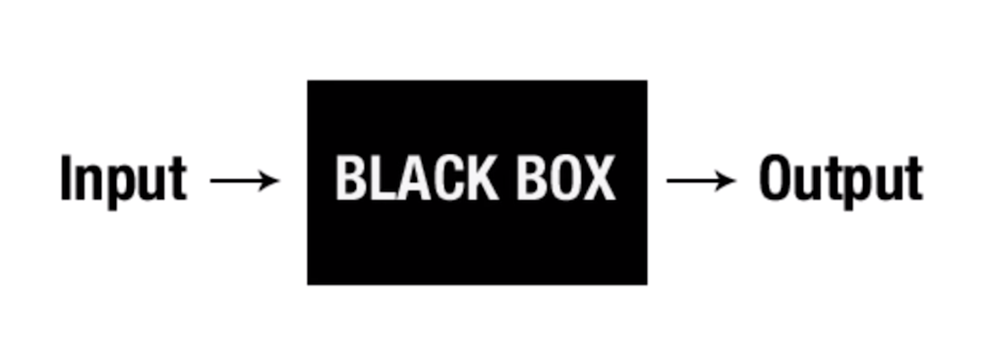
Why should I trust you?
Notes:
Sometimes you don’t know if you can trust a machine learning prediction, take a doctor, you give him or her the best model in the industry and you ask them to use it, they will probably not trust it to make predictions, they can ask for explanations. As data scientists, we can look into the accuracy but is it enough to really trust the algorithm? What about big data and having more dimensions and more relationships.
That’s when LIME can help
What if you can understand why any classifier is making a prediction even incredibly complicated models wouldn’t that be cool?

Slide 3
What is LIME?
In 2016, Marco Tulio Riberio, Sameer Singh, and Carlos Guestrin from UW released a paper, “Why Should I Trust You?: Explaining the Predictions of Any Classifier” that was discussed at KDD 2016 as well as within a blog post. Within the paper, Riberio, Singh, and Guestrin propose LIME as a means of “providing explanations for individual predictions as a solution to the ‘trust the prediction problem’, and selecting multiple such predictions (and explanations) as a solution to ‘trusting the model’ problem.” Riberio, Singh, and Guestrin also define LIME as “an algorithm that can explain the predictions of any classifier or regressor in a faithful way, by approximating it locally with an interpretable model”.
Notes:
Algorithms like LIME is a black box algorithms in a business setting that is stil able to explain the logic behind the predictions intuitively to a business user.

Slide 4
What is LIME?
Local: refers to how we get to these explanations. It approximates the black box locally and the neighborhood of the explanations being explained.
Interpretable: Explanations produced by Lime can be interpreted and understood by a human.
Model-Agnostic: Treats the model as a black box and it works for any model.
Explanations: Understand what the model does and which features it picks from to develop the predictions.

Slide 5
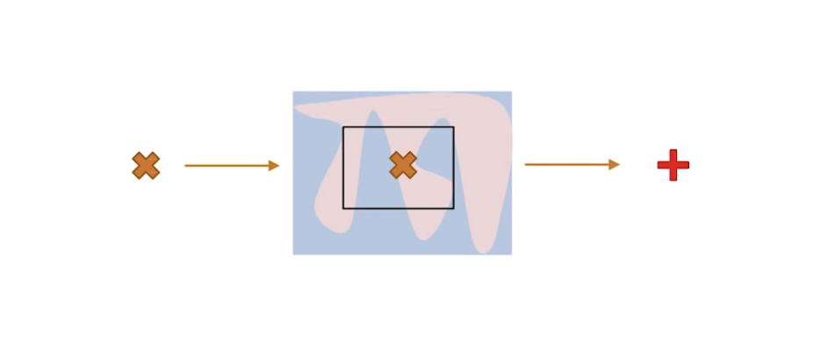
Being Local and Model Agnostic
Let’s pretend this is the landscape we have between predictors and outcomes variables and we don’t get much by having a global view.

Slide 6
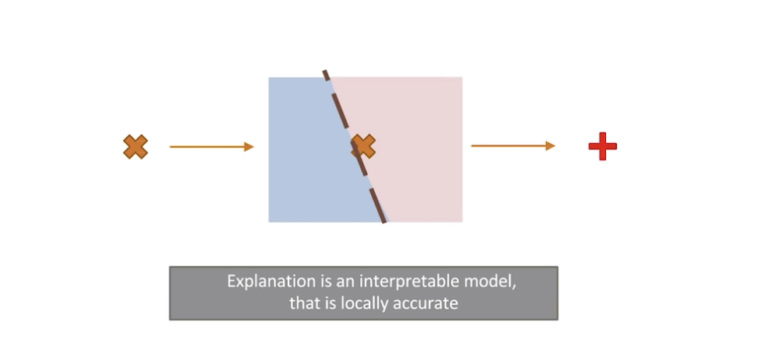
Being Local and Model Agnostic..
What LIME does, it ignores that and it goes very locally to a class of observation or an observation and gets to the point that it can use a linear regression to make a prediction and it will be very accurate at that level.

Slide 7
How Lime works
It makes use of the fact that linear models are easy to explain because they are based on linear relationships between features and class labels: The complex model function is approximated by locally fitting linear models to permutations of the original set.

Slide 8
How Lime works
On each permutation, a linear model is being fit and weights are given so that incorrect classification of instances that are more similar to the original data are penalized ( positive weights support a decision, negative weights contradict them). This will give an approximation of how much (and in which way) each feature contributed to a decision made by the model.

Slide 9
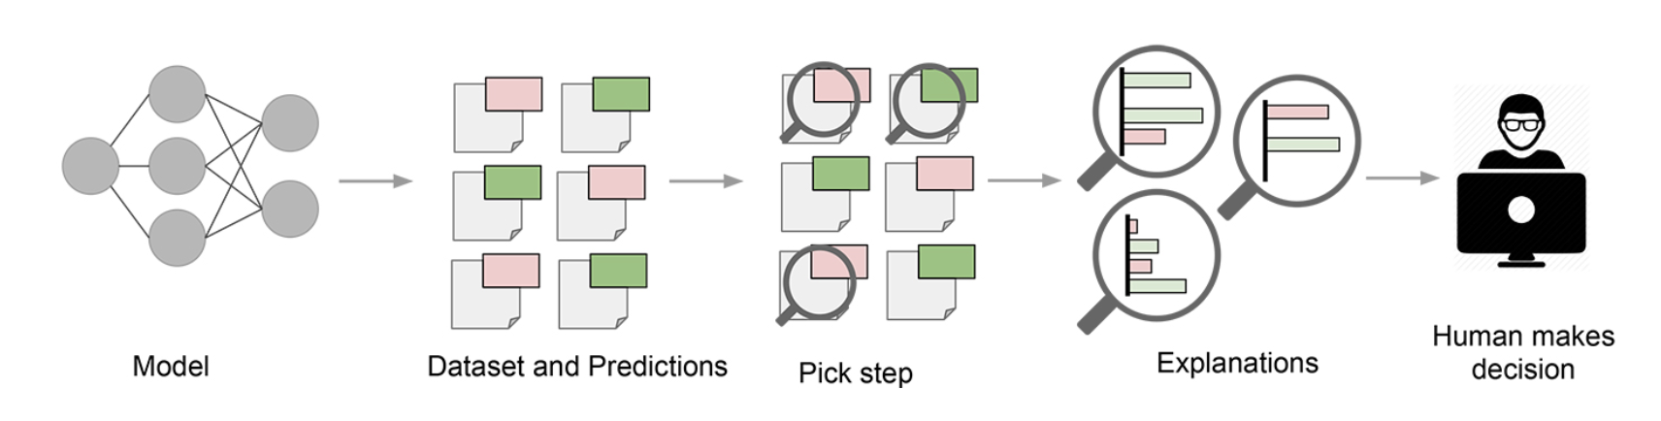
LIME in practice
Notes:
Since humans often have good intuition and business intelligence that is hard to capture in evaluation metrics. Assuming a “pick step” in which certain representative predictions are selected to be explained to the human would make the process similar to this one

Slide 10
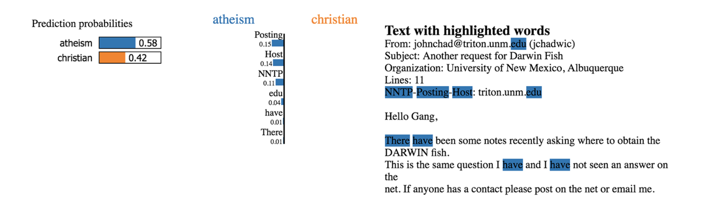
LIME Examples
Notes:
Using the famous 20 newsgroup data, the data contains 2 classes that are hard to distinguish because they share many words: Christianity and atheism. Author used a random forest with 500 trees and got 92.4% accuracy. Additional exploration shows us that the word "posting" (part of the email header) appears in 21.6% of the examples in the training set but only two times in the class “Christianity.” This is also the case in the test set, where the word appears in almost 20% of the examples but only twice in “Christianity.” This kind of artifact in the data set makes the problem much easier than it is in the real world, where we wouldn't expect such patterns to occur. These insights become easy once you understand what the models are actually doing, which in turn leads to models that generalize much better.

Slide 11
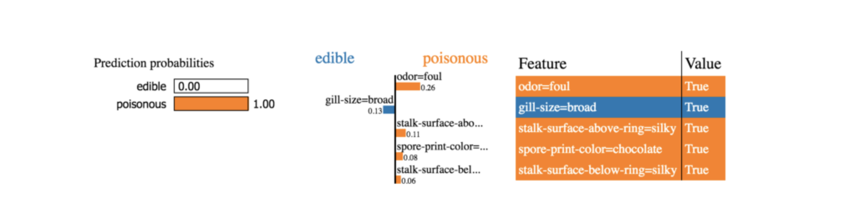
LIME Examples
Notes:
Model predicts if a mushroom is poisonous or not. We can see that odor= foul is indicative of a poisonous mushroom ( If odor was not foul, on average this predictions would be 0.26 less ‘poisonous’.

Slide 12
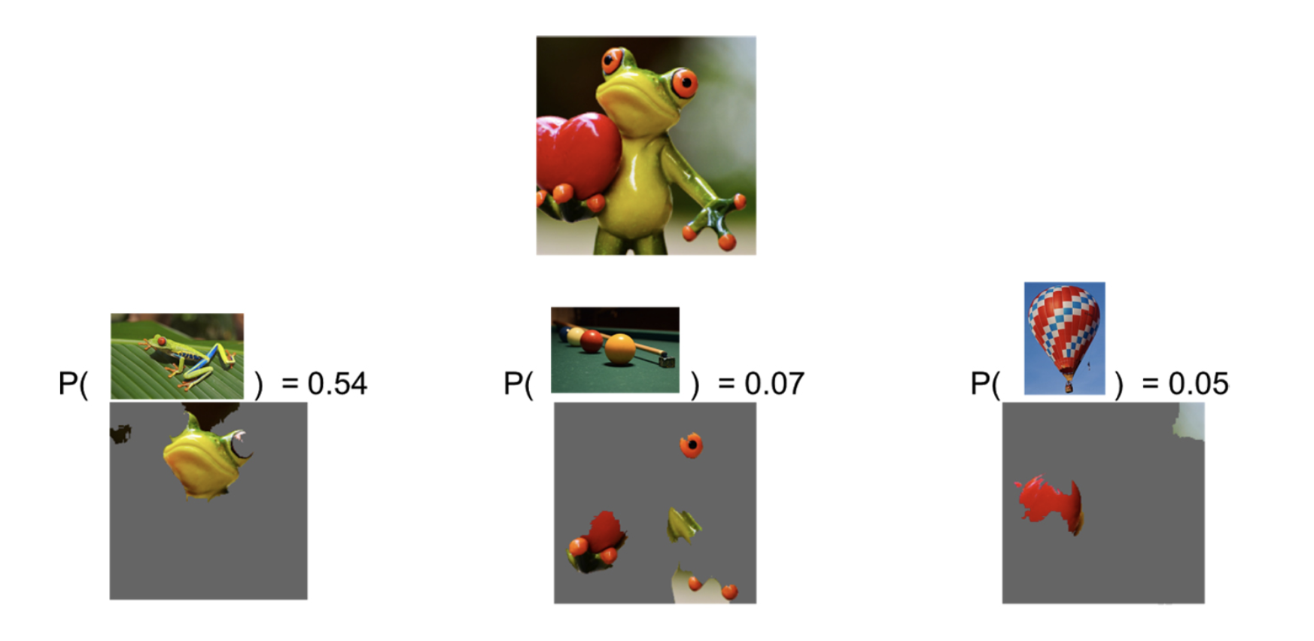
LIME Examples
Notes:
the classifier predicts “tree frog” as the most likely class, followed by "pool table" and "balloon" with lower probabilities. The explanation reveals that the classifier primarily focuses on the frog's face as an explanation for the predicted class. It also sheds light on why "pool table" has non-zero probability: the frog's hands and eyes bear a resemblance to billiard balls, especially on a green background. Similarly, the heart bears a resemblance to a red balloon.

Slide 13
Why we should use LIME?
Trust is crucial for effective human interaction with machine learning systems, and explaining individual predictions is an effective way of assessing trust. LIME is an efficient tool to facilitate such trust for machine learning practitioners and a good choice to add to their tool belts (available in Python and R).
On a legal side, in Europe for example companies that incorporate an automated decision making process are obliged to provide customers who ask a reason and explanation for refusing a loan, a job application etc.

