Slide 1
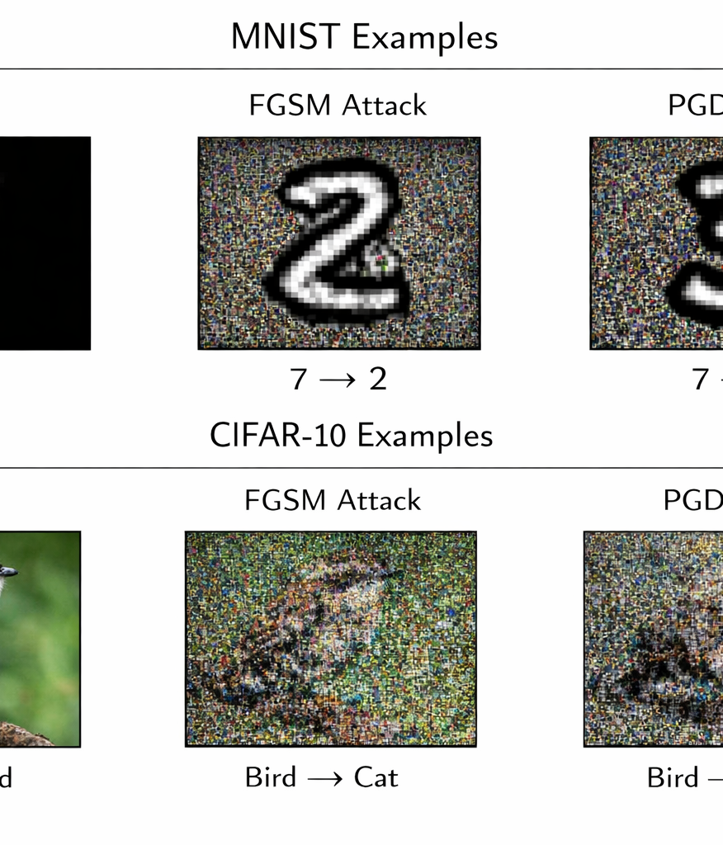
Evaluating and Improving
Adversarial Robustness
in Neural Networks
A reproducible handwritten-digit study with a transfer protocol for MNIST and CIFAR-10
Research + Applied Project for presentation before the graduate cohort
Core empirical result:
Clean baseline 96.67% -> 0.28% under PGD
Adversarial training restores 30.28% robust accuracy
Notes:
[Sources] - Generated hero illustration created with OpenAI image generation for this presentation. - Local performance figures come from the accompanying run_experiments.py execution on scikit-learn digits.

Slide 2
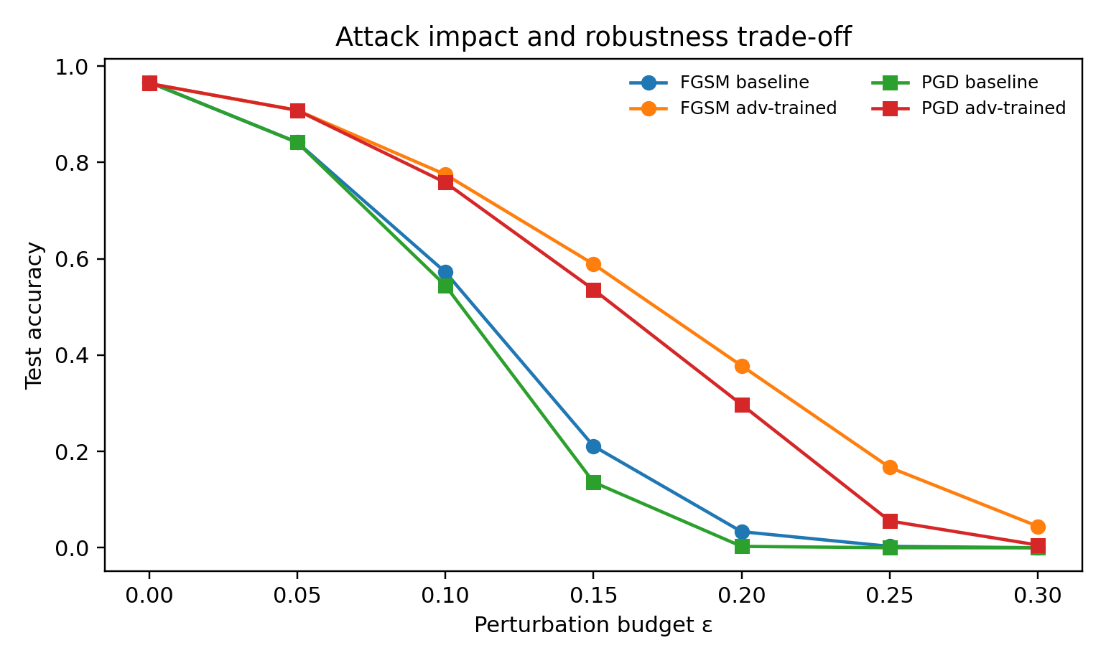
Why this problem matters
Accuracy is not enough when a model can be broken on demand
Adversarial examples are not random noise. They are gradient-aligned perturbations crafted to push an otherwise accurate classifier across a decision boundary.
That makes robustness a neural-networks question, not only a cybersecurity question: it is about loss geometry, feature fragility, and optimization under worst-case stress.
96.67%
0.28%
30.28%
clean baseline
baseline under PGD
PGD after defense
Robustness curve from the local experiment
Notes:
[Sources] - Goodfellow, Shlens, and Szegedy, "Explaining and Harnessing Adversarial Examples," arXiv:1412.6572. - Madry et al., "Towards Deep Learning Models Resistant to Adversarial Attacks," arXiv:1706.06083. - Plot on this slide is local experimental output generated from run_experiments.py.

Slide 3
Research design
A complete narrative: train the model, break it, explain the failure, then repair part of it
Benchmark
Baseline model
Adversarial stress test
Defense
Evaluation
Local reproduction on scikit-learn digits
Target extension: MNIST + CIFAR-10
MLP with ReLU, dropout, Adam
20 epochs, clean training
FGSM and PGD under an $\ell_infty$ threat model
FGSM-based adversarial training
after a short clean warm-up
Clean accuracy, robust accuracy,
visual examples, confusion shift
Why the dual-benchmark plan is strong: MNIST provides interpretability; CIFAR-10 exposes whether robustness survives in a harder, more realistic visual regime.
Honest reproducibility note: the execution environment allowed local reproduction on a handwritten-digit proxy, while the same pipeline is already specified for direct transfer to MNIST and CIFAR-10.
Notes:
[Sources] - scikit-learn digits dataset documentation: https://scikit-learn.org/stable/modules/generated/sklearn.datasets.load_digits.html - MNIST dataset summary: https://systemds.apache.org/datasets/mnist - CIFAR-10 official dataset page: https://www.cs.toronto.edu/~kriz/cifar.html

Slide 4

Threat model and attack equations
White-box, first-order adversary with bounded perturbation budget
FGSM
Operational reading
1. Compute how the loss changes with respect to the input.
2. Move the input in the direction that maximally increases loss.
3. Keep the perturbation small enough to remain visually subtle.
4. Measure whether the prediction boundary collapses.
One gradient step. Fast, interpretable, ideal for showing how a classifier can be fooled almost instantly.
PGD
In this project, PGD is the decisive test because it transforms a nearly perfect classifier into a near-random one.
Iterative and much stronger. In practice it reveals worst-case local boundary weakness more faithfully than FGSM.
Notes:
[Sources] - Goodfellow, Shlens, and Szegedy, "Explaining and Harnessing Adversarial Examples," arXiv:1412.6572. - Madry et al., "Towards Deep Learning Models Resistant to Adversarial Attacks," arXiv:1706.06083.

Slide 5
Model and defense mechanism
Simple architecture, strong enough to expose the robustness problem clearly
Baseline architecture
Defense: adversarial training
Input
64 pixels
Mini-batch loop
Clean batch -> generate FGSM variants -> concatenate clean and adversarial samples -> optimize the same classifier on both distributions
Dense + ReLU
128 units
Dropout
p = 0.20
Why this defense was chosen
It is the most convincing student-project defense because it changes the training objective itself, not just the evaluation stage.
Dense + ReLU
64 units
Output
10 classes
Trade-off
Slightly harder optimization, slightly lower clean accuracy, but far higher resistance under attack.
Notes:
[Sources] - Madry et al., "Towards Deep Learning Models Resistant to Adversarial Attacks," arXiv:1706.06083. - Model architecture and defense setup on this slide are local project design choices implemented in run_experiments.py.

Slide 6
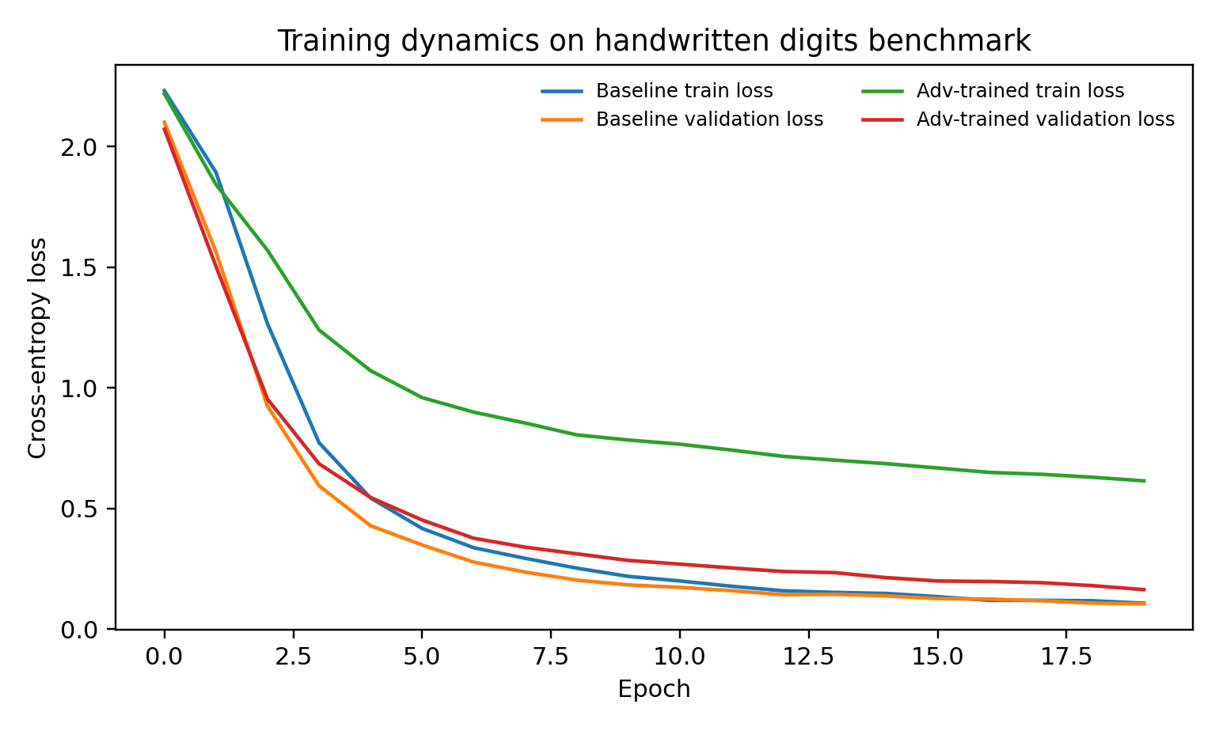
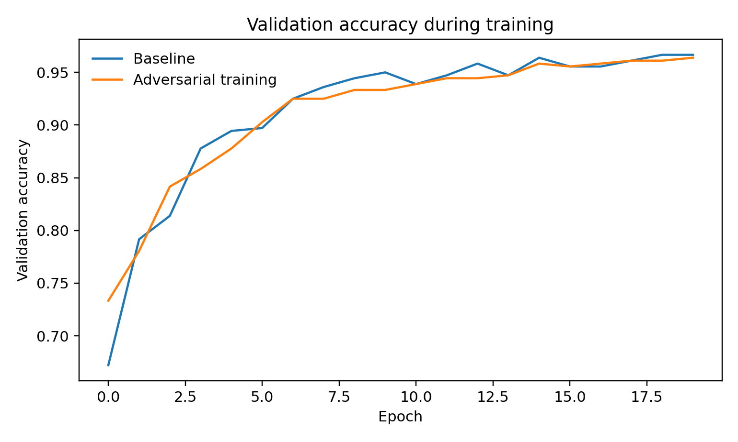
Training dynamics
Robust learning converges more slowly, but it stays stable and preserves clean performance
Loss curves
Validation accuracy
Interpretation: adversarial training raises the optimization burden, but it does not destroy clean-data learning. This is exactly the type of trade-off expected in robust optimization.
Notes:
[Sources] - Both charts are local experimental outputs generated from run_experiments.py using the scikit-learn digits benchmark. - Robust-optimization interpretation is grounded in Madry et al., arXiv:1706.06083.

Slide 7
Main result: the baseline collapses under attack
The defense does not make the model invincible; it makes the model materially harder to break
Headline metrics
Baseline clean: 96.67%
Baseline under FGSM: 21.11%
Baseline under PGD: 0.28%
After adversarial training
Clean: 96.39%
FGSM: 58.89%
PGD: 30.28%
Key sentence for the oral defense
"PGD is not just stronger than FGSM; it exposes the worst-case local vulnerability of the decision boundary."
Notes:
[Sources] - Plot and metrics are local experimental outputs generated from run_experiments.py. - PGD interpretation grounded in Madry et al., "Towards Deep Learning Models Resistant to Adversarial Attacks," arXiv:1706.06083.

Slide 8
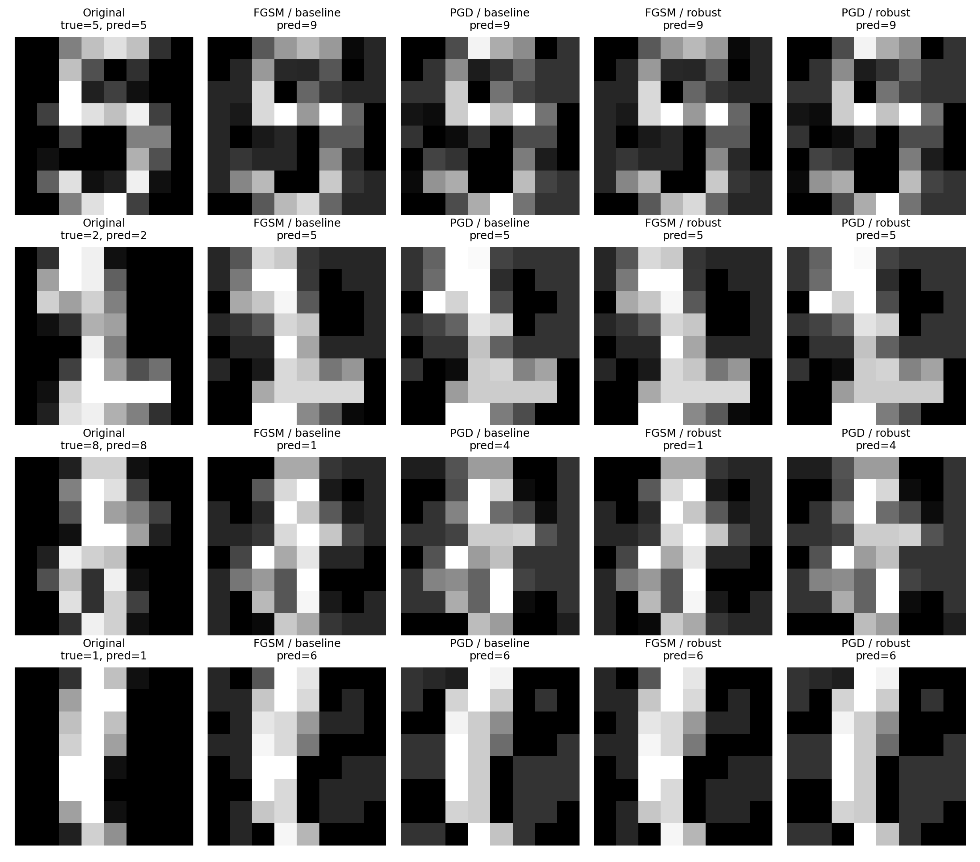
Qualitative adversarial evidence
The failure is visible: tiny perturbations can redirect the prediction
What makes this persuasive in a live presentation is that the audience can see the mechanism. The model is correct on the original sample, wrong after a carefully chosen perturbation, and often partially recovered after adversarial training.
Notes:
[Sources] - Figure is a local experimental output generated from run_experiments.py using the scikit-learn digits benchmark.

Slide 9
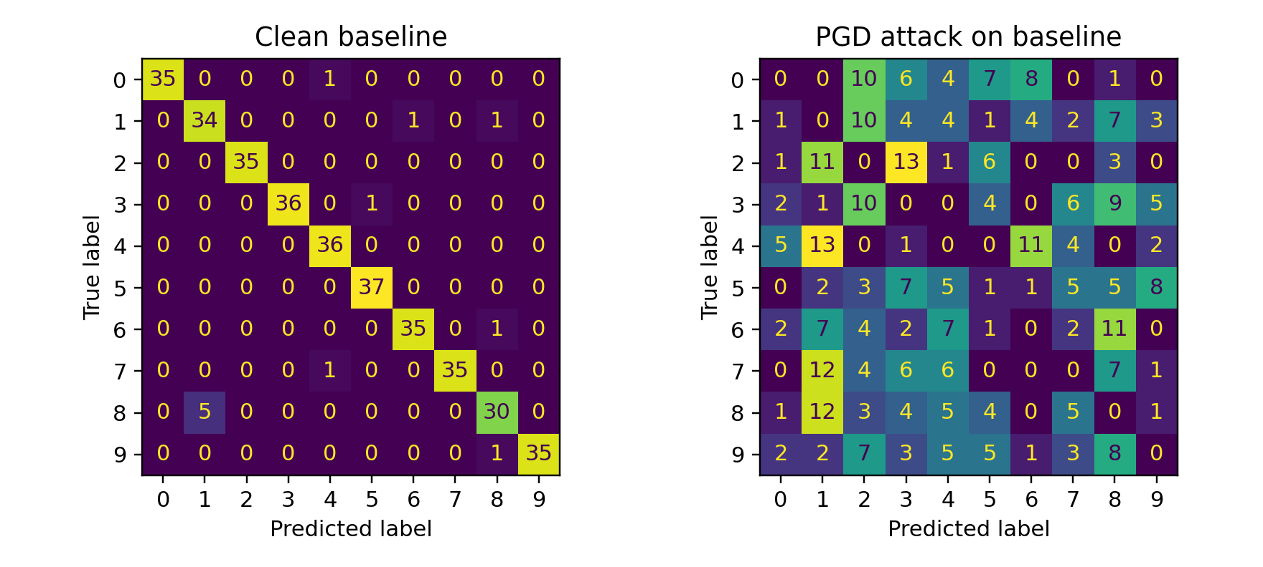
Failure analysis
Under PGD, the error pattern does not just grow; it diffuses across the label space
What the confusion shift tells us
• The clean classifier is strongly diagonal: representation and decision rule are aligned.
• Under PGD, diagonal dominance largely disappears.
• The attack therefore changes the geometry of class assignment, not just the confidence score.
• This is why robustness should be reported explicitly, not hidden inside a single clean-accuracy number.
Oral takeaway
The model did not fail randomly; it failed systematically.
Notes:
[Sources] - Confusion-matrix comparison is a local experimental output generated from run_experiments.py.

Slide 10
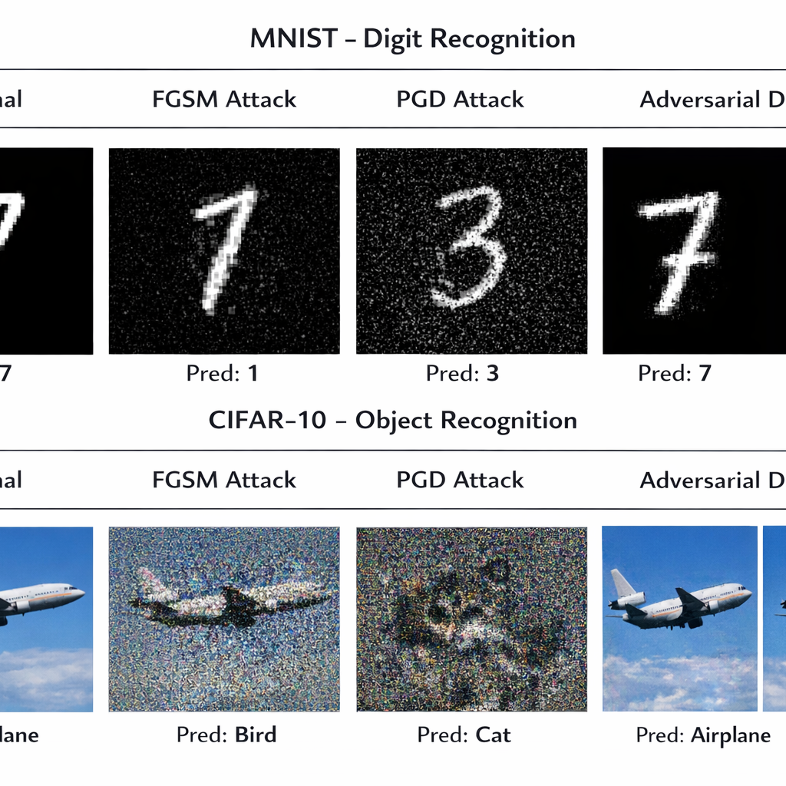
How this becomes a full MNIST + CIFAR-10 study
The current project already contains the transfer logic needed for a stronger benchmark paper
Direct next steps
1. Replace the local digit proxy with native MNIST tensors (28 x 28).
2. Move from the MLP to a CNN for MNIST and a deeper ResNet-style backbone for CIFAR-10.
3. Keep FGSM and PGD, then add TRADES as a stronger defense comparison.
4. Report clean accuracy and robust accuracy separately.
5. Use CIFAR-10 to test whether robustness generalizes to realistic color images.
Benchmark facts
MNIST: 60,000 train / 10,000 test
CIFAR-10: 50,000 train / 10,000 test, 10 classes, 32 x 32 color images
Notes:
[Sources] - Generated comparative illustration created with OpenAI image generation for this presentation. - MNIST dataset summary: https://systemds.apache.org/datasets/mnist - CIFAR-10 official dataset page: https://www.cs.toronto.edu/~kriz/cifar.html - TRADES paper: Zhang et al., "Theoretically Principled Trade-off between Robustness and Accuracy," arXiv:1901.08573.

Slide 11
Conclusion
What this project proves and how to defend it academically
1
A neural network can be highly accurate on clean inputs and still be severely non-robust.
2
PGD is the critical stress test because it better exposes worst-case boundary fragility than one-step attacks.
3
Adversarial training meaningfully improves robustness while preserving most clean accuracy, which makes robustness a design objective rather than an afterthought.
Best final sentence to say aloud
"My model did not simply classify digits; it demonstrated how reliability changes when accuracy is forced to survive under attack."
Notes:
[Sources] - Closing claims synthesize local experimental outputs and the cited adversarial-robustness literature: Goodfellow et al. (FGSM), Madry et al. (PGD/robust optimization), and Zhang et al. (TRADES / robustness-accuracy trade-off).

