Slide 1

Fernando Lovera
Databricks - Delta Live Tables
Inspiring technology

Slide 2

20/08/2022
Fernando Lovera
Who am I?
Fernando Lovera on behalf of Arinti. Consultancy in Unilever and working with Databricks
which helped to leverage this talk!

Slide 3
20/08/2022
Fernando Lovera
Agenda
Introduction to Delta Live Tables (DLT)
What is the problem with Data Engineering?
What is DLT?
Key Differentiators(Continuous or scheduled data ingestion, Declarative SQL & Python APIs, Change data capture (CDC), Data quality validation and monitoring, Data pipeline observability, Workflow Orchestration)
Code:
How to get started
A proof of concept
Conclusion

Slide 4
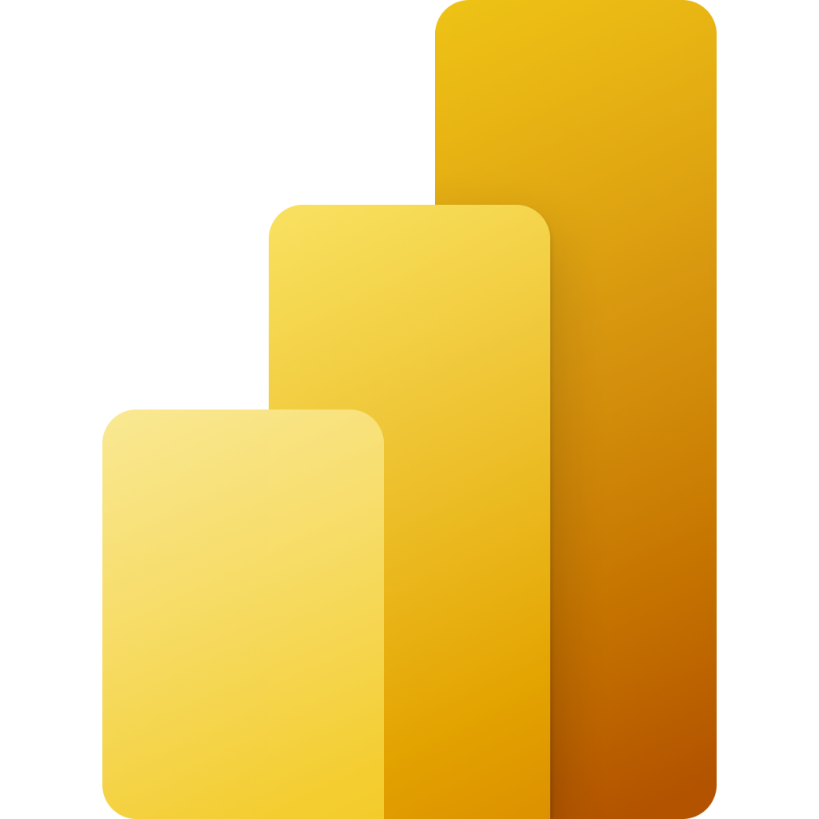
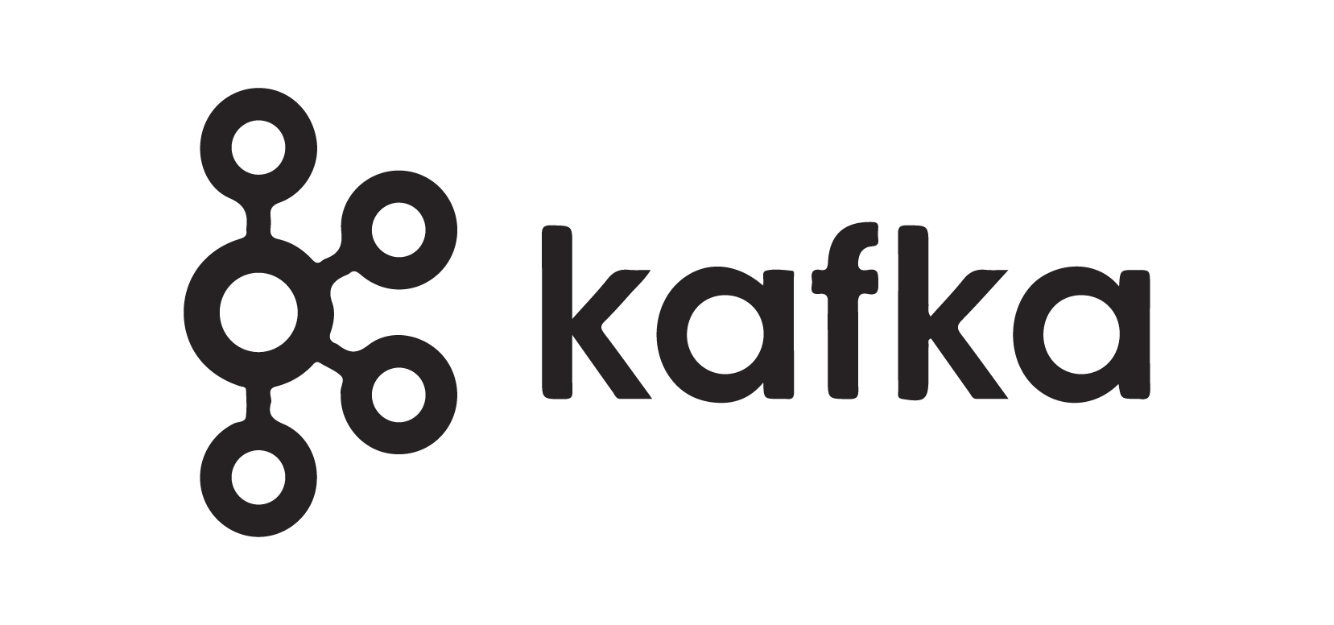



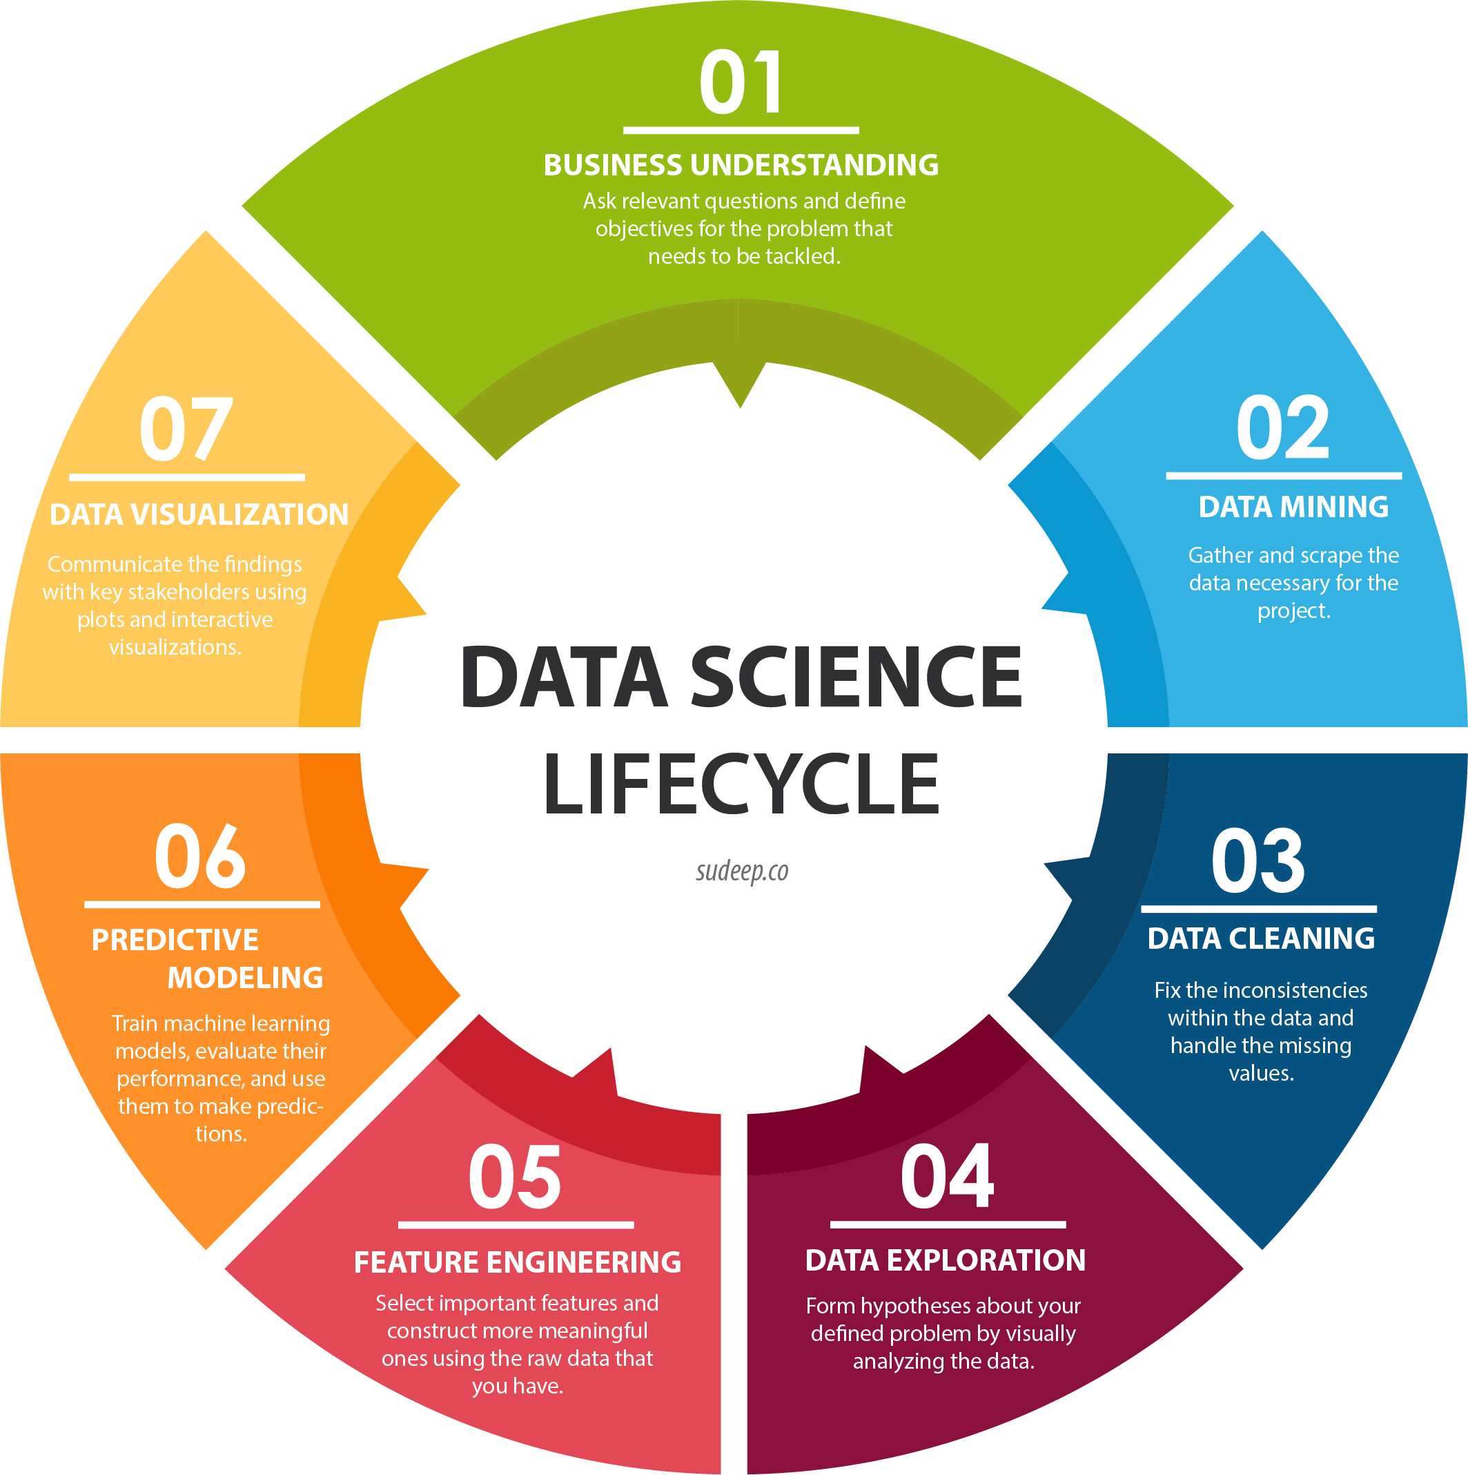

20/08/2022
Fernando Lovera
Introduction to Delta Live Tables (DLT)
What is the problem with Data Engineering?
Good data is the foundation of the Lakehouse
Streaming analytics
BRONZE
SILVER
GOLD
PLATINUM
Quality >
Data lake

Slide 5














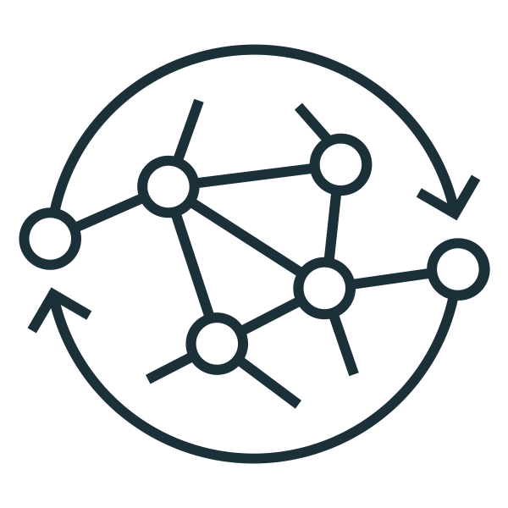
20/08/2022
Fernando Lovera
Introduction to Delta Live Tables (DLT)
What is the problem with Data Engineering?
The truth is that there is a lot of complexity going on
Home-
Grown ETL
Streaming Analytics
Data Sources
Streaming
Sources
Cloud Object Stores
SaaS Applications
NoSQL
Relational Databases
On-premises systems
TASK
FLOW
Azure Data Factory
TASK
FLOW
Unstructured
ETL
Home-
Grown ETL
ETL
Azure Synapse
Business Insights
Semi-structured
Analytics
Code Generated
AWS EMR
ETL
Structured
Cloud Data Lake
ETL
TASK
FLOW
ETL
Machine
Learning
AWS Glue
ETL
Data sharing

Slide 6
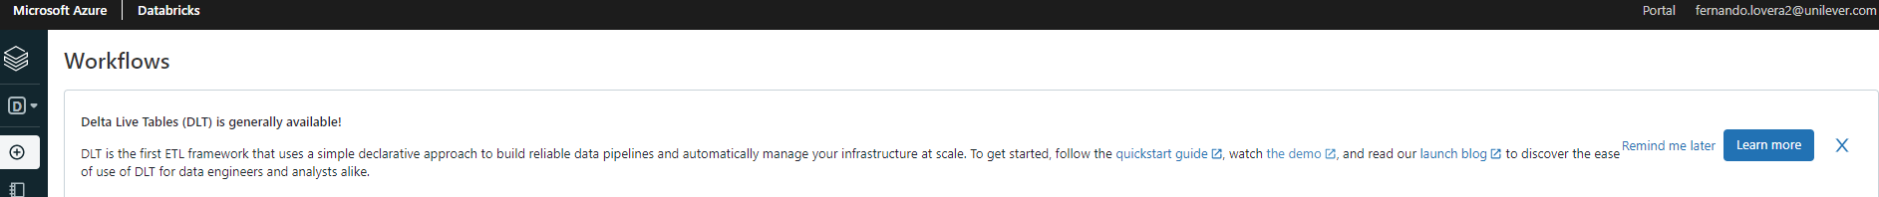
20/08/2022
Fernando Lovera
Introduction to Delta Live Tables (DLT)
What is DLT?
Delta Live Tables (DLT) is the first ETL framework that uses a simple declarative approach to build reliable data pipelines and automatically manages your infrastructure at scale so data engineers and data scientists can spend less time tooling and focus on getting value from data. Remember the 3 major concepts.
Accelerate ETL
dev
Automatically manage infra
+ Augment confidence in your data
Simplify batch & streaming

Slide 7





20/08/2022
Fernando Lovera
Introduction to Delta Live Tables (DLT)
What is DLT?
Lakehouse Platform
Data
Warehousing
Data Engineering
Data Streaming
Data Science
and ML
Unity Catalog Fine-grained governance for data and AI
DLTs live here!
Databricks Lakehouse Platform is the foundation for Data Engineering
Delta Lake
Data reliability and performance
Cloud Data Lake
All structured and unstructured data

Slide 8
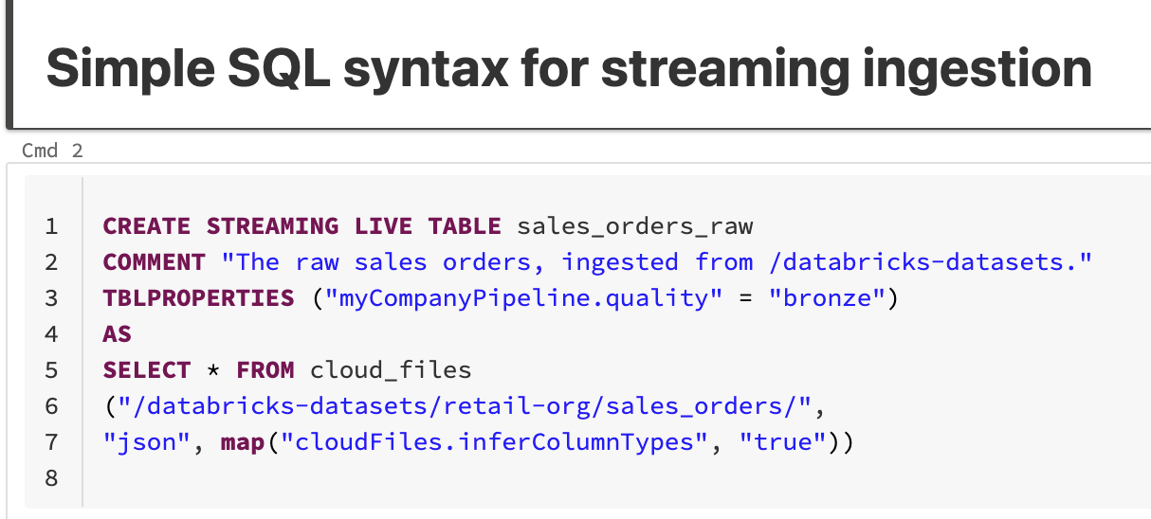
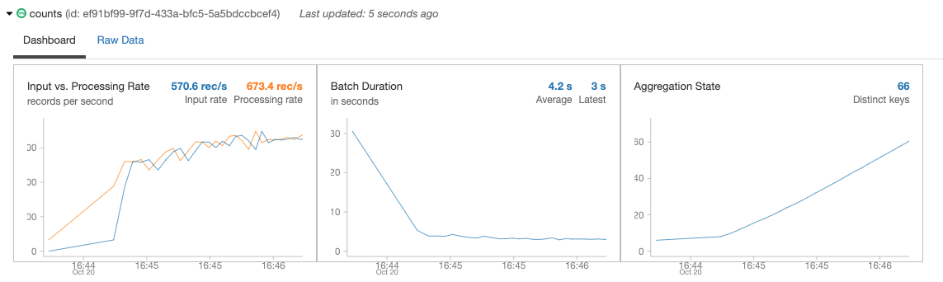
20/08/2022
Fernando Lovera
Introduction to Delta Live Tables (DLT)
Declarative SQL & Python APIs
Process new data files as they arrive in cloud storage using Auto Loader.
Automatically infer schema of incoming files or superimpose what you know with Schema Hints
Automatic schema evolution
Rescue data column - never lose data again

Slide 9
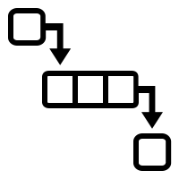






20/08/2022
Fernando Lovera
Introduction to Delta Live Tables (DLT)
Autoloader: Better
Incrementally listening mode – listing with performance of notification mode
Automatically infer schema
Automatically add columns
Try #1: list
Try #2: list
Try #1: listFrom(“”)
CDC001.csv
CDC001.csv
CDC001.csv
CDC001.csv
CDC001.csv
CDC001.csv
CDC001.csv
CDC001.csv
CDC001.csv
CDC001.csv
CDC001.csv
CDC001.csv
Automatically-Deployed Resources
Notification Mode
CDC001.csv
Message Queue
Cloud Storage
Structured Streaming cloudFiles
RocksDB
Before: entire directory backfilled again
After: only new files are read
Directory Listing Mode

Slide 10
20/08/2022
Fernando Lovera
Introduction to Delta Live Tables (DLT)
Declarative SQL & Python APIs
Declarative instead of imperative.
Automatically generate a flow of info based on table dependencies across the data pipeline.
Checks for errors, dependencies and syntax errors.
/* Create a temp view on the accounts table */
CREATE STREAMING LIVE VIEW raw AS
SELECT * FROM cloud_files(“/data”, “csv”);
Source
Bronze
/* Stage 1: Bronze Table drop invalid rows */
CREATE STREAMING LIVE TABLE bronze AS
COMMENT "Bronze table with valid account ids"
SELECT * FROM raw ...
Silver
/* Stage 2:Send rows to Silver, run validation rules */
CREATE STREAMING LIVE TABLE silver AS
COMMENT "Silver Accounts table with validation checks"
SELECT * FROM bronze ...
Gold

Slide 11

20/08/2022
Fernando Lovera
Introduction to Delta Live Tables (DLT)
Change data capture (CDC)
Stream change records (inserts, updates, deletes) from any data source supported by DBR, cloud storage, or DBFS
Schema evolution
Slowing Changed Data (SCD2) support. Since it keeps logs of what operations are being develop by the DLTs.
Data Sources
Streaming Sources
Cloud Object Stores
Structured Data
Unstructured Data
Semi-
structured data
Data Migration Services
UPSERT via CDC
UPSERT via CDC
UPSERT via CDC
Bronze
Silver

Slide 12
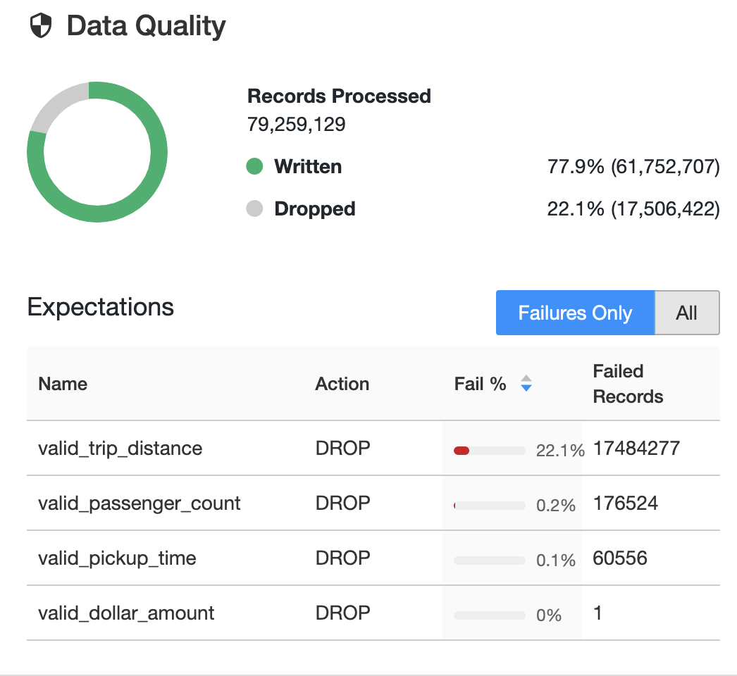
20/08/2022
Fernando Lovera
Introduction to Delta Live Tables (DLT)
Data quality validation and monitoring
Stream: readStream is feasible, overcoming systems and files: Coalescing small files, “exactly-once” processing, efficiency discovering are new.
You can read CSV or Delta tables already.
CREATE STREAMING LIVE TABLE … AS
( CONSTRAINT ..EXPECT (dt is not null and (dt > a_dt)) ON VIOLATION DROP ROW
COMMENT ..
SELECT * FROM fire_account_raw ...

Slide 13
20/08/2022
Fernando Lovera
Introduction to Delta Live Tables (DLT)
Data pipeline observability
High-quality lineage diagram that provides visibility into how data flows for impact analysis
Granular logging for operational, governance, quality and status of the data pipeline at a row level
Continuously monitor data pipeline jobs to ensure continued operation
Notifications using Databricks SQL

Slide 14
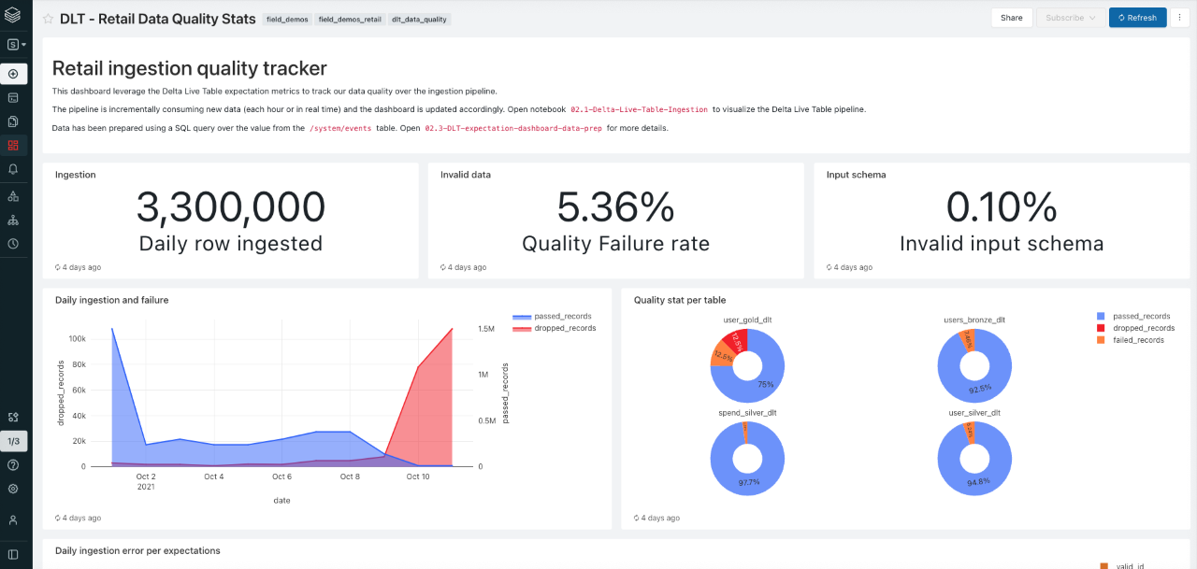
20/08/2022
Fernando Lovera
Introduction to Delta Live Tables (DLT)
Data pipeline observability

Slide 15

20/08/2022
Fernando Lovera
Introduction to Delta Live Tables (DLT)
Workflow Orchestration
Orchestrate in the same DAG
Fully integrated
Multi-cloud environments
You can run a Delta Live Tables pipeline as part of a data processing workflow with Databricks jobs, Apache Airflow, or Azure Data Factory.
Simplify orchestration and management of data pipelines
Multi-Task Jobs Orchestration
DLT Pipeline
Task
Task
DLT Pipeline

Slide 16
22/08/2022
Fernando Lovera
Let’s jump to the code

Slide 17
Conclusion
22/08/2022
Fernando Lovera
DLTs are the new gold standard for data pipelines. It helps in the automation of data ingestion and maintain high standards such as expectations and observability.
Due to automation, better performance and the possibility of triggering pipelines only when it’s needed DLT actually allows to save money.
Better technology for engineering, it is able to perform at optimal levels, for example by using views and streaming. Also allow schema evolution.

Slide 18
Contact
22/08/2022
Fernando Lovera
You can write an email or directly talk with me; I can help you build your DLT pipeline, and I’m happy to help: loverfe@cronos.be Fernando.Lovera@arinti.ai Fernando.Lovera2@unilever.com (until the end of the month) LinkedIn

