Slide 1
Retviews: real time fashion analytics
Fernando Lovera

Slide 2
Purpose of this presentation
Try to express ideas about a solution to a problem given and that it’s part of a selection process by the company. Please, interrupt me if I do something wrong.
My intention is also to introduce myself in a broader perspective to the audience, for example, by talking about other areas of computer science that I am interested.

Slide 3

The problem that I needed to solve
The problem I needed to solve was: Given two csv files that contain information about products and their evolution during a period of time,
i) identify the best seller.
ii) construct a model that learns how to predict new best sellers.

Slide 4
But first, I would like to talk about myself
I proudly graduated from university Universidad Simon Bolivar in 2013, I studied computer science languages - interpreters & compilers; and also software engineering.
I also graduated from KU Leuven in 2017, I studied a program called Master Artificial Intelligence (MAI), which is an advanced program (focus on research). Mainly studied Natural Language Processing (NLP) and Machine Learning (ML).
Now… as jobs I’ve been developing software for 4 years, mainly in web development, using tools such as django, angular and JSP, and old (but good) tools in the frontend such as HTML combined with Javascript. I developed the billing system for a telephone company in my country and couple of webpages. I also worked during the last year developing iOS applications.

Slide 5
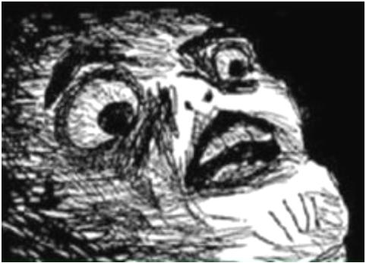
One of the things I liked the most was interpreters & computer languages.
Because everything can be interpreted as a language in one way or another. To implement a computer science language you have to divide your problem in front-end and back-end. Basically, on the front-end we implement an interpreter and in the back-end the memory related.
Let’s see a quick example of one of this projects.

Slide 6

So… coming back to our Retviews’ problem how do we address this problem?
“KNOW YOUR DATA” is the golden rule for machine learning problems.
We have two csv files, both with important information about what we will define as “best seller”. I think we need to study the time factor to be able to solve the problem, so what I will do is to merge these two datasets into one, that contains the information of products but also the how do they variate through time.

