Slide 1
Second interview
Luceda Photonics

Slide 2
First part
It was about a script that needed some touches.
1st: When you execute the script (python ./read_measurements.py) you'll see
that the experiment_A is listed twice, do you know why and can you solve it?
That is because in the data, the column Name in the “measurements.csv” file contains a blank space before the name experiment_A. Basically, “experiment_A” is different from “ experiment_A”
^{Solutions:}
1) Replace the string in the data file, searching for its regex and replace that space by nothing.
2) Create a database and just consult the data in a query.
3) use of .strip() function in the string comparison. So, the blank spaces do not count.

Slide 3
First part
2nd: When I execute the script from the parent directory (python ./measurements/read_measurements.py") I get the following error: Traceback (most recent call last):
File "./measurements/read_measurements.py", line 35, in <module>
with open('./measurements.csv') as data_file:
IOError: [Errno 2] No such file or directory: './measurements.csv'
Do you know what is wrong and can you solve it? (Assuming that measurements.csv is in the same directory as read_measurements.py)
?
  Mainly this happens because you are using “.” as a directory and then you specify the path of the file from “.”. Therefore it doesn’t find the file.
  What to do here is to provide the absolute path with the os.path.dirname(__file__) functionality. Basically, opening the directory where that file is being executed and attaching the file name.

Slide 4
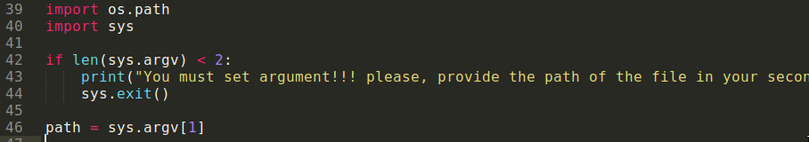
First part
3rd part: Now the script can only read './measurements.csv', please modify the script so that you can specify the file as an argument.
  The simplest way I can do this is using the sys library in Python.

Slide 5
First part
4th part: This script is written in a difficult and inefficient way, can you try to make modifications so that:
  Show the code.
- it's easier to understand
- it's more efficient
        To make more readable we can add some functions that will execute parts of the code. This is to make it more readable.
        We will try to make it more efficient too.

Slide 6
Second part
Pcell service:
I understand that a Pcell is a meaningless concept unless that it has a Layout with properties. So, then
  Organization: Luceda, OpenAccess.
  Microservice: add_parameter(name, type) http_200 http_500
  Microservice: add_layout(Layout) http_200 http_500
Layout service:
  generate_elements(elems) http_200 http_500
  Define the methods regarding to that layOut. http_200 http_500
An example:
  The line given in the email, the layout would be the one for a line and the Layout would include the length of the line, etc.

Slide 7
Second part
Pcell Placement service: Basically a service that assigns a Pcell to its rightfull evaluator.
  It will have the number of Pcell evaluators and for each evaluator type a stack.
    Void calculate_number_of_stacks(evaluatos_list)
  Void add_pcell(Pcell) http_200 http_500
  O(n).
  This functionality should place a Pcell to its stack.
  Void remove_pcell(Pcell) http_200 http_500
  look up? Hash table to look where you need to remove the pcell.
  Void assign_evaluator(stack, evaluators_list)
  Basically for each stack “type” you will look for it’s rightful evaluator and apply it to the pcell,
  then, call the method remove_pcell before.

