Slide 1
专业外语
软件工程 物联网
2023-5-2

Slide 2
PART 2 INTERNET APPLICATIONS CHAPTER 5 NEW INTERNET APPLICATIONS 5.3 CLOUD COMPUTING

Slide 3
KEYWORDS
cloud computing 云计算
delivery 交付，投递
electricity grid 电网
utility 实用程序
end-user 最终用户，直接用户
thin client 瘦客户
data center 数据中心
manageability 可管理性
maintenance 维护
infrastructure 基础设施，基础结构
infrastructure convergence 基础会聚
public cloud 公共云
subscription 订购，订阅
accessible 可访问的，可接入的

Slide 4
callout 标注
architecture 体系结构，架构
VM (Virtual Machine) 虚拟机
private cloud 私有云
client 客户
hybrid cloud 混合云
RC2 (Research Compute Cloud) 研究计算云
scatter 撒播，分散
pool of users 用户群
redundant 冗余的

Slide 5
Cloud computing is the delivery of computing as a service rather than a product, whereby shared resources, software, and information are provided to computers and other devices as a utility (like the electricity grid) over a network (typically the Internet).

Slide 6
1. Overview
Cloud computing is a marketing term for technologies that provide computation, software, data access, and storage services that do not require end-user knowledge of the physical location and configuration of the system that delivers the services.
A parallel to this concept can be drawn with the electricity grid, wherein end-users consume power without needing to understand the component devices or infrastructure required to provide the service.

Slide 7
Cloud computing describes a new supplement, consumption, and delivery model for IT services based on Internet protocols, and it typically involves provisioning of dynamically scalable and often virtualised resources.
It is a byproduct and consequence of the ease-of-access to remote computing sites provided by the Internet.
This may take the form of web-based tools or applications that users can access and use through a web browser as if the programs were installed locally on their own computers.

Slide 8
Cloud computing providers deliver applications via the Internet, which are accessed from web browsers and desktop and mobile apps, while the business software and data are stored on servers at a remote location.

Slide 9
In some cases, legacy applications (line of business applications that until now have been prevalent in thin client Windows computing) are delivered via a screen-sharing technology, while the computing resources are consolidated at a remote data center location; in other cases, entire business applications have been coded using web-based technologies such as AJAX (Asynchronous JavaScript And XML).

Slide 10
At the foundation of cloud computing is the broader concept of infrastructure convergence (or Converged Infrastructure) and shared services.
This type of data center environment allows enterprises to get their applications up and running faster, with easier manageability and less maintenance, and enables IT to more rapidly adjust IT resources (such as servers, storage, and networking) to meet fluctuating and unpredictable business demand.

Slide 11
Most cloud computing infrastructures consist of services delivered through shared data-centers and appearing as a single point of access for consumers’ computing needs.
The tremendous impact of cloud computing on business has prompted the federal United States government to look to the cloud as a means to reorganize their IT infrastructure and decrease their spending budgets.

Slide 12
With the advent of the top government official mandating cloud adoption, many agencies already have at least one or more cloud systems online.
A cloud computing logical diagram shows in Figure 5-1.

Slide 13
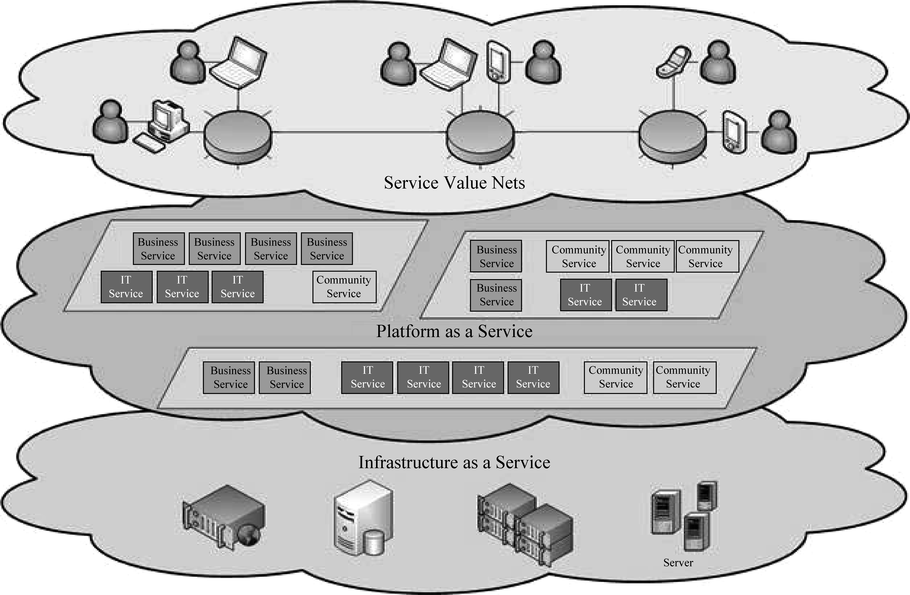
Figure 5-1 Cloud computing logical diagram

Slide 14
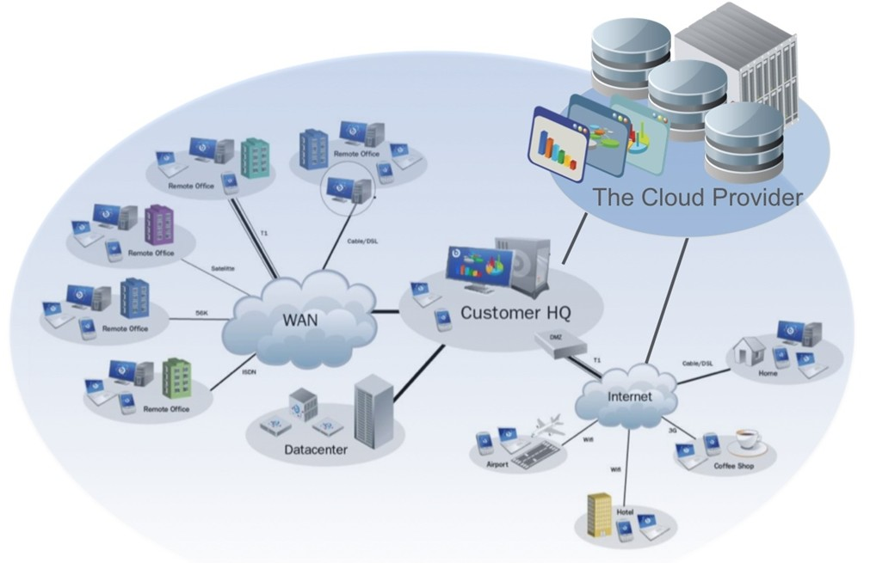
From the Internet

Slide 15
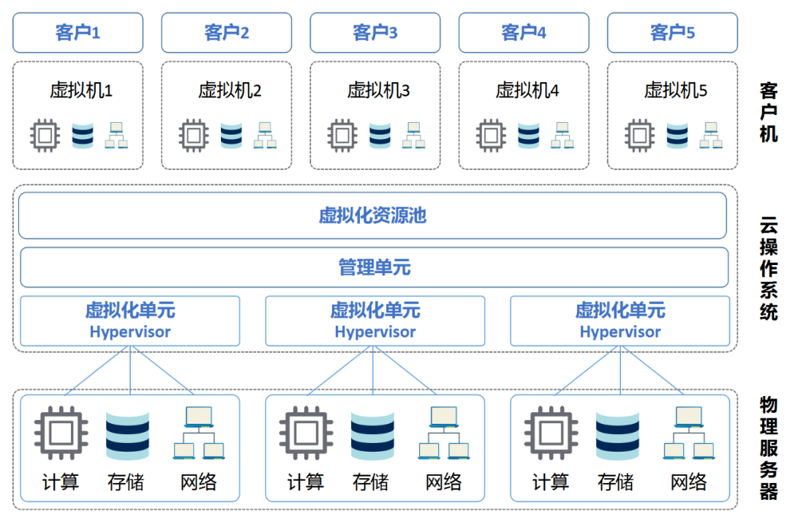
From the Internet

Slide 16
2. Public, Private, and Hybrid Clouds
A public cloud is built over the Internet and can be accessed by any user who has paid for the service.
Public clouds are owned by service providers and are accessible through a subscription.
The callout box in top of Figure 5-2 shows the architecture of a typical public cloud.
Many public clouds are available, including Google App Engine (GAE), Amazon Web Services (AWS), Microsoft Azure, IBM Blue Cloud, and Salesforce.com’s Force.com.

Slide 17
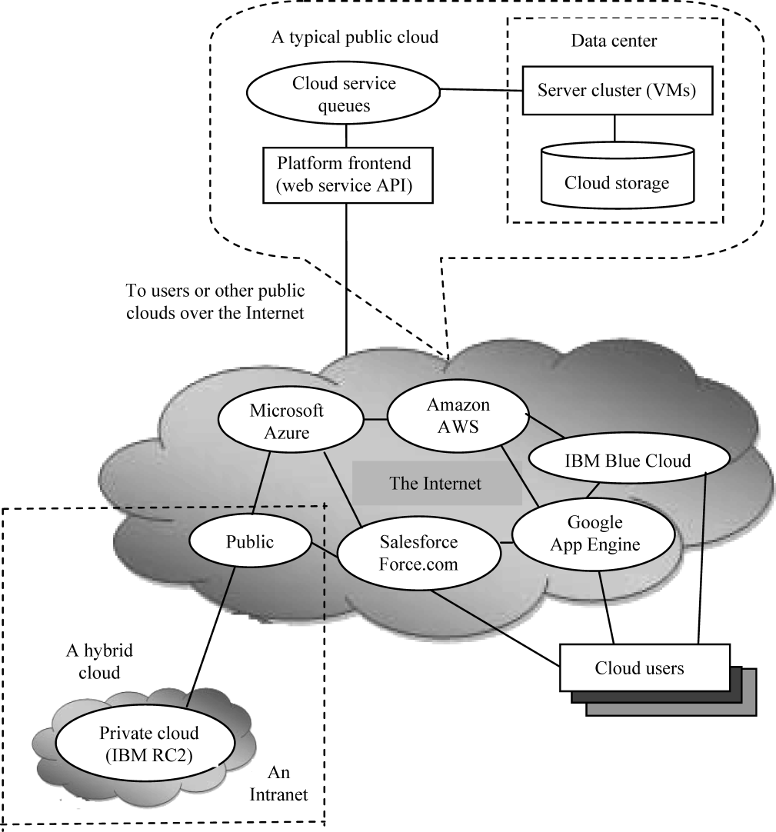
Figure 5-2 Public, private, and hybrid clouds illustrated by functional architecture and connectivity of representative clouds

Slide 18
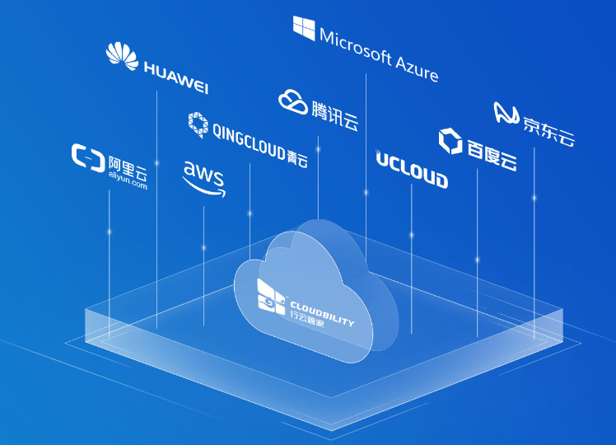
From the Internet

Slide 19
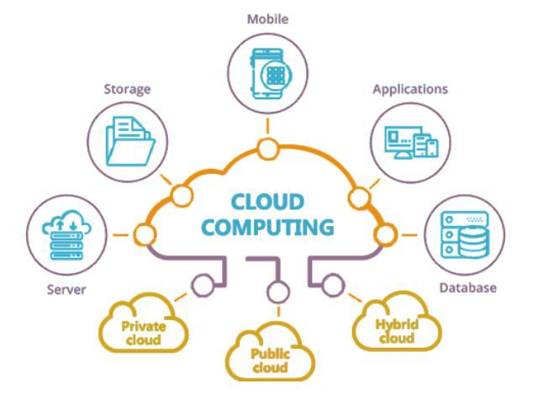
From the Internet

Slide 20
The providers of the aforementioned clouds are commercial providers that offer a publicly accessible remote interface for creating and managing VM (Virtual Machine) instances within their proprietary infrastructure.
A public cloud delivers a selected set of business processes.
The application and infrastructure services are offered on a flexible price-per-use basis.

Slide 21
A private cloud is built within the domain of an intranet owned by a single organization.
Therefore, it is client owned and managed, and its access is limited to the owning clients and their partners.
Its deployment was not meant to sell capacity over the Internet through publicly accessible interfaces.
Private clouds give local users a flexible and agile private infrastructure to run service workloads within their administrative domains.

Slide 22
A private cloud is supposed to deliver more efficient and convenient cloud services.
It may impact the cloud standardization, while retaining greater customization and organizational control.
Intranet-based private clouds are linked to public clouds to get additional resources.

Slide 23
A hybrid cloud is built with both public and private clouds, as shown at the lower-left corner of Figure 5-2.
Private clouds can also support a hybrid cloud model by supplementing local infrastructure with computing capacity from an external public cloud.
For example, the Research Compute Cloud (RC2) is a private cloud, built by IBM, that interconnects the computing and IT resources at eight IBM Research Centers scattered throughout the United States, Europe, and Asia.

Slide 24
A hybrid cloud provides access to clients, the partner network, and third parties.
In summary, public clouds promote standardization, preserve capital investment, and offer application flexibility.
Private clouds attempt to achieve customization and offer higher efficiency, resiliency, security, and privacy.
Hybrid clouds operate in the middle, with many compromises in terms of resource sharing.

Slide 25
3. Characteristics
Cloud computing exhibits the following key characteristics:
(1) Empowerment of end-users of computing resources by putting the provisioning of those resources in their own control, as opposed to the control of a centralized IT service.

Slide 26
(2)Agility improves with users’ ability to re-provision technological infrastructure resources.
(3)Application programming interface (API) accessibility to software that enables machines to interact with cloud software in the same way the user interface facilitates interaction between humans and computers.
Cloud computing systems typically use REST-based APIs (Representational State Transfer).

Slide 27
(4)Device and location independence enable users to access systems using a web browser regardless of their location or what device they are using (e.g., PC, mobile phone).
As infrastructure is off-site (typically provided by a third-party) and accessed via the Internet, users can connect from anywhere.

Slide 28
(5)Multi-tenancy enables sharing of resources and costs across a large pool of users.
(6)Reliability is improved if multiple redundant sites are used, which makes well-designed cloud computing suitable for business continuity and disaster recovery.
(7)Performance is monitored, and consistent and loosely coupled architectures are constructed using web services as the system interface.

Slide 29
(8)Security could improve due to centralization of data, increased security-focused resources, etc.
(9)Maintenance of cloud computing applications is easier, because they do not need to be installed on each user’s computer.

Slide 30
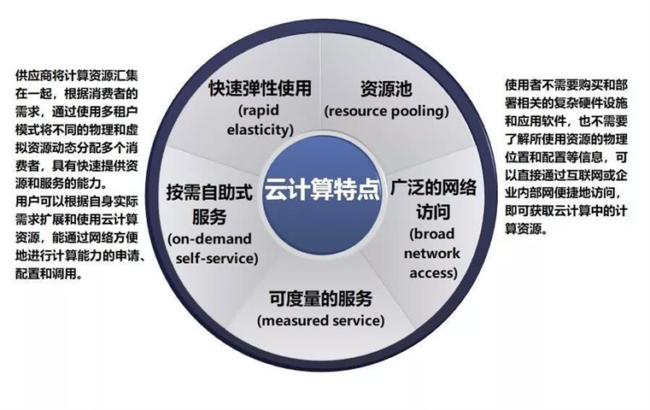
From the Internet

Slide 31
PART 2 INTERNET APPLICATIONS CHAPTER 5 NEW INTERNET APPLICATIONS 5.4 BIG DATA

Slide 32
KEYWORDS
big data 大数据
data set 数据集，数据传输机
capture 捕获，捕捉，截获
curation 策展
visualization 可视化，目视，显像
predictive analytics 预测分析
informatics 信息控制论，信息科学，情报学，资料学
genomics 基因学
connectomics 连接组学
biological 生物学的，生物的
remote sensing 远程传感技术
RFID (Radio Frequency Identification) 射频识别
per-capita 人均的，人均

Slide 33
exabyte (10¹⁸ byte) 艾字节
exponential 指数，指数的，幂
IDG (International Data Group) 国际数据集团
stream 流，序列
social media 社交媒体
sensor 传感器
database 数据库
hierarchical 层次的，分层的
OLAP (On-Line Analytical Processing) 联机分析处理
smart metering 智能仪表
parallel processing 并行处理
clustering 聚类，分类归并，群集，分群，分组，划分
MPP (Massively Parallel Processing) 大规模并行处理系统

Slide 34
grid 格栅，栅极
throughput 吞吐量，通过量，总处理能力
decision making 决策支撑

Slide 35
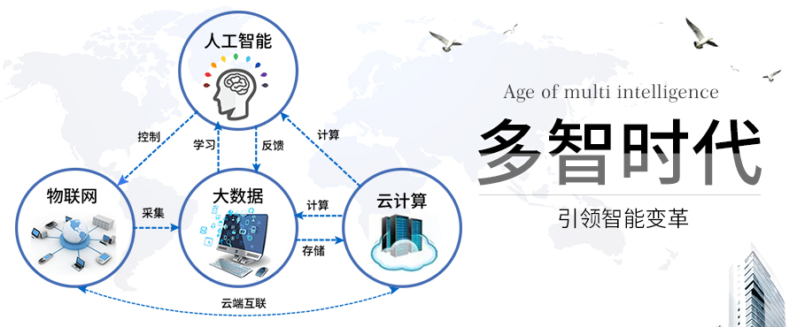
From the Internet

Slide 36
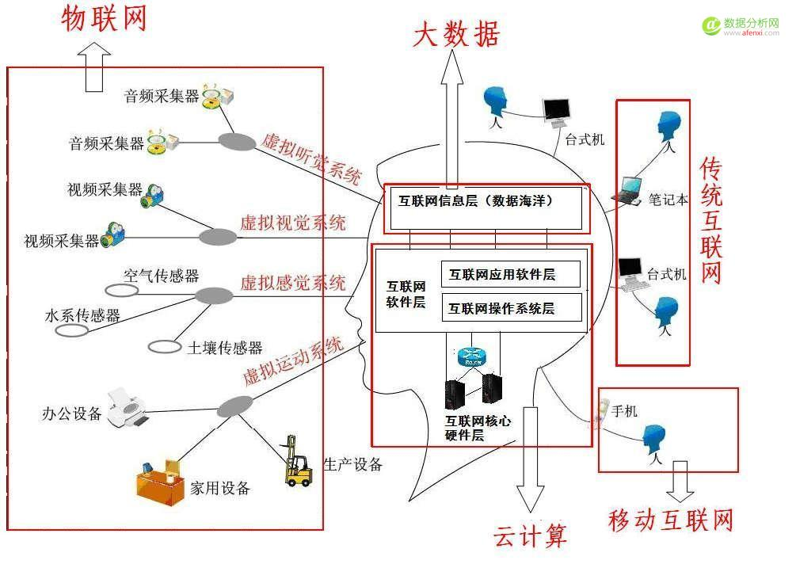
From the Internet

Slide 37
Big data is a broad term for data sets so large or complex that traditional data processing applications are inadequate.
Challenges include analysis, capture, curation, search, sharing, storage, transfer, visualization, and information privacy.
The term often refers simply to the use of predictive analytics or other certain advanced methods to extract value from data, and seldom to a particular size of data set.

Slide 38
Analysis of data sets can find new correlations, to “spot business trends, prevent diseases, combat crime and so on.”
Scientists, Practitioners of Media and Advertising and Governments alike regularly encounter limitations due to large data sets in many areas.
The limitations affect Internet search, finance and business informatics.

Slide 39
Scientists, for example, encounter limitations in e-Science work, including meteorology, genomics, connectomics, complex physics simulations, and biological and environmental research.
Data sets grow in size in part because they are increasingly being gathered by cheap and numerous mobile devices, aerial sensory technologies (remote sensing), software logs, cameras, microphones, radio-frequency identification (RFID) readers, and wireless sensor networks.

Slide 40
The world’s technological per-capita capacity to store information has roughly doubled every 40 months since the 1980s; as of 2012, every day 2.5 exabytes (2.5×10¹⁸) of data were created; the challenge for large enterprises is determining who should own big data initiatives that straddle the entire organization.

Slide 41
Figure 5-3 shows the growth of global information storage capacity.

Slide 42
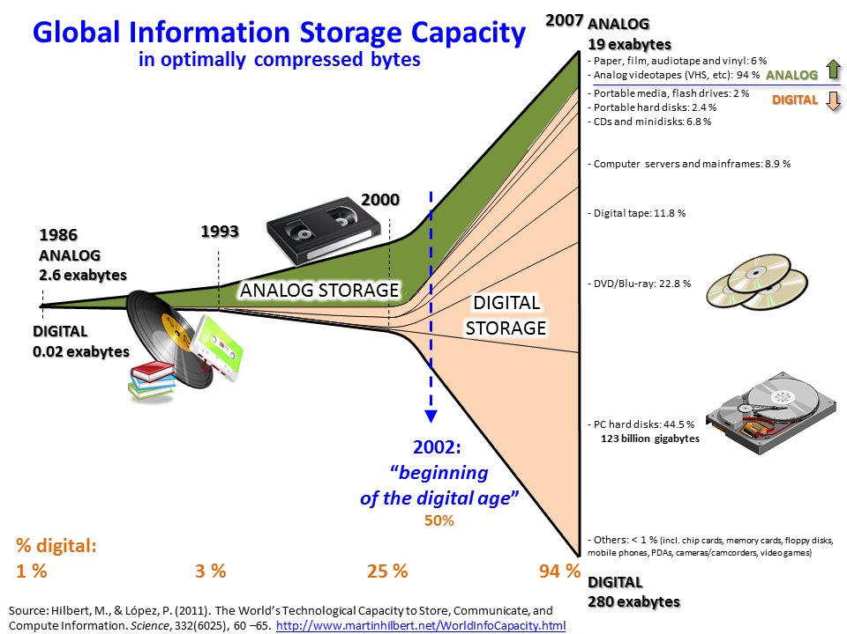
Figure 5-3 Growth and Digitization of Global Information Storage Capacity Source

Slide 43
1. Definition
Big data is a popular term used to describe the exponential growth, availability and use of information, both structured and unstructured.
According to IDG (Internatioonal Data Group), it is imperative that organizations and IT leaders focus on the ever-increasing volume, variety, and velocity of information that forms big data.

Slide 44
(1) Volume
Many factors contribute to the increase in data volume-transaction-based data stored through the years, text data constantly streaming in from social media, increasing amounts of sensor data being collected, etc.
In the past, excessive data volume created a storage issue.
But with today’s decreasing storage costs, other issues emerge, including how to determine relevance amidst the large volumes of data and how to create value from that is relevant.

Slide 45
(2) Variety
Data today comes in all types of formats—from traditional databases to hierarchical data stores created by end users and OLAP (On-Line Analytical Processing) systems, to text documents, E-mail, meter-collected data, video, audio, stock ticker data and financial transactions.
By some estimates, 80 percent of an organization’s data is not numeric!
But it still must be included in analyses and decision making.

Slide 46
(3) Velocity
According to Gartner, velocity “means both how fast data is being produced and how fast the data must be processed to meet demand”.
RFID tags and smart metering are driving an increasing need to deal with torrents of data in near-real time.

Slide 47
2. Uses for big data
So the real issue is not that you are acquiring large amounts of data (because we are clearly already in the era of big data).
It’s what you do with your big data that matters.
The hopeful vision for big data is that organizations will be able to harness relevant data and use it to make the best decisions.

Slide 48
Technologies today not only support the collection and storage of large amounts of data, they provide the ability to understand and take advantage of its full value, which helps organizations run more efficiently and profitably.

Slide 49
For instance, with big data and big data analytics, it is possible to:
1) Analyze millions of SKUs (Stock Keeping Unit) to determine optimal prices that maximize profit and clear inventory.
2) Recalculate entire risk portfolios in minutes and understand future possibilities to mitigate risk.
3) Quickly identify customers who matter the most.

Slide 50
4) Generate retail coupons at the point of sale based on the customer’s current and past purchases, ensuring a higher redemption.
5) Send tailored recommendations to mobile devices at just the right time, while customers are in the right location to take advantage of offers.

Slide 51
6) Analyze data from social media to detect new market trends in demand.
7) Use clickstream analysis and data mining to detect fraudulent behavior.
8) Determine root causes of failures, issues and defects by investigating user sessions, network logs and machine sensors.

Slide 52
Examples of big data:
1) RFID systems generate up to 1000 times the data of conventional bar code systems.
2) 10000 payment card transactions are made every second around the world.
3) Walmart handles more than 1 million customer transactions an hour.

Slide 53
4) 340 million tweets are sent per day. That’s nearly 4000 tweets per second.
5) Facebook has more than 901 million active users generating social interaction data.
6) More than 5 billion people are calling, texting, tweeting and browsing websites on mobile phones.

Slide 54
3. Technologies
A number of recent technology advancements are enabling organizations to make the most of big data and big data analytics:
1) Cheap, abundant storage and server processing capability.
2) Faster processors.
3) Affordable large-memory capabilities, such as Hadoop.

Slide 55
4) New storage and processing technologies designed specifically for large data volumes, including unstructured data.
5) Parallel processing, clustering, MPP (Massively Parallel Processing), virtualization, large grid environments, high connectivity and high throughputs.
6) Cloud computing and other flexible resource allocation arrangements.

Slide 56
Big data technologies not only support the ability to collect large amounts of data, they provide the ability to understand it and take advantage of its value.
The goal of all organizations with access to large data collections should be to harness the most relevant data and use it for optimized decision making.

Slide 57
It is very important to understand that not all of your data will be relevant or useful.
But how can you find the data points that matter most?
It is a problem that is widely acknowledged.

Slide 58
“Most businesses have made slow progress in extracting value from big data.
And some companies attempt to use traditional data management practices on big data, only to learn that the old rulers no longer apply,” says Dan Briody, in the 2011 Economist Intelligence Unit’s publication, “Big Data Harnessing a Game-Changing Asset.”

Slide 59
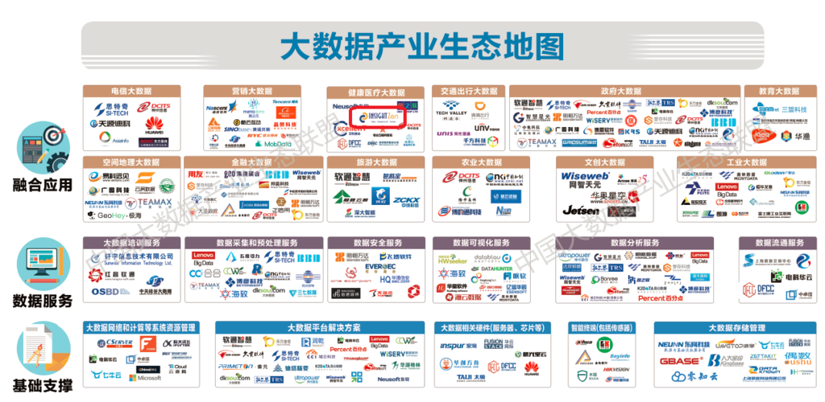
From the Internet

Slide 60
The End of this Section

