Slide 1
专业外语
软件工程 物联网
2023-6-1

Slide 2
PART 3 PROGRAMMING LANGUAGES AND DATABASES CHAPTER 6 PROGRAMMING LANGUAGES 6.1 C, C++, AND C#

Slide 3
KEYWORDS
structured language 结构化语言
OOP (Object-Oriented Programming) 面向对象程序设计
compiler 编译器（程序）
class 类
Java language 一种面向对象的程序设计语言
encapsulation 包装，封装
data hiding 数据隐藏

Slide 4
inheritance 继承性
polymorphism 多态性
portable 可移植的
ANSI 美国国家标准学会
superset 超类
bug 故障，错误，安全漏洞
fix 修正，修正程序
specification 规范，规格，说明书，技术要求
suite 套件，程序集，一套，一组
unqualified 非限定的，不合格的
reference 引用，参考，基准，坐标，标记
context 上下文，前后关系，语言环境，场合

Slide 5
C combines the best features of a structured high-level language and an assembly language—that is, it’s relatively easy to code (at least compared to assembly language) and it uses computer resources efficiently.
Although originally designed as a system programming language (in fact, the first major program written in C was the UNIX operating system), C has proven to be a powerful and flexible language that can be used for a variety of applications.

Slide 6
It is used mostly by computer professionals to create software products.
A newer object-oriented version of C is called C++ (see Figure 6-1).
C++ includes the basic features of C, making all C++ programs understandable to C compilers, but has additional features for objects, classes, and other components of an OOP (Object-Oriented Programming).

Slide 7
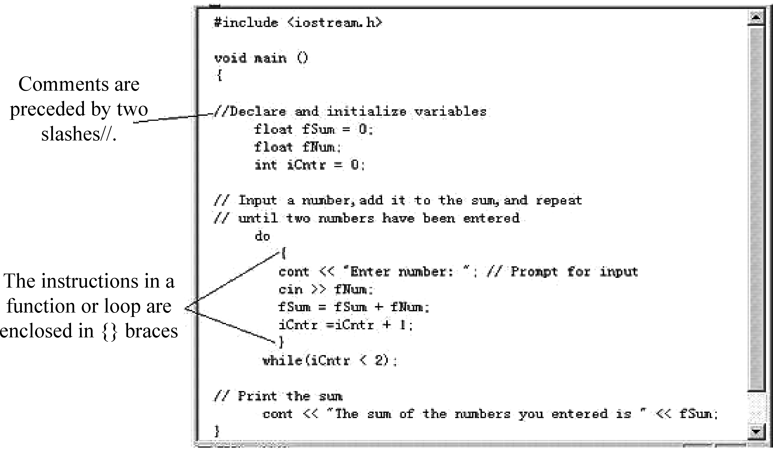
Figure 6-1 Adding-two-numbers program implemented in C++.

Slide 8
There is also a visual version of the C++ language.
All in all, C++ is one of the most popular programming languages for graphical applications.

Slide 9
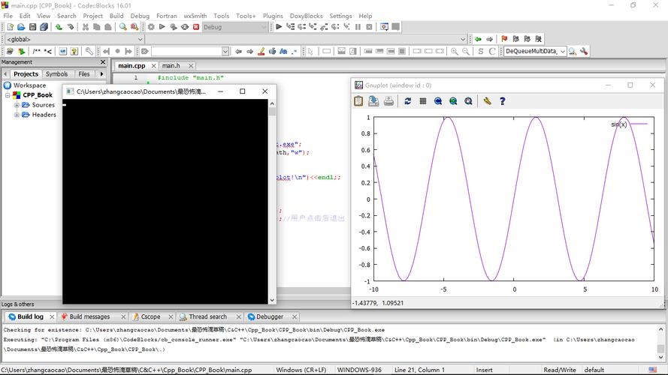
From the Internet

Slide 10
C++ fully supports object-oriented programming, including the four pillars of object- oriented development: encapsulation, data hiding, inheritance, and polymorphism.
The property of being a self-contained unit is called encapsulation.
With encapsulation, we can accomplish data hiding.
Data hiding is the highly valued characteristic that an object can be used without the user knowing or caring how it works internally.

Slide 11
Just as you can use a refrigerator without knowing how the compressor works, you can use a well-designed object without knowing about its internal data members.
C++ supports the properties of encapsulation and data hiding through the creation of user-defined types, called Classes.

Slide 12
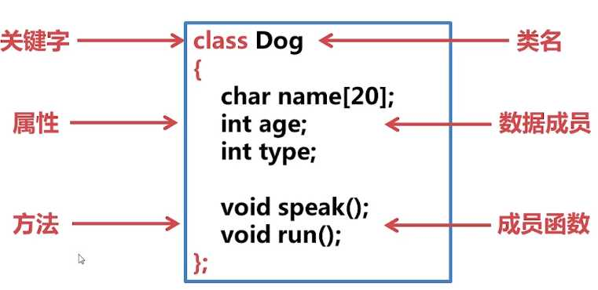
From the Internet

Slide 13
Once created, a well-defined class acts as a fully encapsulated entity—it is used as a whole unit.
The actual inner workings of the class should be hidden.
Users of a well-defined class do not need to know how the class works; they just need to know how to use it.

Slide 14
When the engineers at Acme Motors want to build a new car, they have two choices: They can start from scratch, or they can modify an existing model.
Perhaps their Star model is nearly perfect, but they’d like to add a turbocharger and a six-speed transmission.
The chief engineer would prefer not to start from the ground up, but rather to say, “Let’s build another Star, but let’s add these additional capabilities. We’ll call the new model a Quasar.”
A Quasar is a kind of Star, but one with new features.

Slide 15
C++ supports the idea of reuse through inheritance.
A new type, which is an extension of an existing type, can be declared.
This new subclass is said to derive from the existing type and is sometimes called a derived type.
The Quasar is derived from the Star and thus inherits all its qualities, but can add to them as needed.

Slide 16
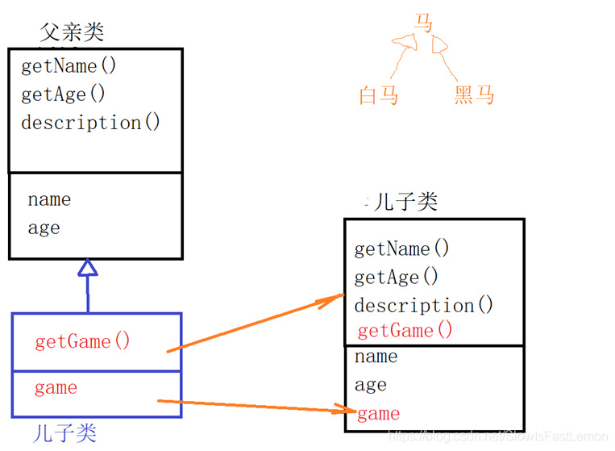
From the Internet

Slide 17
C++ supports the idea that different objects do “the right thing” through what is called function polymorphism and class polymorphism.
Poly means many, and morph means form.
Polymorphism refers to the same name taking many forms.
While it is true that C++ is a superset of C, and that virtually any legal C program is a legal C++ program, the leap from C to C++ is very significant.

Slide 18
C++ benefited from its relationship to C for many years, as C programmers could ease into their use of C++.
To really get the full benefit of C++, however, many programmers found they had to unlearn much of what they knew and learn a whole new way of conceptualizing and solving programming problems.

Slide 19
One of the major revisions of the C++ standard, C++11 (formerly known as C++0x), was approved and released on the 12 August 2011.

Slide 20
In 2014, C++14 (also known as C++1y) was released as a small extension to C++11, featuring mainly bug fixes and small improvements.
It aims at doing what C++03 did to C++98.
The Draft International Standard ballot procedures completed in mid-August 2014.
After C++14, a major revision, informally known as C++17, is planned for 2017.

Slide 21
The newer version of C is C# (pronounced “C sharp”).
A hybrid of C and C++, C# is Microsoft’s newest programming language developed to compete directly with Sun’s Java language.
C# is an object-oriented programming language designed to improve productivity in the development of Web applications.
The most recent version is C# 5.0, which was released on August 15, 2012.

Slide 22
Microsoft Visual C# is Microsoft’s implementation of the C# specification, included in the Microsoft Visual Studio suite of products.
It is based on the ECMA/ISO (European Computer Manufacturers Association / International Standardization Organization) specification of the C# language, which Microsoft also created.
While multiple implementations of the specification exist, Visual C# is by far the one most commonly used.

Slide 23
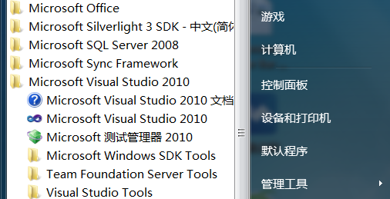

Slide 24
PART 3 PROGRAMMING LANGUAGES AND DATABASES CHAPTER 6 PROGRAMMING LANGUAGES 6.2 JAVA

Slide 25
KEYWORDS
Java 一种程序设计语言
Java platform Java平台
object model 对象模型
bytecode 字节代码
class file 类文件
JVM(Java Virtual Machine) Java虚拟机
concurrent 并发（行）的
object-oriented 面向对象的
portable 可移植的

Slide 26
interpret 解释
JRE(Java Runtime Environment) Java运行时环境
library （程序）库
overhead 开销
compiler 编译程序
recompilation 再次编译
client-server 客户-服务器（方式）
Java applet Java小应用程序
visualization 可视化
cross-platform 交叉平台
IDE (Integrated Development Environment) 集成开发环境

Slide 27
1. Overview of Java
Java is a programming language originally developed by James Gosling at Sun Microsystems (now part of Oracle Corporation) and released in 1995 as a core component of Sun Microsystems’ Java platform.
The language derives much of its syntax from C and C++ but has a simpler object model and fewer low-level facilities.
Java applications are typically compiled to bytecode (class file) that can run on any Java Virtual Machine (JVM) regardless of computer architecture.

Slide 28
Java is a general-purpose, concurrent, class-based, object-oriented language that is specifically designed to have as few implementation dependencies as possible.
It is intended to let application developers “write once, run anywhere.” (WORA), meaning that compiled Java code can run on all platforms that support Java without the need for recompilation.
Java is one of the most popular programming languages in use, particularly for client-server web applications, with a reported 9 million developers.

Slide 29
2. Goals
There were five primary goals in the creation of the Java language:
1) It should be “simple, object-oriented and familiar”
2) It should be “robust and secure”
3) It should be “architecture-neutral and portable”
4) It should execute with “high performance”
5) It should be “interpreted, threaded, and dynamic”

Slide 30
3. Java Platform
One characteristic of Java is portability, which means that computer programs written in the Java language must run similarly on any hardware/operating-system platform.
This is achieved by compiling the Java language code to an intermediate representation called Java bytecode, instead of directly to platform-specific machine code.
Java bytecode instructions are analogous to machine code, but are intended to be interpreted by a virtual machine (VM) written specifically for the host hardware.

Slide 31
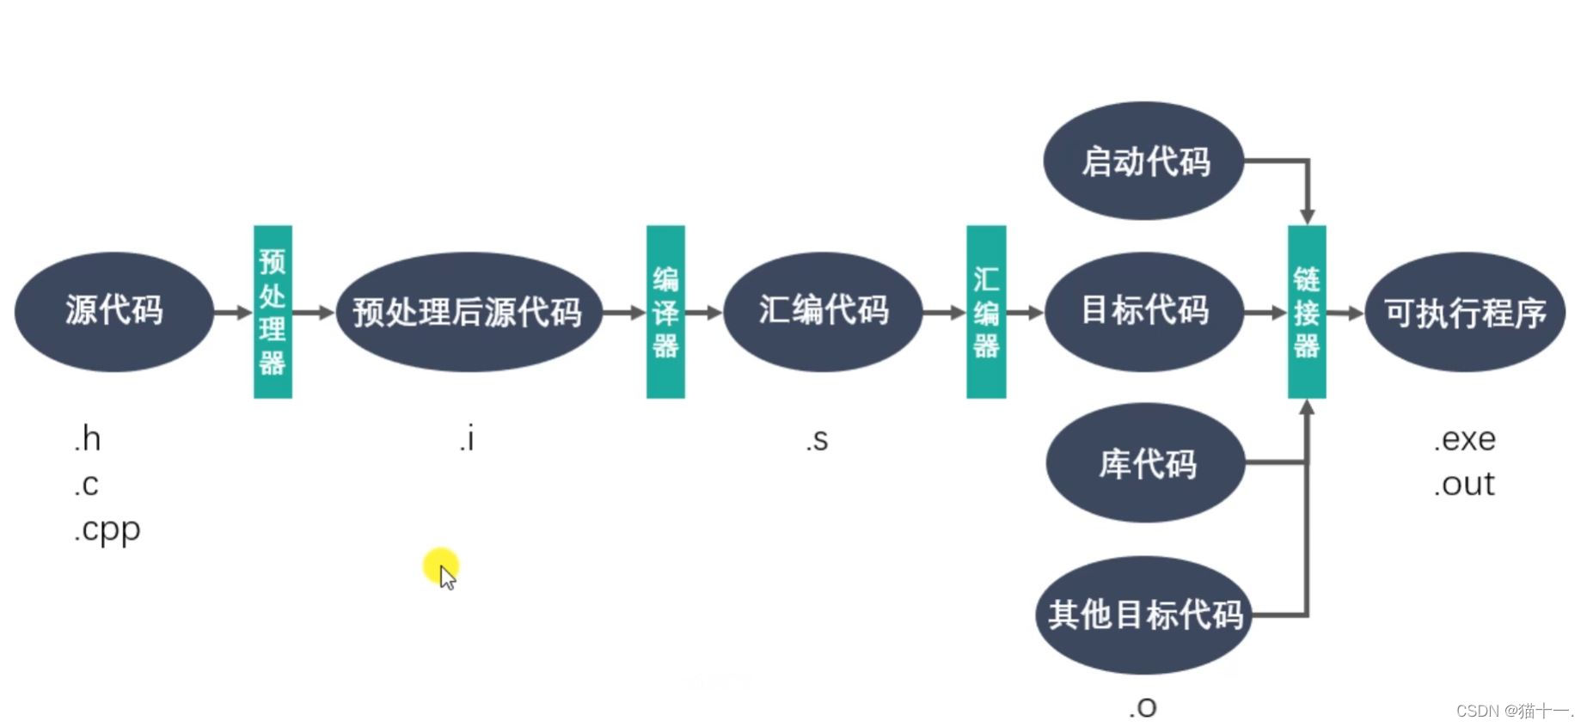
From the Internet

Slide 32
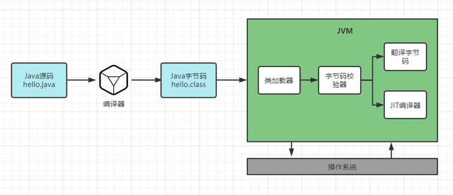
From the Internet

Slide 33
End-users commonly use a Java Runtime Environment (JRE) installed on their own machine for standalone Java applications, or in a Web browser for Java applets.
Standardized libraries provide a generic way to access host-specific features such as graphics, threading, and networking.

Slide 34
A major benefit of using bytecode is porting.
However, the overhead of interpretation means that interpreted programs almost always run more slowly than programs compiled to native executables world.
Just-in-Time compilers were introduced from an early stage that compile bytecodes to machine code during runtime.

Slide 35
4. Java applet
A Java applet is an applet delivered to users in the form of Java bytecode.
Java applets can run in a Web browser using a Java Virtual Machine (JVM), or in Sun’s AppletViewer, a stand-alone tool for testing applets.
Java applets run at speeds comparable to, but generally slower than, other compiled languages such as C++, but until approximately 2011 many times faster than JavaScript.

Slide 36
In addition they can use 3D hardware acceleration that is available from Java.
This makes applets well suited for non trivial, computation intensive visualizations.
When browsers have gained support for native hardware accelerated graphics in the form of Canvas and WebGL, as well as Just in Time compiled JavaScript, the speed difference has become less noticeable.

Slide 37
Since Java’s bytecode is cross-platform or platform independent, Java applets can be executed by browsers for many platforms, including Microsoft Windows, UNIX, Mac OS and Linux.
It is also trivial to run a Java applet as an application with very little extra code.
This has the advantage of running a Java applet in offline mode without the need for any Internet browser software and also directly from the integrated development environment (IDE).

Slide 38
PART 3 PROGRAMMING LANGUAGES AND DATABASES CHAPTER 6 PROGRAMMING LANGUAGES 6.3 MAKEUP AND SCRIPTING LANGUAGES

Slide 39
KEYWORDS
markup language 标记（置标）语言
scripting language 脚本[描述] 语言，过程[编制] 语言
HTML (Hyper-Text Markup Language) 超文本标记语言
line capacity 线路容量
tag 标记
word processor 字处理器（软件）
text editor 文本编辑器（软件）
W3C(World Wide Web Consortium) 万维网联盟
browser 浏览器
parser 语法分析程序
subsume 包含，包括
syntactic 句法的，句法上的
SVG(Scalable Vector Graphics) 可缩放的矢量图形

Slide 40
plugin 插件
API (Application Program Interface) 应用程序接口
XML (eXtensible Markup Language) 可扩展的标记语言
JavaScript Java过程（程序）语言，基于对象的脚本语言
DHTML (Dynamic HTML) 动态超文本标记语言
attribute 性质，特性，本性，属性，象征
human-readable 人可读的
machine-readable 机器可读的
interpreter 解释程序

Slide 41
There are languages other than programming languages that are used in conjunction with application development .
The majority of these are Web related, as discussed in the next few sections.

Slide 42
1. HTML and Other Markup Languages
(1) HTML
Most Web pages today are written in a markup language.
Markup languages are designed to make it possible to transmit documents over a network using minimal line capacity.
Instead of sending exact specifications regarding the appearance of a Web page, markup languages define the structure and layout of a Web page by using a variety of tags.

Slide 43
The most common markup language for Web pages is HTML(Hypertext Markup Language).
HTML uses HTML tags.
When a Web page is created—using either a word processor, text editor, or a special Web site development program—HTML tags are inserted in the appropriate locations within the Web page’s text.
Some tags are used along; others are used in pairs.

Slide 44
For example, <b> turns bolding on for the text that follows up until a tag </b> is reached, so the following HTML statement
<b>This text is bolded. </b>
would produce the following when viewed with most Web browsers.
This text is bolded

Slide 45
A Web page and its corresponding HTML code are shown in Figure 6-2, with some common HTML tags.
HTML5 is a core technology markup language of the Internet used for structuring and presenting content for the World Wide Web.
As of October 2014 this is the final and complete fifth revision of the HTML standard of the World Wide Web Consortium (W3C)).
The previous version, HTML 4, was standardized in 1997.

Slide 46
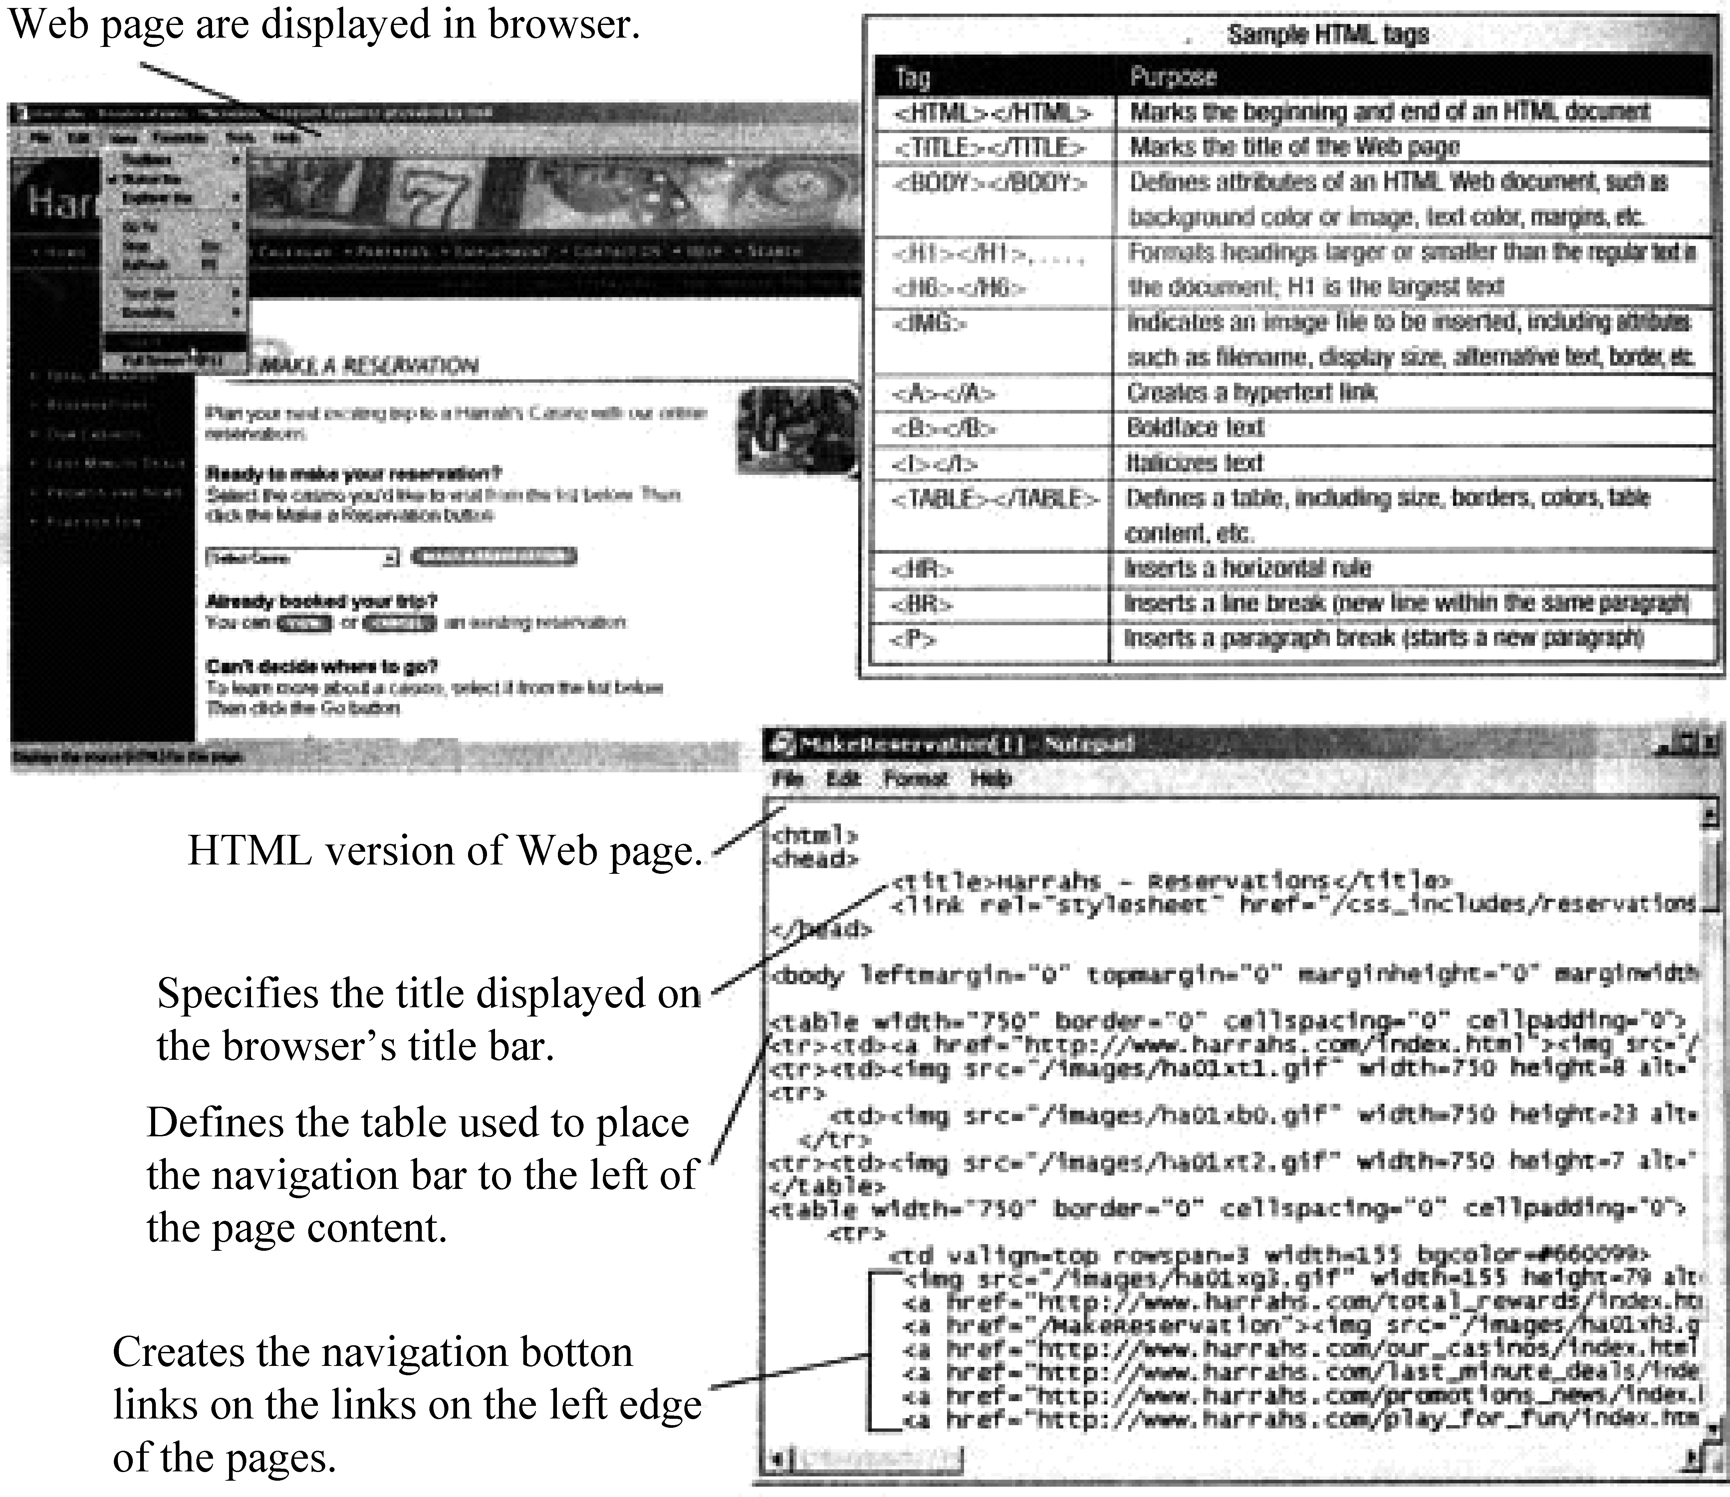
Figure 6-2 HTML.

Slide 47
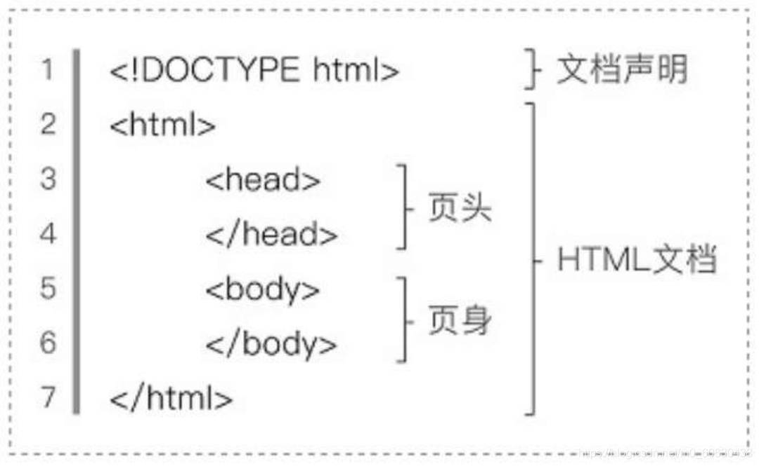
From the Internet

Slide 48
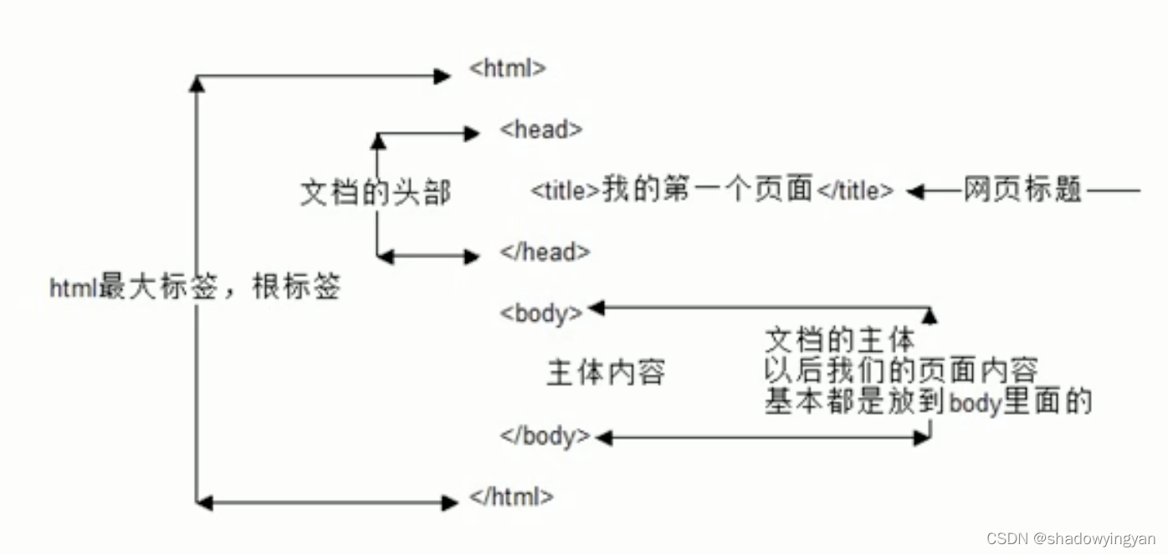
From the Internent

Slide 49
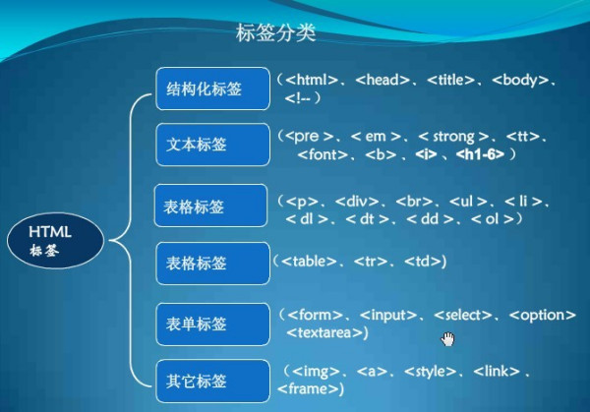
From the Internet

Slide 50
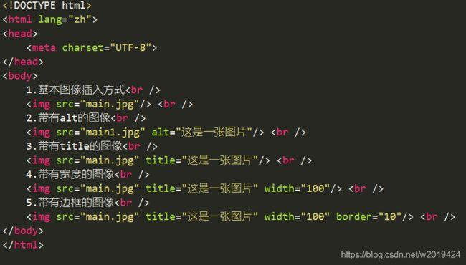
From the Internet

Slide 51
Its core aims have been to improve the language with support for the latest multimedia while keeping it easily readable by humans and consistently understood by computers and devices (web browsers, parsers, etc.)
HTML5 is intended to subsume not only HTML4, but also XHTML1 and DOM Level 2 HTML.

Slide 52
In particular, HTML5 adds many new syntactic features.
These include the new <video>, <audio> and <canvas> elements, as well as the integration of scalable vector graphics (SVG) content (replacing generic <object> tags), and MathML for mathematical formulas.

Slide 53
These features are designed to make it easy to include and handle multimedia and graphical content on the web without having to resort to proprietary plugins and APIs.
Other page structuring new elements, such as <main>, <section>, <article>, <header>, <footer>, <aside>, <nav> and <figure>, are designed to enrich the semantic content of documents.

Slide 54
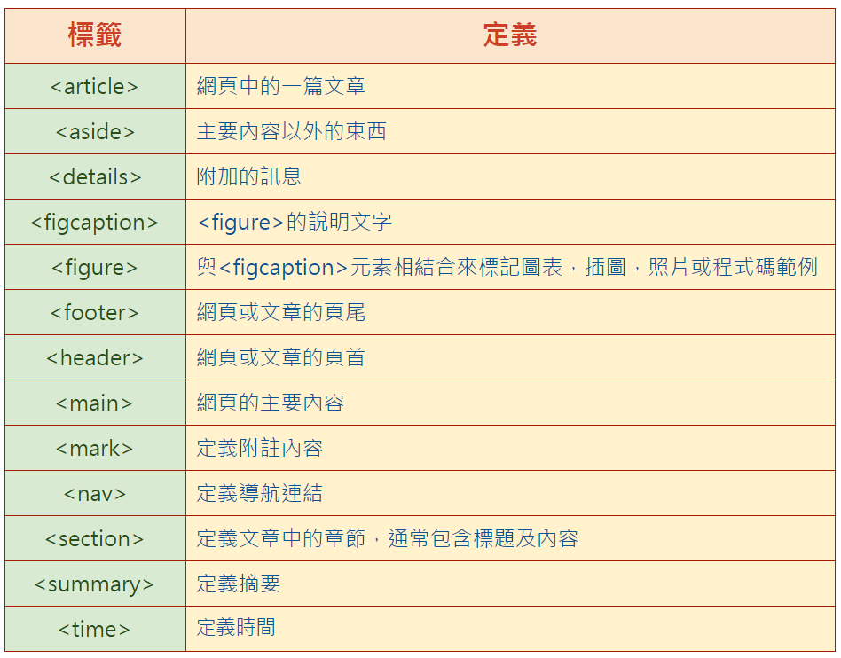
From the Internet

Slide 55
New attributes have been introduced for the same purpose, while some elements and attributes have been removed.
Some elements, such as <a>, <cite> and <menu> have been changed, redefined or standardized.
The APIs and Document Object Model (DOM) are no longer afterthoughts, but are fundamental parts of the HTML5 specification.

Slide 56
HTML5 also defines in some detail the required processing for invalid documents so that syntax errors will be treated uniformly by all conforming browsers and other user agents.

Slide 57
(2) XML
Extensible Markup Language (XML) is a markup language that defines a set of rules for encoding documents in a format which is both human-readable and machine-readable.
It is defined by the W3C’s XML 1.0 Specification and by several other related specifications, all of which are free open standards.
The design goals of XML emphasize simplicity, generality and usability across the Internet. It is a textual data format with strong support via Unicode for different human languages.

Slide 58
Although the design of XML focuses on documents, it is widely used for the representation of arbitrary data structures, such as those used in web services.
Several schema systems exist to aid in the definition of XML-based languages, while many application programming interfaces (APIs) have been developed to aid the processing of XML data.

Slide 59
(3) .NET
Very closely interrelated with XML is Microsoft’s .NET strategy to increase the convergence of personal computing with the Web.
In a nutshell, .NET is Microsoft’s platform to implement XML-based Web services.
These services allow applications to communicate and share data over the Internet, regardless of the operating system or programming language being used.

Slide 60
2. Scripting Languages
(1) JavaScript
HTML is principally designed for laying out Web pages that have on moving elements, much as a desktop-publishing program is designed for laying out printed pages.
Thus, HTML has minimal tools to create Web pages that change as the user looks at them or to enable users to interact with Web pages on their screens, other than some capabilities with DHTML and recent HTML enhancements.

Slide 61
If you want to develop pages with a great deal of dynamic content, a scripting languages, such as JavaScript, may be appropriate.
Such languages enable you to build program instructions, or scripts, directly into a Web page’s code to add dynamic content.
For example, JavaScript is commonly used to display submenus or new images when a menu item is pointed to (see Figure 6-3).

Slide 62
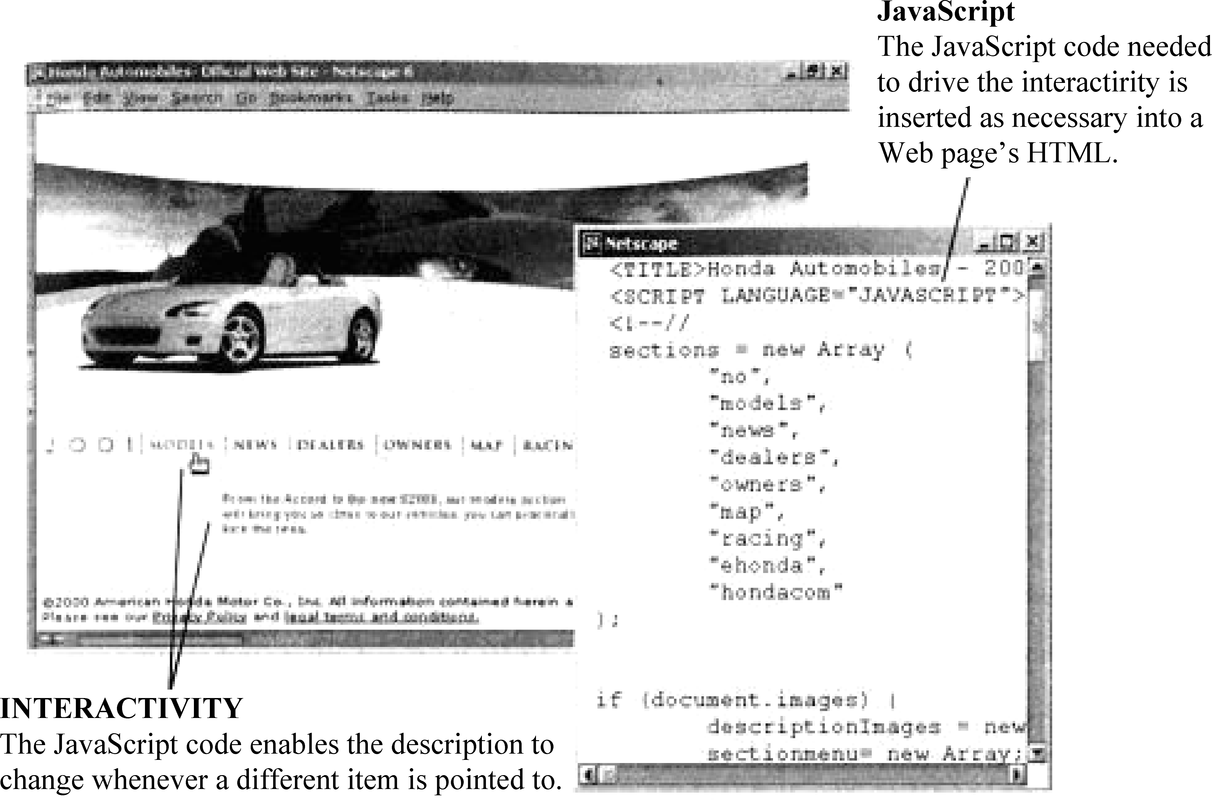
Figure 6-3 JavaScript.

Slide 63
JavaScript was originally developed by Netscape to enable Web authors to implement interactive Web sites.
Although it shares many of the features and structures of the full Java language, it was developed independently.
When using JavaScript, it is important to realize that not all scripting commands work with all browsers.
Because of this, make sure that the important features you add to your site with JavaScript are not browser specific.
(2) PHP

Slide 64
(2) PHP
PHP is a server-side scripting language designed for web development but also used as a general-purpose programming language.
As of January 2013, PHP was installed on more than 240 million websites (39% of those sampled) and 2.1 million web servers.
PHP code can be simply mixed with HTML code, or it can be used in combination with various templating engines and web frameworks.

Slide 65
PHP code is usually processed by a PHP interpreter, which is usually implemented as a web server’s native module or a Common Gateway Interface (CGI) executable.
After the PHP code is interpreted and executed, the web server sends resulting output to its client, usually in form of a part of the generated web page; for example, PHP code can generate a web page’s HTML code, an image, or some other data.
PHP has also evolved to include a command-line interface (CLI) capability and can be used in standalone graphical applications.

Slide 66
The canonical PHP interpreter, powered by the Zend Engine, is free software released under the PHP License.
PHP has been widely ported and can be deployed on most web servers on almost every operating system and platform, free of charge.
Despite its popularity, no written specification or standard existed for the PHP language until 2014, the canonical PHP interpreter is as a de facto standard.
Since 2014, there is ongoing work on creating a formal PHP specification.
As of 2014, work is underway on a new major PHP version named PHP 7.

Slide 67
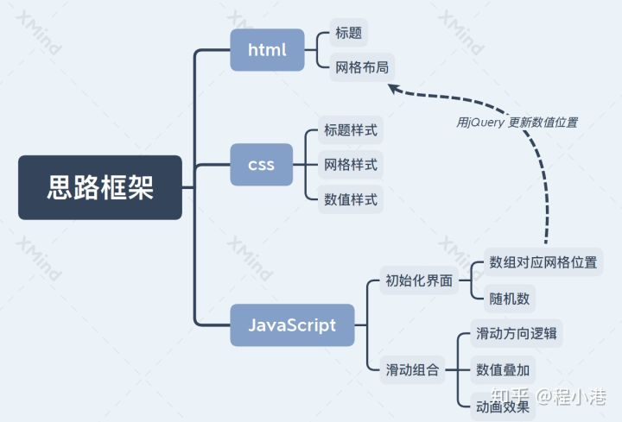
From the Internet

Slide 68
The End of this Section

