Slide 1
专业外语
软件工程 物联网
2023-5-1

Slide 2
PART 2 INTERNET APPLICATIONS CHAPTER 5 NEW INTERNET APPLICATIONS 5.1 INSTANT MESSAGING (IM)

Slide 3
KEYWORDS
blog 博客
social network 社交网
microblogging 微博
voice chat 语音聊天
portal 门户
video call 视频呼叫
multimedia 多媒体
counterpart 副本，复本，对应物
open source 开源
cross platform 跨平台
reverse engineering 逆（反）向工程

Slide 4
5.1.1 QQ

Slide 5
1. Overview of the QQ
Tencent QQ, generally referred to as QQ, is the most popular free instant messaging computer program in Mainland China.
As of September 30, 2010, the active QQ user accounts for QQ IM amounted to 636.6 million, possibly making it the world’s largest online community.

Slide 6
The number of simultaneous online QQ accounts exceeded 100 million.
In February 2011, QQ.com ranked 10th overall in Alexa’s internet rankings just behind Twitter ranked 9th.
The program is maintained by Tencent Holdings Limited (HKEX: 0700), owned in part by Naspers.

Slide 7
Since its entrance into Chinese households QQ quickly emerged as a modern cultural phenomenon, now being portrayed in popular culture.
Aside from the chat program, QQ has also developed many sub-features including games, virtual pets, ringtone downloads, music, shopping, blogs, microblogging, and group and voice chat etc.

Slide 8
The current version of QQ is QQ2010 beta2.
Tencent periodically releases special versions of QQ to coincide with events such as the Olympics or Chinese New Year.
The official client runs on Microsoft Windows and a beta public version was launched for Mac OS X version 10.4.9 or newer.
The Web versions, WebQQ (full version) and WebQQ Mini (Lite version), which makes use of Ajax (Asynchronous Javascript and XML), are currently available.
As of January 2015, there are 829 million active QQ accounts, with a peak of 176.4 million simultaneous online QQ users.

Slide 9
2. QQ International
(1) Windows
In 2009 QQ began to expand its services internationally with its QQ International client for Windows distributed through a dedicated English-language portal.
QQ International offers non-Mandarin speakers the opportunity to use all the features of its Chinese counterpart to get in touch with other QQ users via chat and videocalls, it provides a non-Mandarin interface to access Qzone, Tencent’s social network.

Slide 10
The client supports English, French, Spanish, German, Korean, Japanese and Classical Chinese.
A wealth of third-party applications is bundled with QQ International and it is mainly aimed at making cross-cultural communications in and out of China more convenient.
One of the main features of QQ International is the optional and automatic machine translation of all chats.

Slide 11
(2) Android
An Android version of QQ International was released in September 2013.
The client’s interface is in English, French, Spanish, German, Korean, Japanese and Classic Chinese.
In addition to text messaging, users can send each other images, video, and audio media messages.

Slide 12
Moreover, users can share multimedia content with all contacts through the client’s Qzone interface.
The live translation feature is available for all incoming messages and supports up to 18 languages.

Slide 13
(3) iOS / iPhone
QQ International for iPhone and iOS devices was released at the end of 2013, fully equivalent to its Android counterpart.

Slide 14
3. Web QQ
Tencent launched its web-based QQ formally on 15 September 2009, the latest version of which being 3.0.
Rather than solely a web-based IM, WebQQ 3.0 functions more like its own operating system, with a desktop in which web applications can be added.

Slide 15
4. Open source and cross-platform clients
Using reverse engineering, open source communities have come to understand the QQ protocol better and have attempted to implement client core libraries compatible with more user-friendly clients.

Slide 16
Most of these clients are cross-platform, so they are usable on operating systems which the official client does not support.
However, these implementations had only a subset of the functions of the official client and therefore were more limited in features.

Slide 17
5.1.2 FACEBOOK

Slide 18
KEYWORDS
profile 配置文件，概貌，轮廓
patent 专利
hosting 托管
upload 加载，上载，（向上）装入
compile 编译
consumption 消耗，耗散，消费
monolithic 单块（片）的
distributed machines 分布式（计算）机
log file 日志文件
aggregate 集合，聚集，集合的，合计的

Slide 19
1. Features
Facebook is a social networking service and website launched in February 2004, operated and privately owned by Facebook Inc.
As of June 2014, Facebook has more than 1.3 billion active users.
Users may create a personal profile with photo, lists of personal interests, contact information, and other personal information, add other users as friends, and exchange messages, including automatic notifications when they update their profile.
Additionally, users may join common-interest user groups, organized by workplace, school or college, or other characteristics.

Slide 20
Facebook has a number of features with which users may interact:
(1) Wall, a space on every user’s profile page that allows friends to post messages for the user to see.
(2) Pokes, which allows users to send a virtual “poke” to each other (a notification then tells a user that they have been poked).
(3) Photos, where users can upload albums and photos.
(4) Status, which allows users to inform their friends of their whereabouts and actions.
Depending on privacy settings, anyone who can see a user’s profile can also view that user’s Wall.

Slide 21
On February 23, 2010, Facebook was granted a patent on certain aspects of its News Feed.
The patent covers News Feed in which links are provided so that one user can participate in the same activity of another user.
The patent may encourage Facebook to pursue action against websites that violate its patent, which may potentially include websites such as Twitter.

Slide 22
One of the most popular applications on Facebook is the Photos application, where users can upload albums and photos.
Facebook allows users to upload an unlimited number of photos, compared with other image hosting services such as Photobucket and Flickr, which apply limits to the number of photos that a user is allowed to upload.
During the first years, Facebook users were limited to 60 photos per album.
As of May 2009, this limit has been increased to 200 photos per album.

Slide 23
2．Technical aspects
Facebook is built in PHP which is compiled with HipHop for PHP, a ‘source code transformer’ built by Facebook engineers that turns PHP into C++.
The deployment of HipHop reportedly reduced average CPU consumption on Facebook servers by 50%.
Facebook used a combination platform based on HBase to store data across distributed machines.
Using a tailing architecture, new events are stored in log files, and the logs are tailed.

Slide 24
The system rolls these events up and writes them into storage.
The User Interface then pulls the data out and displays it to users.
Facebook handles requests as AJAX behavior.
These requests are written to a log file using Scribe (developed by Facebook).

Slide 25
5.1.3 TWITTER

Slide 26
KEYWORDS
register 注册，寄存器
post 邮政，邮寄，记入，位置
SMS (Short Message Service) 短消息服务
tweet 推文
retweet 转推文
profile 配置文件，简表，概貌，轮廓
stack 栈，堆栈
Java 一种程序设计语言

Slide 27
Twitter is an online social networking service that enables users to send and read short 140-character messages called “tweets”.
Registered users can read and post tweets, but unregistered users can only read them.
Users access Twitter through the website interface, SMS, or mobile device app.
Twitter Inc. is based in San Francisco and has more than 25 offices around the world.

Slide 28
Twitter was created in March, 2006.
The service rapidly gained worldwide popularity, with more than 100 million users who in 2012 posted 340 million tweets per day.
The service also handled 1.6 billion search queries per day.
In 2013 Twitter was one of the ten most-visited websites, and has been described as “the SMS of the Internet.”
As of December 2014, Twitter has more than 500 million users, out of which more than 284 million are active users.

Slide 29
1. Features
Tweets are publicly visible by default, but senders can restrict message delivery to just their followers.
Users can tweet via the Twitter website, compatible external applications (such as for smartphones), or by Short Message Service (SMS) available in certain countries.
Retweeting is when a tweet is forwarded via Twitter by users.

Slide 30
Both tweets and retweets can be tracked to see which ones are most popular.
While the service is free, accessing it through SMS may incur phone service provider fees.
Twitter allows users to update their profile via their mobile phone either by text messaging or by apps released for certain smartphones and tablets.

Slide 31
As a social network, Twitter revolves around the principle of followers.
When you choose to follow another Twitter user, that user’s tweets appear in reverse chronological order on your main Twitter page.
If you follow 20 people, you’ll see a mix of tweets scrolling down the page: breakfast-cereal updates, interesting new links, music recommendations, even musings on the future of education.

Slide 32
2. Implementation
Twitter places great reliance on open-source software.
The Twitter Web interface uses the Ruby on Rails framework, deployed on a performance enhanced Ruby Enterprise Edition implementation of Ruby.

Slide 33
As of April 6, 2011, Twitter engineers confirmed they had switched away from their Ruby on Rails search stack, to a Java server they call Blender.
The service’s application programming interface (API) allows other web services and applications to integrate with Twitter.

Slide 34
5.1.4 WECHAT

Slide 35
KEYWORDS
Web Chat 微信
message 消息，信息，电文
register 注册，寄存器
sign up 签约，参加，入队
text messaging 文本消息
broadcast 广播
photograph 照片，相片
video 视频

Slide 36
Bluetooth 蓝牙
random 随机的
integration 集成，整合
social networking service 社交网络服务
embellish 美化，装饰，修饰
filter 过滤器，滤波器，筛选程序
caption 标题，图片说明，字幕
subscriber 用户

Slide 37
WeChat is a mobile text and voice messaging communication service developed by Tencent in China, first released in January 2011.
It is the largest standalone messaging app by monthly active users.
The app is available on Android, iPhone, BlackBerry, Windows Phone and Symbian phones, and there are also Web-based and OS X clients but these require the user to have the app installed on a supported mobile phone for authentication.
As of August 2014, WeChat has 438 million active users; with 70 million outside of China.

Slide 38
Users can register WeChat with Facebook account or sign up with phone number.
WeChat currently supports phone numbers of more than 100 countries to register.
Registration cannot be done directly through Tencent QQ.
But users can connect their WeChat account with Tencent QQ account after registering through phone number.

Slide 39
WeChat provides text messaging, hold-to-talk voice messaging, broadcast (one-to-many) messaging, sharing of photographs and videos, and location sharing.
It can exchange contacts with people nearby via Bluetooth, as well as providing various features for contacting people at random if desired and integration with social networking services such as those run by Facebook and Tencent QQ.

Slide 40
Photographs may also be embellished with filters and captions, and a machine translation service is available.
WeChat supports users to register as a public account which enables them to push feeds to subscribers, interact with subscribers and provide them with service.
By the end of 2014, number of Wechat public accounts had reached 8 million.

Slide 41
In China, WeChat public accounts have become a common service or promotion platform for government, news media and companies.
Specific public account subscribers use the platform for service like hospital pre-registration, visa renewal or credit card service.
On 30 September 2014, WeChat 6.0 was launched with new features and functions include Sight capture and share.
According to GlobalWebIndex, WeChat is the fifth most used smartphone app worldwide and in August 2013, following Google Maps, Facebook, YouTube and Google+.

Slide 42
WeChat claimed it had 100 million registered international users which is achieved in only 3 months from 50 million registered international users.
It also claimed 300 million registered Chinese users.
According to Xinhua, WeChat total users reached 600 millions users worldwide in October 2013.
In addition,approximately 30 per cent of the total WeChat are users abroad.

Slide 43
PART 2 INTERNET APPLICATIONS CHAPTER 5 NEW INTERNET APPLICATIONS 5.2 SOCIAL NETWORKING SERVICE (SNS)

Slide 44
5.2.1 WIKI

Slide 45
KEYWORDS
interlink 相互链接
community website 团体网站
intranet 内联网
add-on 附件
landscape 景色，风景
hyperlink 超链接
database 数据库
searching 搜索
user account 用户账户
log 登录

Slide 46
cookie 网络跟踪器，“小甜饼”
authentication 验证，鉴别
markup language 标记（置标）语言
text editor 文本编辑程序，文本编辑器
implicit structure 隐式结构
emerge 出现，露出，显现，发生
encyclopedia 百科全书
access 访问，接入，存取

Slide 47
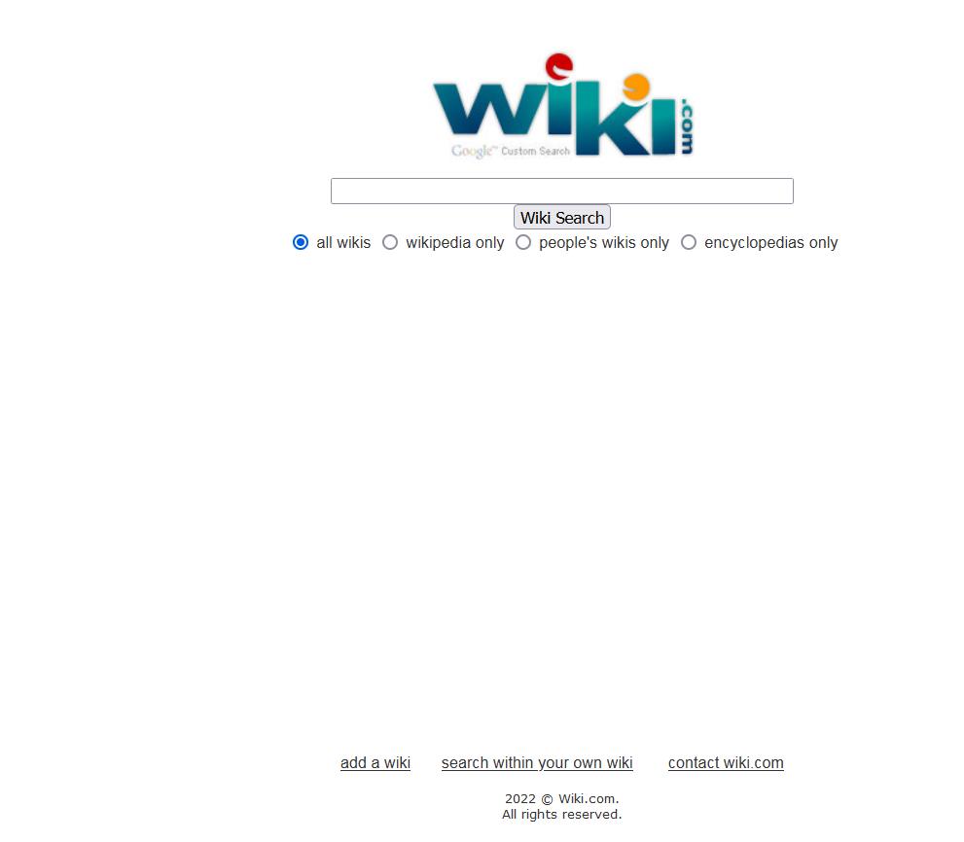

Slide 48
A wiki is a website that allows the creation and editing of any number of interlinked web pages via a web browser using a simplified markup language or a WYSIWYG text editor.
Wikis are typically powered by wiki software and are often used collaboratively by multiple users.
Examples include community websites, corporate intranets, knowledge management systems, and note services.
The software can also be used for personal notetaking.

Slide 49
Wikis serve different purposes.
Some permit control over different functions (levels of access).
For example editing rights may permit changing, adding or removing material.
Others may permit access without enforcing access control.

Slide 50
The essence of the wiki concept is as follows:
(1) A wiki invites all users to edit any page or to create new pages within the wiki Web site, using only a plain-vanilla Web browser without any extra add-ons.
(2) Wiki promotes meaningful topic associations between different pages by making page link creation almost intuitively easy and showing whether an intended target page exists or not.
(3) A wiki is not a carefully crafted site for casual visitors.
Instead, it seeks to involve the visitor in an ongoing process of creation and collaboration that constantly changes the Web site landscape.

Slide 51
A single page in a wiki website is referred to as a “wiki page”, while the entire collection of pages, which are usually well interconnected by hyperlinks, is “the wiki”.
A wiki is essentially a database for creating, browsing, and searching through information.

Slide 52
A defining characteristic of wiki technology is the ease with which pages can be created and updated.
Generally, there is no review before modifications are accepted.
Many wikis are open to alteration by the general public without requiring them to register user accounts.
Sometimes logging in for a session is recommended, to create a “wiki-signature” cookie for signing edits automatically.

Slide 53
Many edits, however, can be made in real-time and appear almost instantly online.
This can facilitate abuse of the system.
Private wiki servers require user authentication to edit pages, and sometimes even to read them.

Slide 54
A wiki is an application also, typically a web application, which allows collaborative modification, extension, or deletion of its content and structure.
In a typical wiki, text is written using a simplified markup language (known as “wiki markup”) or a rich-text editor.
While a wiki is a type of content management system, it differs from a blog or most other such systems in that the content is created without any defined owner or leader, and wikis have little implicit structure, allowing structure to emerge according to the needs of the users.

Slide 55
The encyclopedia project Wikipedia is the most popular wiki on the public web in terms of page views, but there are many sites running many different kinds of wiki software.
Wikis can serve many different purposes both public and private, including knowledge management, notetaking, community websites and intranets.

Slide 56
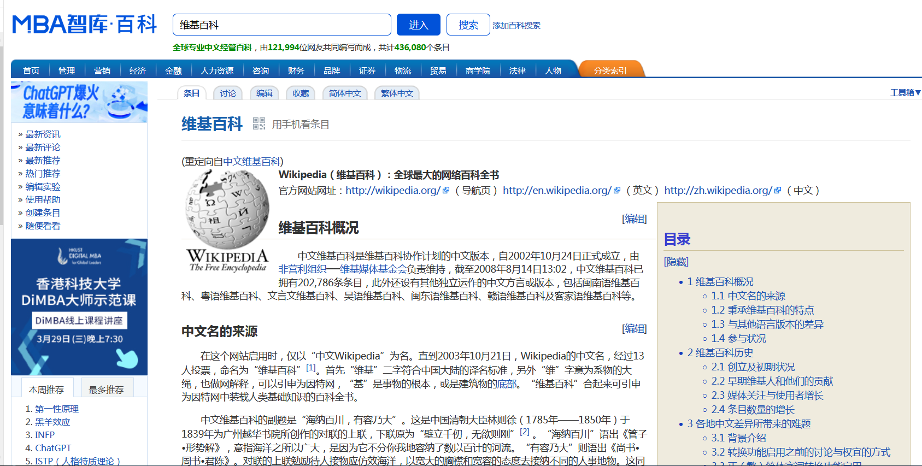

Slide 57
Some permit control over different functions (levels of access).
For example, editing rights may permit changing, adding or removing material.
Others may permit access without enforcing access control.
Other rules may also be imposed to organize content.

Slide 58
5.2.2 BLOG AND MICROBLOG

Slide 59
KEYWORDS
entry 条目，词条，入口，进入
commentary 评论，注释
reverse-chronological order 反时间顺序
interactive 交互式的
widget 小装置（窗口），窗件
art blog 艺博
photoblog 影博
video blogging 视博
podcasting Pod广播技术
blogger 博客版主
statistics 统计，统计数字，统计表，统计学
microblog 微博
aggregate file 聚合文件
post 邮件，邮箱

Slide 60
microblogger 微博版主
open source software 开源软件
instant messaging 即时消息
digital audio 数字音频
authorship 著述业，著者，来源
circumventing 阻遏，设法规避，欺诈，绕行
hosted 托管的

Slide 61
1. Blog
A blog (a blend of the term web and log) is a type of website or part of a website.
Blogs are usually maintained by an individual with regular entries of commentary, descriptions of events, or other material such as graphics or video.
Entries are commonly displayed in reverse-chronological order.
Blog can also be used as a verb, meaning to maintain or add content to a blog.

Slide 62
Most blogs are interactive, allowing visitors to leave comments and even message each other via widgets on the blogs and it is this interactivity that distinguishes them from other static websites.
Many blogs provide commentary or news on a particular subject; others function as more personal online diaries.
A typical blog combines text, images, and links to other blogs, Web pages, and other media related to its topic.

Slide 63
The ability of readers to leave comments in an interactive format is an important part of many blogs.
Most blogs are primarily textual, although some focus on art (art blog), photographs (photoblog), videos (video blogging), music (MP3 blog), and audio (podcasting).
Microblogging is another type of blogging, featuring very short posts.

Slide 64
As of 16 February 2011, there were over 156 million public blogs in existence.
On 20 February 2014, there were around 172 million Tumblr and 75.8 million WordPress blogs in existence worldwide.
According to critics and other bloggers, Blogger is the most popular blogging service used today, however Blogger does not offer public statistics.
Technorati has 1.3 million blogs as of February 22, 2014.

Slide 65
There are many different types of blogs, differing not only in the type of content, but also in the way that content is delivered or written.

Slide 66
2. Microblog
Microblog is a broadcast medium in the form of blog.
A microblog differs from a traditional blog in that its content is typically smaller in actual file size.
Microblogs “allow users to exchange small elements of content such as short sentences, individual images, or video links”.

Slide 67
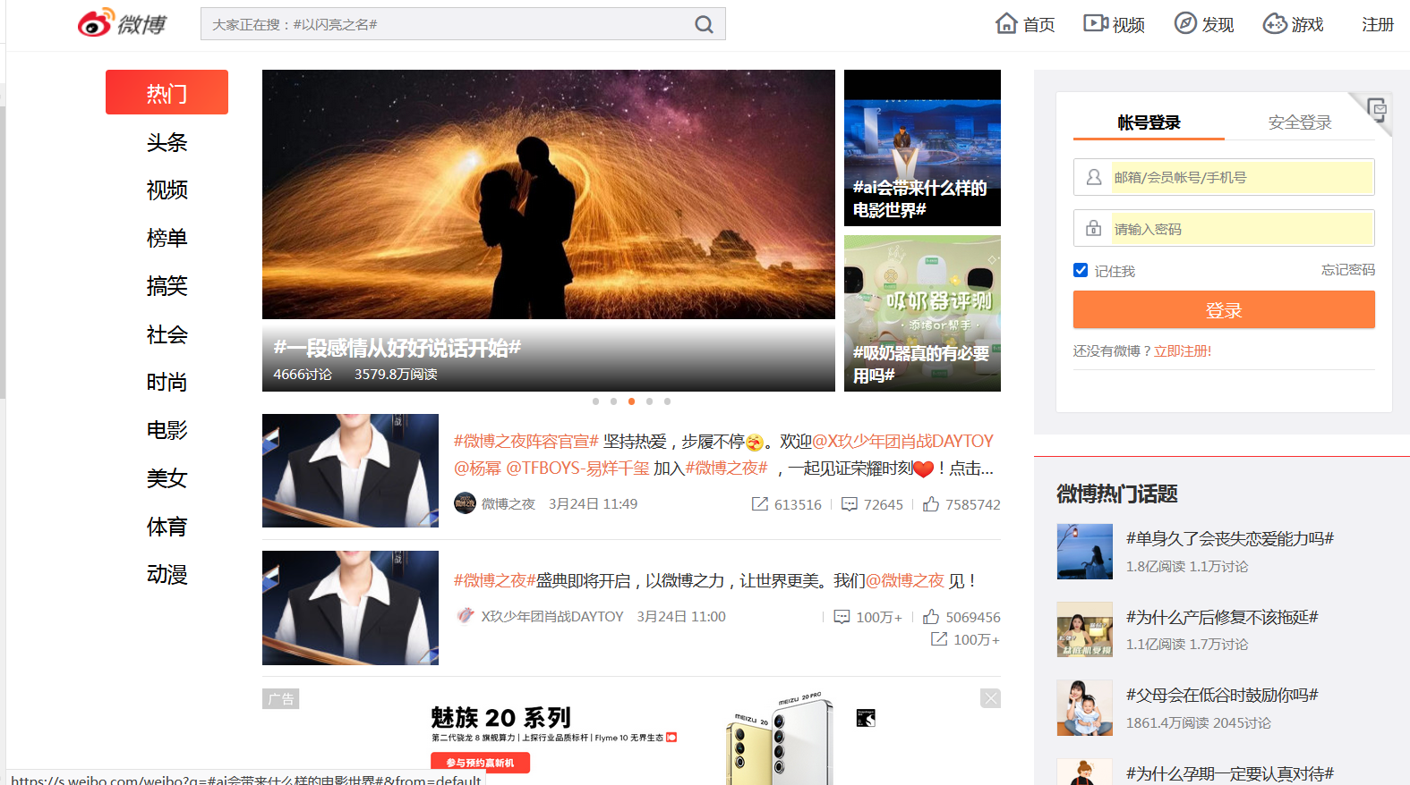

Slide 68
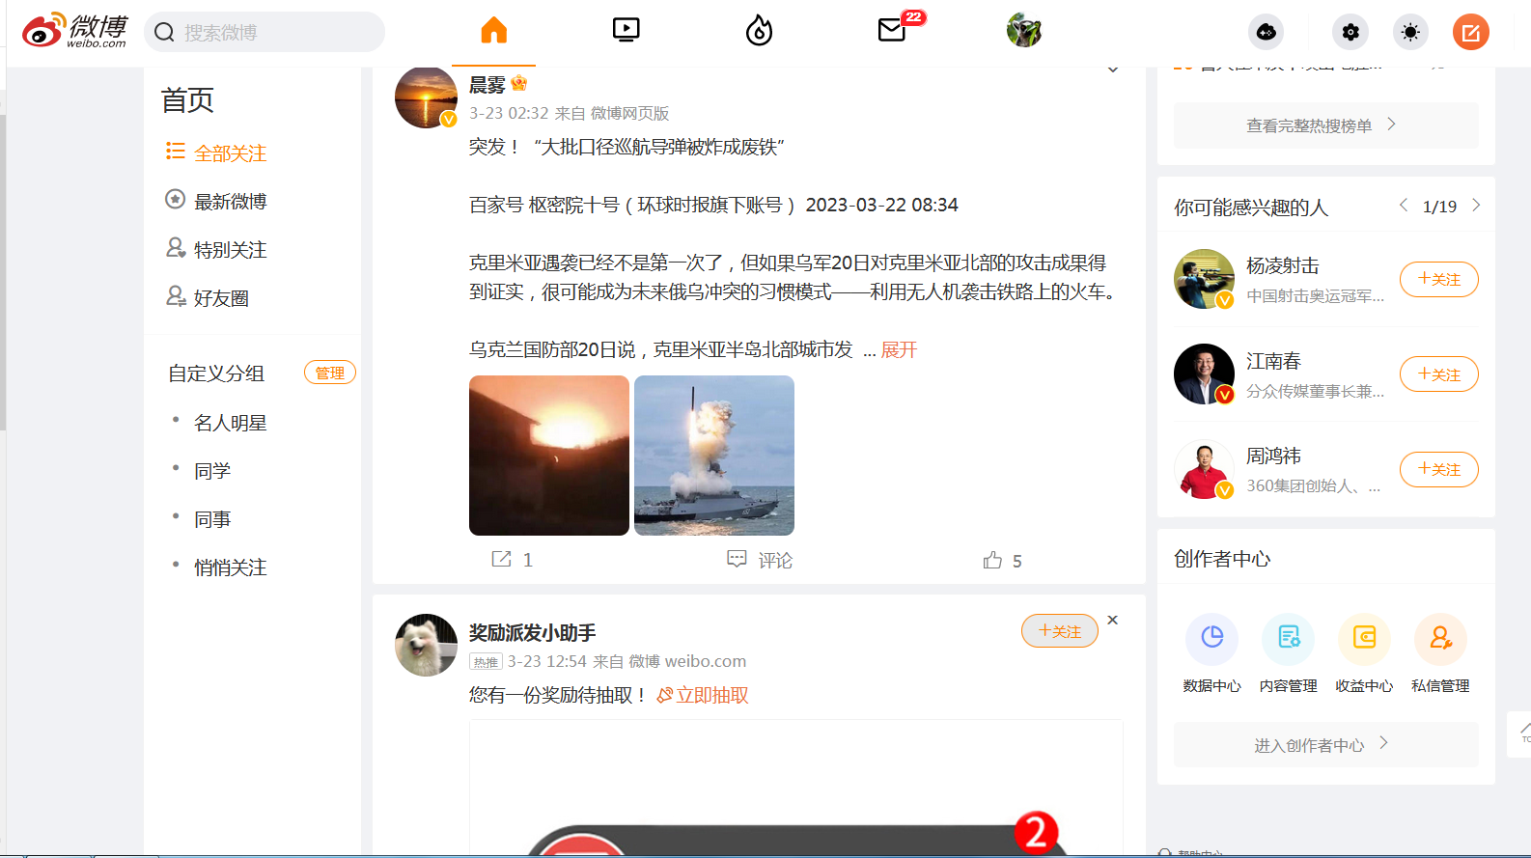

Slide 69
As with traditional blog, microbloggers post about topics ranging from the simple, such as “what I’m doing right now,” to the thematic, such as “sports cars.”
Commercial microblogs also exist, to promote websites, services and/or products, and to promote collaboration within an organization.

Slide 70
Some microblog services offer features such as privacy settings, which allow users to control who can read their microblogs, or alternative ways of publishing entries besides the web-based interface.
These may include text messaging, instant messaging, E-mail, or digital audio.

Slide 71
Microblog services have revolutionized the way information is consumed.
It has empowered citizens themselves to act as sensors or sources of data which could lead to important pieces of information.
People now share what they observe in their surroundings, information about events, and what their opinions are about certain topics, for example government policies in healthcare.

Slide 72
Moreover, these services store various metadata from these posts, such as location and time.
Aggregated analysis of this data includes different dimensions like space, time, theme, sentiment, network structure etc., and gives researchers an opportunity to understand social perceptions of people in the context of certain events of interest. Microblogging also promotes authorship.
On the microblogging platform Tumblr, the reblogging feature links the post back to the original creator.

Slide 73
Microblogging has the potential to become a new, informal communication medium, especially for collaborative work within organizations.
Over the last few years communication patterns have shifted primarily from face-to-face to online in email, IM, text messaging, and other tools.
However, some argue that email is now a slow and inefficient way to communicate.

Slide 74
For instance, time-consuming “email chains” can develop, whereby two or more people are involved in lengthy communications for simple matters, such as arranging a meeting.
The one-to-many broadcasting offered by microblogs is thought to increase productivity by circumventing this.

Slide 75
Users and organizations can set up their own microblog service: free and open source software is available for this purpose.
Hosted microblog platforms are also available for commercial and organizational use.

Slide 76
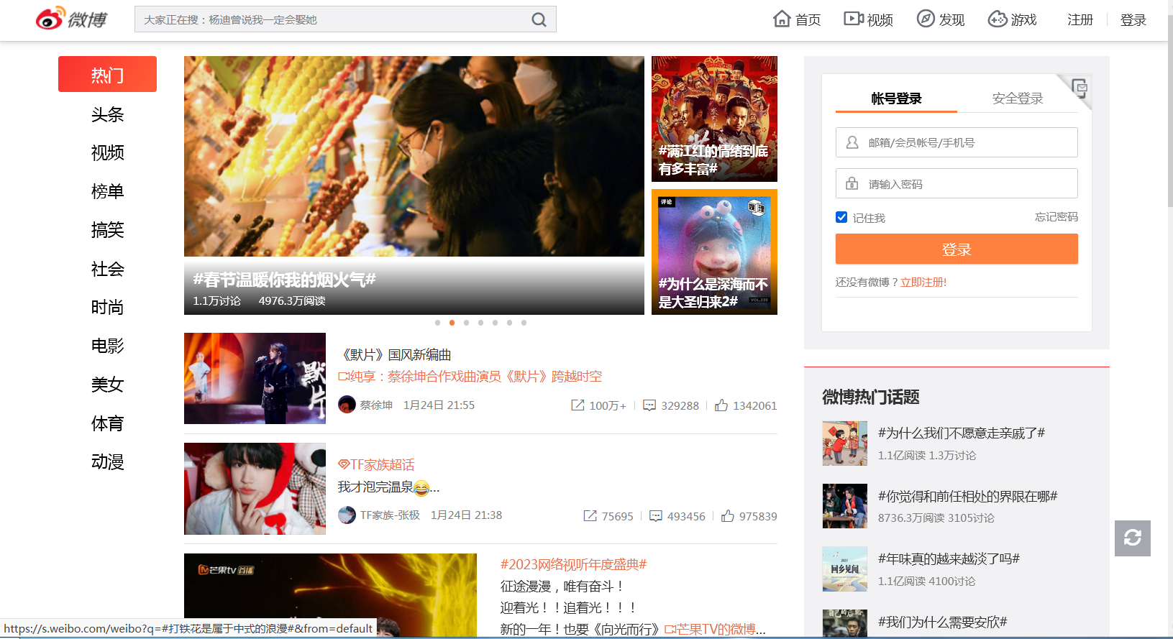

Slide 77
The End of this Section

