Slide 1

AUTOMATED ESSAY SCORING
إعداد الطالبات:
تسنيم زغموت حلا عويس
وسام السحلي عبير السيد

Slide 2
Project Idea:
Mobile Application
system that can score essays automatically like a human

Slide 3
Users
Schools
English Language Centers
People who wants to improve their writing skills

Slide 4

Objectives:
Helping students to prepare for their English writing exam
Saving time and money for both students and teachers

Slide 5
Input & Output
Input
____
Output
____
Essay
Score
details

Slide 6
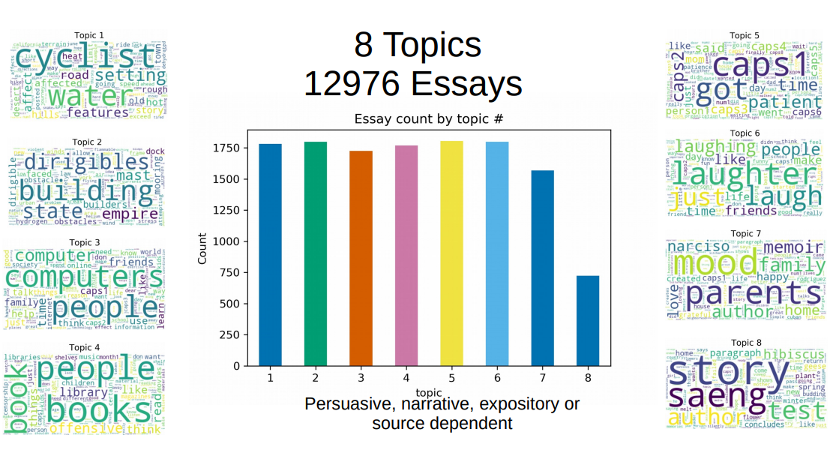
Data Set

Slide 7
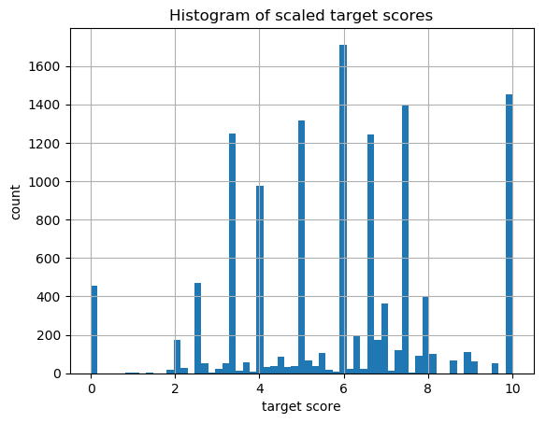
Data Normalization

Slide 8
measure essays writing quality
The model was trained using handcrafted features like:
Number of difficult & uncommon words
Number of spelling and grammar mistakes.
Number of POS tagging.

Slide 9
measure essays writing quality.
readability features
sentences count
Part-of-speech bigrams & trigrams.
word count
Number of transition words

Slide 10
Features Preprocessing:
Features Scaling
Features Selection

Slide 11
Model to measure essay relatedness to the question
Summarization essay
get semantic similarity with the question

Slide 12
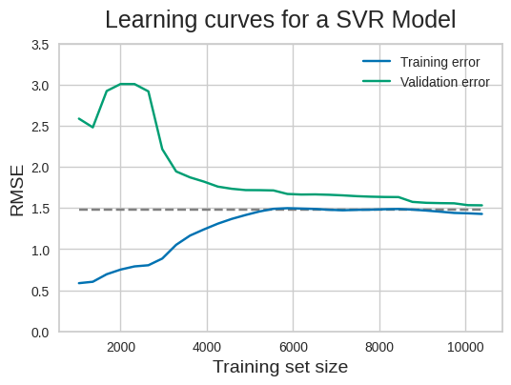
Learning Curve

Slide 13
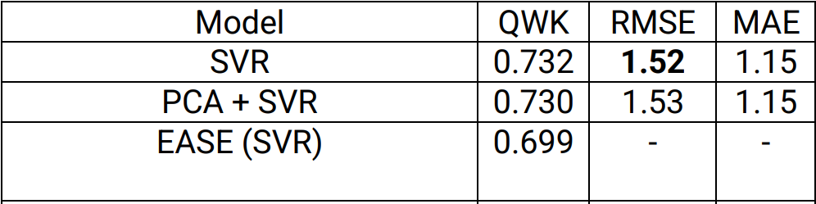
Results

Slide 14
Thank you

