Slide 1
The Little TensorFlower
Yuxian Qiu
Oct 26th, 2017

Slide 2
What is TensorFlow?
An embedded language for tensor computation over Python (or other hosted languages)
A distributed runtime on heterogeneous hardware (CPU / GPU / TPU)
A rich toolset for machine learning (especially deep learning)

Slide 3
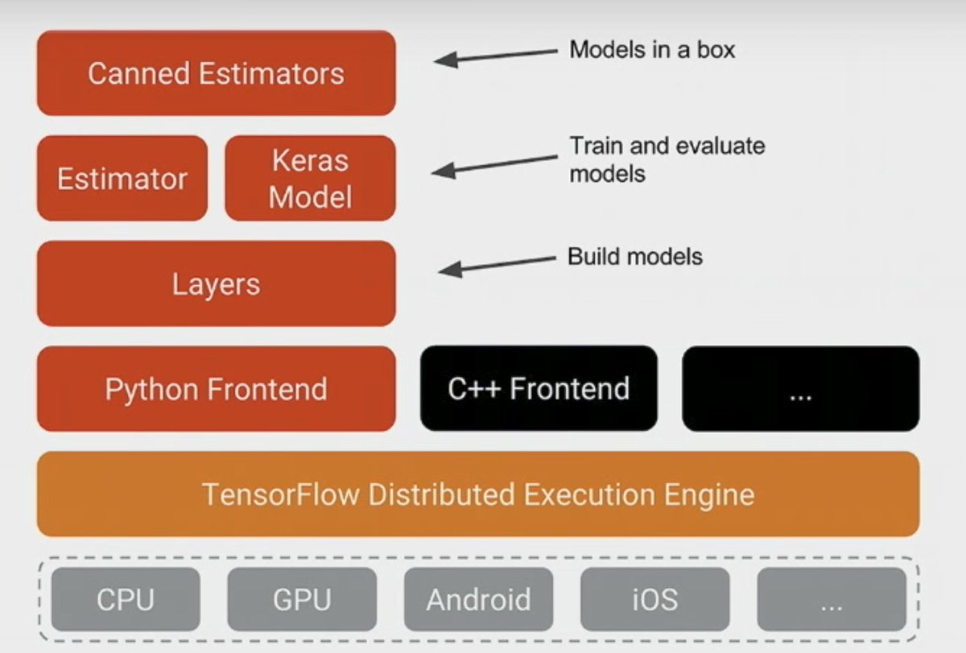
Overview of TensorFlow

Slide 4
Overview of TensorFlow

Slide 5
TensorFlow as a language
All objects in TensorFlow are tensors
Tensor
Typed n-dimensional array
Data type: float32 / float64 / int32
Shape: 256 X 256 X 3
When tensor is
Immutable value => Constant
Mutable value => Variable
Parameter => Placeholder
All functions in TensorFlow are ops

Slide 6
How to calculate 1 + 1
Define add function
Invoke it
import tensorflow as tf
x = tf.placeholder(tf.float32)
y = tf.placeholder(tf.float32)
output = tf.add(x, y)
session = tf.Session()
print sess.run(
[output],
feed_dict={x:[1.], y:[1.]})
# add.tf
def add(x, y):
return x + y
# add.tf
graph add:
placeholder x
placeholder y
fetch add_op(x, y)
tf add.tf x=1 y=1
session add.tf feed_dict={x:1, y:1}

Slide 7
TensorFlow API
Define a graph
Define placeholders / variables / constants
Use ops to combine them
Run the graph in a session
Session as an interpreter
Feed: input
Fetch: output

Slide 8
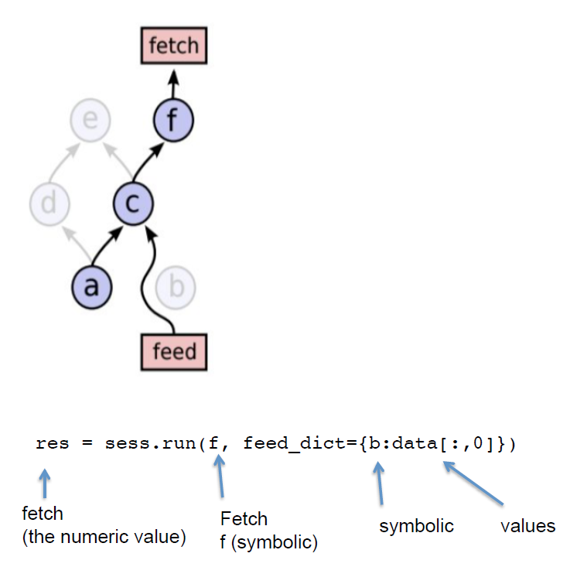
One more thing about feed & fetch
Only calculate necessary subgraph

Slide 9
Use TensorFlow for ML
Define model
Define loss function
Define Graph
Select optimizer
Use examples to train
Use session to run
ML
TensorFlow

Slide 10
An example
import tensorflow as tf
# Model parameters
W = tf.Variable([.3], dtype=tf.float32)
b = tf.Variable([-.3], dtype=tf.float32)
# Model input and output
x = tf.placeholder(tf.float32)
linear_model = W * x + b
y = tf.placeholder(tf.float32)
# loss
loss = tf.reduce_sum(tf.square(linear_model - y)) # sum of the squares
# optimizer
optimizer = tf.train.GradientDescentOptimizer(0.01)
train = optimizer.minimize(loss)
# training data
x_train = [1, 2, 3, 4]
y_train = [0, -1, -2, -3]
# training loop
init = tf.global_variables_initializer()
sess = tf.Session()
sess.run(init) # reset values to wrong
for i in range(1000):
sess.run(train, {x: x_train, y: y_train})
# evaluate training accuracy
curr_W, curr_b, curr_loss = sess.run([W, b, loss], {x: x_train, y: y_train})
print("W: %s b: %s loss: %s"%(curr_W, curr_b, curr_loss))

Slide 11
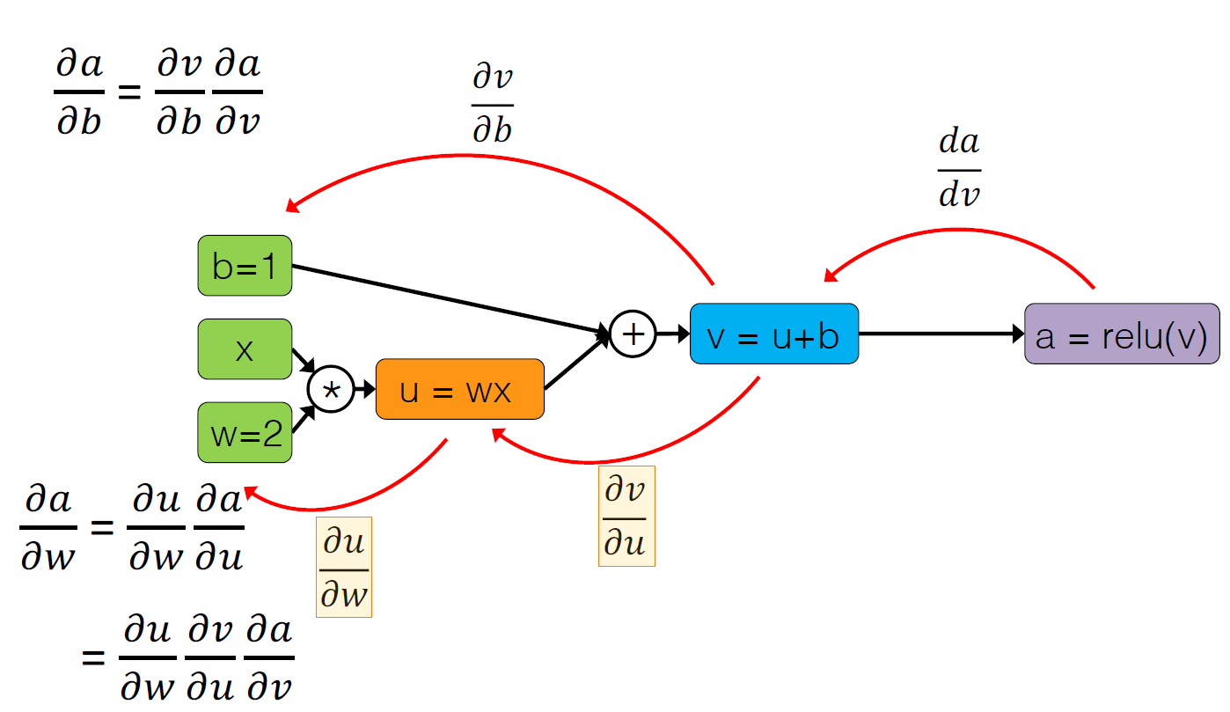
Optimizer use automatic differentiation

Slide 12
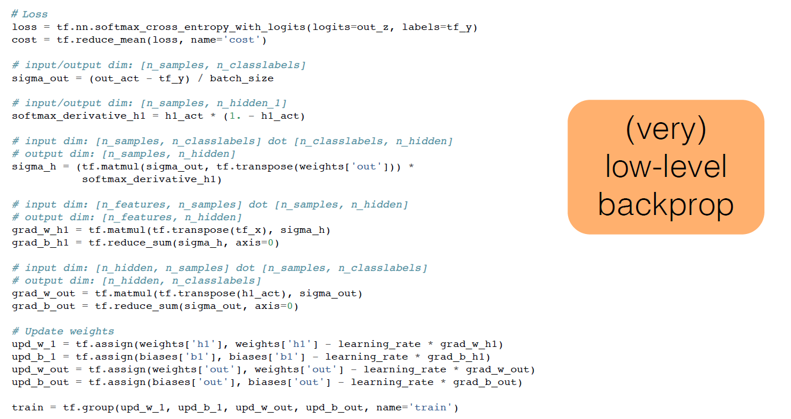
Without automatic differentiation

Slide 13
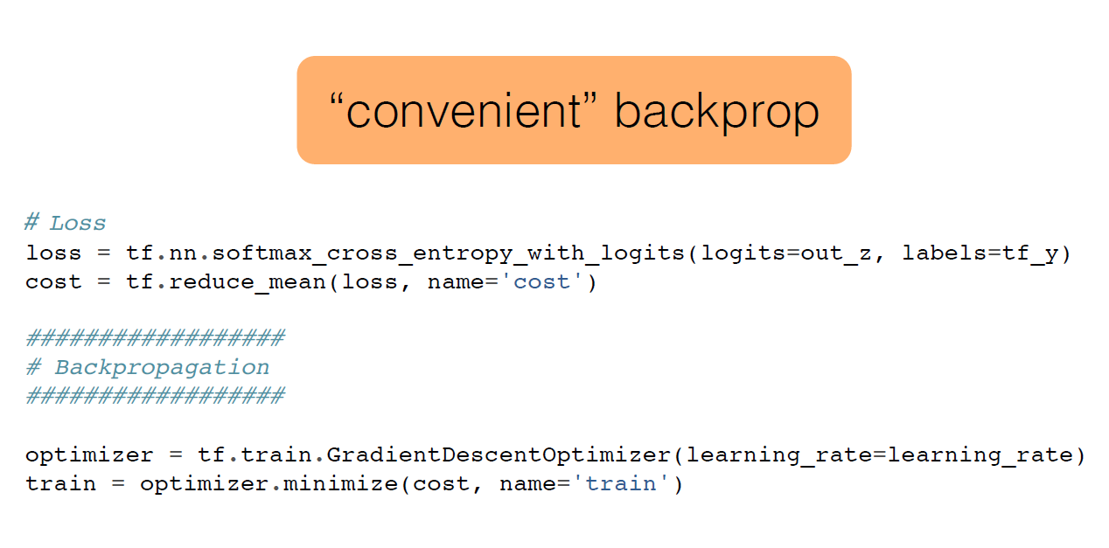
With automatic differentiation

Slide 14
Overview of TensorFlow

Slide 15
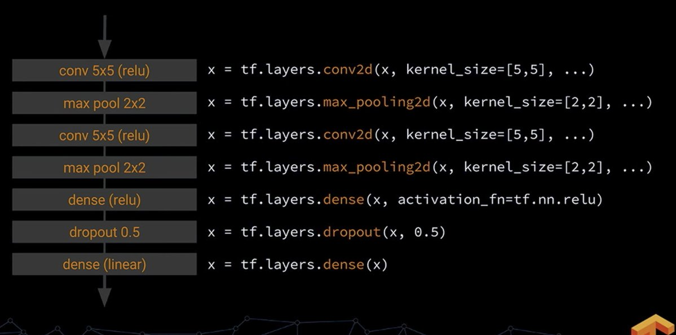
Layers: Ops for Neural Network

Slide 16
Overview of TensorFlow

Slide 17
Estimator
Define model
Define loss function
Select estimator
Select optimizer
import tensorflow as tf
import numpy as np
# select estimator
feature_columns = [tf.feature_column.numeric_column("x", shape=[1])]
estimator = tf.estimator.LinearRegressor(feature_columns=feature_columns)
# select data
x_train = np.array([1., 2., 3., 4.])
y_train = np.array([0., -1., -2., -3.])
input_fn = tf.estimator.inputs.numpy_input_fn(
{"x": x_train}, y_train, batch_size=4, num_epochs=None, shuffle=True)
# train
estimator.train(input_fn=input_fn, steps=1000)

Slide 18
Overview of TensorFlow

Slide 19
Keras: High-level API for DL
Keras 2.0 API Spec
fchollet/keras (official implementation)
Support TensorFlow / Theano / CNTK
tf.keras (TensorFlow implementation)

Slide 20
Vanilla Keras
from keras.models import Sequential
from keras.layers import Dense, Activation
# define model
model = Sequential()
model.add(Dense(units=64, input_dim=100))
model.add(Activation('relu'))
model.add(Dense(units=10))
model.add(Activation('softmax'))
model.compile(loss='categorical_crossentropy',
optimizer='sgd',
metrics=['accuracy'])
# select data
model.fit(x_train, y_train, epochs=5, batch_size=32)
# train
model.train_on_batch(x_batch, y_batch)

Slide 21
Keras in TensorFlow (AFAIK)
from tensorflow.keras.models import Sequential
from tensorflow.keras.layers import Dense, Activation
# define model
model = Sequential()
model.add(Dense(units=64, input_dim=100))
model.add(Activation('relu'))
model.add(Dense(units=10))
model.add(Activation('softmax'))
model.compile(loss='categorical_crossentropy',
optimizer='sgd',
metrics=['accuracy'])
# select data
model.fit(x_train, y_train, epochs=5, batch_size=32)
# train
model.train_on_batch(x_batch, y_batch)

Slide 22
Overview of TensorFlow

Slide 23
Distribute Graph among Devices
Ops provide implementations for different devices (CPU / GPU)
Automatically insert Send/Recv Ops to transport tensors across devices
Recv ops pull data from Send ops

Slide 24
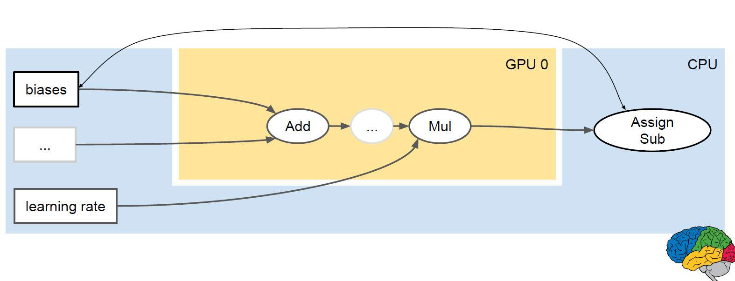
Original dataflow graph

Slide 25
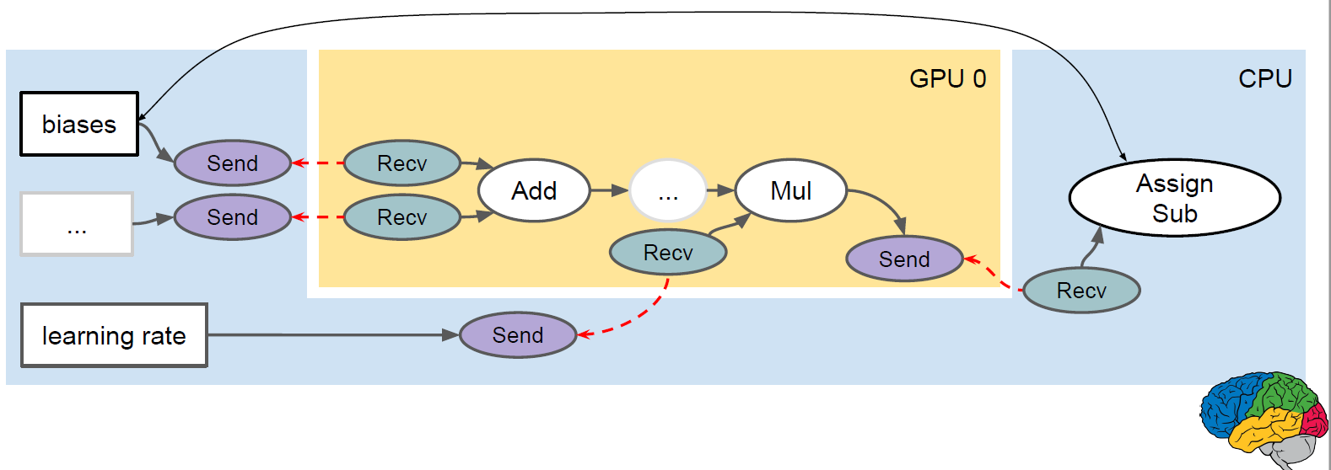
Dataflow Graph with Send/Recv Ops

Slide 26
Send and Receive Implementations
Different implementations depending on source/dest devices
GPUs on same machine: local GPU → GPU copy
CPUs on different machines: cross-machine RPC
GPUs on different machines: RDMA
Yahoo fork (https://github.com/yahoo/tensorflow/tree/yahoo)

Slide 27
Thanks~ Questions?

