Slide 1

+
—
NAU 2023
AI society

Slide 2
WPS AI
目录
Copilot AI
ChatGPT
My expectations

Slide 3

+
—
Firstly, let me share how artificial intelligence has gradually become crucial, drawing from my own experiences. In my daily tasks, I frequently utilize the WPS AI feature of Kingsoft Office software, especially when my mentor is about to hold a meeting. With the intelligent PPT function, I simply input the topic on a page, and within less than thirty seconds, a fifteen-page PPT is generated.
01

Slide 4

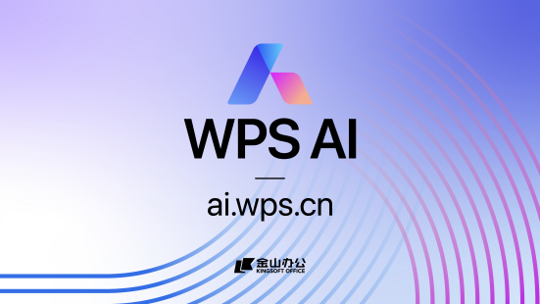
WPS AI

Slide 5
+
—
When coding, I rely on GitHub Copilot, a powerful tool that converts comments into code. By describing the desired logic in a comment, GitHub Copilot automatically "understands" and generates the corresponding code, even filling in repetitive code.
02

Slide 6
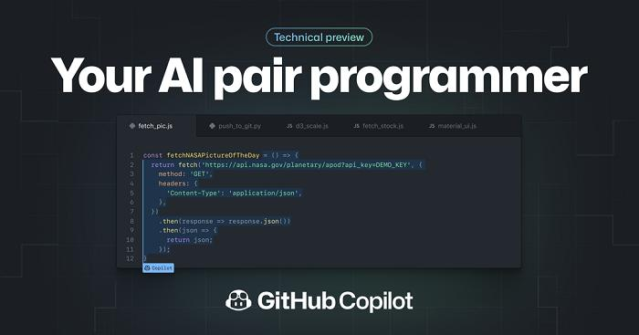
Copilot AI

Slide 7
+
—
Additionally, when facing challenges in writing papers, I turn to ChatGPT from OpenAI to gain inspiration. These experiences underscore the importance of judiciously using AI tools to enhance productivity.
03

Slide 8
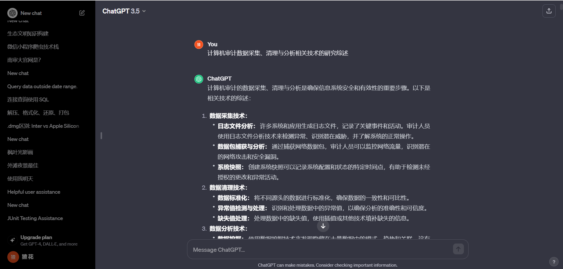
ChatGPT

Slide 9
+
—
In a society equipped with artificial intelligence capabilities, I anticipate witnessing numerous transformative changes across various domains. Industries will experience enhanced automation and efficiency, education and healthcare will benefit from personalized and adaptive technologies, advanced predictive capabilities will shape decision-making, and innovative solutions will emerge for complex problems.
04

Slide 10
+
—
Moreover, the widespread adoption of artificial intelligence is likely to spark extensive discussions and explorations on ethical considerations and societal impacts. The integrated use of AI technologies is poised to reshape our modes of work, learning, and interaction with the world.
04

Slide 11

AI acclerates society

Slide 12
+
—
NAU
Thank you!

