Slide 1


Rockbuster Stealth LLC Data Analysis
Beatriz Acosta

Slide 2
Key Objectives
The goal of this presentation is to explore customer behavior from a global perspective, identify who our most valuable customers are, and recommend business strategies based on the patterns found in the data. All findings are visualized using Tableau and available via an interactive dashboard

Slide 3
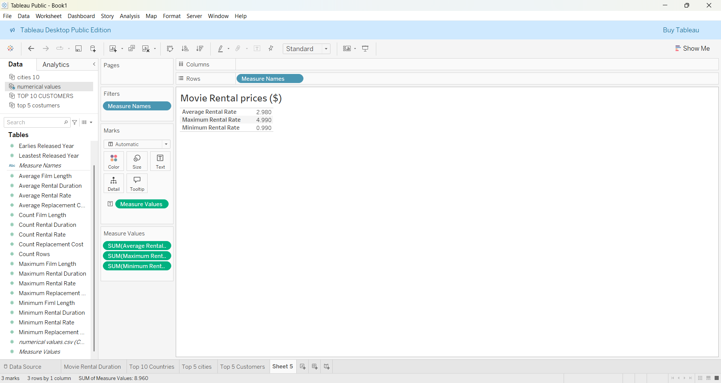
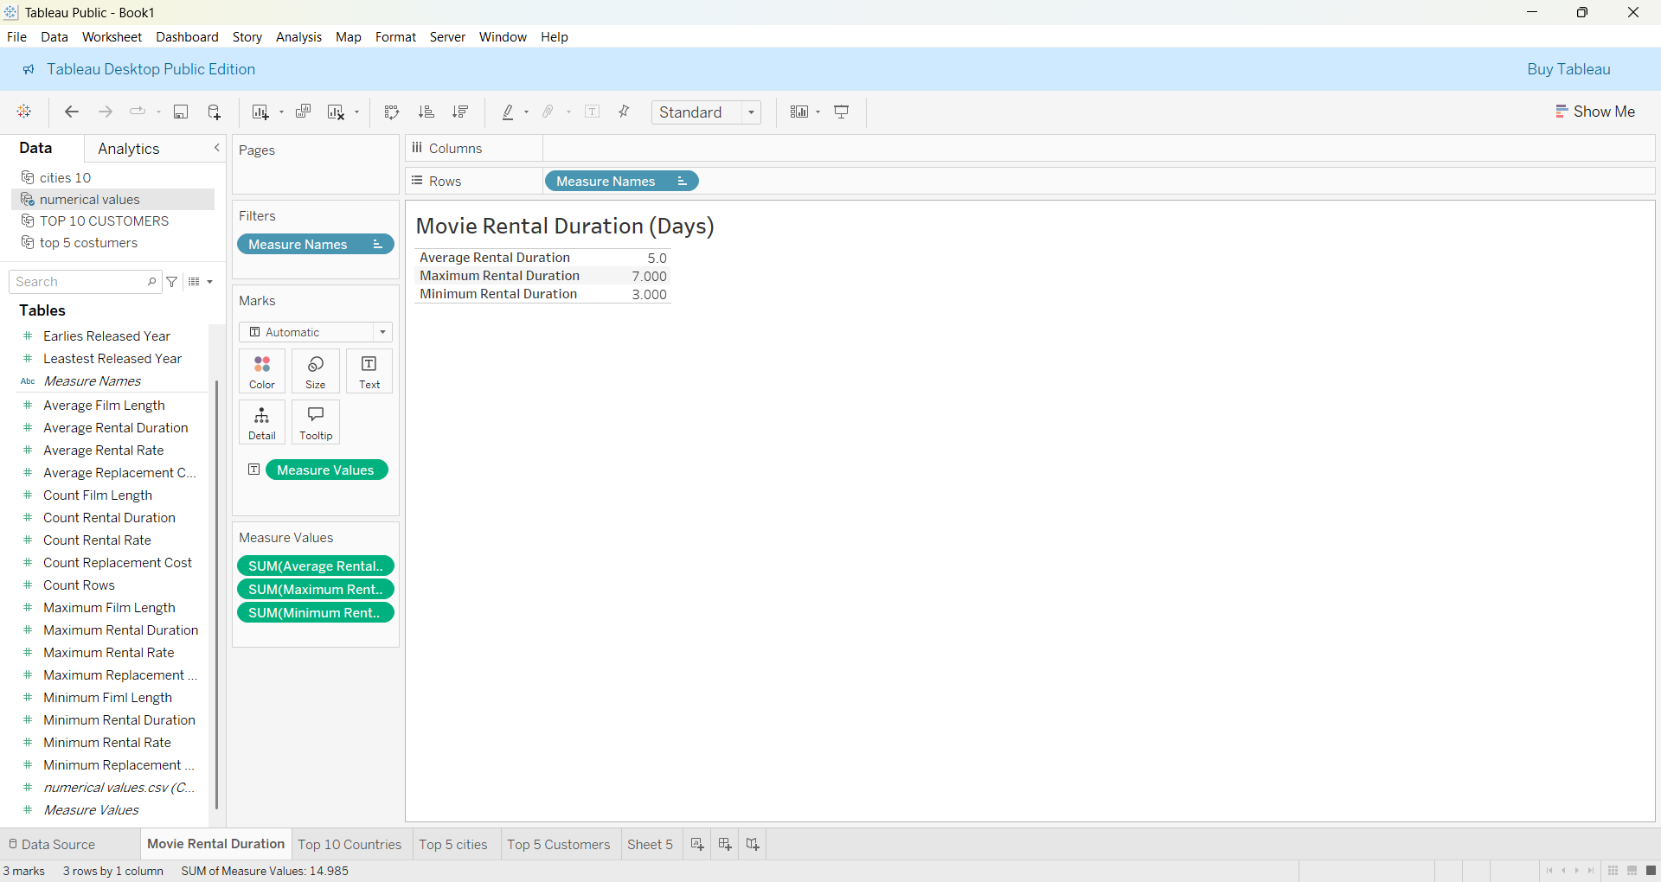
Summary Statistics
Most movie rentals cost around $3, but prices vary significantly, with some as low as 99 cents and others nearly $5. Rentals typically last 5 days, though users sometimes keep movies for shorter or longer periods. This range suggests opportunities for flexible pricing or rental duration models.

Slide 4
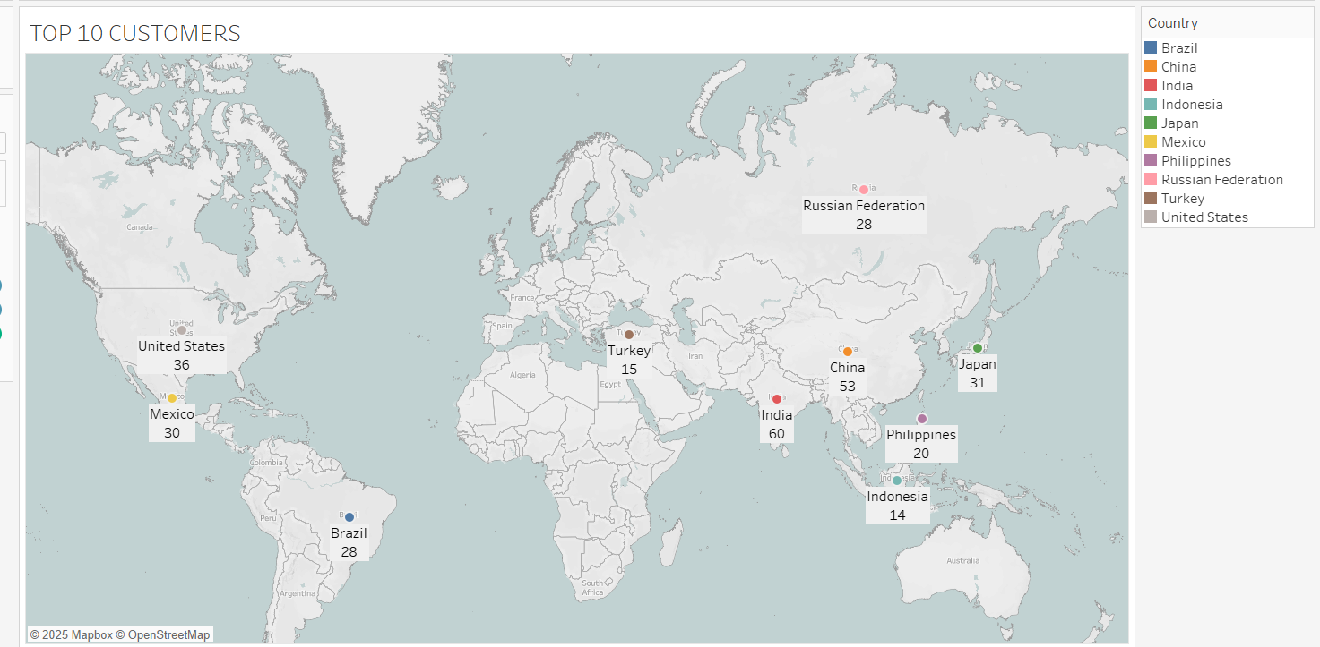
Countries with most Customers
Our top customer bases are concentrated in India, China, and the United States, making up nearly half of all top customers. Asia shows the strongest performance overall, with five countries in the top 10. Regions like Brazil, Mexico, and Russia also show strong engagement, while countries like Indonesia and Turkey may benefit from targeted marketing strategies to boost customer numbers.

Slide 5
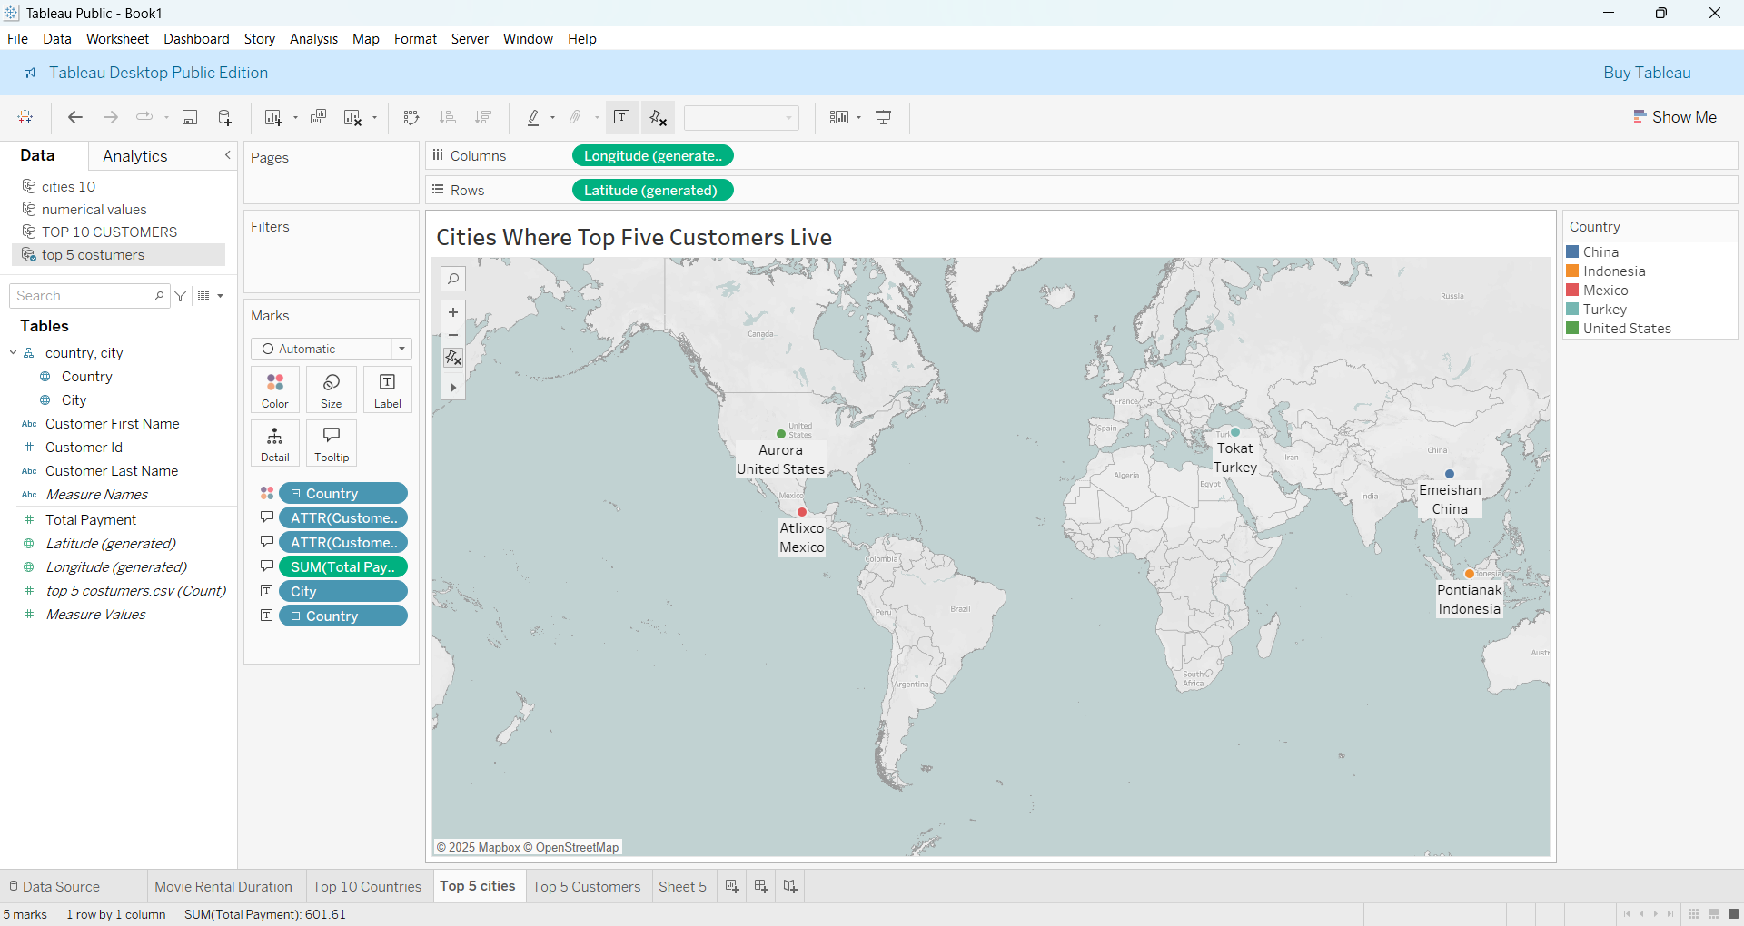
Top 5 cities from top countries
Our top five individual customers are spread across the globe from Aurora in the U.S. to Pontianak in Indonesia. This highlights the importance of maintaining strong international support and tailoring customer engagement strategies to specific regions where high spenders reside.

Slide 6
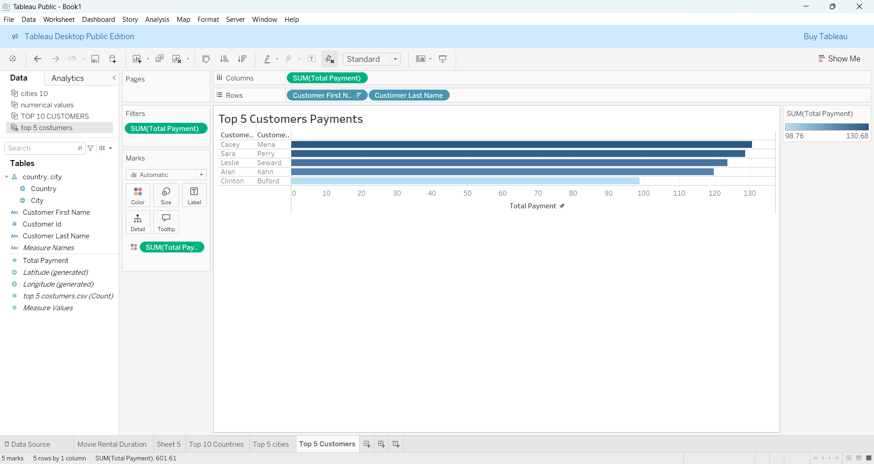
Top 5 customers
Our top 5 customers together contributed over $600 in revenue, with Casey Mena leading at $130. These high spending users are spread globally and present opportunities for targeted retention programs, personalized offers, and deeper customer engagement strategies

Slide 7
Tableau Public Link
View interactive dashboard here:
3.10 Presenting SQL results | Tableau Public

Slide 8
Turning Insights into action
1. Focus on High-Performing Markets: Prioritize India, China, and the United States for marketing and customer retention efforts, as they represent the largest customer bases by volume and payment activity.
2. Strengthen Relationships with Top Customers: The top 5 customers alone contributed over $600 in total payments. Consider launching a VIP loyalty program or exclusive offers for high-value customers to maintain engagement and increase lifetime value.
3. The current average rental price is $2.98, with prices ranging from $0.99 to $4.99. This wide spread suggests an opportunity to implement a tiered pricing model that aligns with customer value perception and content type.

Slide 9
Q&A Session
Thank you for your attention
Please feel free to ask any questions or feedback regarding the presentation at this time.

