Slide 1


BIG IoT Open Call 2
midterm status for Flowhub
Jon Nordby, 26 September, 2018

Slide 2
Extension objectives
Simple to build web applications
based on BIG IoT offerings
Using standard JavaScript in browser
Using Flowhub+NoFlo visual programming

Slide 3
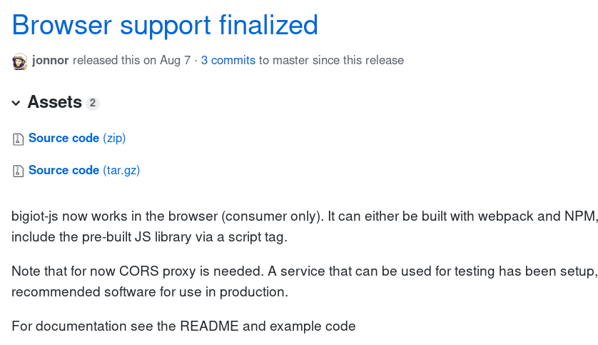
D1: Browser support in bigiot-js
NPM: bigiot-js

Slide 4
bigiot-js use in browser
Same API as for Node.JS
+ supports a CORS proxy server

Slide 5
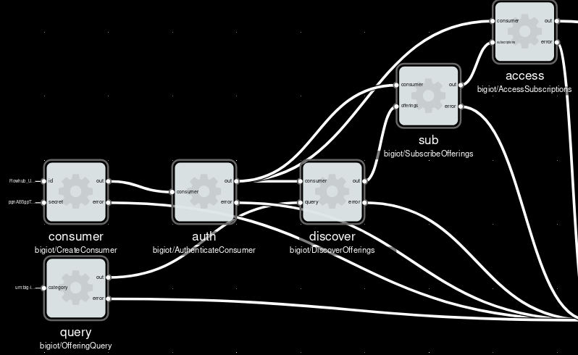
D2: NoFlo components for consumers
NPM: noflo-bigiot

Slide 6
I1: Marketplace API not CORS enabled
Gitlab: marketplace#42

Slide 7
I2: Marketplace SSL soon untrusted
Chrome 70 will remove certificate.
Release: Sept 13 – Oct 15
Gitlab: marketplace-portal#44

Slide 8
I3: Most offerings not browser ready
Using defaults in Java Provider:
Self-signed SSL certificate
CORS headers not enabled

Slide 9
Enable CORS for offerings

Slide 10
Setup SSL for offerings
A) Setup own cert in Java Provider lib (?)
B) Use a HTTP proxy (nginx/Apache...)

Slide 11
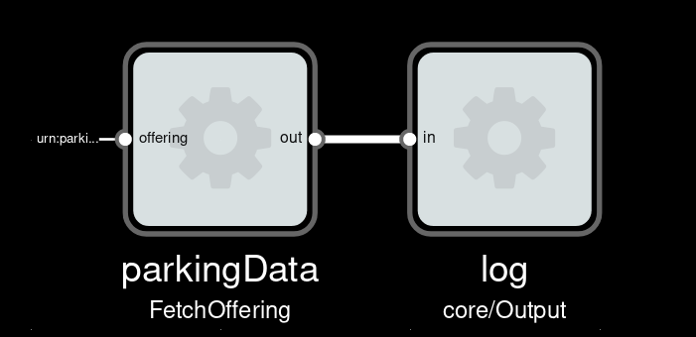
D3: “Driver” Parking space app
Builds on D1: bigiot-js and D2: noflo-bigiot
Done: Project skeleton, fetching data
TODO:
App/User Interface

Slide 12
Summary
Deliverables 1,2 are completed:
Can develop BIG IoT apps in browser
BUT must use CORS proxy
Deliverable 3 on schedule for second half
WANT: Marketplace CORS and SSL fixes
Nice-to-have: More browser-friendly offerings

