Slide 1


BIG IoT Open Call 2
final meeting - Flowhub
Jon Nordby, 07 November, 2018

Slide 2
Extension objective
Make it simple to
build web applications
based on BIG IoT offerings

Slide 3
Extention parts
1) Enable standard JavaScript in browser
2) Enable Flowhub+NoFlo visual programming
3) Demo app: “Park My Car”

Slide 4
Park My Car
Scenario
You are driving in a new city,
looking for an available parking spot.

Slide 6
Park My Car - summary
Minimally useful
Android, iOS, desktop
Integrates like a native app
BIG IoT benefit: data from many providers

Slide 7
Browser requirements for APIs
Well-known SSL certificate
Cross-Origin-Request-Sharing (CORS)
Marketplace API
Offerings

Slide 8
bigiot-js
JavaScript library for BIG IoT Marketplace
alternative to BIG IoT Java lib
Provider and consumer support
Open Call 1: Node.js only
Open Call 2: Browser support

Slide 9
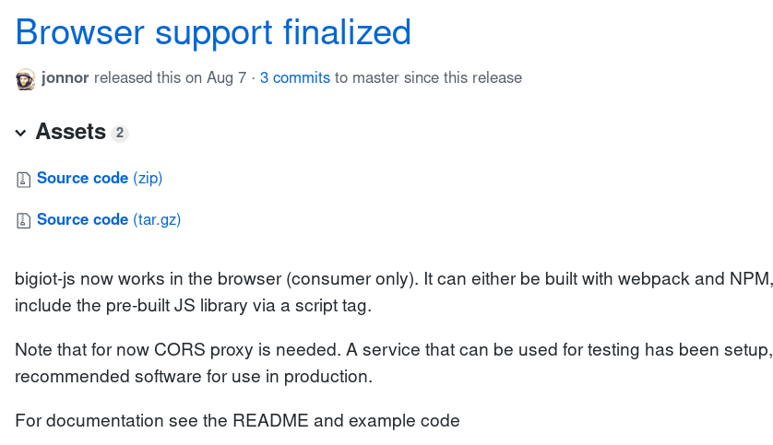
D1: Browser support in bigiot-js
NPM: bigiot-js

Slide 10
bigiot-js use in browser
Same API as for Node.JS
+ supports a CORS proxy server

Slide 11
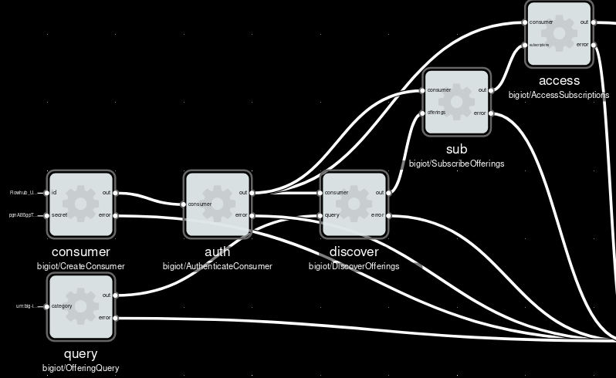
D2: NoFlo components for consumers
NPM: noflo-bigiot

Slide 12
I1: Marketplace API not CORS enabled
Gitlab: marketplace#42

Slide 13
I2: Marketplace SSL soon untrusted
Chrome 70 will remove certificate.
Release: Sept 13 – Oct 15
Gitlab: marketplace-portal#44

Slide 14
I3: Most offerings not browser ready
Using defaults in Java Provider:
Self-signed SSL certificate
CORS headers not enabled

Slide 15
Enable CORS in provider

Slide 16
Setup SSL in provider
A) Setup cert in Java Provider lib
ex: Santander offerings
B) Use a HTTP proxy
ex: nginx/Apache/Caddy…
or Heroku/Cloudflare/GCE/...

Slide 17
Summary 1/2
Deliverables 1,2,3 completed:
Can develop BIG IoT apps in browser
BUT must currently use CORS proxy

Slide 18
Summary 2/2
Marketplace CORS tested OK in dev
Santander,Thingful,Flowhub offerings OK

