Slide 1
SPI Slave Design
BY Eric Yang 2026.08

Slide 2
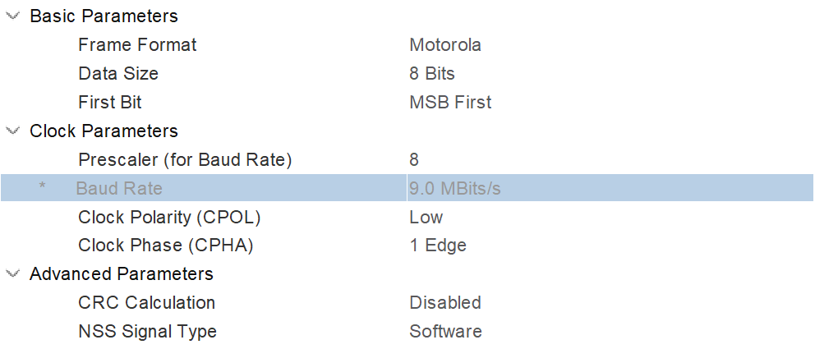
Overview
Features
CPOL=0, CPHA=0
MSB first
Back-to-back transfer support
8 x 16-bit registers available
Read data within the same frame
No system clock
24-bit self-defined frame protocol
Frame Structure (MSB first)
[23] RW 0 = write, 1 = read
[22:16] ADDR only the low AW bits are decoded, upper bits ignored
[15:0] DATA
Easy to communicate with MCU using an 8-bit SPI peripheral.
3 Back-to-back transfers per frame with software NSS control.

Slide 3
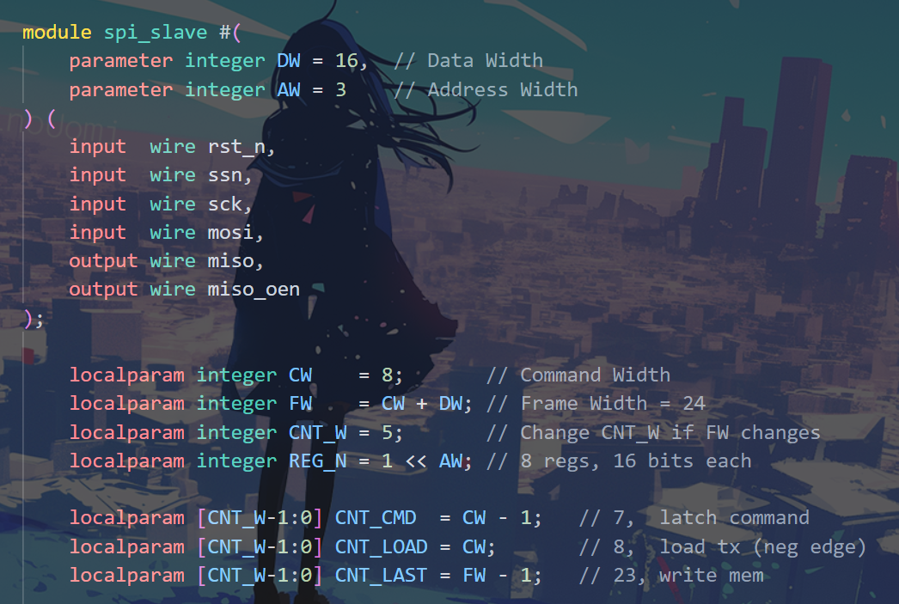
Front-end Design
No system clock:
- No CDC problem
Design is parameterized –
Easy to customize the frame format,
or modify the number of registers.
SPI Slave Block Diagram

Slide 4
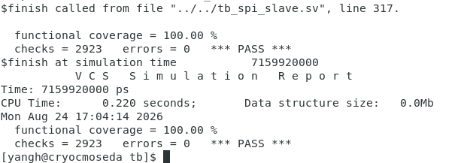
RTL Simulation
Simulator: VCS
Testbench Language: SystemVerilog
Verification tasks:
Reset behavior
All zeros/ones transfer
Back-to-back transfer
Read/Write same addr
Read/Write when deselected
Randomized multi-frame transfer
Functional coverage

Slide 5
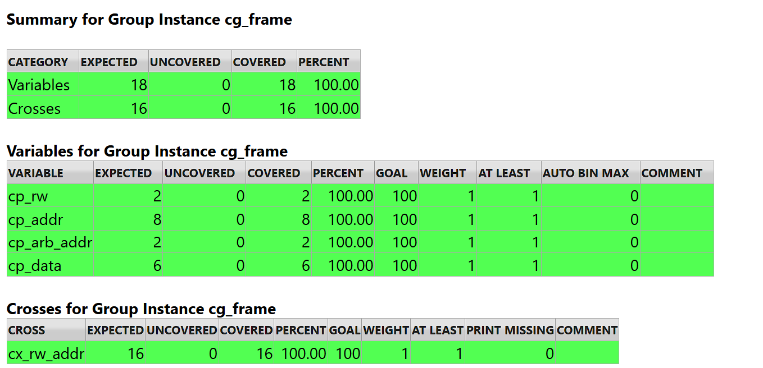
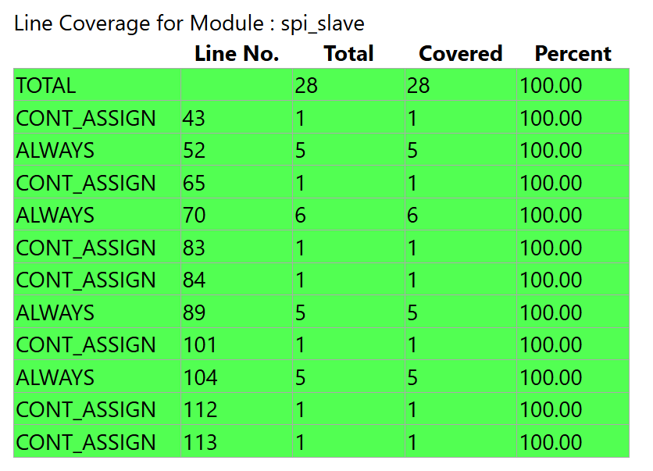
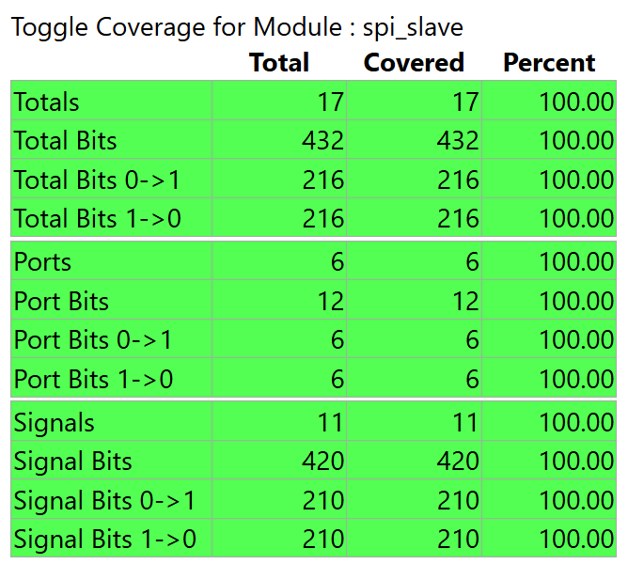
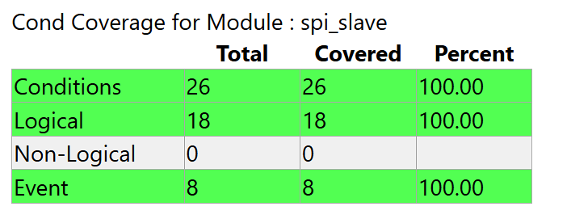
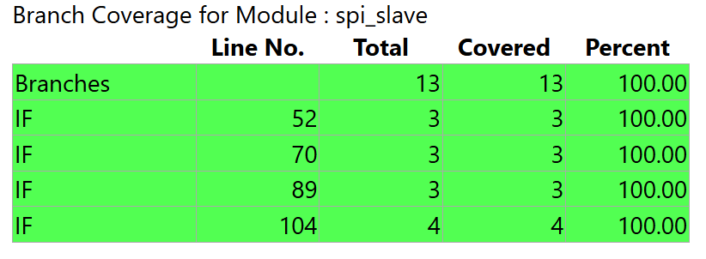
Coverage Report
Functional Coverage
Cover both read and write
Cover all 8 regs
Cover arbitrary addr_hi
Cover data with boundary conditions
(Cross Cover) All regs should be both read and written
Line/Cond/Toggle/Branch Coverage
All 100% in VCS coverage report

Slide 6
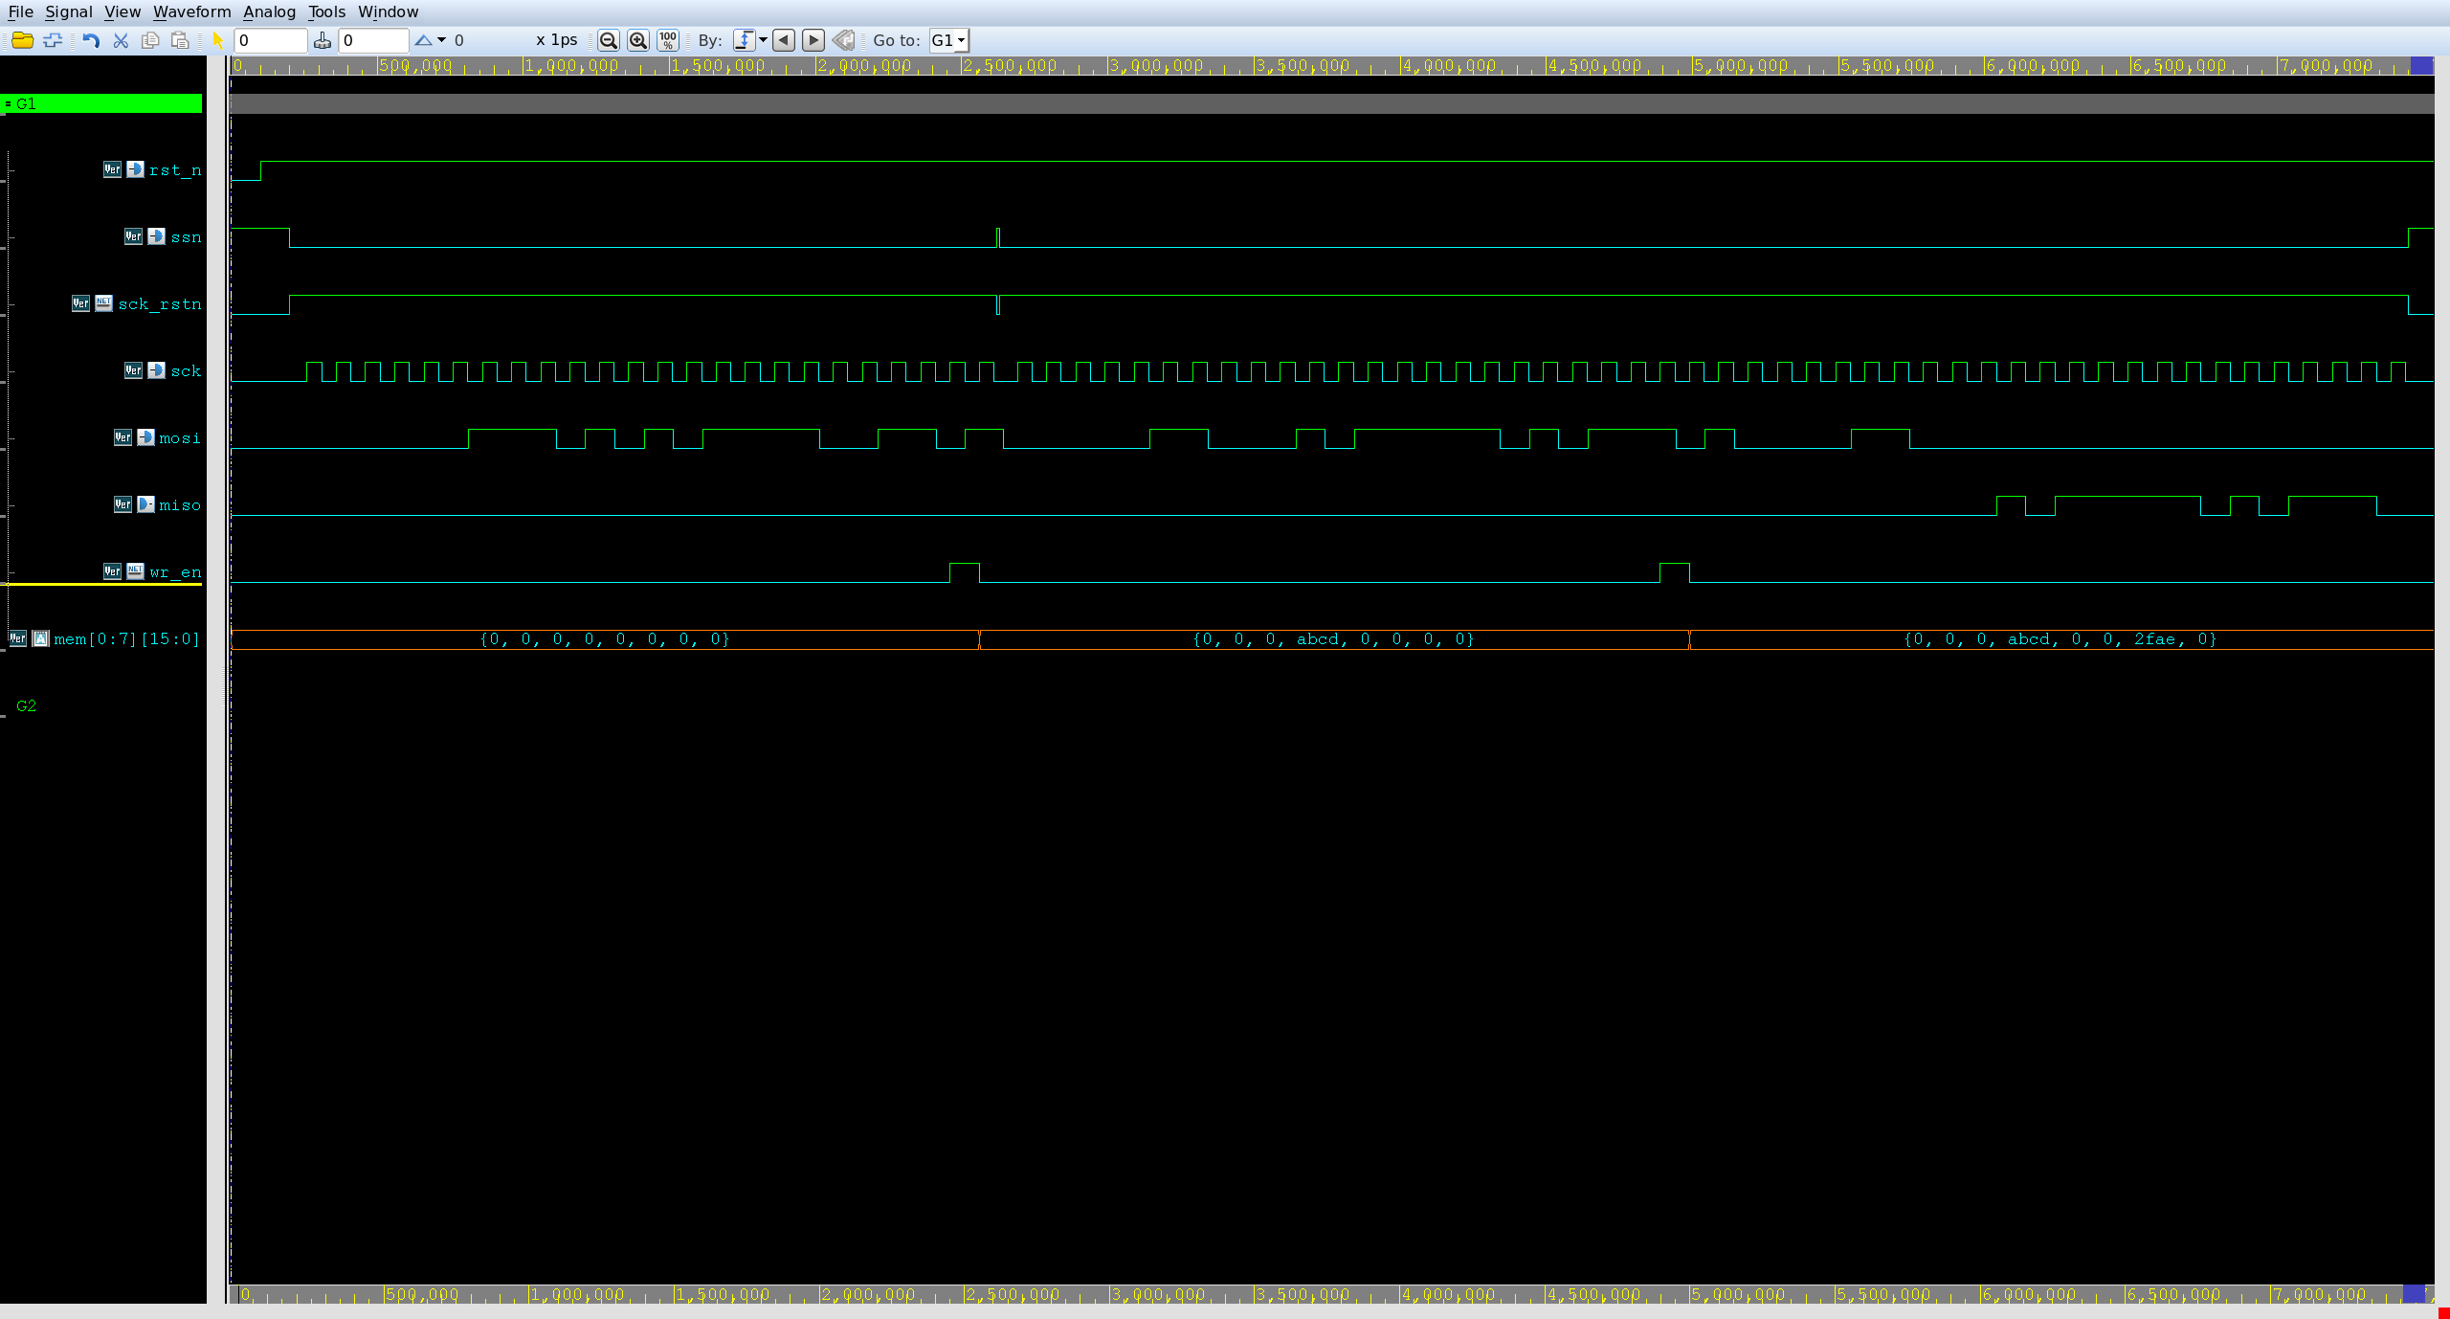
Waveforms of Transfers
Read Command
Data Received
Write 16’hABCD to 7’d3
Write 16’h2FAE to 7’d6
Read from 7’d6
Back-to-back transfer

Slide 7
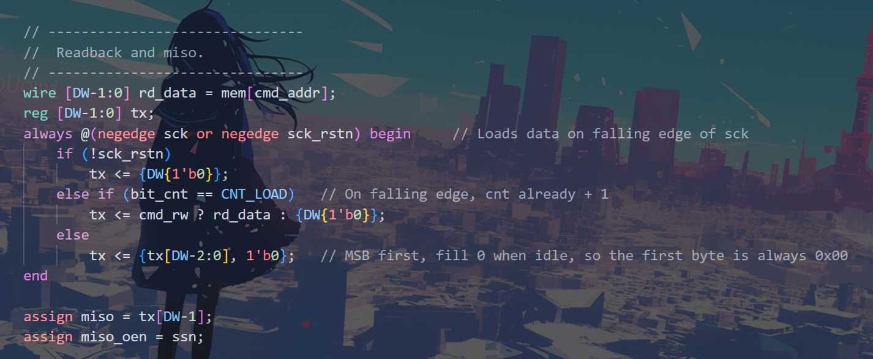
Back-end Design
Constraints (Without IO)
Clock Frequency: 10MHz
Clock Uncertainty: ~10% T
Clock Transition: 0.3ns
Duty Cycle 60% (60% High, 40% Low)
Input/Output delay:
Max (setup): Assume 50% CLK_LOW for setup
Min (hold): No requirement as a half-cycle remains before sampling
Max Fanout: 20
Data is transmitted at negedge,
but sampled at posedge.
Critical path for output delay (setup).

Slide 8
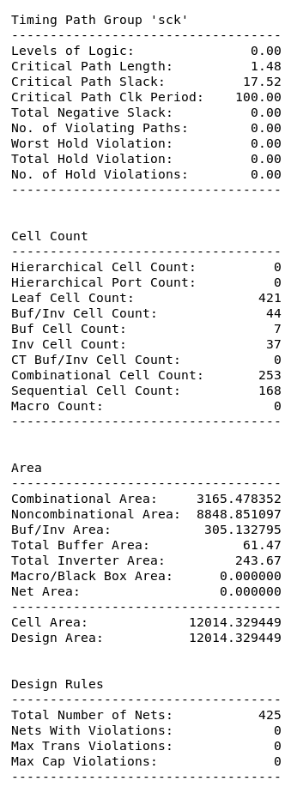
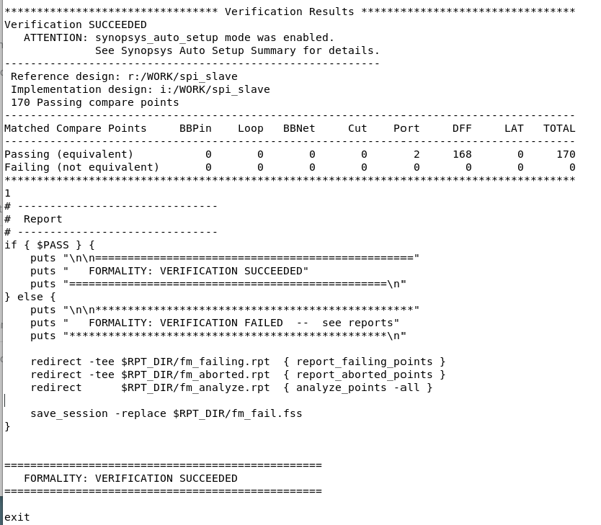
DC & FM
DC Summary
No Violation
Area: 12014.33 um²
FM Summary
No LAT
Verification Succeeded

Slide 9
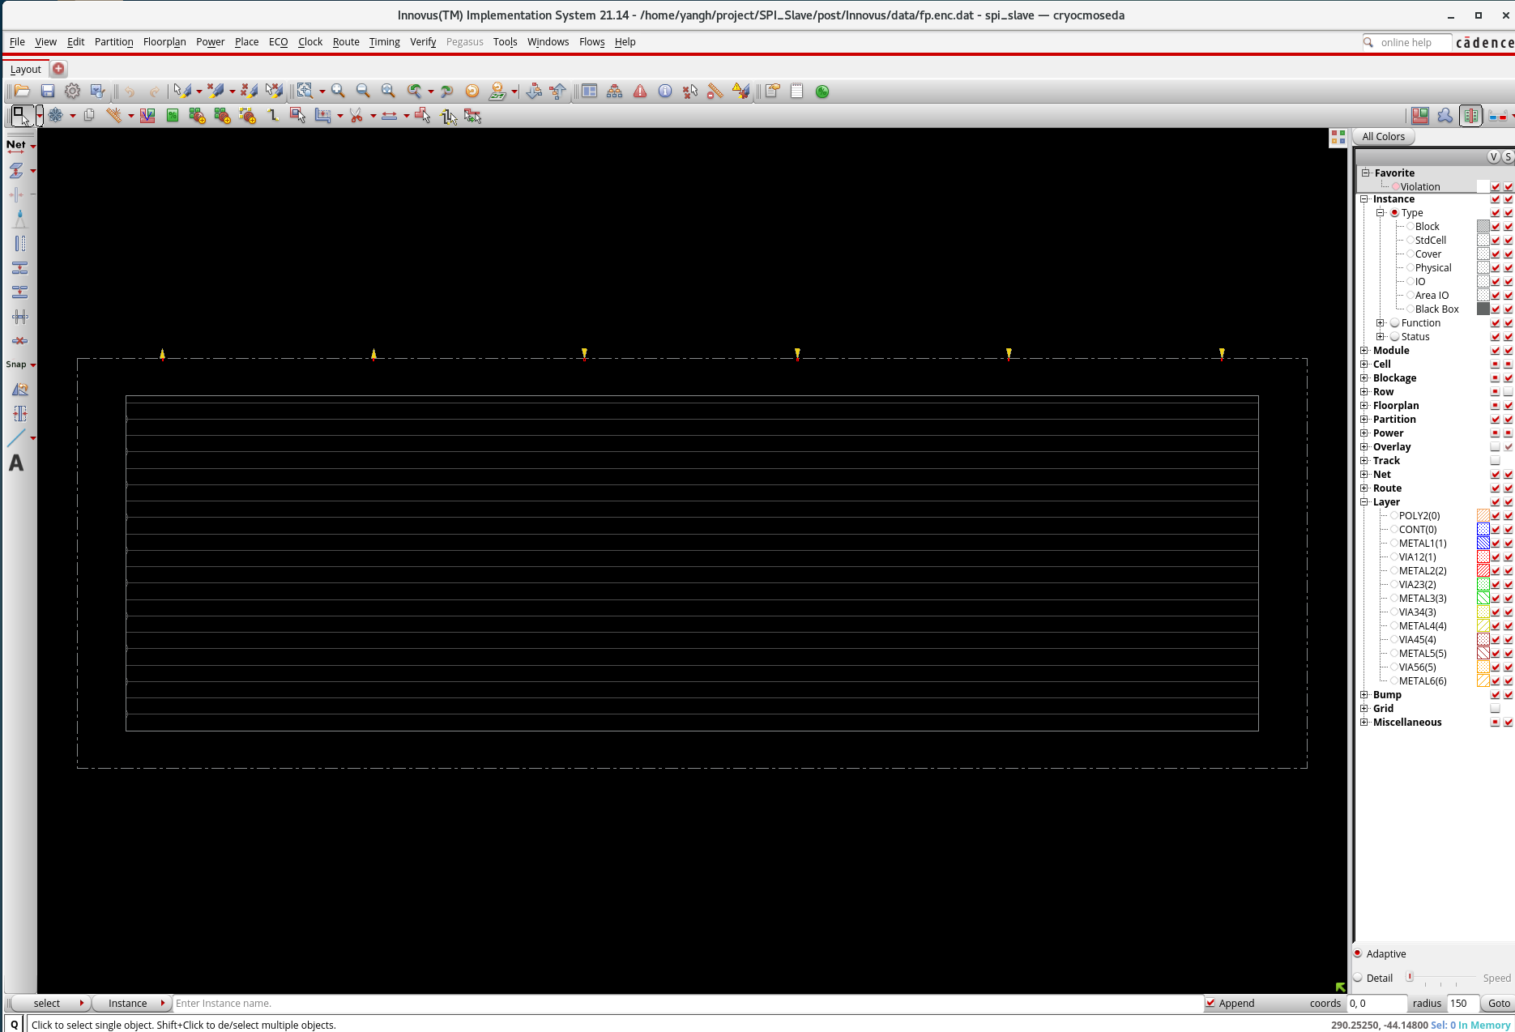
Innovus
Process: TSMC 0.18um
LIB: tcb018gbwp7t
WC: SS/125℃/1.62V for setup
BC: FF/ 0℃ / 1.98V for hold
FloorPlan
Die: 294um * 98um
DIE_W = 294 = core 270 + 2 x 12 margin
DIE_H = 98 = core 80 + 2 x 9 margin
Pins: {miso miso_oen mosi sck ssn rst_n}

Slide 10
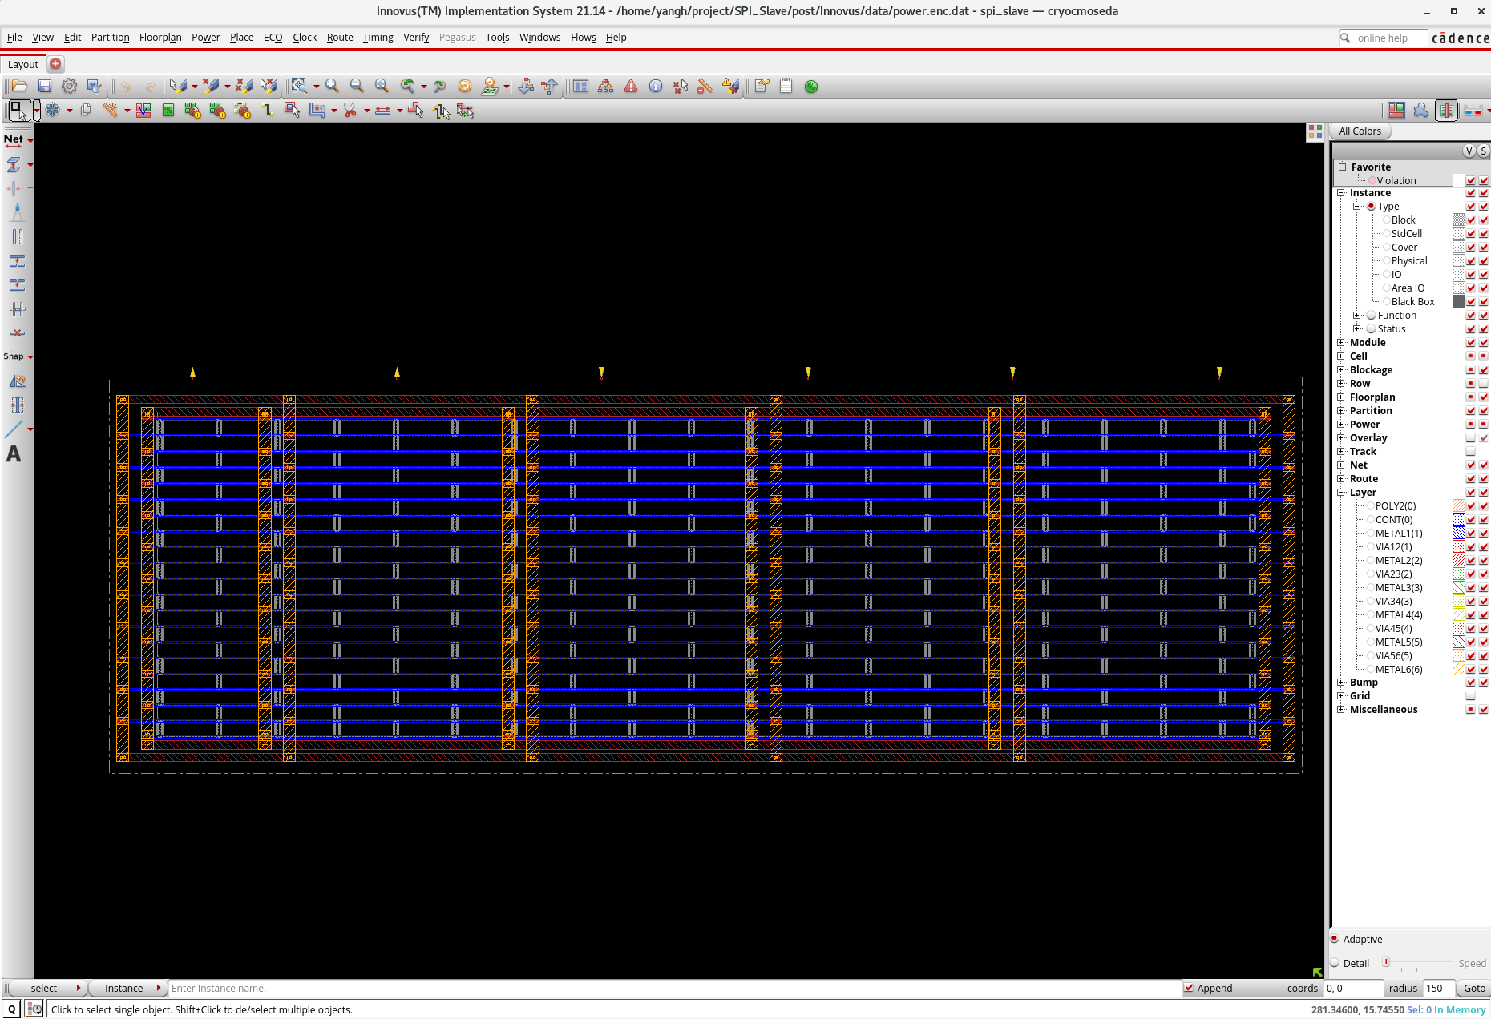
Innovus
Power
Power Ring
Metal 6 Vertical
Metal 5 Horizontal
Power Stripe
Metal 6 Vertical
4 sets
Power Rail
Metal 1 Horizontal

Slide 11
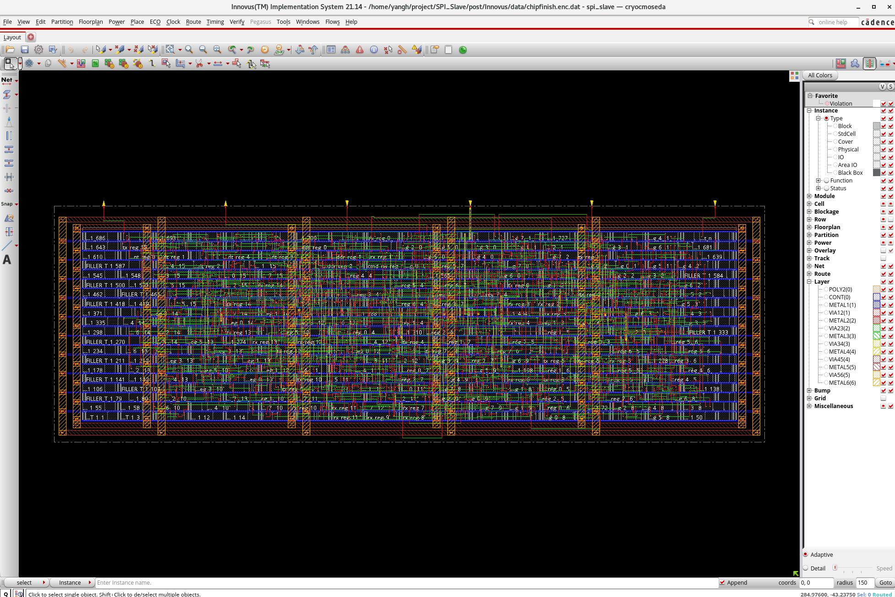
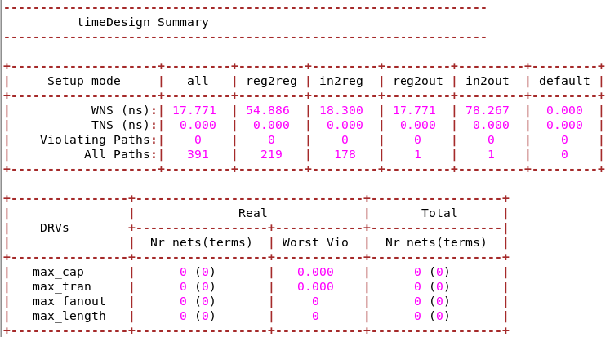
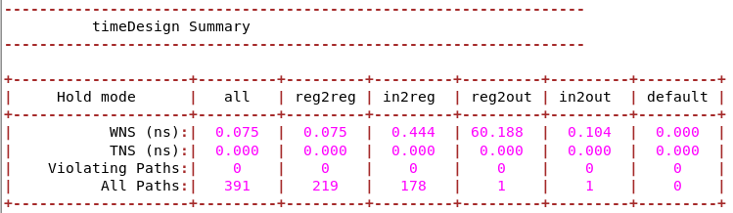
Innovus
Summary
Density: 67.928%
100.000% with Fillers
Total number of glitch violations: 0

Slide 12
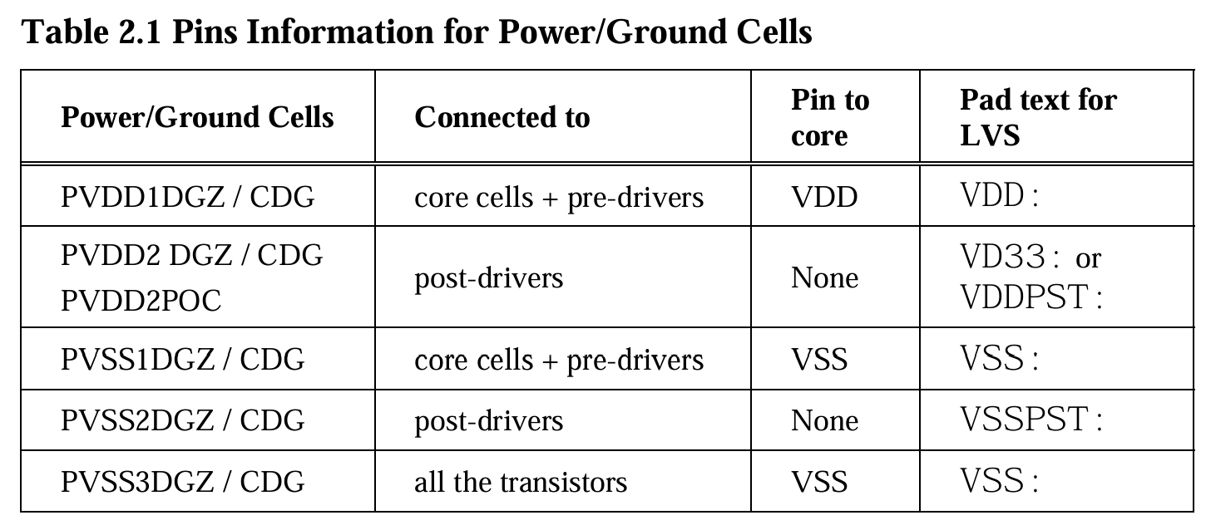
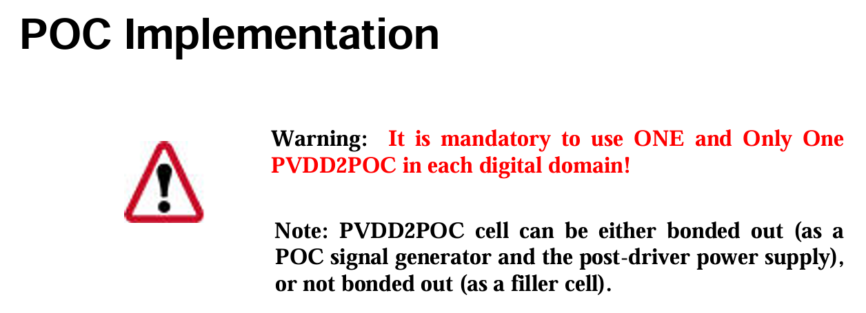
IO Plan
Power IO
Pre-drivers & Core
1.8V
Post-drivers
3.3V
We take PVDD2POC as the
post-driver power supply
Power On Control
Will explain later

Slide 13
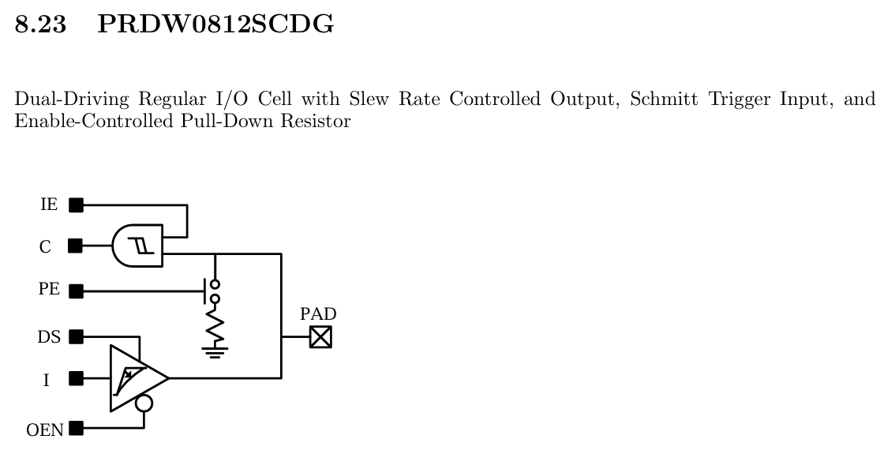
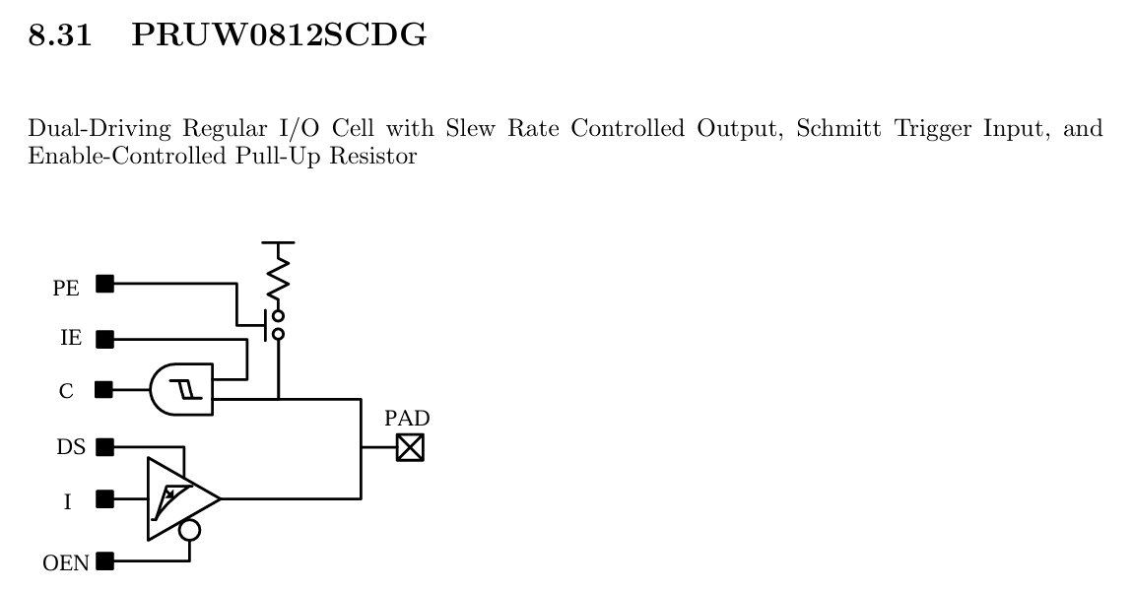
IO Plan
Digital IO
Input (PRXW0812SCDG)
Pull-up: rst_n, ssn
Pull-down: sck, mosi
Schmitt Trigger Input
For noise immunity
Output
PRDW0812SCDG
With Slew Rate Controlled Output
Reduce peak current
8mA output
~7ns edge @20pF, 3.3V

Slide 14
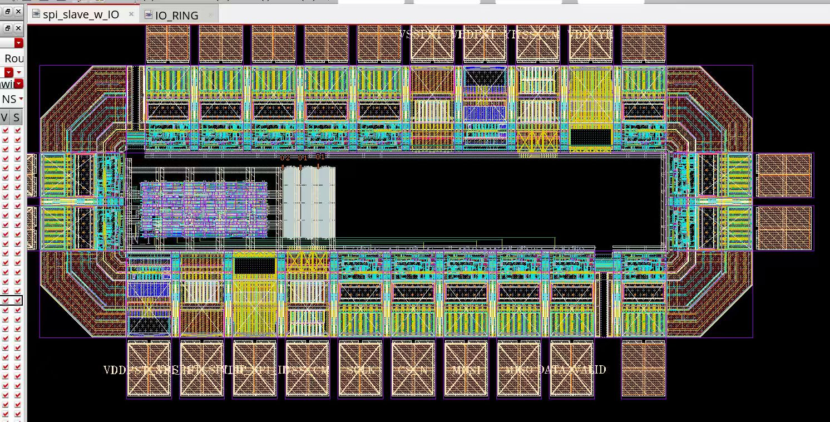
Virtuoso Layout
My Part

Slide 15
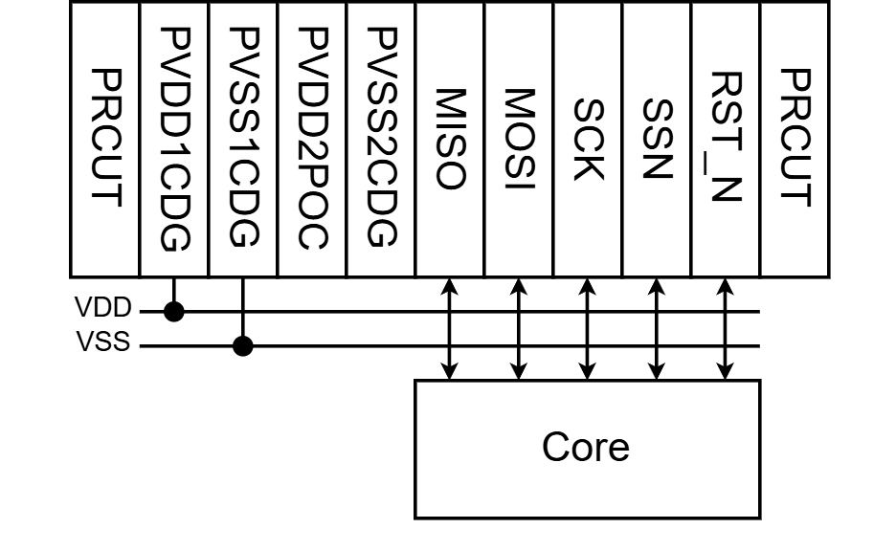
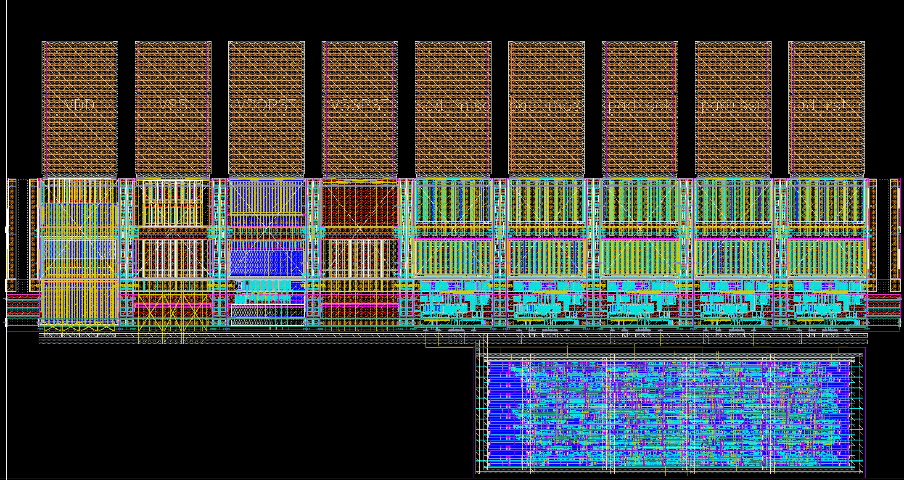
Virtuoso Layout

Slide 16
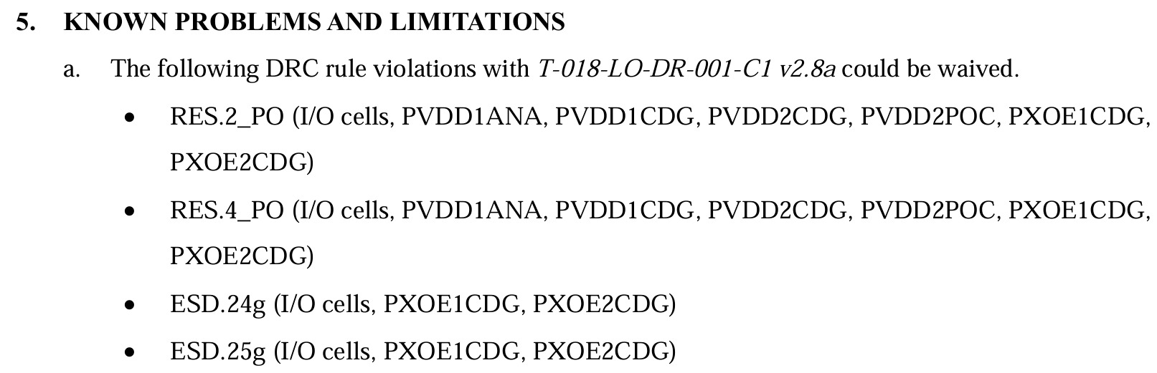
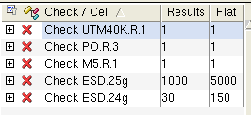
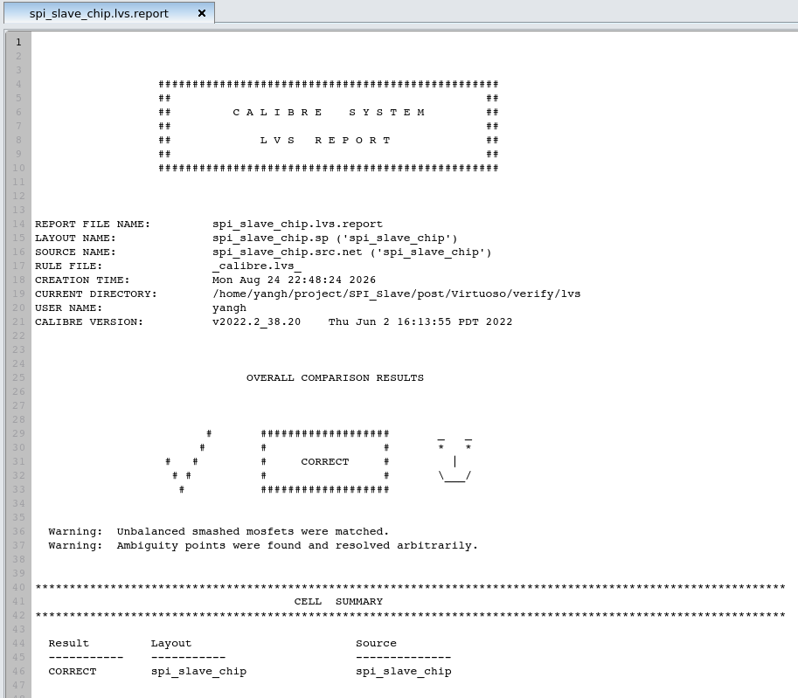
LVS & DRC
LVS
All passed
DRC
UTM40K.R.1 { @ Min. density of M6 area >= 30% }
Dummy fill by others
PO.R.3 { @ Min poly area coverage < 14% }
Dummy fill by others
M5.R.1 { @ Min M5 area coverage < 30%}
Dummy fill by others
ESD.24g & ESD.25g
Waived due to rn_tpd018nv_280a.pdf

Slide 17
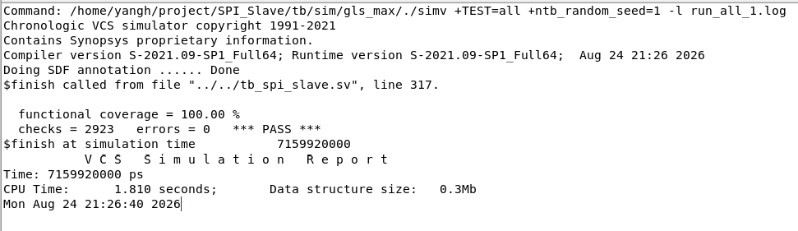
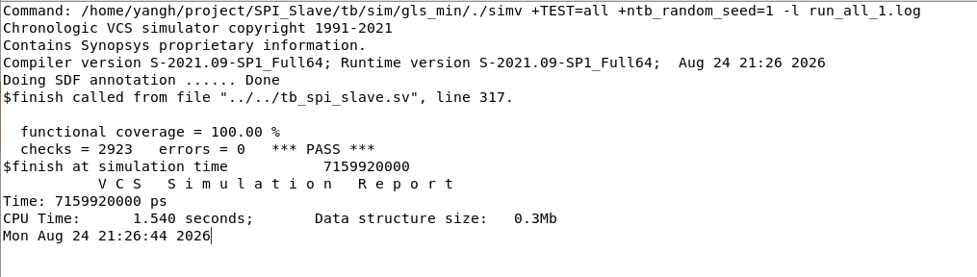
Gate-level Simulation
Simulator: VCS
Testbench Language: SystemVerilog
Same tasks with SDF annotation
Max/Min all passed

Slide 18
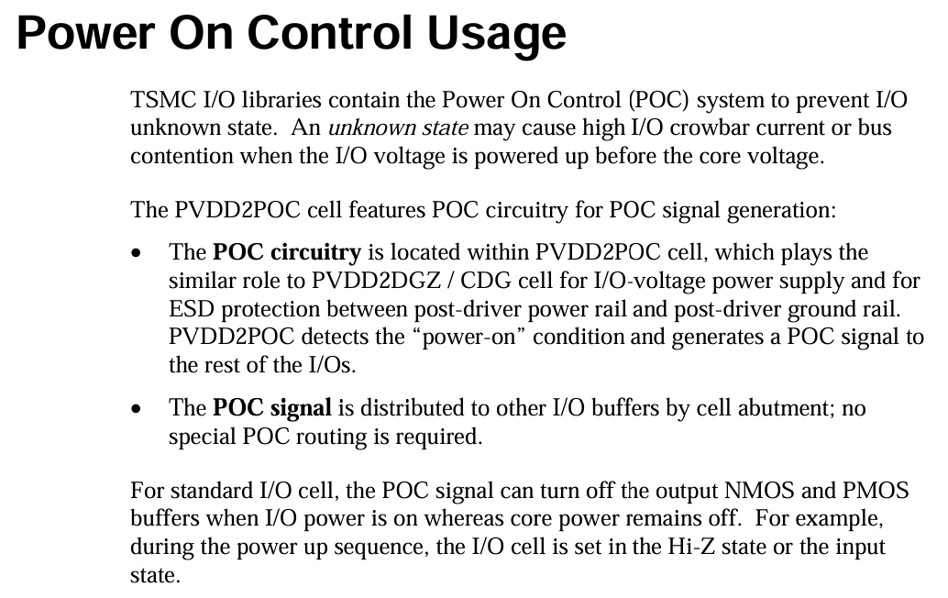
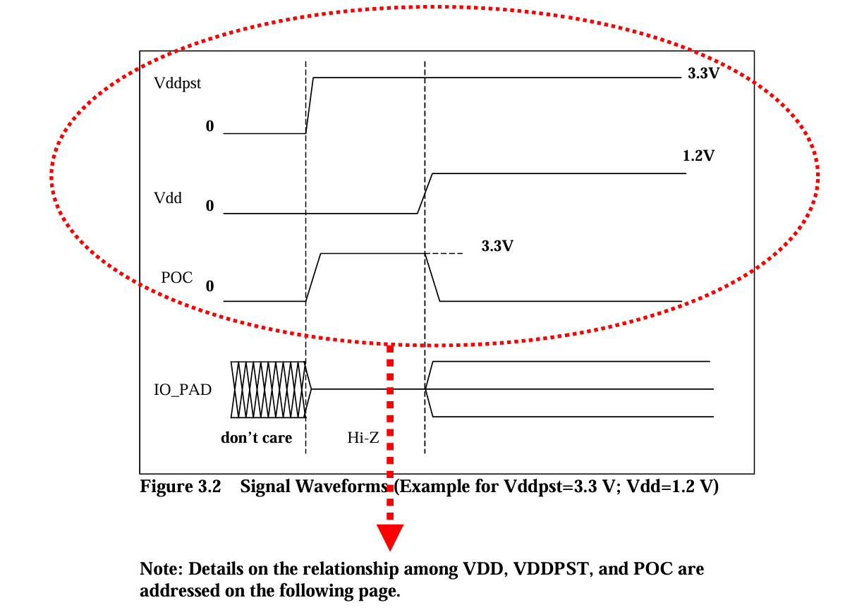
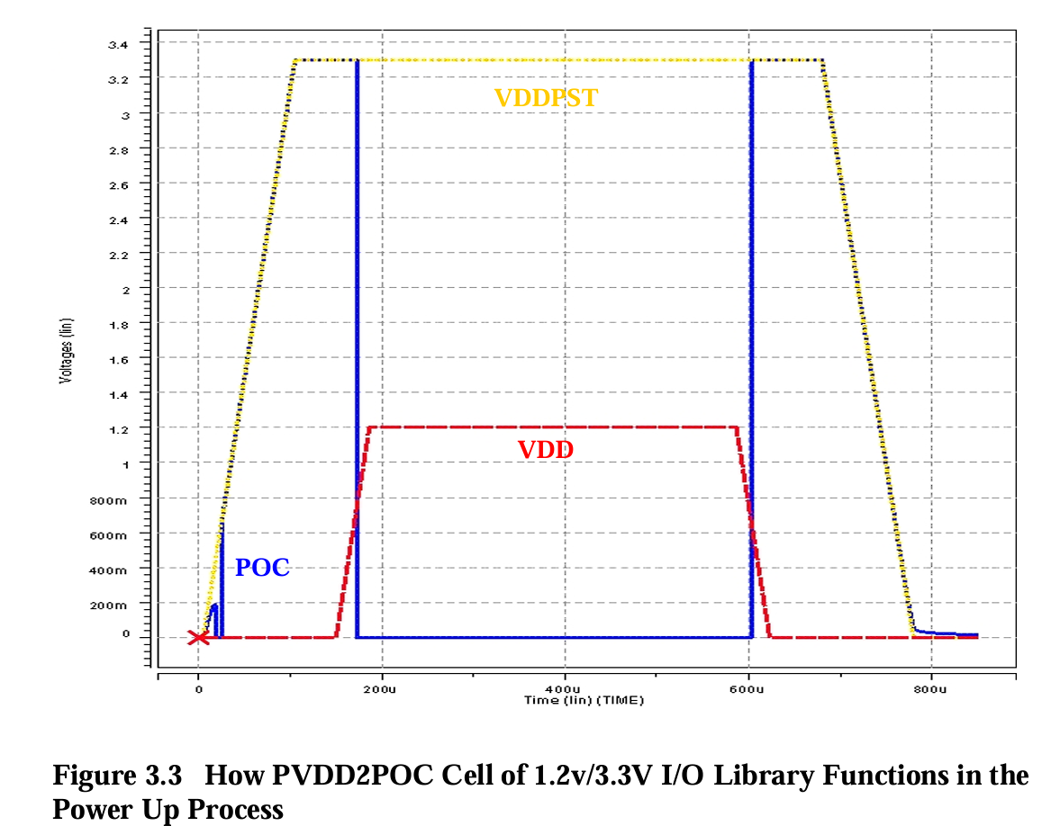
Post-layout Simulation
POC test
Why POC?
The power-up sequence between rails is not guaranteed
It is common for the IO supply (3.3 V) to come up before the core supply (1.8 V)
POC is required to clamp the IO into a known state (typically high-Z) until the core supply is stable

Slide 19
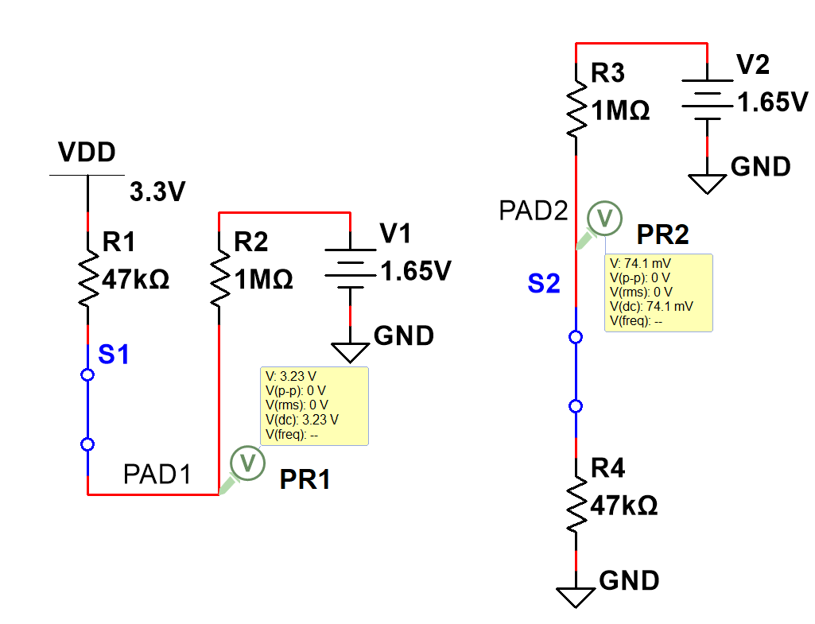
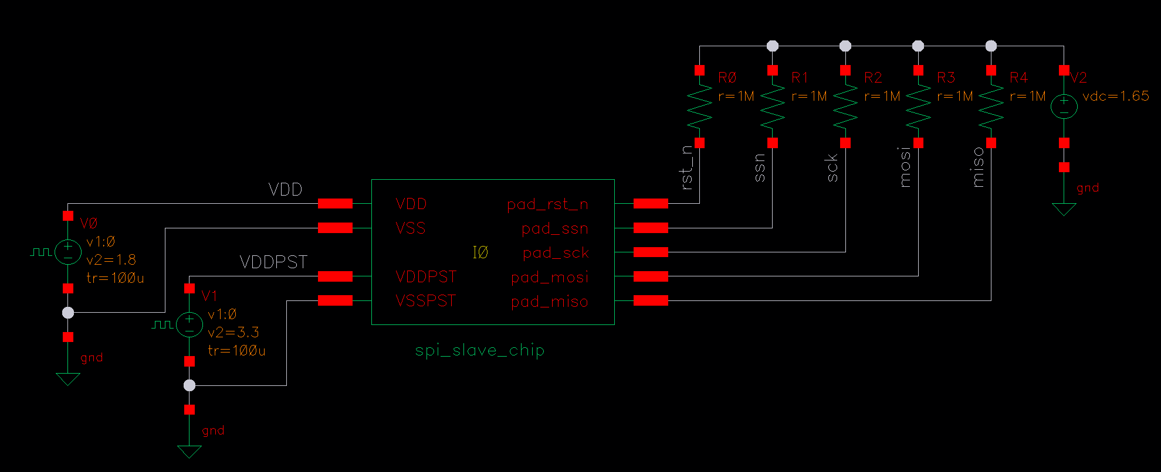
POC Test
How to test high-Z:
Connect IO to 1.65V with 1M resistor
If pad is high-Z,
it’ll be clamped at 1.65V
If pad is controlled by the core,
it’ll be either near 3.3V / 0V

Slide 20
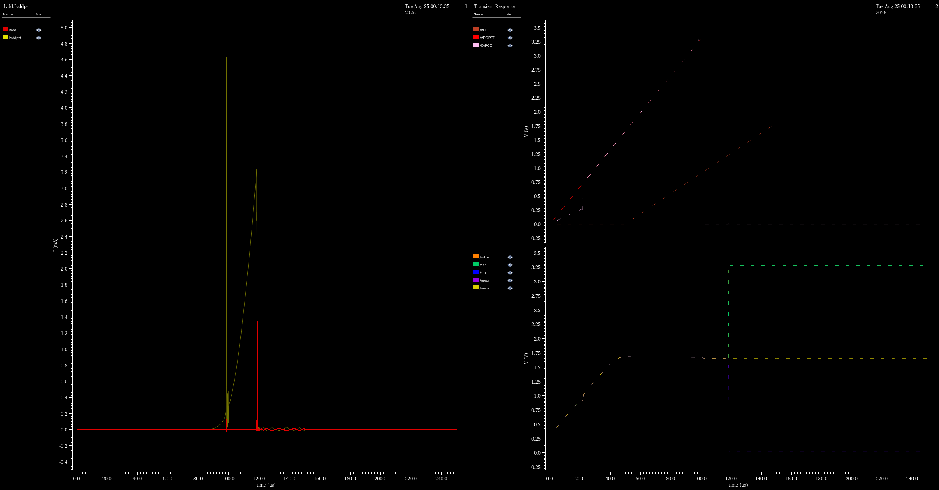
POC Test @ tt/1.8V/3.3V/27°C
POC cutoff
State switch
POC cutoff
VDD is not large enough to turn off
VDDPST-PMOS-NMOS-GND
Current rises
POC on
PAD is controlled by core
50us late for VDD
ssn rst_n high
Level shifter on
Current off
Level shifter on Switching current
Controlled by POC
miso high-Z
sck mosi low

Slide 21
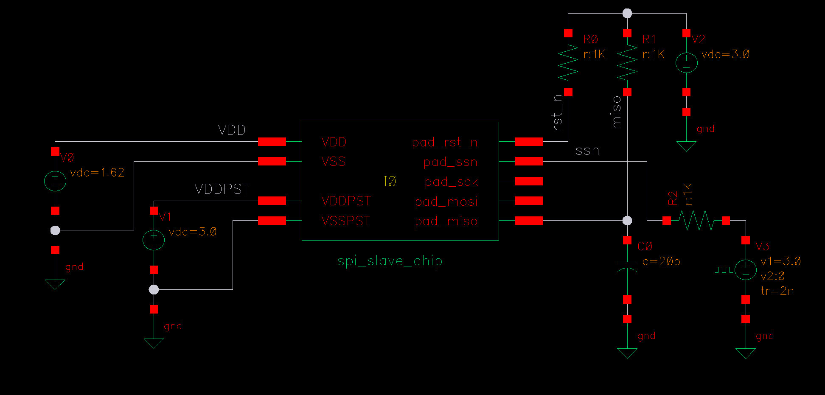
Critical Timings
t_{EN}: Output enable time
Maximum delay from the falling edge of ssn until miso leaves the high-Z state and is actively driven
Measured from the 50% point of the ssn waveform to the 50% point of the miso waveform

Slide 22
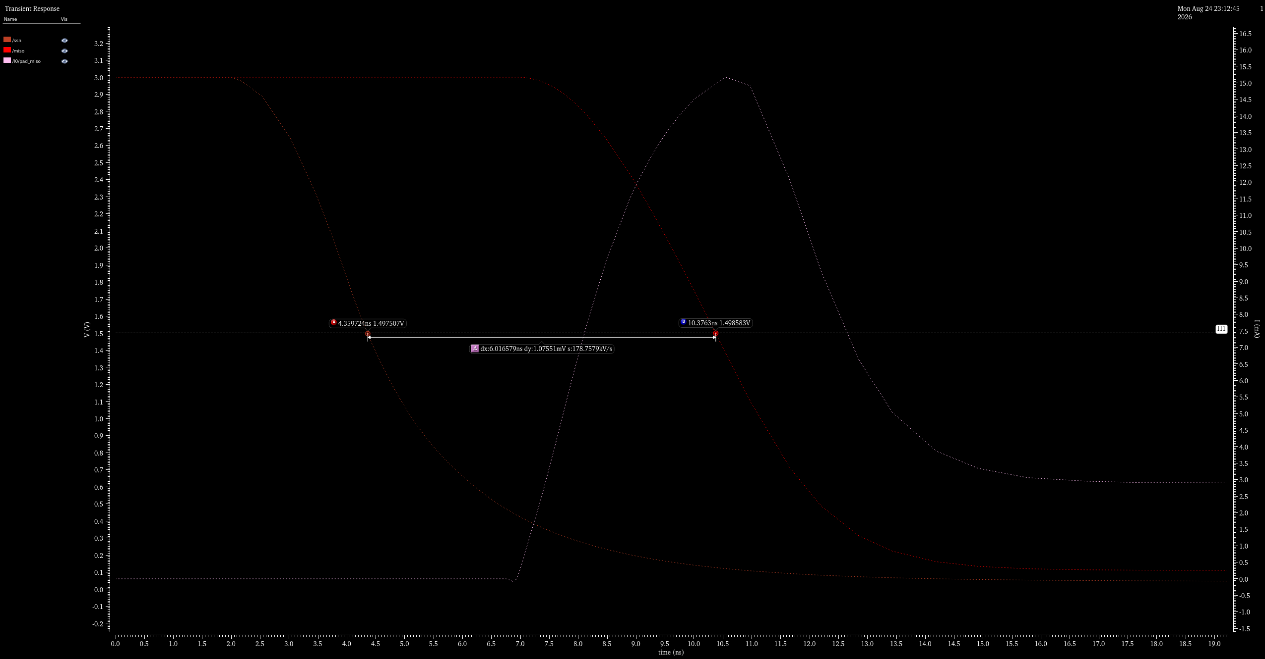
t_{EN} = 6.02ns @ ss/1.62V/3.0V/125℃, C_{L}=20pF

Slide 23
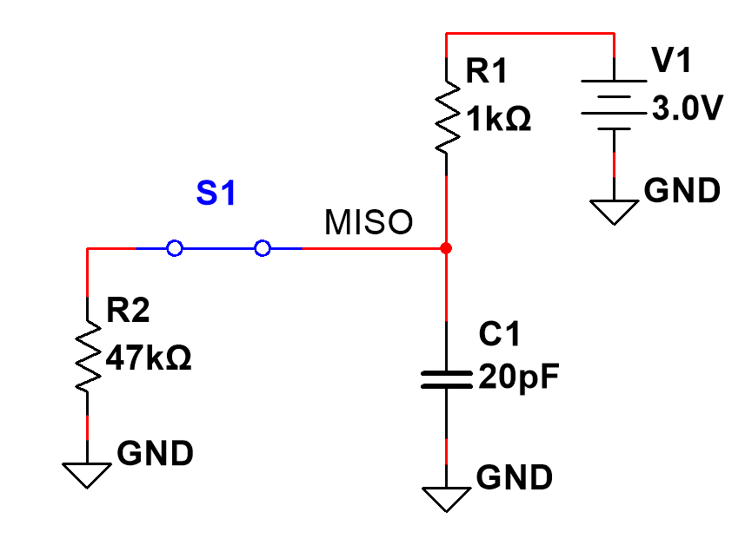
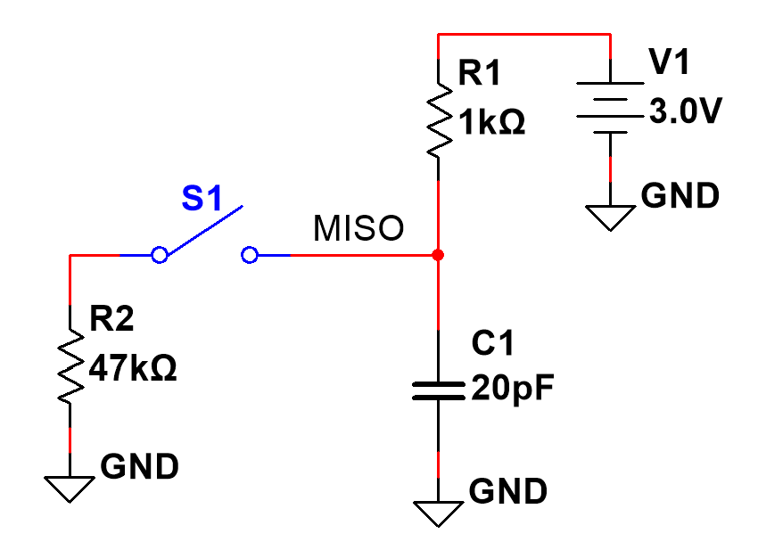
Critical Timings
t_{DIS}: Output disable time
Maximum delay from the rising edge of ssn until miso returns to the high-Z state
Measured the current from stable to approximately 0
Time for miso to return to high-Z voltage is determined by the external R and C_{L}
miso active
miso high-Z
current
current

Slide 24
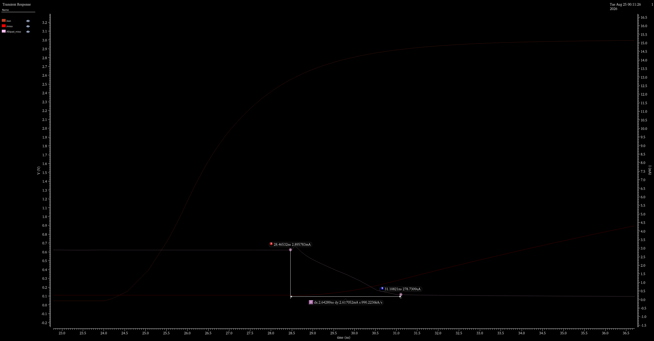
t_{DIS} = 2.64ns @ ss/1.62V/3.0V/125℃, C_{L}=20pF

Slide 25
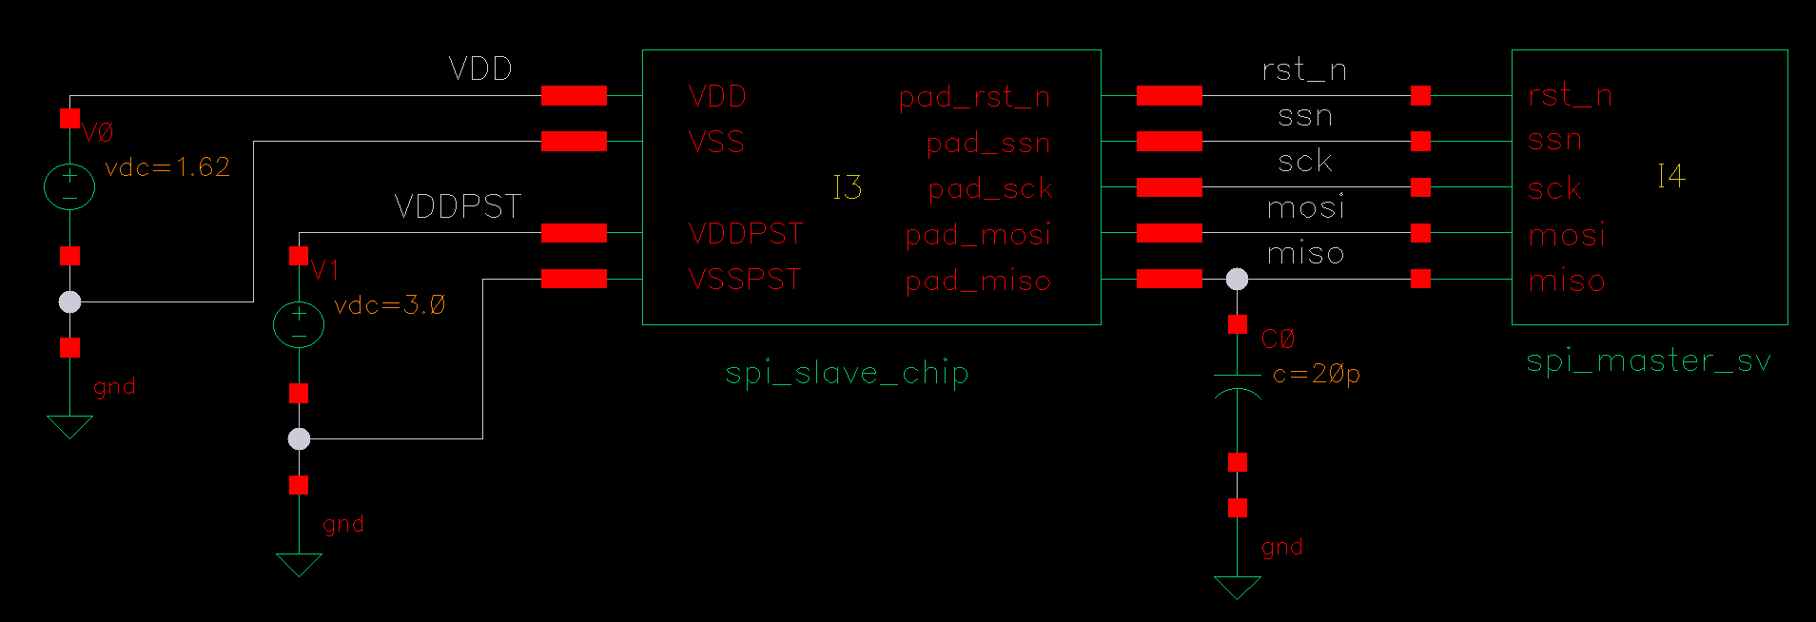
Critical Timings
t_{V}: Data output valid time
Maximum delay from the falling edge of sck to miso becoming valid
Measured from the 50% point of the sck waveform to the 50% point of the miso waveform

Slide 26
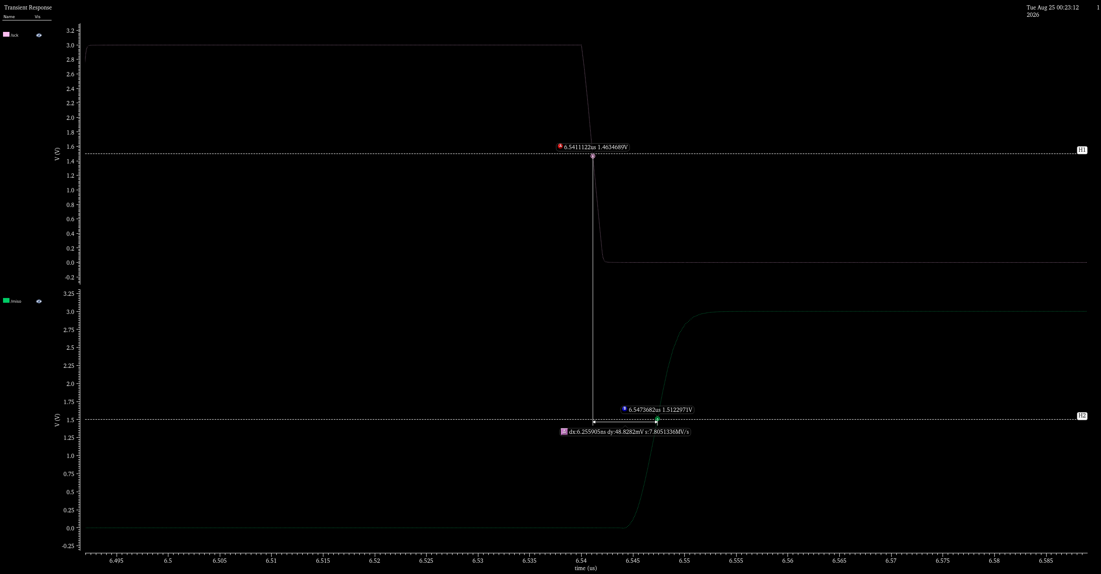
t_{V} = 6.26ns @ ss/1.62V/3.0V/125℃, C_{L}=20pF

Slide 27
AMS Simulation
Write an SPI Master in SystemVerilog
Connect to SPI Slave
Run AMS to check the transfer waveforms

Slide 28
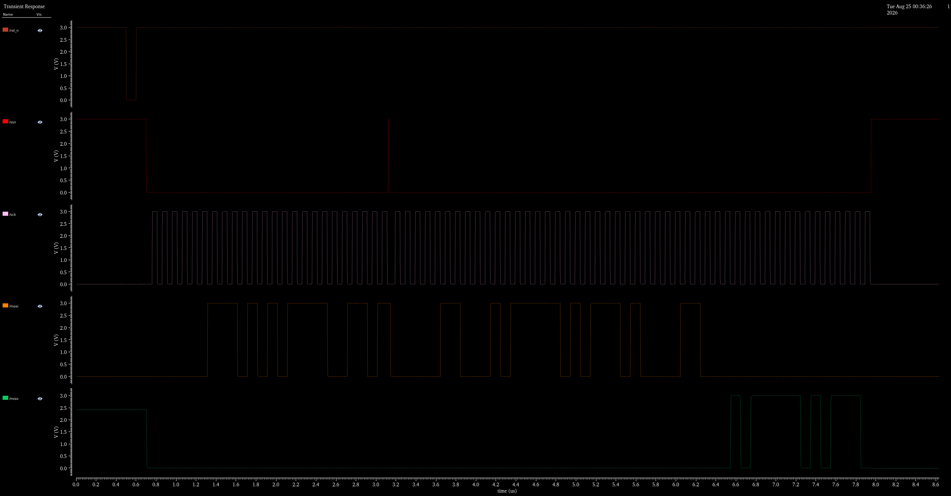
AMS Simulation Passed @ ss/1.62V/3.0V/125℃, C_{L}=20pF

Slide 29
ELECTRICAL CHARACTERISTICS
PARAMETER | SYMBOL | DESCRIPTION | SPEC |  |  | UNIT
 |  |  | MIN | TYP | MAX
IO Supply | VDDPST |  | 3.0 | 3.3 | 3.6 | V
Core Supply | VDD |  | 1.62 | 1.8 | 1.98 | V
Power-on Current | I_{pk} |  |  | 0.1 | 6 | mA
Load Capacitance | C_{L} |  |  | 20 |  | pF
Clock Period | t_{SCK} |  |  | 100 |  | ns
ssn Setup/Hold Time | t_{SSH} /t_{SSN} | Innovus STA & testbench verified |  | 10 |  | ns
Minimum ssn High Time | t_{IDLE} | Innovus STA & testbench verified |  | 10 |  | ns
Output Enable Time | t_{EN} | ss/1.62V/3.0V/125℃, 20pF |  |  | 7 | ns
Output Disable Time | t_{DIS} | ss/1.62V/3.0V/125℃, 20pF |  |  | 3 | ns
Data Output Valid Time | t_{V} | ss/1.62V/3.0V/125℃, 20pF |  |  | 7 | ns

Slide 30
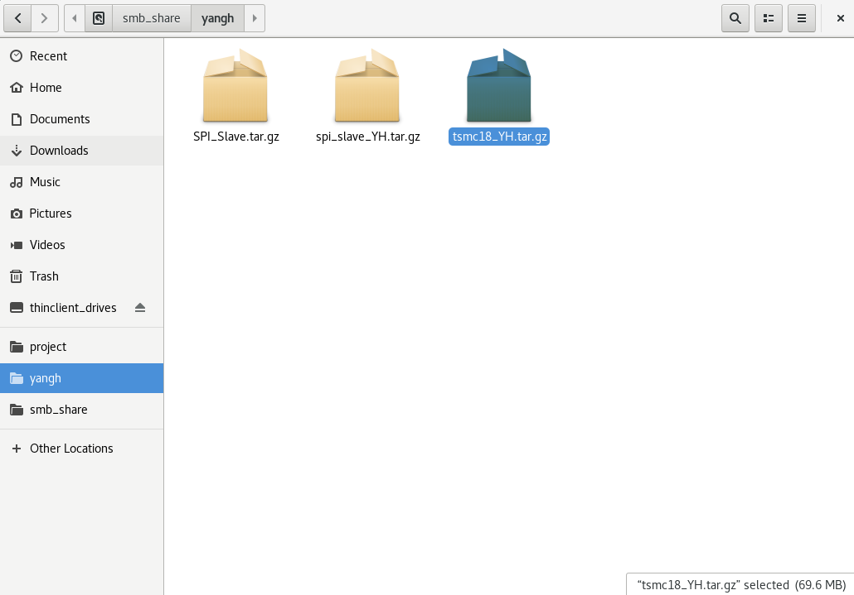
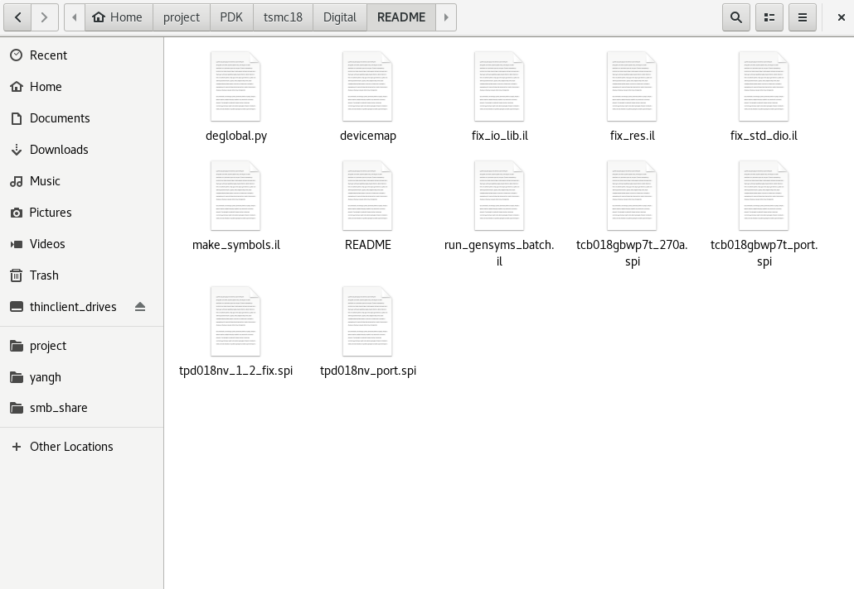
MISC
Resistor/Diode mismatches in IO library have all been fixed,
all IOs in the library are now available
All scripts (updated devicemap and cellmap) are included in tsmc18/Digital/README
Check my smb_share to use the updated version

Slide 31
Thanks!

