Slide 1
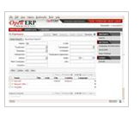
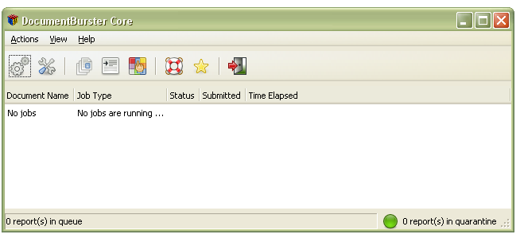











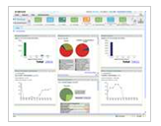
DocumentBurster GUI
Your organization
DocumentBurster GUI
Burst report
Burst report
Burst report
Reports
Distribution
Server
ftp,samba,
Shared drives etc
mail
Your customers
Enterprise portal
SharePoint portal

