Slide 1

Booking Application:

Slide 2
Problem: For: Owner/Operators/Small Business Owners - Customer Cancellations - No-shows

Slide 3
Why
Sample:
Beauty and Personal Care Industry: Cancellations and no-show rates 10-20% rate. Factor for 15% in calculation and about half as factual due to others rebooking so effective rate will be 7.5%
Example: 5 stylists x 8 appointments a day = 40 appointment x 7.5% = 3 unfilled a day.
The barber I go to does about 4 clients an hour @ approx. $15 without tips.
Each appointment is about $50 so 150 a day loss; at mon-sat about 26 days a month $3900 a month, 3900 x 12 = $46,800 loss a year.

Slide 4
Solution:
Cancellations:
Develop a waitlist
Notify anybody on the waitlist if there is a cancellation on a preferred day.
Requires notification function
24 hour reminder for current booking
Notification for waitlist customer if cancellation occurs
Same day cancellation outside of 2 hours will send opening to waitlist
No-Shows
Establish rewards for customer loyalty
Penalty for cancellation with no re-book (ie points grow faster if not a no-show)

Slide 5
Screen 1
Log In or Create Account Screen
Username:
(3)
Password:
Create an Account
(2a)

Slide 6
Screen 2a
Customer Registration
(2b)
Business Portal
(2c)

Slide 7
Customer Registration
Screen 2b
*First Name:
*Last Name:
*Preferred Contact Phone:
*Email/Username:
*Password:
Address:
*Preferred Contact Method:
Loyalty Program:
Save/Update
Pop up confirming save and link to service link to Available business page
Email
Text/SMS
Yes
No

Slide 8
Screen 2c
Business Portal Inputs
*First Name:
*Last Name:
*Phone:
*Email/Username:
*Password:
*Personal Address:
Save/Update
Pop up confirming save and link to service link to Available business page

Slide 9
Screen 2c (cont’d)
Business Portal Inputs (cont’d)
Business Type:
Payment Information:
Payment Options:
Name on Payment Method:
Payment Address:
(3) data
*Business Name:
*Business Address:
*Business Phone:
*Loyalty Program:
*Days of Operation:
*Hours of Operation:
+Add Services:
List of Services:
Yes
No
(4) data
Service
Cost of Service
Time to complete
Display Service & cost only

Slide 10
Screen 3
Available Businesses
Flyout
Profile
Businesses Page
Upcoming Bookings
Sign Out
Search bar
Business One
(4 )
Business Two
Business Three

Slide 11
Service List Page
Screen 4
Flyout
Profile
Businesses Page
Upcoming Bookings
Sign Out
Service and Price
Service and Price
(5)
Service and Price
Service and Price
Service and Price

Slide 12
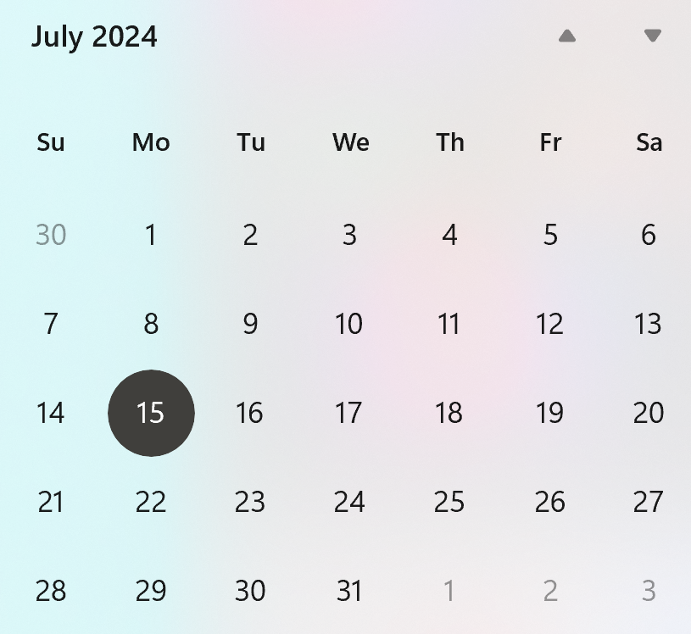
Calendar and Time
Screen 5
Flyout
Profile
Businesses Page
Upcoming Bookings
Sign Out
9: 00
10: 00
11: 00
12: 00
1: 00
2: 00
3: 00
4: 00
5: 00
6: 00
7: 00
8: 00
Book
Waitlist: date time is not available check waitlist. Then select book.
(6)

Slide 13
Confirmation Page
Screen 6
Flyout
Profile
Businesses Page
Upcoming Bookings
Sign Out
Your appointment is confirmed for (services) on (date/time) with (business). Confirmation # . A 24-hour reminder will be sent. If you need to cancel your appointment return to the application to reschedule. View in Upcoming Bookings. (7)
Note: Possibly make pop up confirmation on screen 5

Slide 14
Upcoming Bookings
Screen 7
Flyout
Profile
Businesses Page
Upcoming Bookings
Sign Out
Upcoming Data
Note: Possibly add whole calendar view
Upcoming Data
Upcoming Data
Upcoming Data
Upcoming Data

Slide 15
Lessons Learned
-User validation and carrying it throughout the program (Session Class)
-Page loading (initializing the page with new data or user info)
-Database usage-CRUD
-Use of Observable Collections-good for my collection views and databinding
-Page Navigation in MAUI
-Try catch – great for error handling and let me know some of my problems especially with database access
-Display alerts- feedback feature I found useful
-Impact of using directives-have to get the right namespace

Slide 16
Guest Contact Page
Screen 6b
*First Name
*Last Name
*Email address:
*Preferred Contact Phone Number:
*Notification method:
Email
Text/SMS
Save
(6a)
Services Screen
Profile
Calendar

