Slide 1






2021/22 Climate Change Belief Analysis
Team_6
Supervisor: James Combrink
Floyd Skakane
Lehlogonolo J. Teffo
Muhammed I. Ahmed
Vuyisile Ngobeni
Mulalo Malange

Slide 2
Presentation Outline
Case Study Background and Problem Statement
Exploratory Data Analysis (EDA)
Model Performance and Deployment
1
3
5
2
Building of Models
4
6
Data Processing and Engineering
Conclusion

Slide 3
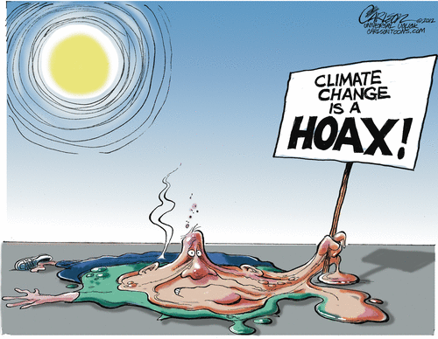
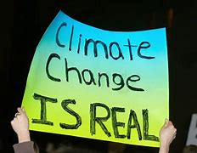
Introduction
Climate Change - change in global climate patterns.
This is mainly a result of burning of fossil fuels.
This can affect our health, safety and livelihoods.
Companies are migrating to environmentally friendly products.
We will apply the data science process to tweet data to predict an individual’s belief in climate change.

Slide 4
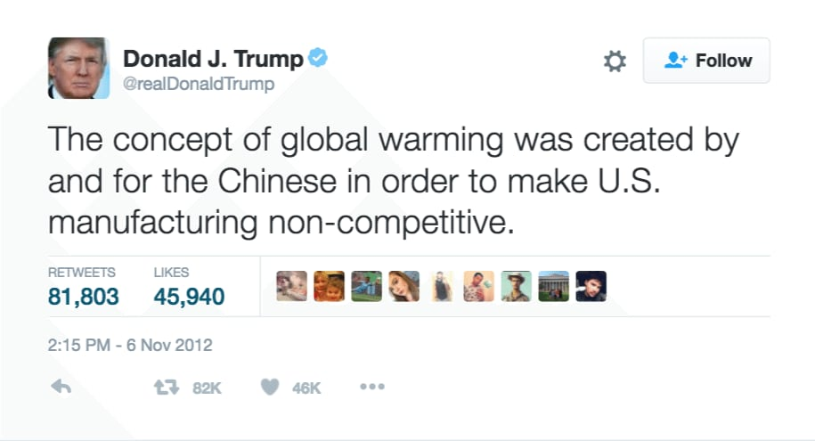
Problem Statement
Twitter climate change sentiments
Employ Machine Learning techniques
Classify individual’s opinion on climate change
Improve marketing strategies

Slide 5

Data Description
Tweets pertaining to climate change collected
between 27/04/15 – 21/02/18.
In total, 43943 tweets were collected.
Sentiment | Description
2 | News: the tweet link to factual news about climate change
1 | Pro: the tweet supports the belief of man-made climate change
0 | Neutral: the tweet neither supports nor refutes the belief of man-made climate change
-1 | Anti: the tweet does not believe in man-made climate change

Slide 6

Data Preprocessing
Data is cleaned and organized so that it can be suitable for our ML model.
There are no null values in the dataset.
Any words that do not contribute to the model are dropped.

Slide 7
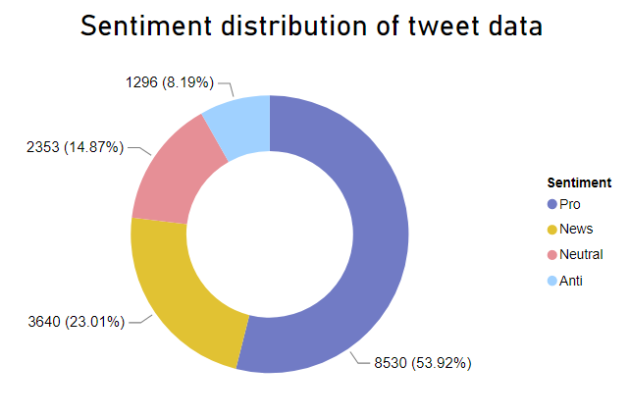
Exploratory Data Analysis
The tweet distribution is uneven
Majority of the tweets are Pro climate change
The least number of tweets are
Anti climate change

Slide 8
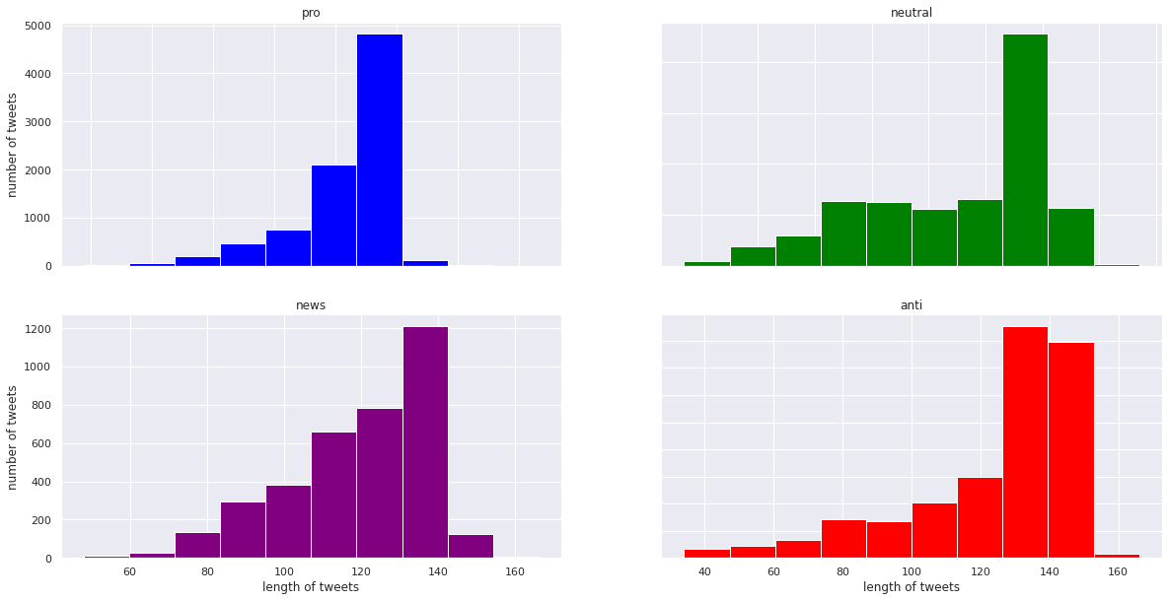
Exploratory Data Analysis
Tweet length distribution
Tweet length is between 130 to 140 characters for all Sentiments
Anti Sentiment tweeters use the most words on their tweets

Slide 9
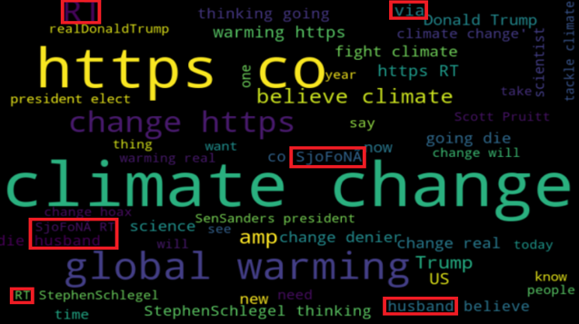
Exploratory Data Analysis
The word cloud shows Top 50 words

Slide 10
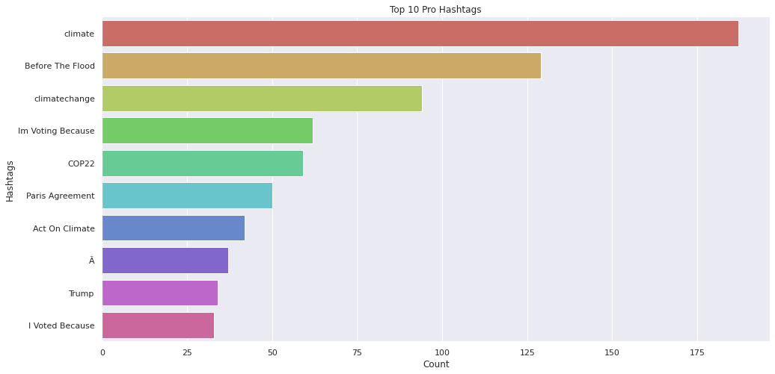
Exploratory Data Analysis
The stacked bar chart shows Top 10 Pro Climate Hashtags

Slide 11
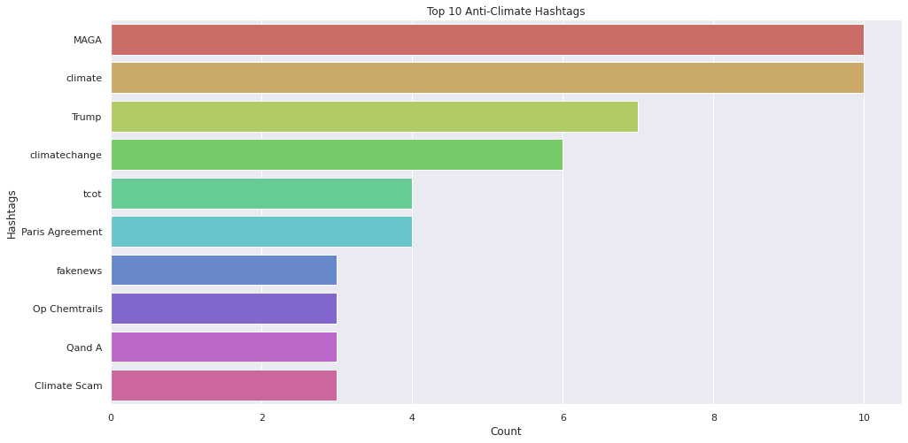
Exploratory Data Analysis
The stacked bar chart shows Top 10 Anti Climate Hashtags

Slide 12
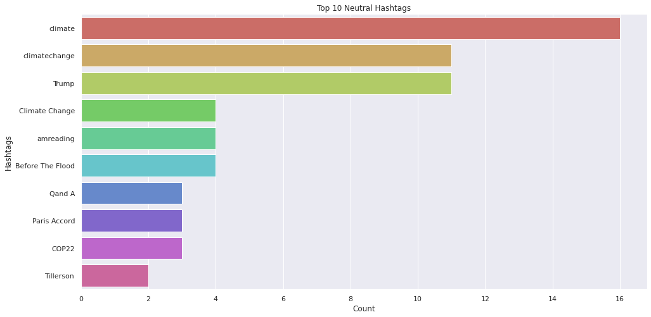
Exploratory Data Analysis
The stacked bar chart shows Top 10 Neutral Climate Hashtags

Slide 13
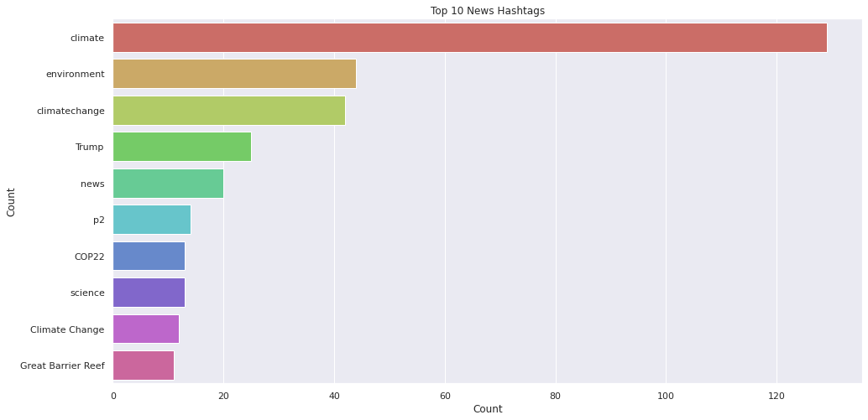
Exploratory Data Analysis
The stacked bar chart shows Top 10 News Climate Hashtags

Slide 14

Building Models
Logistic Regression
K Nearest Neighbour
Linear SVC
RBF SVC
Decision Tree
Random Forest
Multinomial Naive Bayes
AdaBoost

Slide 15
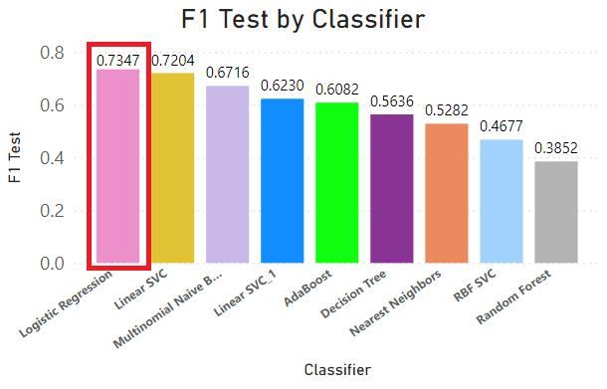
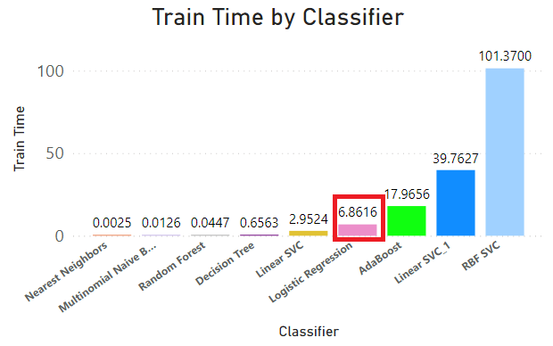
Classification Models
The Logistic Regression has the best F1 test score

Slide 16
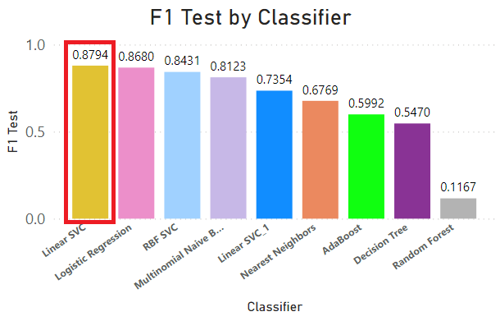
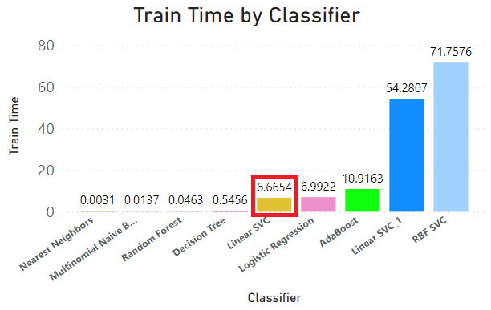
Classification Models
After balancing data, the linear SVC has the best F1 test score

Slide 17
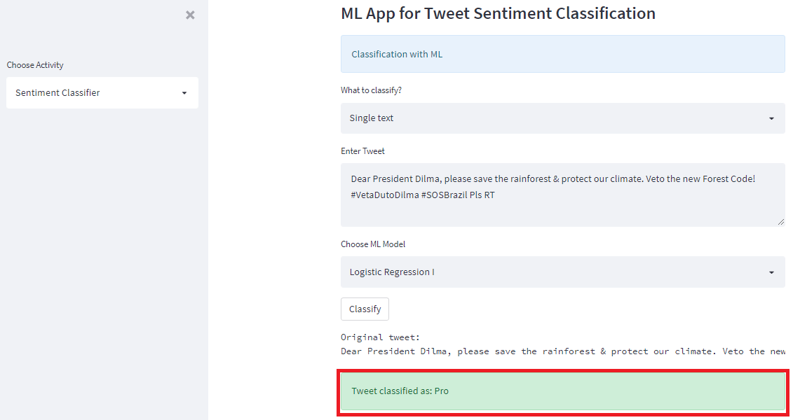
Model Deployment
We have developed a Tweet Sentiment Classifier Machine Learning App

Slide 18
Conclusion
Create awareness to inform Anti climate change tweeters about the negative impact it has on the environment
Most tweets are Pro climate change, so its feasible to sell eco-friendly products
The Linear SVC is the best performing model as it has a good F1 test score after balancing the data.
We built a ML App that is able to classify sentiments on tweets about climate change

Slide 19


