Slide 1
RxJS anatomy
And Multicasting Operators

Slide 2

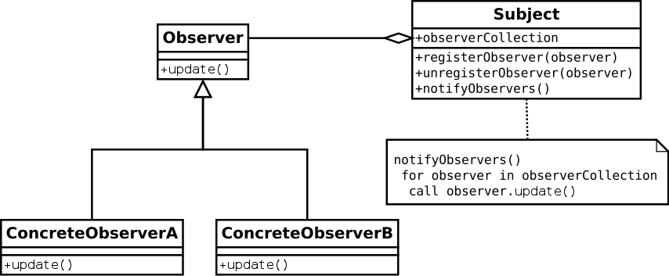
Observer pattern
Observer is an interface introducing next, error and complete callback functions.
Subject is a class extending Observable base class and implementing Observer interface.
Observable is a class implementing subscribe functions.
Notes:
Defines a relationship between objects so that when one changes its state (Subject), all others are notified accordingly (Observers or Subscribers). Relationship is one to many.
In case of RxJS Observer has next() func instead of update like in diagram, and additionally error and complete funcs. Subject has internal list of registered observers, the appropriate register and unregister function which is called subscribe() and unsubscribe() accordingly and the same set of functions like in Observer interface chick are used for broadcasting (emitting) event for subscribed observers.
The role of observable class in this diagram that it just provides basic abstraction of interaction between observers and subject and serves as broadcaster form inside of the class, without public observer functions

Slide 3
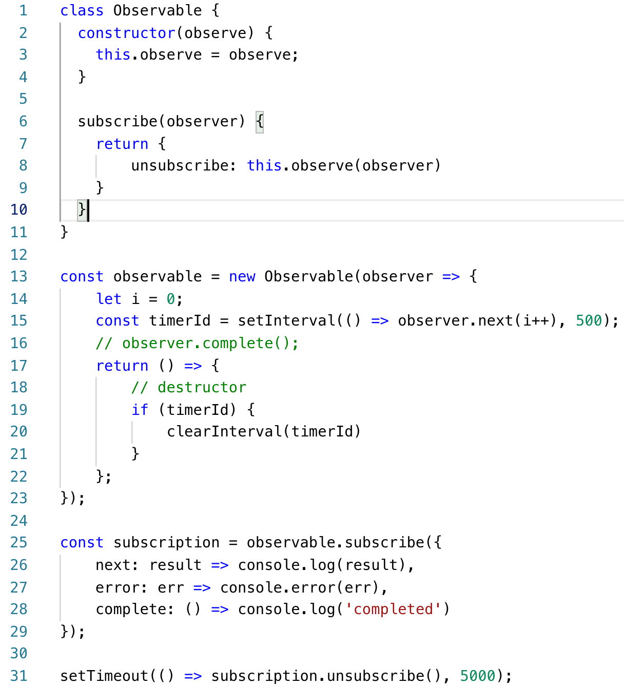
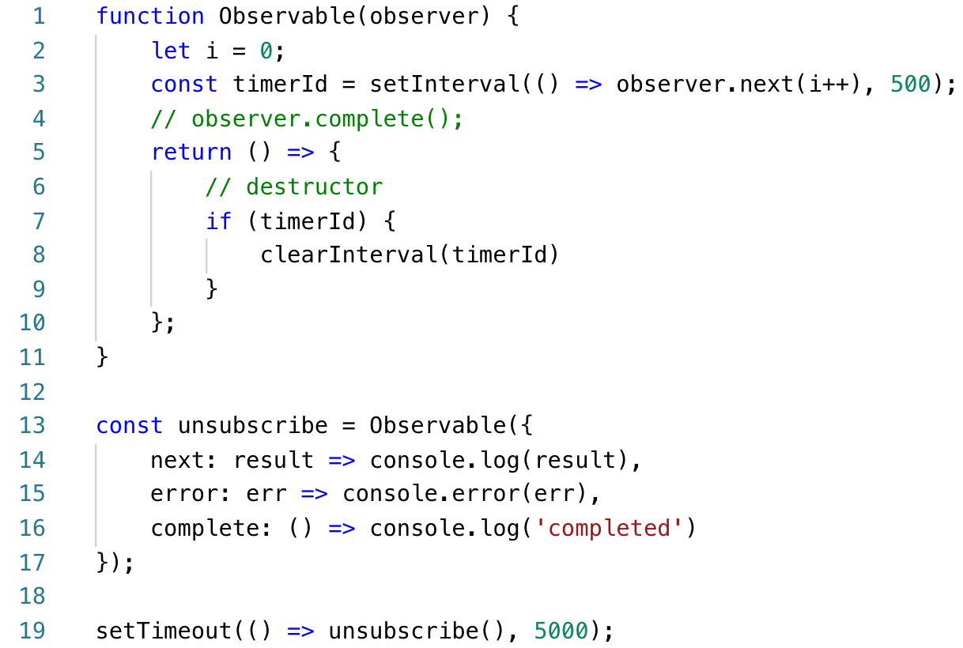
Observable oversimplified
Cold
Notes:
1. Observer doesn’t have to implement all methods.
2. `next` won’t be called after a `complete` or an `error`
3. Observer functions won’t be called if observable is unsubscribed.
4. Calls to `complete` and `error` also call unsubscribe.

Slide 4
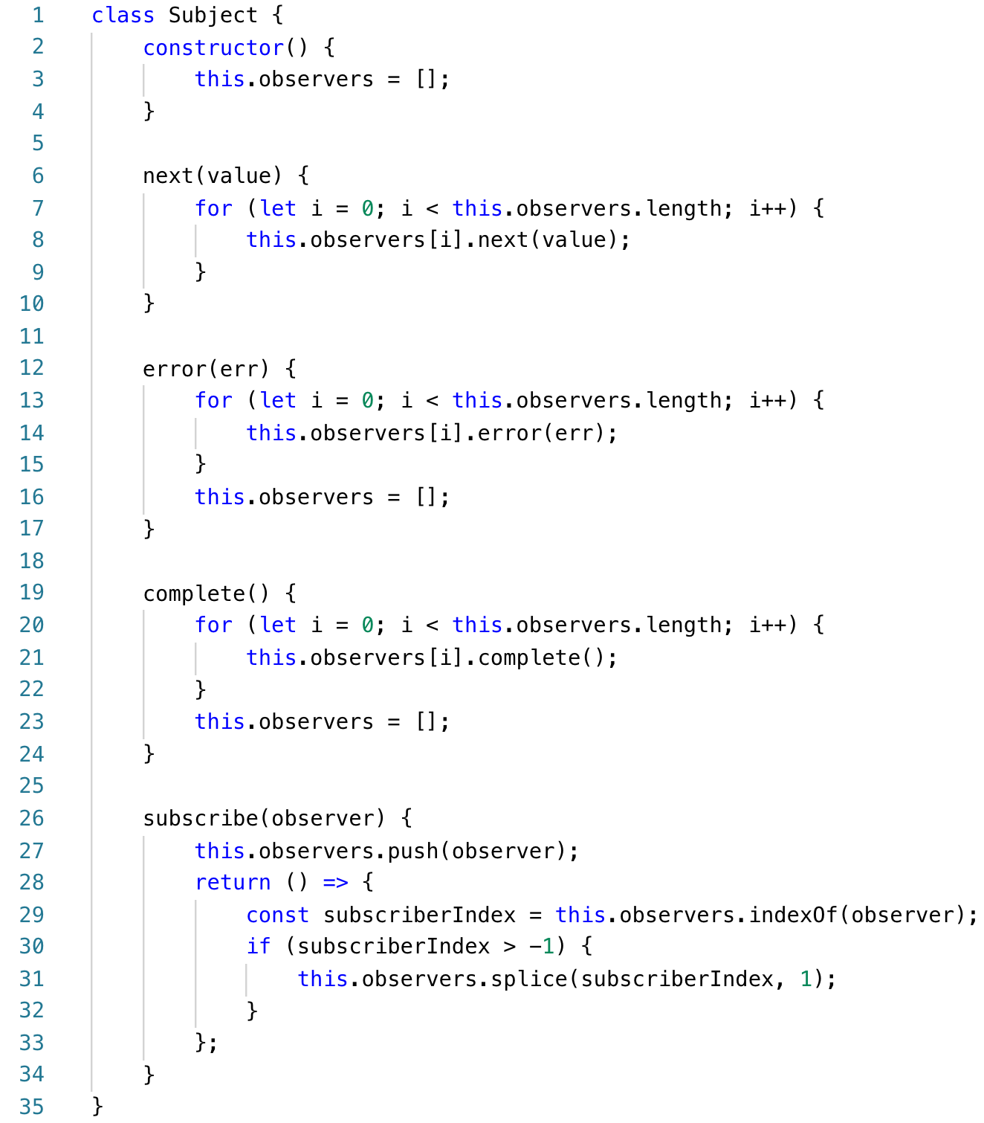
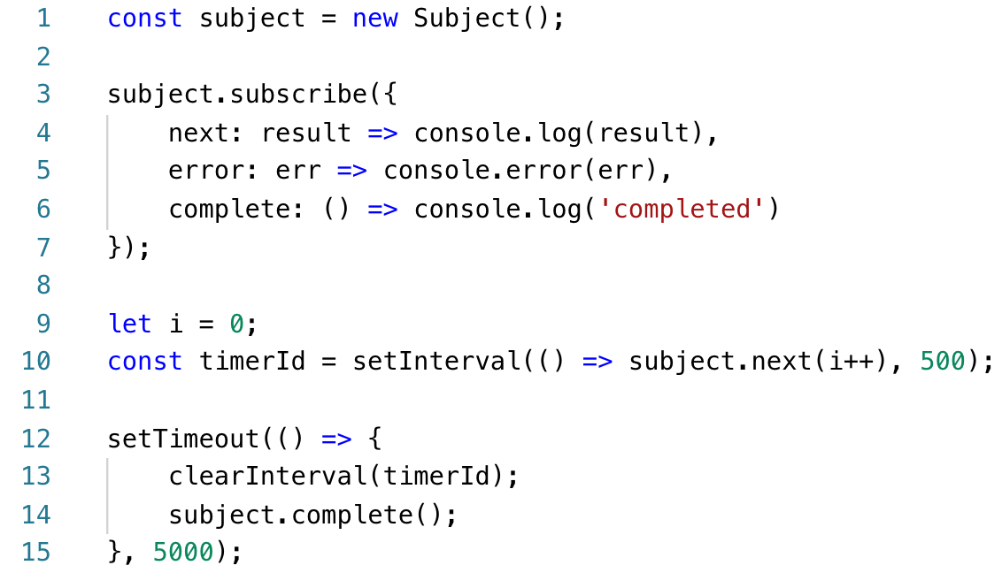
Subject oversimplified
Hot
Notes:
1. It’s an observable and behaves like an observable.
2. It’s an observer. It can be passed as another observable subscribe param.
3. It multicasts. All subscribed observers will get the same events from Subject.

Slide 5
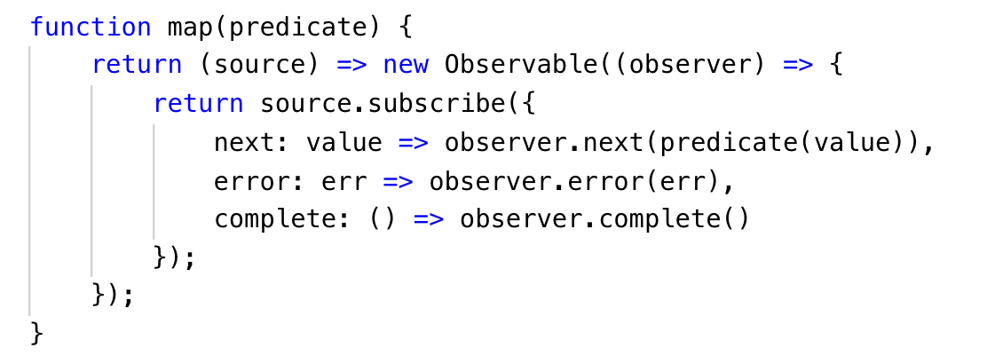
Operators
Operator is a function that takes a source observable and returns a new one to chain.
Operator function is immutable and obeys to functional programming paradigm.
Notes:
https://github.com/ReactiveX/rxjs/blob/0d7d12379ac3eab61183cfb4e0cd8b90b20f9bb8/src/internal/util/pipe.ts#L33

Slide 6
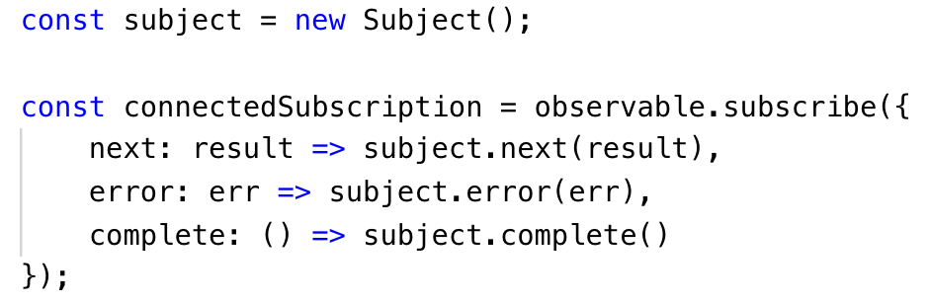
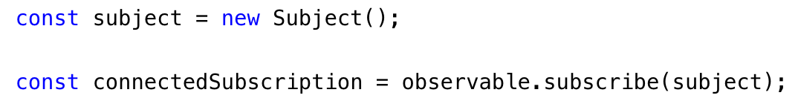
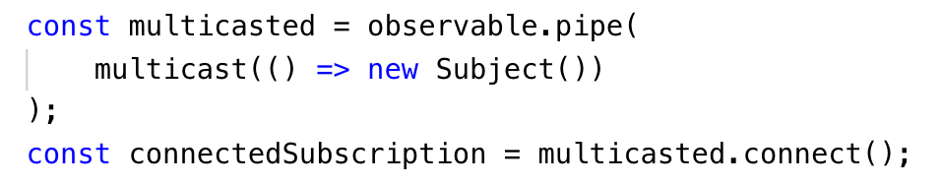
How to “warm up” a cold observable
An observable is “cold” if it is created through constructor, static function create or creation operators like of, interval, range…
To make a source Observable “hot”, observers should subscribe to a new Subject resubscribed to a source Observable.
Or multicast operator can be used due to have this logic pipeable.

Slide 7
Multicast operators: publish…, share...
Connectable observable in output
Use refCount for autoconnection
publish is a simple multicast operator wrapper with simple Subject under the hood.
publishReplay is the same wrapper, but with ReplaySubject under the hood.
publishLast is the wrapper with AsyncSubject under the hood.
publishBehavior is the wrapper with BehaviorSubject.
share is a simple multicast operator wrapper with simple Subject and chained with refCount operator. So it is the same as obs.pipe(publish(), refCount())
shareReplay is the same wrapper, but with ReplaySubject under the hood. The same as obs.pipe(publishReplay(), refCount())

Slide 8
Share operators use cases
In Angular app with AsyncPipe: an Angular HttpClient request returns a “cold” observable, so any time an observer subscribes to it, a new http request is proceeded. Using multiple async pipes with such observables in one template can lead useless duplicate http requests. To avoid this we can chain the observable with share operator (make it “hot”), that means it will broadcast the same result from http request for multiple subscribers.
In case if we use AsyncPipe inside dynamically rendered templates (inside *ngIf or *ngFor) even if we use share operator we can encounter with the same duplicate http requests due to async pipe subscribes during appearing in DOM and unsubscribes on disappearing. In the case we can use shareReplay(1). It will replay the latest cached result in the underlying ReplaySubject to a new subscribers.

Slide 9
Publish operators use cases
A good example is imaging we have external timer library which starts a new timer counter for every single subscriber, so it is cold. And we need to display a result of this timer counter in multiple places reactively. And one of the requirements is an ability to control when a timer should start and stop counting. In this case we can use publish operator to make the observable “hot” (multicasted) and control the timer startup with connect() function of ConnectableObservable operator output.

Slide 10
Links
Learning Observable By Building Observable
Hot vs Cold Observables
RxJS: multicast’s Secret
Angular Async Pipes — Beware the share
RxJS open source
C# 3.0 Design Patterns by Judith Bishop
Design Patterns Elements of Reusable Object-Oriented Software by Gang Of Four

