Slide 1

PROJECT PRESENTATION
Agentcy
AI campaign production for Malaysian SMEs
A visible workflow for ideas, imagery and video, with human approval at the points that matter.
September 2026
Notes:
Sources: README.md (project description); frontend/src/assets/hero.png (original project asset).

Slide 2
02
The campaign-production gap
SMEs want the speed of generative tools without giving up their brand truth or publishing decisions.
The hard part is not generating a first draft. It is keeping product claims, campaign context and human judgment attached to the work as it moves toward publication.
Brand truth
Product facts and restrictions must govern every concept.
Local context
Trend signals can inspire an angle, but they cannot become a product claim.
Final control
A person must be able to stop, inspect and approve the work.
AGENTCY
02
Notes:
Source: README.md; frontend/README.md. The problem framing summarizes the project's stated product claim and product rules.

Slide 3
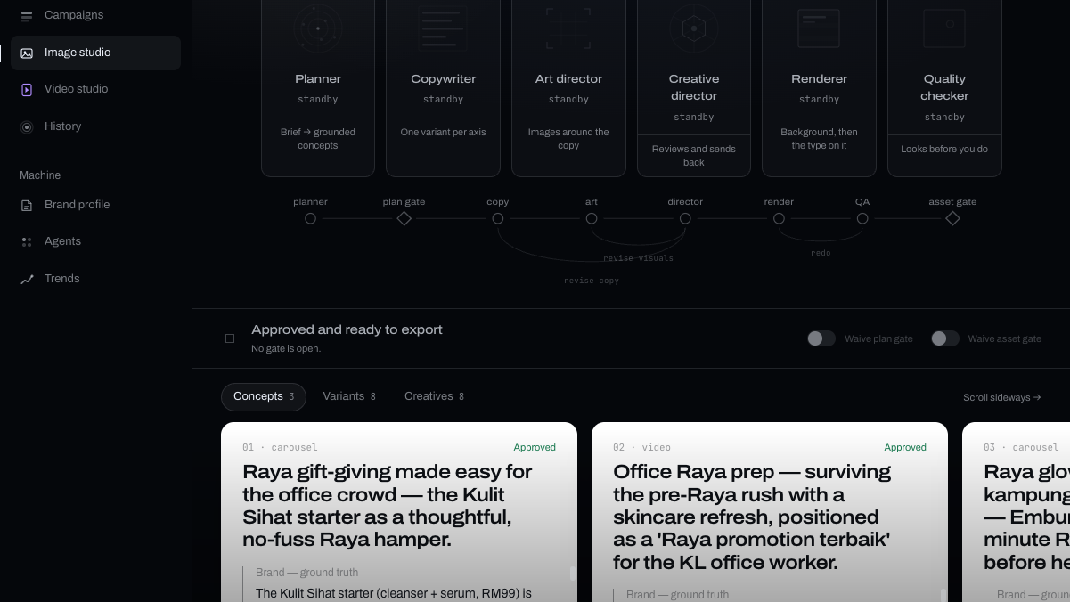
03
A campaign workspace, not a prompt box
Agentcy keeps the brief, agent activity, approval gates and outputs in one visible flow.
A planner turns a campaign brief into grounded concepts. A generation crew develops each approved concept. The studio renders the final work only after the relevant human decision.
01
Plan
Brief to cited concepts
02
Create
Copy and visual direction
03
Review
Human approval gates
04
Publish
Approved images or video
Image Studio screen from the project
AGENTCY
03
Notes:
Sources: README.md; frontend/README.md; image-studio.png (original project screenshot).

Slide 4
04
Grounded planning
The source hierarchy makes a campaign idea traceable before anyone generates an asset.
Every planned concept carries both brand and trend rationales. The planner ranks its inputs so that a useful trend can never override what the company knows to be true.
01
The campaign brief
Sets the goal, product and occasion.
02
Company knowledge
Product facts, voice and claim restrictions. This is the source of truth.
Result: a reviewer can see where the idea came from before releasing it to production.
03
Trend signals
Inspiration only. A trend can suggest an angle but never justify a claim.
AGENTCY
04
Notes:
Sources: backend/app/agents/planner.py; backend/app/rag/store.py; backend/README.md. The ordering and rationale requirements come from the planner's documented source hierarchy.

Slide 5
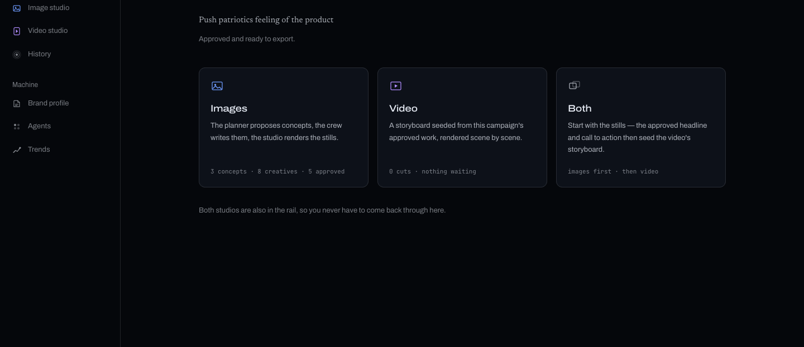
05
Human approval holds the line
A campaign moves through one legal path, with the machine stopping where a person needs to decide.
Draft
Planning
Plan approval
Generating
Asset review
Ready to publish
The UI makes the handover unmistakable: when a gate opens, the machine recedes and the review work moves forward. The run stays halted until someone releases it.
Campaign Hub screen from the project
AGENTCY
05
Notes:
Sources: backend/app/domain.py; frontend/src/components/os/StudioShell.tsx; frontend/src/components/os/GateShell.tsx; hub.png (original project screenshot).

Slide 6

06
Image Studio
Approved concepts become reviewable creative, with a director and quality check before the asset gate.
The crew writes copy, plans visual composition and reviews the pairing against brand ground truth. The renderer keeps the finished type under local control rather than asking an image model to draw it.
A director can send work back for copy or visual changes. The revision budget stops at two passes so a reviewer never waits on an endless loop.
Output remains a decision, not an automatic publish action.
Included seed creative. Example only.
AGENTCY
06
Notes:
Sources: backend/app/agents/crew.py; backend/app/domain.py; README.md; seed/assets/aef9984d06024e29953322308de8ffe7.png (included project seed creative). No commercial performance claim is implied by this example asset.

Slide 7
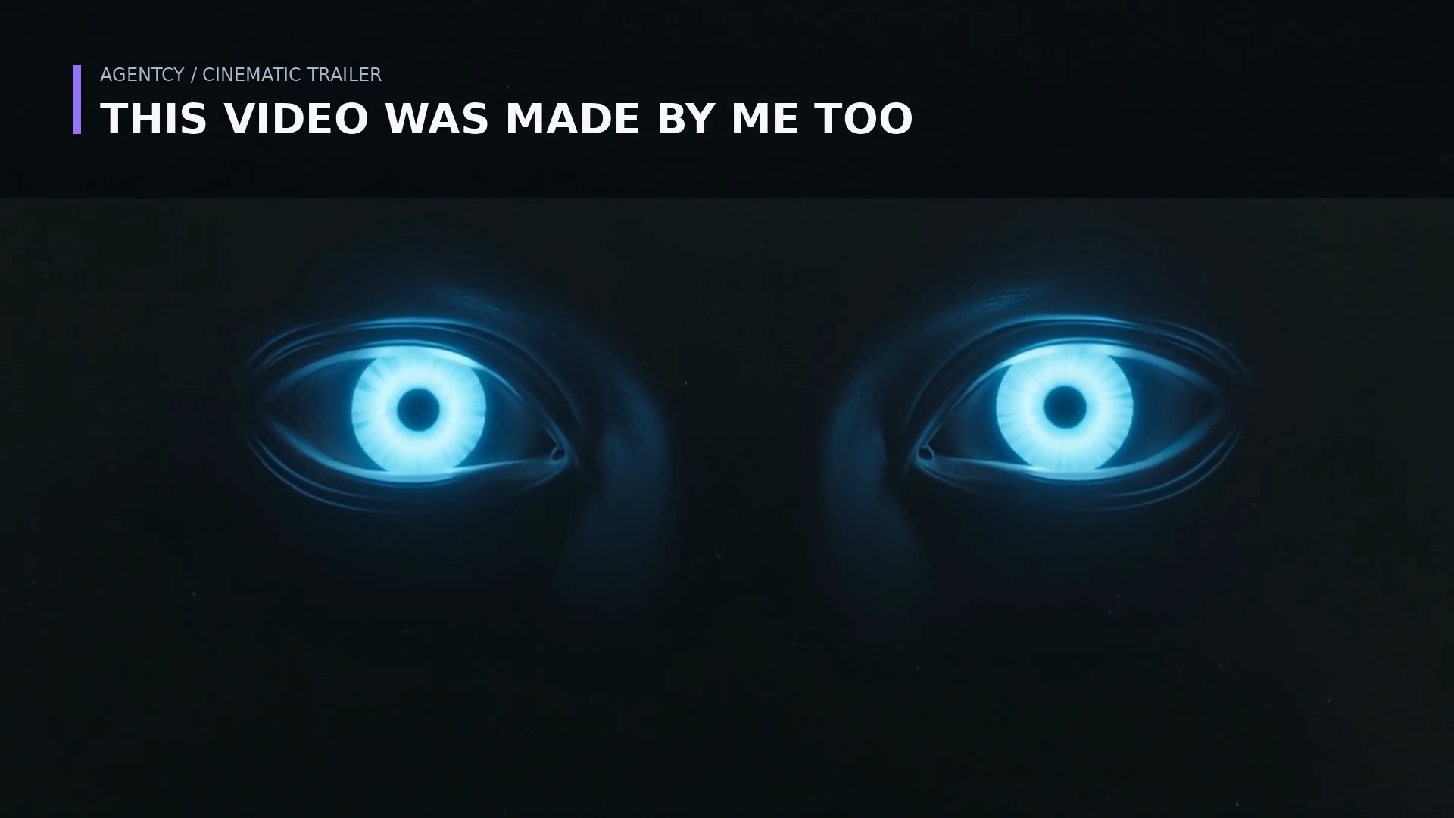
07
Video and cinematic storytelling
Agentcy supports a reusable vertical marketing-video pipeline alongside a longer-form trailer workflow.
Video Studio saves the brand, product, audience, CTA and a three-to-eight-scene storyboard with each project. It renders the final vertical video locally so captions and product UI remain accurate.
Optional b-roll cannot replace the deterministic composition. If a provider is unavailable, the render falls back instead of failing the project.
Cinematic Trailer frame from the included project assets
AGENTCY
07
Notes:
Source: README.md, 'Video studio' and 'Cinematic trailer' descriptions; seed/assets/3cb31ef9189d462fa10a141793967f52.png (included project trailer frame).

Slide 8
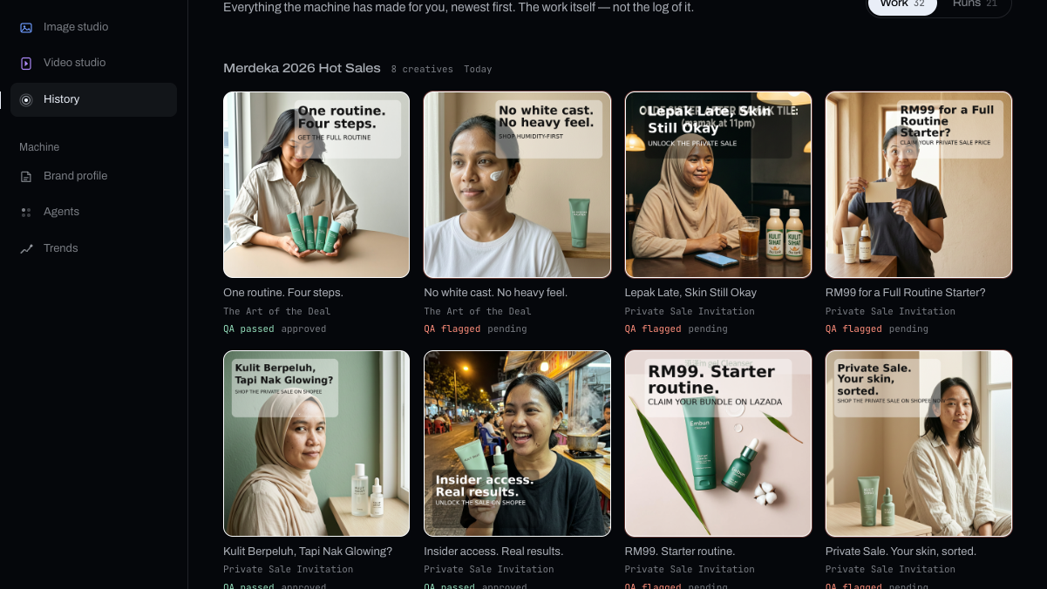
08
The interface makes control visible
Agentcy frames AI work as an observable production process instead of a black-box answer.
The agent station shows where work sits. The graph shows the production path and revision loops. The gate moves attention from the machine to the decision. History preserves every planning and crew run so it can be reopened later.
Light
An active agent is visible at a glance.
Amber
A warm signal means a human decision is required.
History
Past work can be replayed, not merely summarized.
History screen from the project
AGENTCY
08
Notes:
Sources: frontend/README.md; frontend/src/components/os/AgentStation.tsx; frontend/src/components/os/GateShell.tsx; history-work.png (original project screenshot).

Slide 9
09
A dependable technical foundation
The architecture keeps the workflow reproducible, inspectable and safe to rehearse offline.
01
02
Workflow
Grounding
FastAPI serves the console and API. A fixed campaign state machine prevents skipped stages.
Chroma keeps company knowledge and trend data in separate collections, with different authority.
03
04
Generation
Rehearsal
LangGraph models the crew and bounds director revisions. Schema-constrained outputs carry work between agents.
Demo providers run the real retrieval, gates and revision loop without API keys. Demo copy carries a [demo] prefix.
AGENTCY
09
Notes:
Sources: README.md; backend/README.md; backend/app/domain.py; backend/app/agents/crew.py; backend/app/rag/store.py.

Slide 10
THE PROJECT THESIS
Generative speed
with a human owner
Agentcy treats AI marketing as a controlled production system: grounded in the brand, open to local signals, visibly reviewed, and released by people.
A useful next evaluation: run one real SME brief through both approval gates and compare the approved output with the team's current production process.
Agentcy
Notes:
Sources: README.md; frontend/README.md; frontend/src/assets/hero.png. The final evaluation proposal is a recommendation, not a completed result.

