Slide 1

PROJECT PRESENTATION
Agentcy
AI campaign production for Malaysian SMEs
A visible workflow for ideas, imagery and video, with human approval at the points that matter.
September 2026
Notes:
PRESENTER SCRIPT
Good morning everyone. Today I am introducing Agentcy, an AI campaign-production workspace designed for Malaysian SMEs.
The idea behind this project is simple. Marketing teams want to move faster, but they cannot hand product claims, brand voice, and publishing decisions to a black box. Agentcy brings campaign planning, image creation, video creation, and human approval into one visible workflow.
By the end of this presentation, I want to show that the main value of Agentcy is not only generation speed. It is the ability to keep a person in control while the system does useful work.
SOURCES
Sources: README.md (project description); frontend/src/assets/hero.png (original project asset).

Slide 2
02
The campaign-production gap
SMEs want the speed of generative tools without giving up their brand truth or publishing decisions.
The hard part is not generating a first draft. It is keeping product claims, campaign context and human judgment attached to the work as it moves toward publication.
Brand truth
Product facts and restrictions must govern every concept.
Local context
Trend signals can inspire an angle, but they cannot become a product claim.
Final control
A person must be able to stop, inspect and approve the work.
AGENTCY
02
Notes:
PRESENTER SCRIPT
Most generative tools can produce an initial idea quickly. The more difficult problem starts after that first draft.
For a real brand, the content has to remain accurate. It has to respect the product facts and restrictions. It also has to fit the campaign context, especially when local trends or seasonal events are involved.
Agentcy focuses on that gap. It treats brand truth, local context, and final human control as part of the production process rather than as checks added at the end.
SOURCES
Source: README.md; frontend/README.md. The problem framing summarizes the project's stated product claim and product rules.

Slide 3
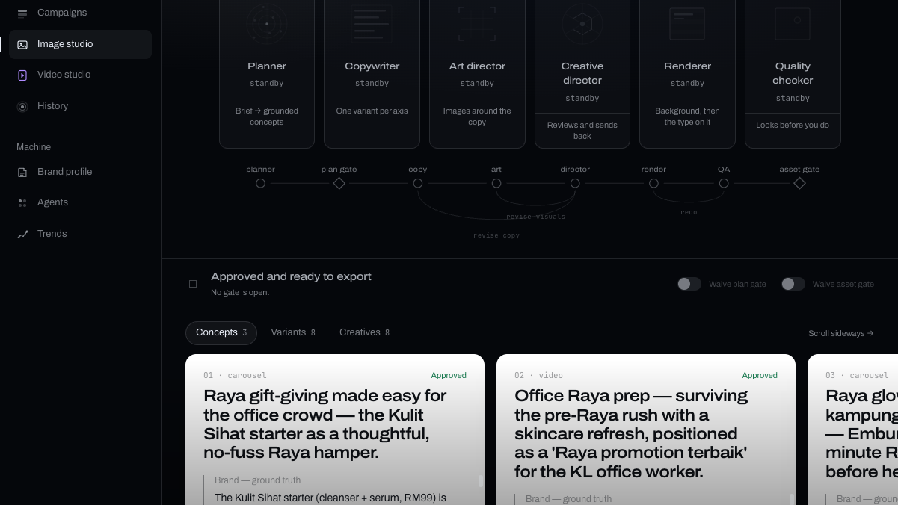
03
A campaign workspace, not a prompt box
Agentcy keeps the brief, agent activity, approval gates and outputs in one visible flow.
A planner turns a campaign brief into grounded concepts. A generation crew develops each approved concept. The studio renders the final work only after the relevant human decision.
01
Plan
Brief to cited concepts
02
Create
Copy and visual direction
03
Review
Human approval gates
04
Publish
Approved images or video
Image Studio screen from the project
AGENTCY
03
Notes:
PRESENTER SCRIPT
This is how Agentcy turns the idea into a working product.
The workflow begins with a campaign brief. The planner develops grounded concepts from that brief. Once a concept is approved, a generation crew prepares the copy and visual direction. The system then supports image or video production, with a human approval point before the work moves on.
On the right, you can see the Image Studio. It exposes the agents, the work path, and the points where a human review happens. The user can see what the system is doing instead of waiting for an unexplained output.
SOURCES
Sources: README.md; frontend/README.md; image-studio.png (original project screenshot).

Slide 4
04
Grounded planning
The source hierarchy makes a campaign idea traceable before anyone generates an asset.
Every planned concept carries both brand and trend rationales. The planner ranks its inputs so that a useful trend can never override what the company knows to be true.
01
The campaign brief
Sets the goal, product and occasion.
02
Company knowledge
Product facts, voice and claim restrictions. This is the source of truth.
Result: a reviewer can see where the idea came from before releasing it to production.
03
Trend signals
Inspiration only. A trend can suggest an angle but never justify a claim.
AGENTCY
04
Notes:
PRESENTER SCRIPT
The planning stage uses a clear hierarchy of information.
First, the campaign brief tells the system what the team wants to achieve. Second, company knowledge provides the product facts, brand voice, approved claims, and restrictions. This is the source of truth.
Trend signals come last. They can suggest a useful creative angle, but they can never become evidence for a product claim. That distinction is important because it prevents the system from treating a popular search topic as a fact about the brand.
Before anything is generated, the reviewer can see the rationale behind the concept and understand where it came from.
SOURCES
Sources: backend/app/agents/planner.py; backend/app/rag/store.py; backend/README.md. The ordering and rationale requirements come from the planner's documented source hierarchy.

Slide 5
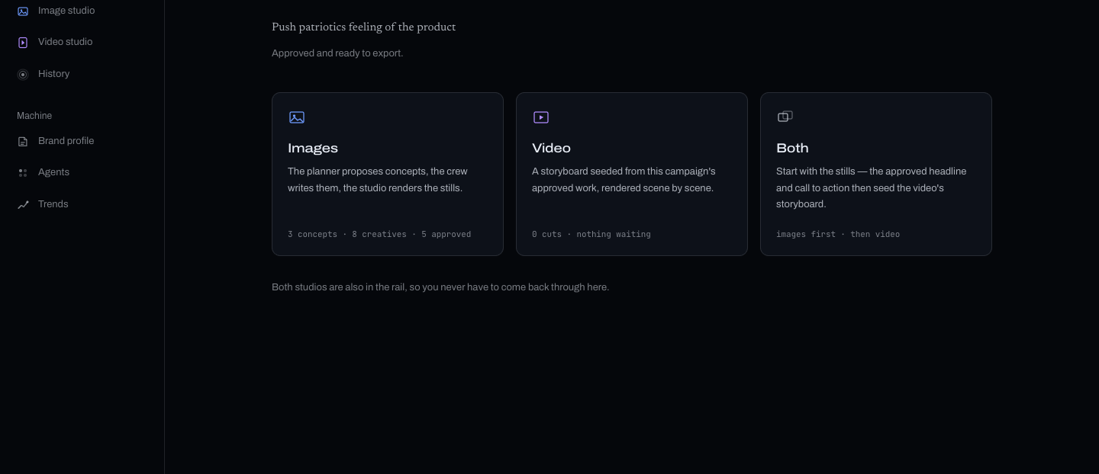
05
Human approval holds the line
A campaign moves through one legal path, with the machine stopping where a person needs to decide.
Draft
Planning
Plan approval
Generating
Asset review
Ready to publish
The UI makes the handover unmistakable: when a gate opens, the machine recedes and the review work moves forward. The run stays halted until someone releases it.
Campaign Hub screen from the project
AGENTCY
05
Notes:
PRESENTER SCRIPT
This slide shows the campaign state path. A campaign starts as a draft, moves into planning, waits for plan approval, then enters generation. After generation, it waits again for asset review before it becomes ready to publish.
The key rule is that the campaign cannot skip these stages. The system does not approve its own concept, and it does not publish its own output.
The interface reinforces that rule visually. When a gate opens, the machine recedes and the review work becomes the focus. The work stays there until a person makes a decision.
SOURCES
Sources: backend/app/domain.py; frontend/src/components/os/StudioShell.tsx; frontend/src/components/os/GateShell.tsx; hub.png (original project screenshot).

Slide 6

06
Image Studio
Approved concepts become reviewable creative, with a director and quality check before the asset gate.
The crew writes copy, plans visual composition and reviews the pairing against brand ground truth. The renderer keeps the finished type under local control rather than asking an image model to draw it.
A director can send work back for copy or visual changes. The revision budget stops at two passes so a reviewer never waits on an endless loop.
Output remains a decision, not an automatic publish action.
Included seed creative. Example only.
AGENTCY
06
Notes:
PRESENTER SCRIPT
Once a team approves a concept, the Image Studio turns it into reviewable creative.
The generation crew writes the copy, plans the image composition, and checks the pairing against the brand knowledge. The renderer keeps the final text under local control, so the system does not depend on an image model to draw accurate captions or product details.
The creative director can request revisions to either the copy or the visuals. However, the revision loop has a fixed limit of two passes. This prevents the workflow from getting stuck and makes sure a reviewer sees work that is clearly marked as passed or flagged.
SOURCES
Sources: backend/app/agents/crew.py; backend/app/domain.py; README.md; seed/assets/aef9984d06024e29953322308de8ffe7.png (included project seed creative). No commercial performance claim is implied by this example asset.

Slide 7
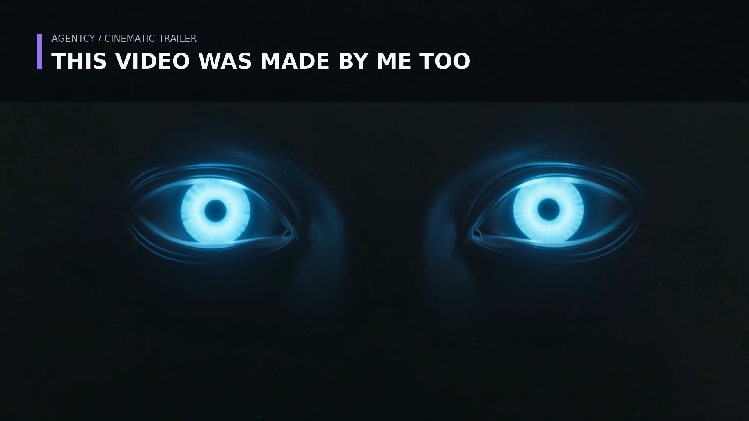
07
Video and cinematic storytelling
Agentcy supports a reusable vertical marketing-video pipeline alongside a longer-form trailer workflow.
Video Studio saves the brand, product, audience, CTA and a three-to-eight-scene storyboard with each project. It renders the final vertical video locally so captions and product UI remain accurate.
Optional b-roll cannot replace the deterministic composition. If a provider is unavailable, the render falls back instead of failing the project.
Cinematic Trailer frame from the included project assets
AGENTCY
07
Notes:
PRESENTER SCRIPT
Agentcy also extends the same control model to video.
The Video Studio saves the brand, product, target audience, call to action, and storyboard with each project. It renders the final vertical video locally so the captions and product interface stay accurate.
The project also includes a Cinematic Trailer workflow for longer-form storytelling. If optional generated b-roll is unavailable, the video pipeline can fall back to its deterministic render rather than failing completely.
That makes video a repeatable production process instead of a one-off prompt experiment.
SOURCES
Source: README.md, 'Video studio' and 'Cinematic trailer' descriptions; seed/assets/3cb31ef9189d462fa10a141793967f52.png (included project trailer frame).

Slide 8
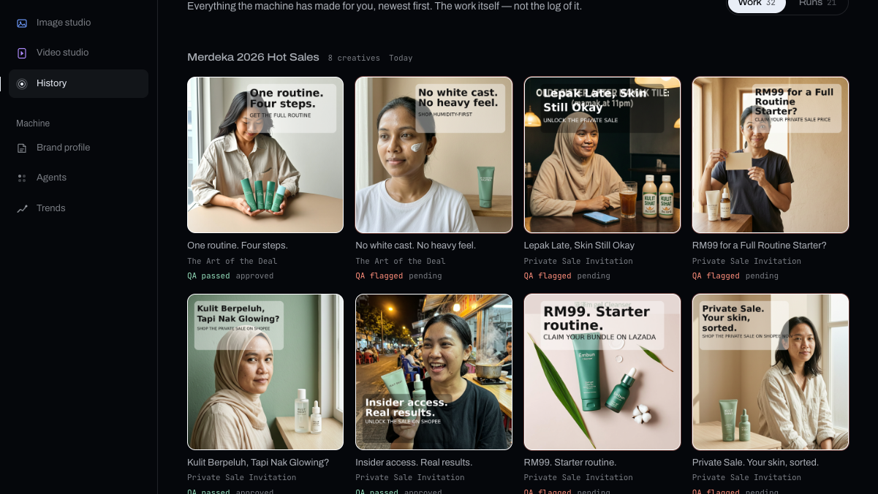
08
The interface makes control visible
Agentcy frames AI work as an observable production process instead of a black-box answer.
The agent station shows where work sits. The graph shows the production path and revision loops. The gate moves attention from the machine to the decision. History preserves every planning and crew run so it can be reopened later.
Light
An active agent is visible at a glance.
Amber
A warm signal means a human decision is required.
History
Past work can be replayed, not merely summarized.
History screen from the project
AGENTCY
08
Notes:
PRESENTER SCRIPT
For me, this is an important part of the project. The interface is designed to make the system understandable while it is working.
The agent station shows which agent currently holds the work. The flow graph shows the production path and any revision loops. Amber is reserved for the moment when a human decision is required.
The History screen on the right keeps both the outputs and the record of the work that produced them. A team can reopen a planning pass or crew run later instead of losing the context once a campaign ends.
SOURCES
Sources: frontend/README.md; frontend/src/components/os/AgentStation.tsx; frontend/src/components/os/GateShell.tsx; history-work.png (original project screenshot).

Slide 9
09
A dependable technical foundation
The architecture keeps the workflow reproducible, inspectable and safe to rehearse offline.
01
02
Workflow
Grounding
FastAPI serves the console and API. A fixed campaign state machine prevents skipped stages.
Chroma keeps company knowledge and trend data in separate collections, with different authority.
03
04
Generation
Rehearsal
LangGraph models the crew and bounds director revisions. Schema-constrained outputs carry work between agents.
Demo providers run the real retrieval, gates and revision loop without API keys. Demo copy carries a [demo] prefix.
AGENTCY
09
Notes:
PRESENTER SCRIPT
Behind the interface, the project uses a foundation designed for a dependable demonstration and future extension.
FastAPI serves the application and API, while a fixed campaign state machine prevents skipped workflow stages. Chroma stores company knowledge and trend data separately because they have different levels of authority.
LangGraph models the generation crew and its bounded revision process. The system also supports an offline demonstration mode. In this mode, retrieval, gates, and revision logic still run, but the generated copy is clearly labelled as demo content.
This makes it possible to test the complete workflow without needing live model credentials.
SOURCES
Sources: README.md; backend/README.md; backend/app/domain.py; backend/app/agents/crew.py; backend/app/rag/store.py.

Slide 10
THE PROJECT THESIS
Generative speed
with a human owner
Agentcy treats AI marketing as a controlled production system: grounded in the brand, open to local signals, visibly reviewed, and released by people.
A useful next evaluation: run one real SME brief through both approval gates and compare the approved output with the team's current production process.
Agentcy
Notes:
PRESENTER SCRIPT
To close, Agentcy presents AI marketing as a controlled production system.
It uses brand knowledge to keep campaigns grounded. It can use local signals to inspire ideas without turning them into false claims. It makes the work and the handoff to the human visible throughout the process.
The next useful step would be a focused pilot with one real SME. We would set up the brand profile, run one campaign brief through both approval gates, and compare the approved output with the team’s current production process.
Thank you. I am happy to answer questions or walk through the workflow in the application.
SOURCES
Sources: README.md; frontend/README.md; frontend/src/assets/hero.png. The final evaluation proposal is a recommendation, not a completed result.

