Slide 1
Aviation_data
File created on: 6/8/2024 6:12:17 AM

Slide 2
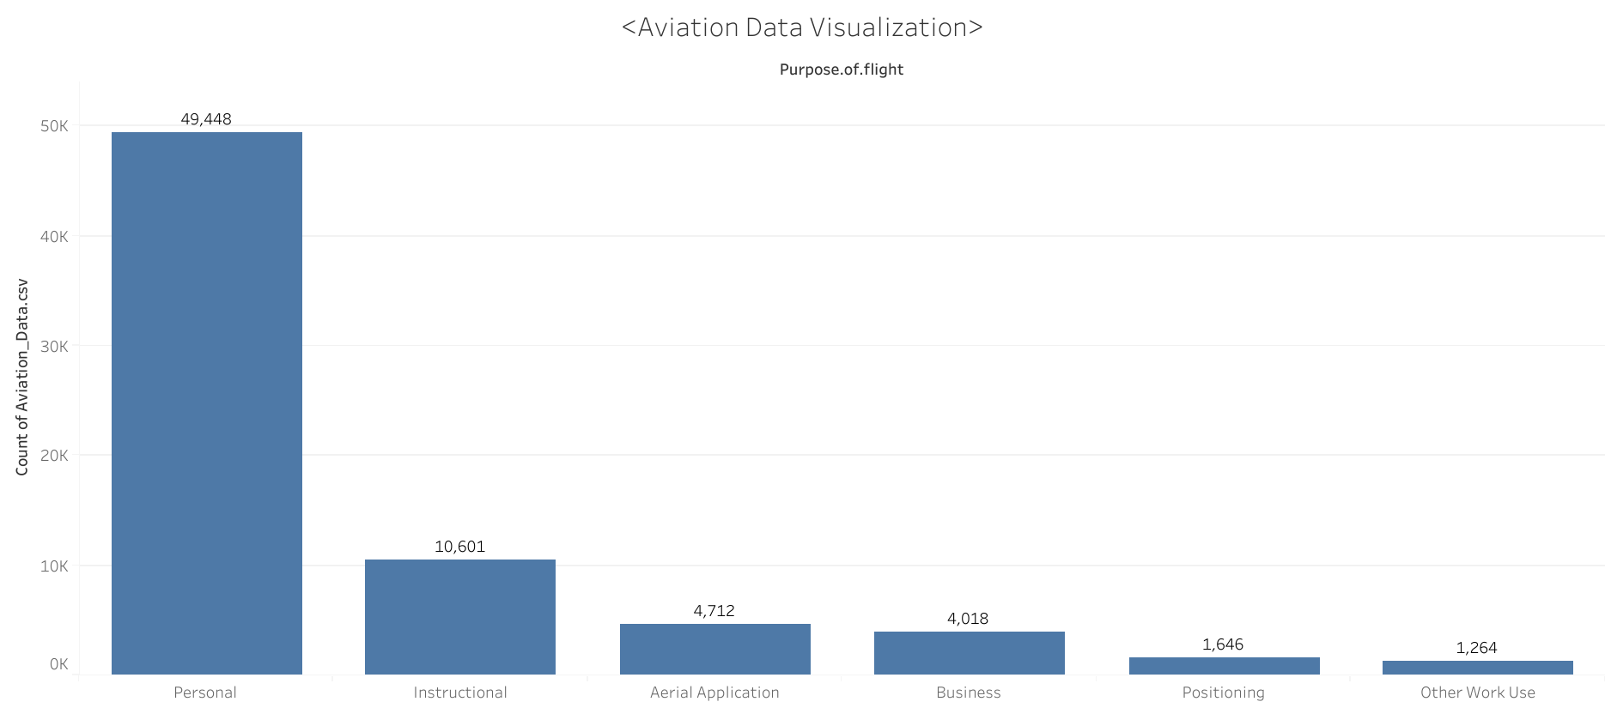

Slide 3
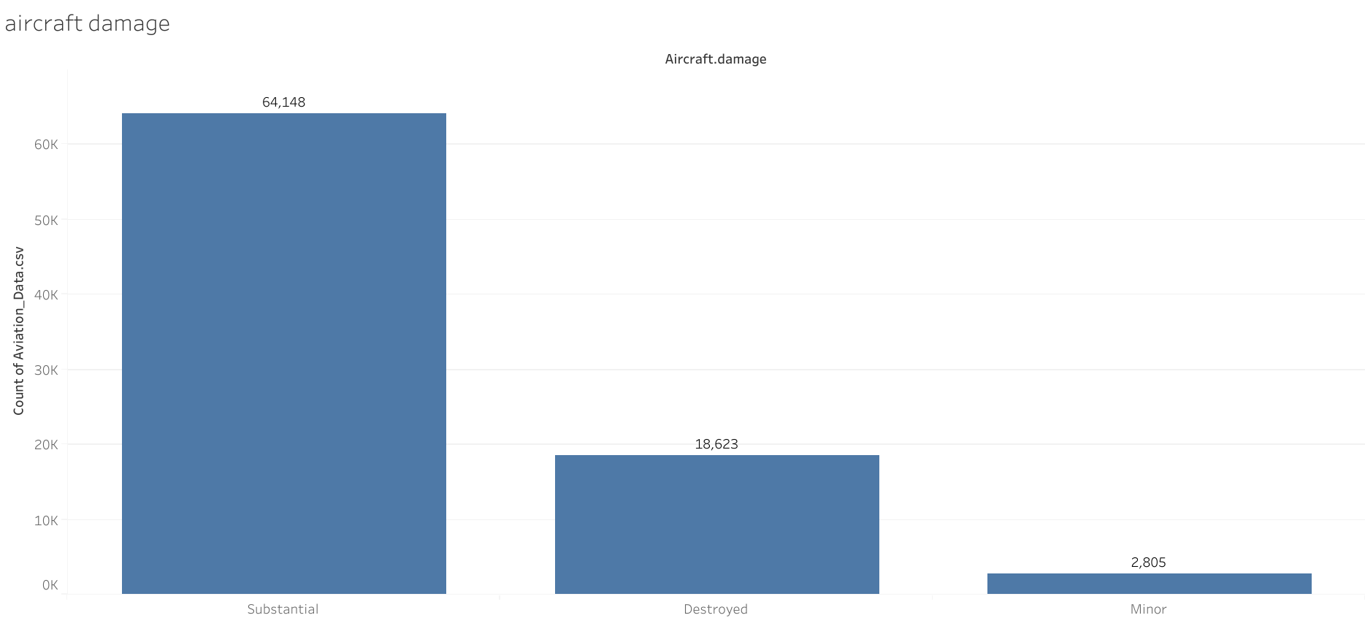

Slide 4
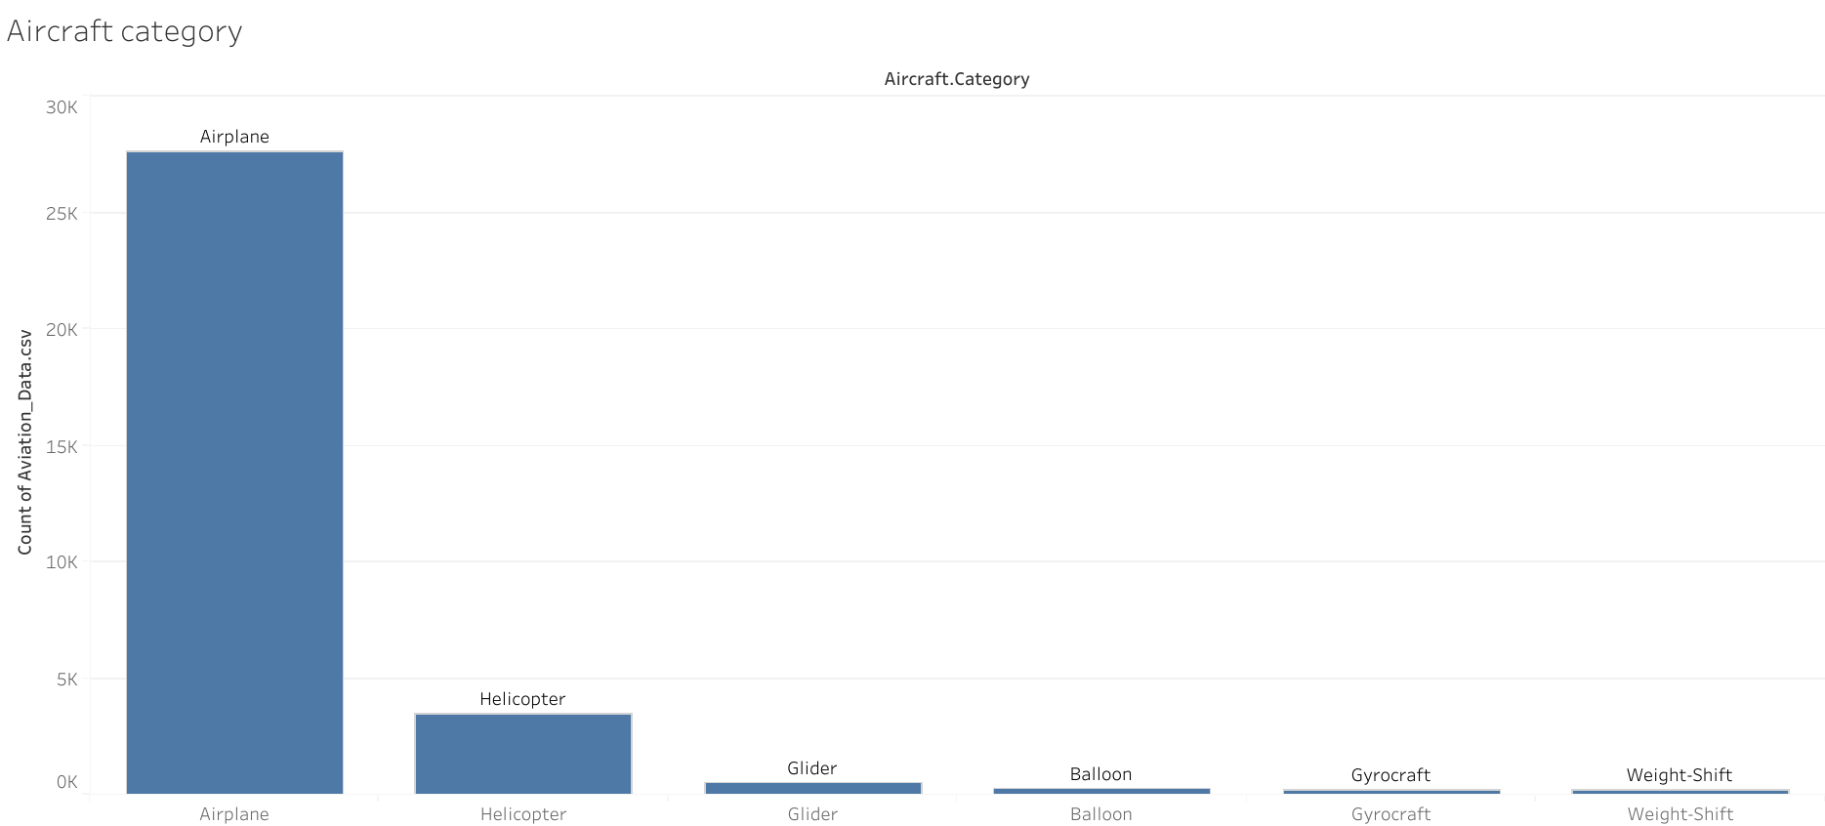

Slide 5
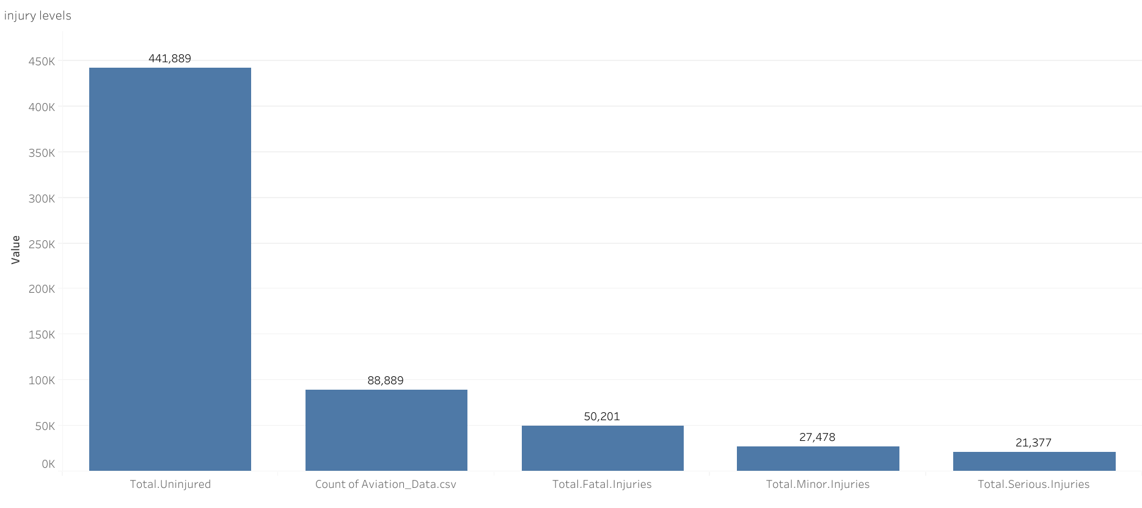

Slide 6
