Slide 1


Template
Sandman Template Architecture

Slide 2
S.O.L.I.D.
S — Single Responsiblity Principle
O — Open-Closed Principle
L — Liskov Substitution Principle
I — Interface Segregation Principle
D — Dependency Inversion Principle

Slide 3


Single Responsiblity Principle
A class should have one and only one reason to change, meaning that a class should have only one job.
If a Class has many responsibilities, it increases the possibility of bugs because making changes to one of its responsibilities, could affect the other ones without you knowing.

Slide 4
Open-Closed Principle
Objects or entities should be open for extension but closed for modification.
Changing the current behaviour of a Class will affect all the systems using that Class.

Slide 5
Liskov Substitution Principle
If S is a subtype of T, then objects of type T in a program may be replaced with objects of type S without altering any of the desirable properties of that program.
This means that every subclass or derived class should be substitutable for their base or parent class.

Slide 6
Interface Segregation Principle
A client should never be forced to implement an interface that it doesn’t use, or clients shouldn’t be forced to depend on methods they do not use.
Many client-specific interfaces are better than one general-purpose interface.

Slide 7
Dependency Inversion Principle
Entities must depend on abstractions, not on concretions. It states that the high-level module must not depend on the low-level module, but they should depend on abstractions.
High-level Module(or Class): Class that executes an action with a tool.
Low-level Module (or Class): The tool that is needed to execute the action
Abstraction: Represents an interface that connects the two Classes.
Details: How the tool works

Slide 8
References
https://www.digitalocean.com/community/conceptual_articles/s-o-l-i-d-the-first-five-principles-of-object-oriented-design
https://medium.com/backticks-tildes/the-s-o-l-i-d-principles-in-pictures-b34ce2f1e898
https://www.baeldung.com/solid-principles

Slide 9

The Repository and Unit of Work Patterns

Slide 10
Advatages
The repository and unit of work patterns are intended to create an abstraction layer between the data access layer and the business logic layer of an application.
Implementing these patterns can help insulate your application from changes in the data store and can facilitate automated unit testing or test-driven development (TDD).
A Unit of Work keeps track of everything you do during a business transaction that can affect the database.

Slide 11
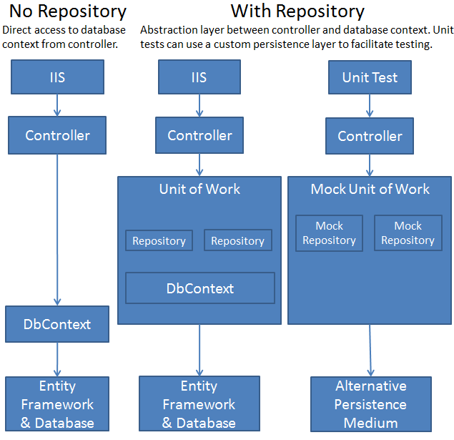

Slide 12
References
https://docs.microsoft.com/en-us/aspnet/mvc/overview/older-versions/getting-started-with-ef-5-using-mvc-4/implementing-the-repository-and-unit-of-work-patterns-in-an-asp-net-mvc-application
https://deviq.com/design-patterns/repository-pattern
https://martinfowler.com/eaaCatalog/unitOfWork.html

Slide 13
Template Specification
DTO – Data Transfer Object
DAL – Data Access Layer
Repository
Unit of work
Service
Crossing cutting

Slide 14
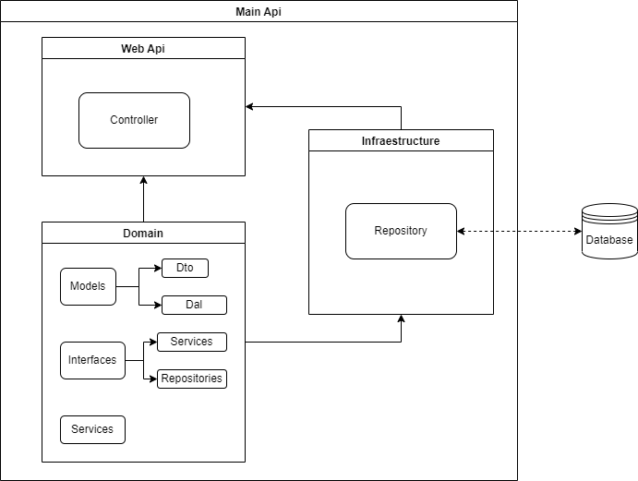

Slide 15
DAL - DTO
DAL
DTO
Data base Access
Can contain Admin e log info
Should represent the data from the data base
Can do data base mapping info
Controller Access
Should not contain Admin e log info
Should deliver the correct information to the user
Can do Json mapping info

Slide 16
Repository - Service
Repository
Service
Access info from data base
Never Contains Business Logic
Do data base logic validation
Process info from repository to controller and vice-versa
Contains Business Logic
Do business logic validation

Slide 17
Unit of Work
Encapsulate all repository logic needed by the servisse
Do transactions, Roll back and commits call
Facilitate the services contructor and service functionalite

Slide 18
Cross Cutting
Optional Project part
Should contains static part which are independente of the Project logic and data, as data validator, exceptions, error message, useful function.
Should be visible for all parts (projects) of the solution
Should be indepent of Project class and interfaces

Slide 19
Example Project
https://github.com/flpinheiro/TemplateApi

Slide 20

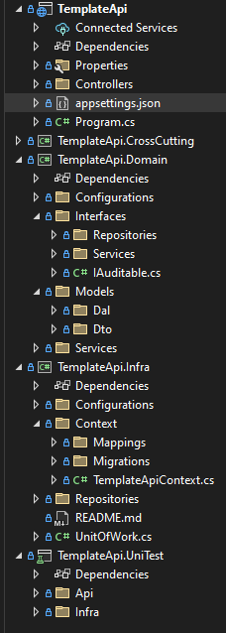
TemplateApi Structure

