Slide 1
Support Vector Machines for Stock market Predictions
By Ben Johnson

Slide 2
AGENDA
Overview of Support Vector Machines
Stock Market Analysis
Significant Findings
Related Work

Slide 3
Overview of Support Vector Machines

Slide 4
Introduction To Support Vector Machines
Purpose: SVM is a supervised machine learning algorithm used for classification and regression tasks.
Core Idea: It finds the optimal hyperplane that best separates data into different classes.
Support Vectors: Data points that are closest to the hyperplane and influence its position and orientation.
Hyperplane: A decision boundary that separates different classes in the feature space.
Reference and learn more: Support Vector Machine — Introduction to Machine Learning Algorithms | by Rohith Gandhi | Towards Data Science

Slide 5
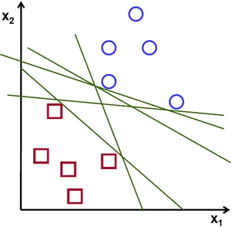
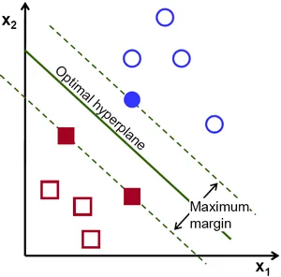
Support Vector Machine – Linear example

Slide 6
Introduction To Support Vector Machines – Main Parameters
Kernel: Determines the type of hyperplane used to separate the data. Common kernels include:
Linear: Suitable for linearly separable data.
Polynomial: Suitable for non-linear data.
Radial Basis Function (RBF): Suitable for non-linear data with a Gaussian distribution.
C (Regularization Parameter): Controls the trade-off between achieving a low error on the training data and minimizing the margin.
A smaller C value allows for a wider margin. Lowers the chance of overfitting.
A larger C value aims for a narrower margin with fewer misclassifications.

Slide 7
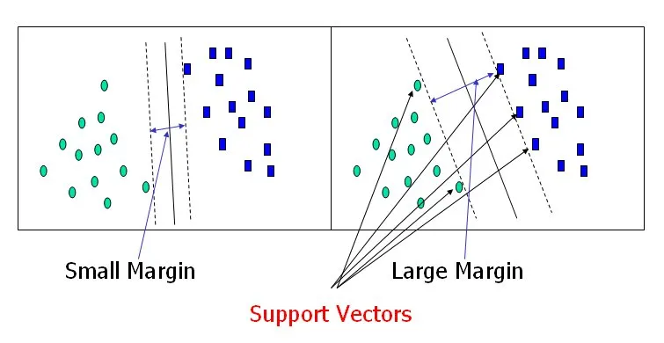
Support Vector Machine – C Parameter Regularization example

Slide 8
Let’s Look at a code example!

Slide 9
SVM Modeling for Stock Market Analysis

Slide 10
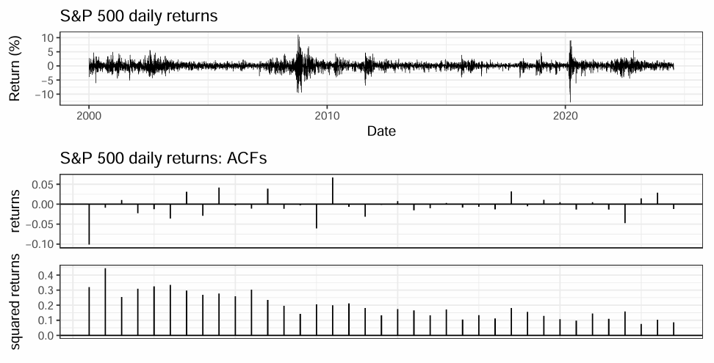
Time Series Stock Market Overview
A random walk?
Code source – ECON5200 – Florin Bidian (Code attached)

Slide 11
Time Series Stock Market Overview
Correlation measures the strength and direction of a linear relationship between two variables
A dependent relationship means that the value of one variable depends on the value of another variable.
Correlation measures the degree of linear relationship between variables, while dependence indicates that one variable’s value is influenced by another.
Next day returns are uncorrelated but NOT independent.

Slide 12
SVM Model Overview
Classifying a stock as a hold or not-hold on a given day
Input feature for open to close price change.
Input feature for high to low price change.
Train features from previous days to predict the next day.
Next day close prediction > current day close is a ‘Hold’.
Compare returns each day to only returns on predicted ‘Hold’ days.
Split 80% days before cutoff to train, test on 20% days after cutoff.
Model each stock individually – cumulative returns for market

Slide 13
Additional Features Attempted
Change in Returns over the past 7 days
Change in Returns over the past 14 days
Change in Volume of the Stock, past day
No significant findings for these features (more work could be done here)

Slide 14
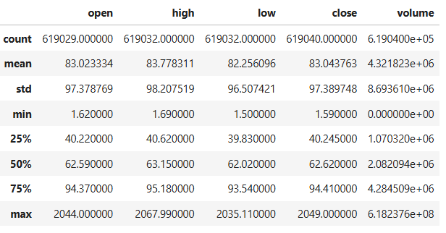
S&P 500 data
Min date: 2013-02-08 Max date: 2018-02-07
From February 8th, 2013, to February 7th, 2018.
Data source: S&P 500 || Time Series Forecasting with Prophet (kaggle.com)

Slide 15
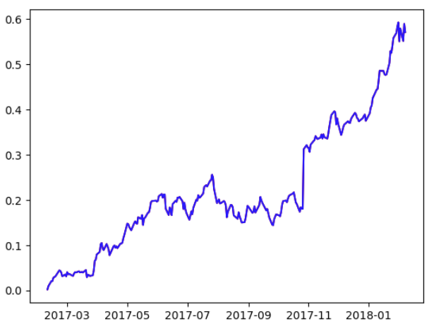
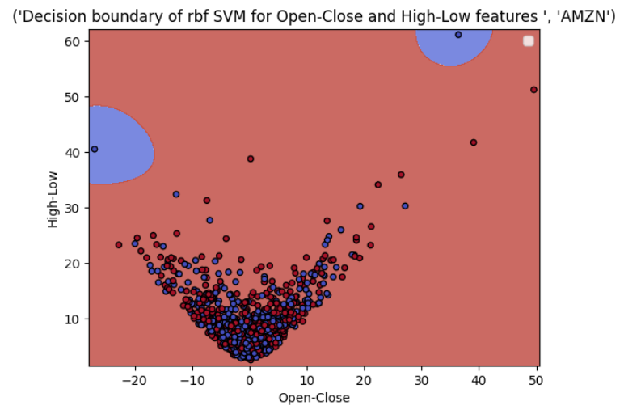
SVM Example - AMZN
The model predicts to almost always hold AMZN
Red – Hold, Blue – Don’t Hold
- Decimal (Y-Axis * 100 for percentage)
Cumulative returns

Slide 16
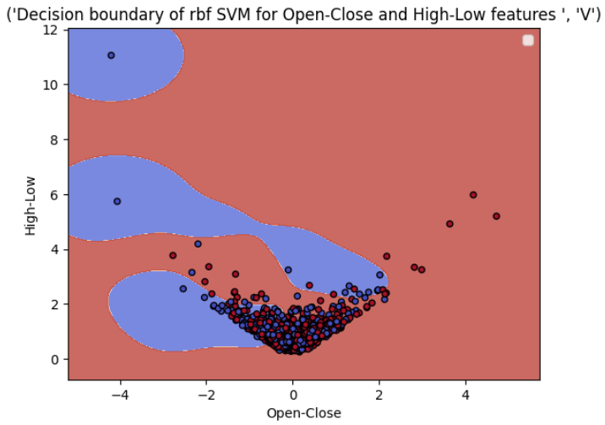
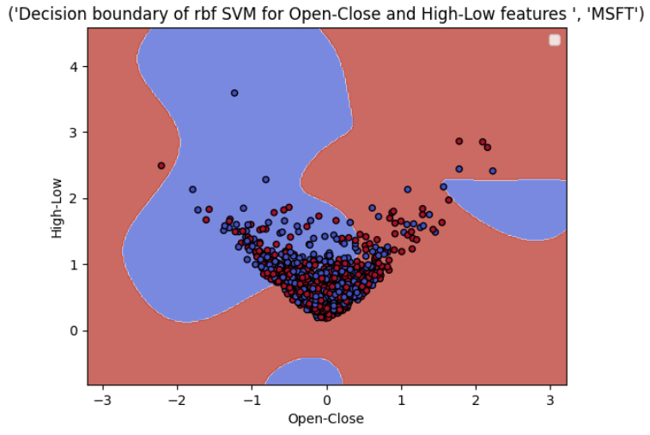
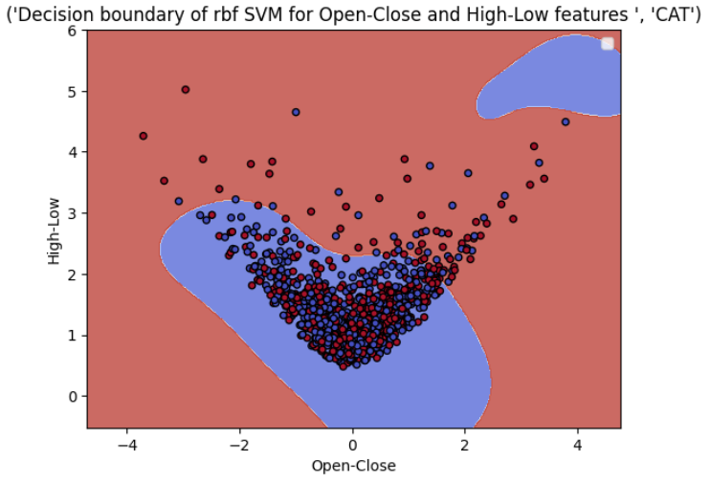
SVM Example – Visa, MSFT, CAT
Visa
Red – Hold, Blue – Don’t Hold
MSFT
CAT

Slide 17
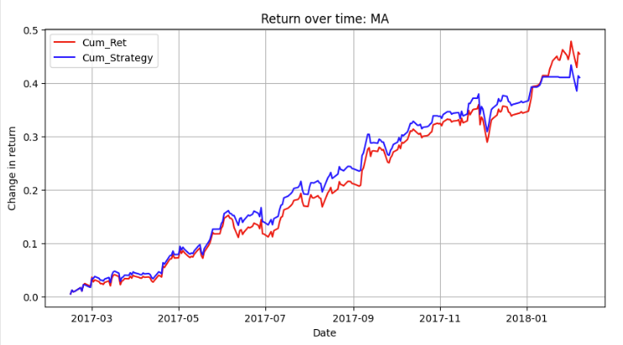
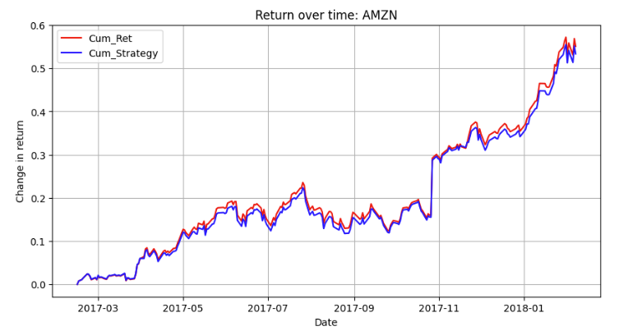
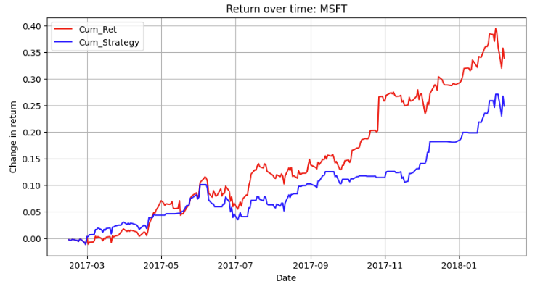
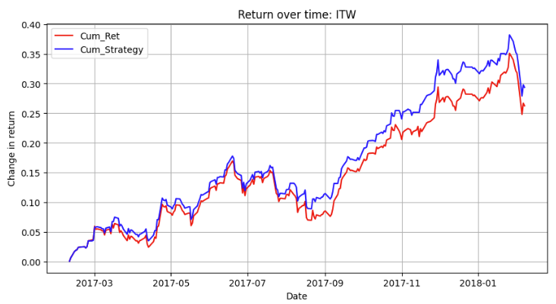

Slide 18
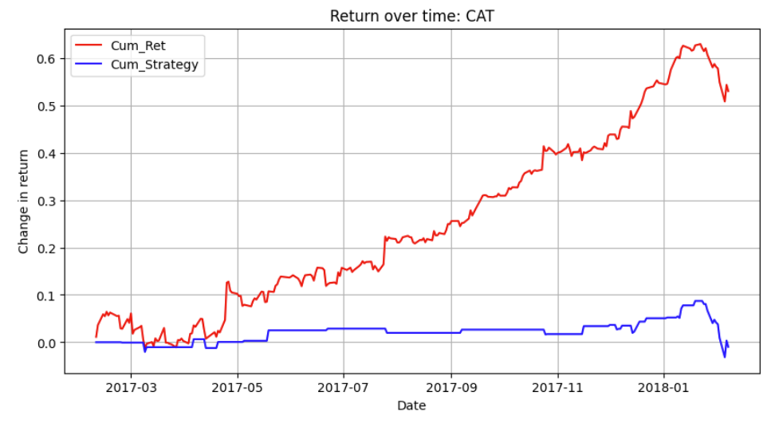
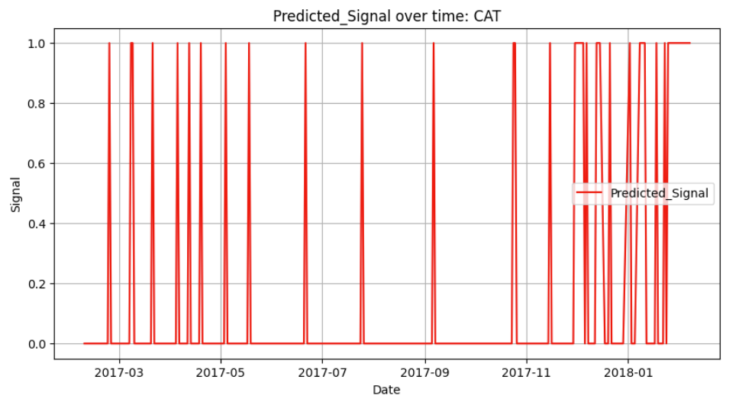
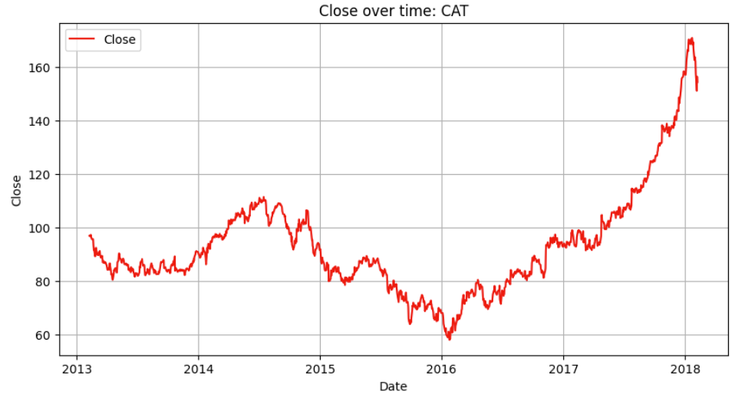
Severe Model Underperformance Example - CAT
Test accuracy: 0.44

Slide 19

Observation: When we Beat the Market? – a market dip

Slide 20
What is the issue with this Approach?
~52% test accuracy depending on the stock.
Training and test data is split on date.
Predictions are generally less helpful the further we move from the training split date.
Can we predict for only the short-run and see an improvement?

Slide 21
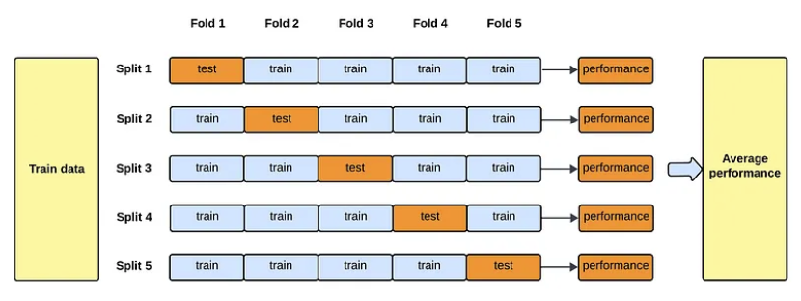
K-Fold Cross validation
Test on multiple subset splits of the data, to reduce the chance of overfitting.

Slide 22
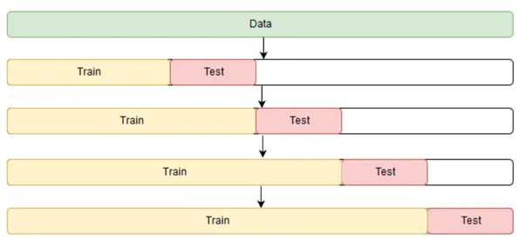
SVM and time series K-FOLD Cross-Validation
Use time series kfold split:
Use sklearn TimeSeriesSplit – Train (0 – N days), Test (N+1, N+30 days)
Compare the cumulative returns for:
1 day out, 3 days out, 5 days out, 10 days out, 15 days out
Also helps reduce overfitting
Source: Cross Validation in Time Series. Cross Validation: | by Soumya Shrivastava | Medium

Slide 23




Performance Measures

Slide 24
AvG. Performance Of SVM model - Across all Stocks and Folds
Average 52% accuracy.
This measures the overall correctness of the model.
Accurate positive and negative predictions over total instances.
Average 56% F1-score.
Accounts for false positive and false negative rates.
Average 53% precision.
Measures the accuracy of the positive predictions.
Ratio of true positive predictions to all predicated positives.
Average 67% recall.
Measures the ability of the model to identify all relevant instances.
Ratio of true positive predictions to all actual positives.

Slide 25
Compare This to market Returns, One day out
TimeSeriesSplit cross validation, sum the cumulative returns one day out (for all stocks)
Compare cumulative market returns one-day out to our returns one-day out
Most examples do not beat the market in the long-run
Not able to conclusively show performance improvements over the market, we would need to experiment with other features
The model seems to perform particularly well at AVOIDING downturns, it is not good at predicting spikes.

Slide 26
Our Model Consistently Outperforms in One-Day Returns On a Market Downturn – Example
Cumulative % returns of all stocks
Market:
1 day: -2.30%
3 days: -0.93%
5 days: -0.14%
10 days: 0.35%
15 days: -1.02%
Model Performance:
1 day: -1.44%
3 days: -0.17%
5 days: 0.67%
10 days: 1.15%
15 days: 0.21%

Slide 27
Our Model Consistently Outperforms in One-Day Returns On a Market Downturn
100 randomized splits over the data.
See if the market cumulative return is less than 0.
Of the 49 market downturns, our model performed better 42 times.
Similar results on repeat experiments.
Similar trend for time series cross-validation.
Average market negative one-day returns: -0.35%
Average model negative one-day returns: -0.26%

Slide 28
Let’s Look at a code example!

Slide 29
Future Research
Deeper validation and testing of results.
Try other features (volume sold, returns, company data).
Factor in the overhead cost of buying and selling stocks.
Smarter exclusion of ‘random walk’ cluster.
Further comparison with more traditional time series model approaches.
Test on a live data set (the real market).

Slide 30
SVM and time series Learning Resources
Other resources
How-To: Cross Validation with Time Series Data | by Haden Pelletier | Towards Data
Predicting Stock Price Direction using Support Vector Machines – GeeksforGeeks
S&P 500 || Time Series Forecasting with Prophet (kaggle.com)
Code from this presentation: flpymonkey/SVM-Stocks

Slide 31
SVM Stock/Price Market Research
Other resources
Predicting Stock Price Direction using Support Vector Machines - Saahil Madge
saahil_madge.pdf (princeton.edu)
A Comprehensive Comparative Study of Artificial Neural Network (ANN) and Support Vector Machines (SVM) on Stock Forecasting | Annals of Data Science (springer.com)
Support Vector Machine Algorithms: An Application to Ship Price Forecasting - Syriopoulos · Tsatsaronis · Karamanos

Slide 32
THANK YOU
Questions?

