Slide 1

王希伟

Slide 2

a)决定答案位置的词语
b)依据：讲究实证，一一对应
c)要求：根据考点做题，拒绝猜测推理

Slide 3

1 数字（温度，时间，百分比），大写字母（地点，人名，专有名词）
2. 特殊名词》特殊动词》特殊形容词或副词
3. 常见词，文章主旨词，题干内部重复出现的词，皆不适合做定位词

Slide 4
According to Professor Yessis, American runners are relying for their current success on _________________.
Yessis describes a training approach from the former Soviet Union that aims to develop an athlete’s __________________.

Slide 5
Yessis links an inadequate diet to __________________.
Yessis claims that the key to setting new records is better _________________.

Slide 6
Questions 11—13
11 Biomechanics films are proving particularly useful because they enable trainers to
12 Biomechanics specialists used theoretical models to
13 John S.Raglin believes our current knowledge of athletics

Slide 7

特点
1 题目要求多变：
YES，NO, NOT GIVEN
TRUE, FALSE, NOT GIVEN
Yes,yes,Y

Slide 8

2 三种答案数量有规律
True≥ False > Not Given
3 顺序出现
4 同时定位两题

Slide 9
考点词
1 仅出现在判断题中
2 考官的出题点所在位置

Slide 10

1 是非考点
The parents of top athletes have often been successful athletes themselves
Be，can 后面的部分

Slide 11
2 程度，only，all，est
3 Performance has improved most greatly in events requiring an intensive burst of energy.

Slide 12
3 比较
剑5 T3-34 P73
Research into agent technology was more costly than research into neural networks.

Slide 13
4 考察一致性
数字,时间,地点

Slide 14

1 Modern official athletic records date from about 1900.
2 There was little improvement in athletic performance before the twentieth century.

Slide 15

3 Performance has improved most greatly in events requiring an intensive burst of energy.
4 Improvements in athletic performance can be fully explained by genetics.

Slide 16
5 The parents of top athletes have often been successful athletes themselves.
6 The growing international importance of athletics means that gifted athletes can be recognized at a younger age.

Slide 17

1 定位词主题
2 先主题后考点，找准二者即可

Slide 18
True
题干与原文信息相符
主题词一致，考点词相符
False
题干与原文相悖
主题词一致，考点词相悖

Slide 19
Not Given
题干在原文没有提及或者没有证据支持
a)主题词没有出现
b)或者主题词一致，方向词描述类型不一致

Slide 20

F1：“绝对”陈述
must
absolutely/definitely/ invariably （一定地）/ Inevitably（必然地）/unarguably（毫无疑问地）/assuredly（确实地）/
indisputably（毫无疑问地)/ certainly/without question=out of question(毫无疑问）/…

Slide 21

impossible(ly) / immediate(ly)/
always / usually / never/
all / every / any / none

Slide 22

possible(ly) / probable(ly) / perhaps/ be likely to（很有可能）/ maybe/ may (might)/
seem to /appear to （似乎）/almost/sometimes/
some/a degree of / occasionally（偶尔）/
not always/not all/ not necessarily/

Slide 23

F2 反义
a)原文当中，定位词周围，否定词否定
not / no longer (不再) / not any more / by no means (决不）…

Slide 24
b)原文当中，定位词周围，隐含否定
used to do sth. / until recently/
as was once the case

Slide 25

F3：单一限定
原文：老王和老李是劳模
题干：只有老王是劳模
剑4 P20
2. Children only accept opinions on rainforests that they encounter in their classrooms.

Slide 26
F4数字做考点
剑4 P48 17
17 Between 1983 and 1990 the numbers of patients visiting alternative therapists rose to include a further 8% of the population.

Slide 27

NG 1: 原文没有提及
题干与原文并无任何关系
剑4 P69 Q10
In some cases, the families of street children may need financial support from S.K.I

Slide 28
NG2 定位词相同，无考点词内容重现
最常见的NG。
剑5 T1-10,P19
Johnson had been planning to write a dictionary for several years

Slide 29
NG3 并不存在的比较关系

Slide 30

NG4 权威效应，大众效应
原文：I believe Chinese football team is much better than Brazilian one.
题干： Chinese football team is much better than Brazilian one.

Slide 31
原文是许愿，保证，发誓等，题干当事实陈述
promise，swear（发誓），pledge（保证），wish
特殊：point out

Slide 32
NG 5 最高级
top 5 1
原文 Beijing is one of the largest cities in the world.
100
题干 Beijing is the largest city in the world.

Slide 33
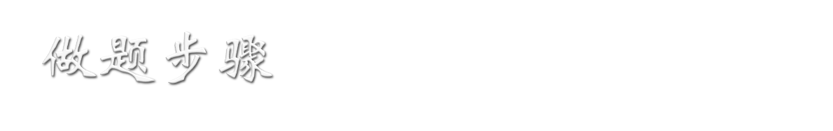
1 勾题目要求
2 勾定位词，考点词
3 两题一组，扫读原文，查找定位词，考点词
4 与题干判断

