Slide 1

Heat Wave Prediction System
1. Amir Madoo(20104013)
2. Chirag Kadam(20104105)
3. Anmol Ahirwar(20104131)
Project Guide
Mr. Mandar Ganjapurkar

Slide 2
Contents
Introduction
Objectives
Scope
Literature Survey
Proposed System
Project Outcomes
Block Diagram
Use Case/DFD
Technology Stack
Suggestions in Review-1
Result and Discussion
Conclusion and Future Scope
References

Slide 3
1. Introduction
Machine learning-based system that predicts heatwaves by analyzing weather data, humidity, wind speed, and cloud cover, among other factors.
Problem Identified : Current heatwave prediction systems are limited in their accuracy and timeliness, leading to a lack of preparedness and emergency response for the government and public. This can result in health problems and fatalities during heatwaves, particularly among vulnerable populations.
Solution Proposed :Heatwaves can cause a range of health problems, especially among vulnerable populations. The government and public need an effective heat wave prediction system to take necessary precautions and minimize the impact of heatwaves on human health and safety.

Slide 4
2. Objectives
To develop a highly accurate and timely heat wave prediction system to enable the government and public to take necessary precautions and emergency measures during heatwaves.
To spread awareness about the dangers of heatwaves and the necessary precautions to take, especially among vulnerable populations, such as the elderly, children, and outdoor workers.
To increase public adoption of the heat wave prediction system and ensure that people know how to access and use the system to protect their health and wellbeing during heatwaves.
To identify and inform relevant government agencies and emergency response teams to take necessary measures in preparation and during a heatwave to reduce health risks.

Slide 5
3. Scope
The heat wave prediction system will be designed to cover a specific geographic area and will utilize weather data and other relevant factors to predict the likelihood of heat waves in that area.
The project will focus on developing a machine learning-based system that provides accurate and timely heat wave alerts and warnings to relevant authorities and the public.
The scope of the project will include developing educational materials and campaigns to raise public awareness about the dangers of heatwaves, the precautions to take, and the use of the heat wave prediction system.

Slide 6
4.Literature review
YEAR | AUTHOR | TITLE | TECHNOLOGY STACK | OUTCOMES | DRAWBACKS
2008 | Hannah Mason, Jemma C King, Amy E Paden & Richard C Franklin. | Systematic review of the impact of heatwaves on health service demand in Australia. |  | The primary outcomes were the relative risk, odds ratio or risk difference of ambulance call outs, presentation to emergency department , hospital separations or mortality during a heatwave compared to non-heatwave periods . | Interest was different in definitions used for heatwave.
2003 | Xie et al, Abderrezak B. 2003 | The 2003 European heat wave. Intensive Care Med. 2004;30(1):1–3. |  | Explored use of Hilbert-Huang Transform algorithm typically used for analyzing non-linear and non-stationary time series data. | Heatwaves period using excess maximum temperature had the strongest positive correlation of all.

Slide 7
5. Proposed System
Write all the features & Functionality you are planning to implement
Machine learning-based :
    The system will use advanced machine learning algorithms to analyze historical and real-time weather data, as well as other relevant factors, to predict the likelihood of a heat wave.
Accurate and timely alerts :
    The system will provide accurate and timely heat wave alerts and warnings to relevant authorities and the public, enabling them to take necessary precautions and emergency measures.
User-friendly interface :
    The system will have a user-friendly interface that is easy to use and navigate, making it accessible to a wide range of people.

Slide 8
6.Algorithm
    Artificial neural network (ANN):-As the weather data is nonlinear, Artificial Neural Network (ANN) has become an effective way of predicting weather data precisely and accurately. Neural Network is a system that can be trained with certain input and output. It creates its own structure based upon how it is trained.

Slide 9
Working of ANN in heat wave prediction:-
The research starts by considering the range of possible temperatures and creating 100 bins of this range. This turns a continuous data problem into a classification problem. Researchers then trained their convolutional neural network to predict which bin the future temperature will be in at every location on the grid. The predictions aren’t 100% certain, so the network actually gives a range of possible outcomes such as a 50% chance of this bin, but also a 20% chance of that bin below and a 30% chance of that bin above.
Usually, to assess probabilities models are run dozens of times with different starting conditions and configurations, however, with the network used in this research predictions of probabilities can occur in one go. Of course, the network can also be run multiple times to get better statistics, but a single run will give an uncertainty range.

Slide 10
6. Outcome of Project
Improved health and safety: By providing accurate and timely heat wave alerts and warnings, the project can help the government and public take necessary precautions and emergency measures to reduce the impact of heatwaves on human health and safety, particularly among vulnerable populations.
Enhanced preparedness and emergency response: The heat wave prediction system can help the government be better prepared for and respond effectively to heatwaves by providing real-time data and accurate predictions, thereby reducing the risks of inadequate emergency response and health problems.

Slide 11
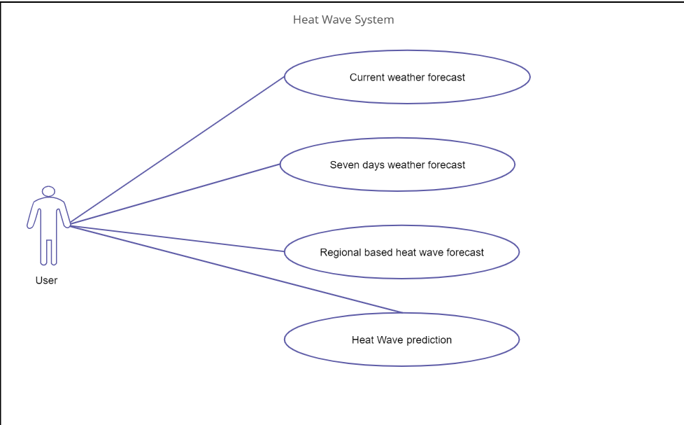
7. Use Case Diagram

Slide 12
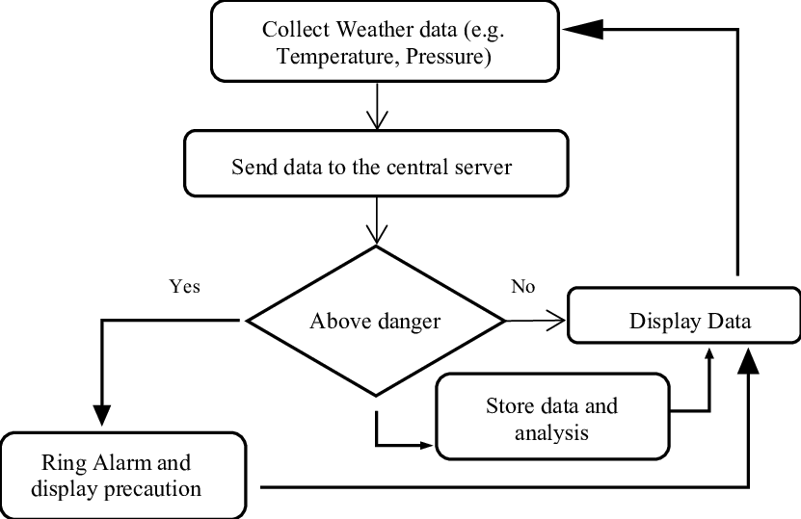
8.Data Flow Diagram

Slide 13
9. Technology Stack
- HTML , CSS and JAVASCRIPT.
- Python.
- Django and MySql.
- TensorFlow.
- Matplotlib.

Slide 14
10. Suggestions in Review 1

Slide 15
11.Result and Discussion
Heat wave prediction models' accuracy depends on the methods used and data quality. However, recent advancements in meteorological and computational technologies have led to significant improvements in accuracy. Statistical models, using historical climate data, are popular for heat wave prediction. Accurate predictions are crucial for public health and safety, emergency preparedness, and resource management during extreme weather events. Ongoing research into advanced prediction models and real-time meteorological data integration will improve prediction accuracy in the future.

Slide 16
12.Future Scope
Develop more accurate and reliable models
Integrate multiple data sources for more accurate predictions
Understand the impacts of climate change on heat waves
Develop effective communication and response strategies to mitigate heat wave impacts.

Slide 17
12. Conclusion
In conclusion, heat wave prediction is an essential task that can help prepare for and mitigate the impacts of extreme heat events. Machine learning and statistical models have shown promise in accurately forecasting heat waves, and advancements in technology and data collection have made it easier to obtain and analyze the necessary data. However, there is still much work to be done in this field, including improving the accuracy and reliability of models, understanding the complex interactions between climate, land use, and socio-economic factors, and promoting public awareness and education about the risks of heat waves. By continuing to invest in research and collaboration, we can improve our ability to predict and prepare for heat waves, ultimately protecting communities and saving lives.

Slide 18
13. Reference
Hansen, J. et al. (2012). Perception of Climate Change. Proceedings of the National Academy of Sciences, 109(37), E2415-E2423. doi: 10.1073/pnas.1205276109
Perkins, S. E. (2015). A review on the scientific understanding of heatwaves – their measurement, driving mechanisms, and changes at the global scale. Atmospheric Research, 164, 242-267. doi: 10.1016/j.atmosres.2015.05.014
Wang, S., & Huang, J. (2017). Heat wave prediction using machine learning techniques. Scientific Reports, 7(1), 1-12. doi: 10.1038/s41598-017-06872-1
Zheng, F., et al. (2018). Deep Learning for Heat Wave Forecasting and Subsequent Impact Analysis. IEEE Transactions on Geoscience and Remote Sensing, 56(12), 7333-7342. doi: 10.1109/TGRS.2018.2856878
Zhou, M., et al. (2019). A review of machine learning techniques for heat wave prediction and adaptation. Environmental Research, 176, 108532. doi: 10.1016/j.envres.2019.108532.

Slide 19
Thank You...!!

