Slide 1
Implementing and Evaluating MPTCP on the SCION Future Internet Architecture
Presentation master thesis
Michael A. Flückiger
August 28, 2020

Slide 2
Projektanalyse – Folie 2
On the menu
Introduction to the work
Functionality of Shila
Performance evaluation
Future work
Notes:
Introduction: What ingredients? What? Why?
Shila: How? (Setup – Connection establishment – Data transfer)
Performance: How good?
Future work: What is next?

Slide 3
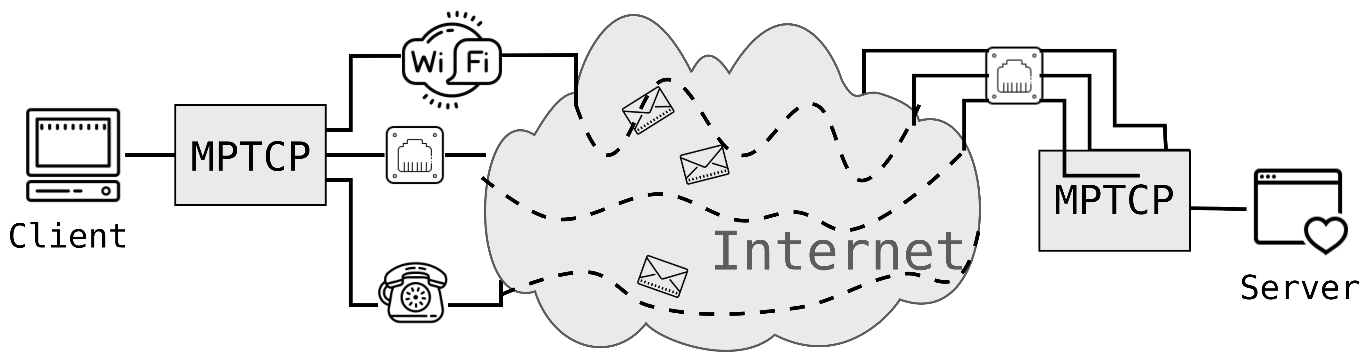
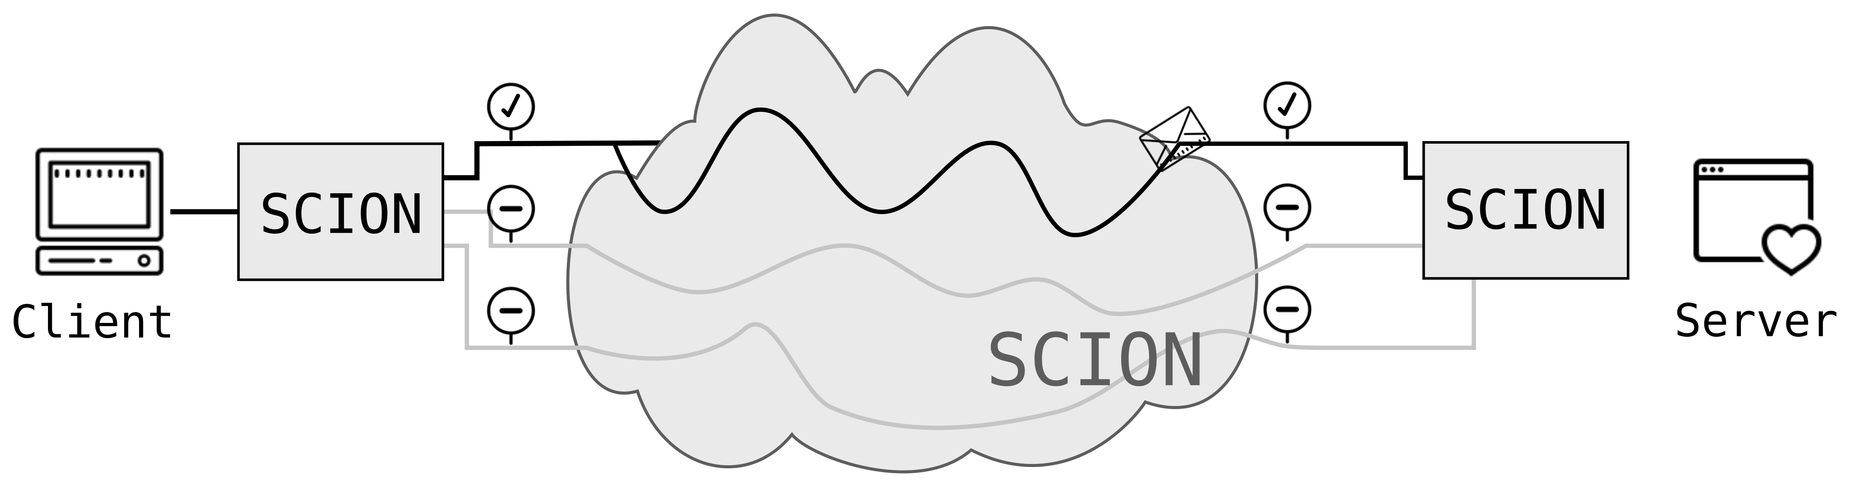
Projektanalyse – Folie 2
Introduction
Ingredients?
TCP (Transmission Control Protocol)
Dominant transport protocol in today’s Internet
One path per connection
MPTCP (Multipath TCP)
Extension to TCP
Multiple paths (flows) per connection
SCION (Scalability, Control and Isolation on next-generation networks)
More secure network architecture
Implements path transparency
Support for multiple paths
Notes:
MPTCP: Usage of all available network interfaces
SCION: Successor of today’s Internet (hopefully ☺)

Slide 4
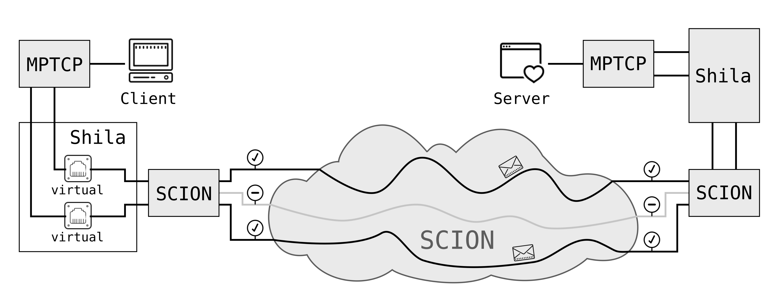
Projektanalyse – Folie 2
Introduction
What?
Main objective and contribution of the presented work:
Implementation (and evaluation) of a shim layer that
allows the usage of MPTCP over SCION.
Notes:
We name our implementation of the shim layer „Shila“

Slide 5
Projektanalyse – Folie 2
Introduction
Why?
Facilitates promotion and development of SCION
Straightforward use TCP applications over SCION
Benefit for endpoints with MPTCP support
Increase of redundancy thanks to multiple paths
Potential through mediating role of Shila in between
Shila is aware and under control of paths used through SCION
Notes:
Easy to use, no changes necessary, user can use his favorite TCP application without having to change alot
Connection with MPTCP over SCION benefits from multiple paths (redundancy) even if there is just one real interface available (at least from path redundance, not from connection redudancy)
Could for example be used to use less consevative congestion contol, w.r.t fairness

Slide 6





Projektanalyse – Folie 2
SCION
SCION
Scalability, control and isolation on next-generation networks
Neuartige Architektur des Internets entwickelt durch die ETH
Redesign von bestehenden Protokollen
Vermindert Vormachtstellung der USA
Nutzer haben Einfluss auf Pfad
SCION

Slide 7


Projektanalyse – Folie 2
Shila
Shila (Shim layer)
Ermöglicht Nutzung von MPTCP in der SCION Internet-Architektur
Prototyp - keine Änderung am Kernel notwendig
Erstellt und überwacht virtuelle Schnittstellen
Kontrolliert Datenfluss für jede Verbindung
virtuell
virtuell
Shila
Shila
SCION
virtuell

Slide 8



Projektanalyse – Folie 2
Warum?
Kontrolle der Pfade erlaubt Lockerung von Fairness-Algorithmus, was höhere Datenraten ermöglicht.
Congestion Control
Shila
Shila
SCION

Slide 9
Projektanalyse – Folie 2
Abschluss
Implementing and Evaluating MPTCP on the
SCION Future Internet Architecture
Kombination eines bestehenden Transportprotokolls mit einer neuartigen Internet-Architektur zwecks Optimierung der Übertragungsgeschwindigkeit.

Slide 10
Thank you.

Slide 11

Shila as a girls’ name means ”blind”. Shila is a varian form of Sheila (Irish, Gaelic): version of Sile.
STARTS/ENDS WITH Sh-, -la

